Slide 1
Eye and Lip Perfection Treatment
Notes:
Hi every one, thank you for being here today
i’m very happy to be with you to show you the Eye and lip perfection treatment presentation.
Duing this presentation i will turn off your micro for a better quality but do not hesitate to use the chat bar if you have any questions.
And you will see we gonnat start the presentation with a small quizz and i hope you will all participate in the chat bar. May i can count on you?

Slide 2
Summary
02
04
01
03
05
Context & market
Complementary products to recommend
Eye and Lip Perfection Treatment
The kit
of training
Objectives
of this launch
Notes:
This presentation will follow 5 specific items, starting with the objectives of this launch, then the context, the market and the target customers, we gonnat see in detail the protocol of the treatment thanks to the corporate film. In 4 we will speak about the complementary products to recommend according to this treatment to extend the benefits of the treatment and finaly I will introduce you the training and commercial kit.

Slide 3
01
Objectives
of this launch

Slide 4
Discover And Be Trained to a new treatment
Objectives
Goal 1
Goal 2
Objective 3
Enrich your treatment menu with an offer that corresponds
to market trends
Boost
Your retail & treatment sales
Notes:
3 mains objectives
First of all, i wish to make you discover and train even if i know remote is more complicated but in this period we must adapt.
Second objective, allow you to enrich your treatment menu to create dynamism ut also novelty.
And third ojetvie, increase your retail and treatment sales.

Slide 5
02
Context & market

Slide 6
Quizz
Did you know that?
According to you :
How many milimeters measures the epidermis of the eye contour?
A: 0,04 mm
B: 0,1 mm
C: 0,4 mm
b. How many lash beats do we do on average per day?
A: 1000
B: 5000
C: 10 000
c. How many words do we pronounce on average per day?
A: between 500 - 1000
B: between 1000 - 3000
C: between 3000 - 5000
Notes:
GENERAL
The eyes :
- A very fragile area: the epidermis of the eye contour measures 0.04mm against 1mm for the rest of the face.
- A stressed area: connected to 22 muscles and 10,000 lashes per day to ensure permanent hydration of the cornea.
Pockets result from the loss of permeability of the vessels, leading to water leakage, fat accumulation, a decrease in the lymphatic system and thus a sagging of the support tissue.
Dark circles are due to a slowing down of the microcirculation often linked to age.
The appearance of dehydration wrinkles is linked to the thinness of the skin and the poverty of its FHL.
Oxidative stress is linked to the presence of free radicals in the oxygen which alter our DNA and thus cause premature aging of our cells and skin.
The lips :
fine, fragile, sensitive, devoid of sebaceous glands
An area of demand with between 3000 and 5000 words per day
^{1st} victim of external aggressions (pollution, wind, cold, sun ...) with agents such as cigarette ...
Over time, loss of upper lip volume

Slide 7
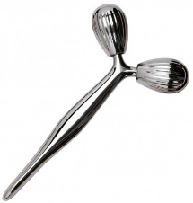
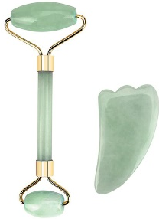
Context & market
An innovation at the crossroads of 2 trends
SHORT AND SPECIFIC CARE FOR EYES AND LIPS
ACCESSORIES
Notes:
The eye and lip perfection treatment asociates 2 trends : short treatment for specifics areas and the use of accessories.
Nowadays everything goes very fast, we want everything, right away… this explains the boom in short term treatments and also cures that meet the need for immediate results.
Eyes and lips are the symbol of communication, of the expression of emotions. They are often signs of good health and in a professional environment the reflection of dynamism, performance, efficiency… A look, a word is enough to say a lot.
In our market, we have seen the birth of specific treatments such as eyelash extension, semi-permanent mascara, semi-permanent lip contour, etc. We can therefore say that there is a real market trend in the eye and lip area.
Associated with this concern for eyes and lips, we have seen the trend of beauty accessories such as jade rolls, guashas, spoons… Adopted for their holistic virtues or for their playful uses, they are now a real success among consumers.

Slide 8
Eye and Lip Perfection Treatment
Ready to find out? What are your expectations?

Slide 9
Eye and Lip Perfection Care
Context ? Why this new treatment? For whom?
Short care and cures
Physiological particularities of these areas
The beauty of the eyes and lips at the heart of concerns
Category : ANTI-AGE
Sub-category: EYES AND LIPS
Notes:
PHYSIOLOGICAL PARTICULARITIES
As we have seen in the quiz, these areas have physiological particularities: they are more fragile, more sensitive, more stressed and have fewer sebaceous glands.
They therefore require specific treatment.
MARKET TREND & IMPORTANCE OF THESE ZONES
Eyes and lips are symbols of communication, expression, emotion and femininity. They reveal our general well-being and dynamism.
In our society of appearances, some specific cares have emerged such as eyelash extensions, eyelash enhancement, mascara or semi-permanent lip contour.
We can therefore say that this is a real market trend.
This is why the competition offers a wide range of specific treatments for these areas.
Yon-Ka proposes a global expert program based on 4 contours: alpha-contour, nutria-contour, phyto-contour, excellence code contours.

Slide 10
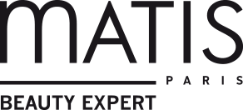
Context & market
Specific care for eyes & lips
^{55’/ 110€}
^{High protection eye care}
Reduces signs of fatigue and aging
associated with modeling porcelain.
^{30’/ 70€}
^{"The eye care "}
Wrinkles are visibly smoothed out, bags are reduced, and the eyes open up.
^{40’/ 45€}
^{Phyt'Sublim Eyes Care}
Draining and decongesting movements that combine care and relaxation. Immediately the eye contour is decongested and energized.
^{45’/ 55€}
^{Regard neuf}
^{Signs of fatigue disappear}
^{20’/ 45€}
^{Gorgeous eyes and lips}
Diminishes dark circles and puffiness, fills in wrinkles and enhances the eyelids to open the eyes.
^{40’/ 60€}
^{Eye lift care}
Reduces the signs of age and fatigue thanks to an exclusive method: muscle stimulation. The eyes are rested and rejuvenated
Which brands do not offer specific eye and lip care?
Notes:
Our competitors mainly offer specific eye care from 20' to 55' and from 45€ to 110€.
We have also noticed that many brands do not offer this type of service.
Offering a treatment combining eyes and lips from 45' to 70€ is therefore a real opportunity.

Slide 11
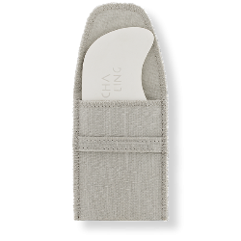
Context & market
Accessories
24€ - EYE CONTOUR MASSAGE SPOON
*Eye contours
*Decongest, reduce puffiness and dark circles.
*Morning & evening
^{25€ - GUA SHA}
*Eye and lip/face contours
* Detoxify
*Morning & evening, weekend
^{59,90€ - SKIN GYM}
*Eye and lip/face contours
*Clear, firm, soothe
*Morning & evening
^{177€ - BEAUTY ROLLER}
*Face and body
*Strengthen and refine
*Morning & evening
^{190€ - SLIM CERA}
*Face
* Smooth, firm and rejuvenate
*Morning & evening

Slide 12
Eye and Lip Perfection Treatment
For whom?
I have a tired eye contour and my first wrinkles have appeared.
Notes:
This treatment has been created for all consumers who want a lively and dynamic look but not want to let the signs of fatigue or aging appear.
Also perfect for clients who want to restrctured the shape of the lips or plumped lips.
These custumers cmay be able to tell you :

Slide 13
Eye and Lip Perfection Treatment
For whom?
I feel like my eyes and lips betray my age!
Notes:
Or :

Slide 14
03
Eye and Lip Perfection Treatment
Notes:
Lets discover now is inspirations, its unfolding, its visible and immediate resuslt and the video which introduce the treatment.

Slide 15
Eye and Lip Perfection Treatment
An exceptional treatment, the synergy of a unique trio combining Chinese medicine, lithotherapy.
and Yon-Ka expertise for a relaxed eye contour and smoothed lips.
Chinese Medicine
Yon-Ka expertise
Lithotherapy
Notes:
Eye and lip perfection treatment is an exceptional care, a synergy of a unique trio:
Chinese medicine
Lithotherapy
Yon Ka expertise
The goal of Chinese medicine is to allow the circulation of energy in our body in order to live in perfect harmony and balance body and mind. For our treatment, we have selected with a specialist in Chinese medicine, energy points present at the eye contour and lips in order to have a smoothed eye contour and smoothed lips.
As you know, we have been a holistic brand for over 65 years. It is therefore natural that we decided to draw inspiration from lithotherapy. Indeed, the particularity of this new treatment is the massage with an accessory: the Yon-Ka massage Quartz shaped from aventurine. Aventurine is a natural stone, symbol of the harmony of body and mind that has many cosmetic virtues such as: decongestioning, draining, smoothing, soothing…
This stone seems to us to be the ideal stone to massage the area of the eyes and lips
Finally, an asset that you know perfectly well, is Yon-Ka’s product and treatment expertise. Indeed, in this treatment, you will find emblematic skincare steps of the brand but also specific products of the eye area and lips contour with our range of contours.

Slide 16
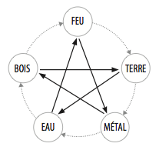
Perfect eye & lip care
The foundations of traditional Chinese medicine
The theory of yin and yang
The theory of the 5 elements
Notes:
2 categories of meridians:
Regular Meridians
Connecting Meridians
REGULAR MERIDIANS
*12 main meridians (6 yin meridians: lung, spleen/pancreas, heart, kidney, master heart, liver = circulate from bottom to top front side of the body / 6 yang meridians: large intestine, stomach, small intestine, bladder, triple heater, gallbladder = circulate from top to bottom back side of the body)
*8 extraordinary vessels (including VC/VG)
*12 divergent meridians
Yin/Yang = 2 complementary energies, inseparable, opposed, always in movement.
Yang= meridians of the posterior face = Light, Day, Activity, Warm, Summer, Sky, Masculinity = governor vessel
Yin = meridians of the anterior face = Dark, Night, Rest, Cold, Winter, Earth, Femininity = vessel conception

Slide 17
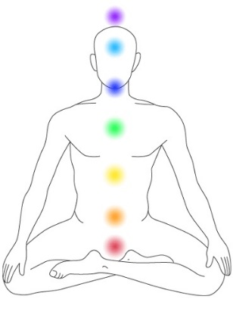
Balance the energies
Perfect eye & lip treatment
The foundations of traditional Chinese medicine
Maintain in good health
Notify
imbalances & diseases
Notes:
2 categories of meridians:
Regular Meridians
Connecting Meridians
REGULAR MERIDIANS
*12 main meridians (6 yin meridians: lung, spleen/pancreas, heart, kidney, master heart, liver = circulate from bottom to top front side of the body / 6 yang meridians: large intestine, stomach, small intestine, bladder, triple heater, gallbladder = circulate from top to bottom back side of the body)
*8 extraordinary vessels (including VC/VG)
*12 divergent meridians
Yin/Yang = 2 complementary energies, inseparable, opposed, always in movement.
Yang= meridians of the posterior face = Light, Day, Activity, Warm, Summer, Sky, Masculinity = governing vessel
Yin = meridians of the anterior face = Dark, Night, Rest, Cold, Winter, Earth, Femininity = vessel conception

Slide 18
Improves Disposal
Traditional Chinese Medicine
The meridians & off meridians worked in the treatment
Bladder
Stomach
Gallbladder
Large intestine
Outside the meridian
Improves digestion
Calm the mind
Detoxifies
Rebalance
Notes:
BRAID
*yang meridian
*longest meridian
*path: the inner corner of the eye rises to the forehead and then to the top of the skull where a branch detaches and plunges down to the brain. The main channel reaches the nape of the neck where it divides into 2 branches:
An internal branch which, after touching point 14 of the governor vessel, runs along the transverse apophyses of the first and second dorsal vertebrae at two fingertips from the midline, to descend vertically from the 11th point located between the transverse apophyses of the 1st and 2nd dorsal vertebrae. It then reaches the posterior aspect of the buttock and thigh to arrive at the gluteal crease. Very important branch on which are located the points of the back which correspond to all the organic functions. A branch detached from point 23 reaches the kidney and then the bladder.
An outer branch that is adjacent and parallel to the inner branch through the fingertips of the midline. It descends to the middle of the gluteal cleft to behind the thigh where it crosses the inner branch, then the branches meet on the posterior side of the knee.
ESTOMAC
*yang meridian
*path: the side of the nose, and then passes through the inner corner of the eye to emerge at the lower part of the eye. It then moves upwards past the ear until it reaches the corner of the forehead (one finger rib backwards and four over the outer corner of the orbit). From there it is divided into two branches: one external and one internal.
The outer branch continues its path, passing outside the corner of the lips, down the anterolateral part of the neck to its base. It continues to descend through the nipple, the groin to the thigh, the anterolateral side of the knee and leg, the outer edge of the tibia, to reach the dorsal side of the foot and reach the outer nail angle of the second toe.
The inner branch emerges from the lower part of the descending jaw until it reaches the organ with which the meridian is associated, the stomach.
GALL BLADDER
*yang meridian
*path: outer corner of the eye - an inner branch enters the cheek, runs down the neck, through the chest to the liver and gallbladder. This branch then joins the main branch at the hip - The main branch reaches the front of the ear and then the temporal region in several curves, follows the side of the skull, the nape of the neck, enters the ear and runs along the side of the neck. A vessel detaches at the supraclavicular hollow to join the internal branch.
The main branch then passes through the armpit and down the side of the abdomen to the hip where the inner branch connects to it.
Then it goes down on the external lateral face of the thigh, the knee, the leg and arrives at the foot until the end of the 4th toe.
BIG INTESTINATION
*yang meridian
*Path: The outer corner of the index finger, on the thumb side, follows the outer edge of the finger to the wrist and then along the back of the radius to the elbow. It continues its path by passing to the anterior face of the shoulder, then to the posterior upper edge of the joint, from where a branch reaches the anterolateral face of the neck to end up on the face at the upper end of the naso-labial fold which corresponds to the 20th point.
HM1
*3rd eye
*balances yin/yang energy
HM3
* middle eyebrows

Slide 19
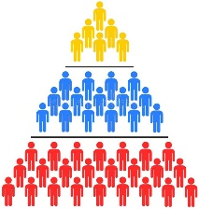
Aventurine, the stone of harmony
Origin
Belongs to the quartz family
Aventurine throughout history
TIBETAINS
CELTES
CHINESE
INCAS
Aventurine & its symbolism

Slide 20
Aventurine, its cosmetic virtues
Draining / Decongestant
Anti-dark circles
Anti-pockets
Detoxifying
Improves the elimination of toxins
Smoothing / Plumping
Reduces fine lines and wrinkles
Liftant
Tones the eyelid
Relaxing
Rebalance
Harmonise
A luminous skin
blurred pockets and dark circles
smoothed wrinkles and fine lines
Notes:
Draining: stimulates blood and lymphatic circulation
*Detoxifying: elimination of toxins by its reflex action linked to pressure on energy points.
*Decongestant: relaxes eyelids and eyes - anti-puffiness, anti-dark circles
*Smoothing/Repulping: reduces wrinkles and fine lines
*Natural lifting effect: tones the tissues
*Relaxing effect: harmonizes body and mind and relaxes intensely
BENEFITS
A luminous skin, bags and dark circles faded, wrinkles and fine lines smoothed.

Slide 21
Yon-Ka expertise
The main stages of the treatment
Notes:
We will find in the protocol some steps that we already know :
The first step, i’m sure you can perfome these one very easely, aromatic awakening. It is an essentials step that allow the immersion in the world of the brand, a total disconnexion. The inhalation of th 5 EO of the quintessence awakens all the senses.
The second step is a double cleansing and makeup removal with lait nettoyant et gel nettoyant to remove make up, impurities, sebum and cleanse in deepth while respecting the hydrolipidic film.
Third step, scrub with gommage Yon Ka, botanical gel 4 in 1 which allow an exfoliation, clarifies, hydrates and balances even the most sensitive areas.
Then we gonna continu with 20 minutes massage, at first only manual technics and after technics with the quartz.
After the massage, we will apply the masque modelant, to hydrates, tonifies and release the tensions.
And finaly, we conclude this treatments with the application of the daily treatments, and in order to return smoothly to reality, a stimulating and invigorating aromatic awakening

Slide 22
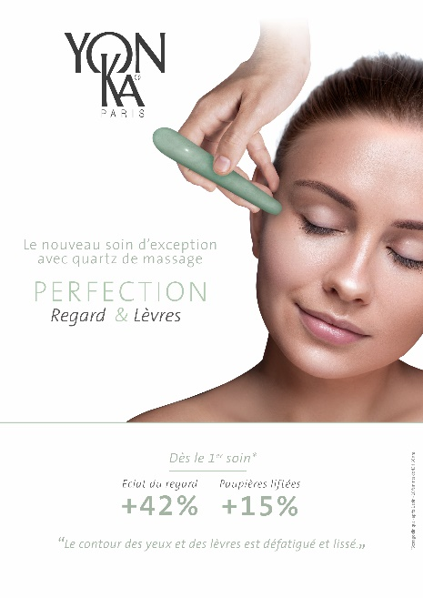
Attenuated wrinkles and fine lines
Eye and Lip Perfection Treatment
Visible & immediate results
+42%
Glance radiance
+15%
Eyelids lifted
Results
01
02
03
04
Illuminates
the look
Stump
pockets and dark circles
Repulp
The lips
Notes:
2 types of tests carried out by Eurofins (independent lab) after 1 treatment on 10 women aged 43 to 66 years old.
Clinical test (wilcoxon test)
Self-satisfaction test via a questionnaire asked orally by a technician
Thanks to these two tests, we can claim that after only one treatment, we obtain visible and immediate results on the bags, dark circles and wrinkles around the eyes and lips. Indeed, the clinical test reveals a more radiant look at +42% and eyelids lifted at +15%. 90% of panelists estimate their eye and lip contours smoothed and 80% soothed.
RADIANCE OF THE GLANCE
Visual evaluation obtained by comparison before the 1st application and within one hour after the treatment.
*Score 0: no radiance of the glance, dull glance
*Score 9: very important radiance of the glance, radiant glance
The analysis of the scores then allows us to calculate the % variation in the brightness of the eyes.
PTOSIS OF THE EYELID
Visual evaluation obtained by comparison before the 1st application and within one hour after the treatment.
*Score 0: no ptosis of the upper eyelid/significant opening of the glance
*Score 9: very important ptosis of the upper eyelid / no opening of the glance, closing of the glance
The analysis of the scores then allows us to calculate the % change in eyelid ptosis.

Slide 23
Eye and Lip Perfection Treatment
Notes:
After this introduction, it’s time to discover this new treatment in video.
This video takes 30 minutes long and I will comment on it as we go along

Slide 24
Your turn to speak
Feedback Box

Slide 25
The 5 subtleties to remember for a successful massage
Be in the present moment
The fluidity
of the movement
personnalization
Posture
Contact
Notes:
I hope that you like the treatment and that you are impatient to perform it
Here I wanted to focus 5 key details for a successful massage.
First one, be in the present moment. Its means ignore everything that surrounds us, be with the client, give meaning to what yo do and act in awareness and presence.
Second, posture
Your body is your work tool, you must preserve it by working in the best conditions.
Dit is important to work on its supports: one leg in front, knees bent, it is appropriate to work with the weight of the body
This posture will allow to put intention in each movement and will increase the sensations and benefits.
Third one, contact.
As with all care, contact with the client must be continuous and reassuring. To do this, one hand is in contact and the other is working. It is also possible (as for the 3rd eye) that the two superimposed hands work simultaneously. For a good control of the pressure of the energy points and for a better ergonomics, it is important to establish its eminence thenar and hypothenar in contact with the customer before realizing the pressure. The hand is thus stabilized.
Next one, the fluidity of the movement
A massage is like a dance, which would be an integral part of us… If the gestures are beautiful to look at, the feeling is guaranteed!
In our treatment, it is important to connect all the energy points together by a smoothing in order to circulate the energy.
And the last one, personnalization
There are two possibilities of working on an energy point: dispersion and toning.
Dispersion allows to diffuse the energy. This movement is superficial and fast. We recommend using the fine tip of the Yon-Ka massage quartz
Toning stimulates energy. This movement is deep and slow. We recommend using the thick tip of the Yon-Ka massage quartz
Concretely, regarding our protocol for example, under the eye, on the bags you can work on dispersion in order to draine and detoxify the area, whereas on the eyebrown point we work on toning to smoothes and lifts the eyelids.

Slide 26
Soin Perfection Regard 30’
The main stages of the treatment
30min
6 min
3 min
7 min
6 min
4 min
Notes:
Given the context, we decided to adapt and offer you an alternative to the 45-minute treatment, a 30-minute treatment focused on the eye area, which would allow your customers to keep the mask. The protocol of the treatment is identical; the only difference is the length of time allowed for the different steps.
CARE PERFECTION REGARD 30 ' RECO : WITH MASK, to be changed after the treatment,
AROMATIC AWAKENING 1 MIN
DOUBLE MAKE-UP REMOVAL 6 MIN
SCRUBPING 3 MIN
SPECIFIC MANUAL TECHNIQUES 7 MIN x3 each movement
QUARTZ TECHNIQUES 6 MIN x3 each movement
BASE 1 MIN
AROMATIC AWAKENING 1 MIN
MODELING MASK 5 MIN
EYE BASE 1 MIN
AROMATIC AWAKENING 1 MIN
COST PRICE
5.2633 (contours)
5.9333 (CONTOUR CODE EXCELLENCE)
The duration does not correspond to what is written in the slide; moreover the cost price above is incomprehensible.

Slide 27
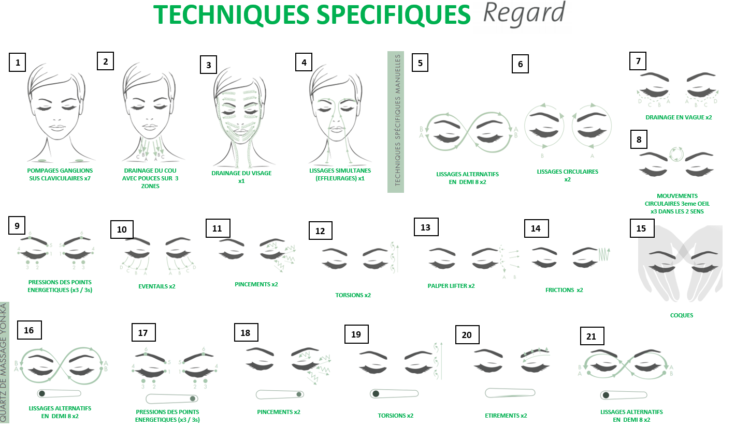
Soin Perfection Regard 30’
Focus on massage techniques
Notes:
Afin de faciliter l’apprentissage de ce Soin Perfection Regard 30’, nous avons développé une plaquette de massage comportant uniquement des vignettes avec le nom de la technique et le visuel associé.

Slide 28
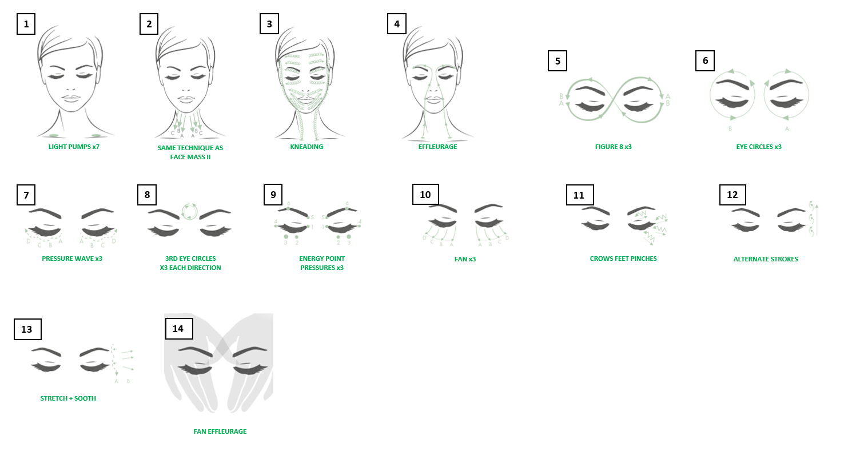
Yon-Ka expertise
Focus on massage techniques
Notes:
Particularities of this treatment :
Double make-up removal
10' of manual massage techniques
10' of massage techniques with the Yon-Ka Massage Quartz
The green texts in the slide are not very legible.

Slide 29
Sell the perfect eye & lip care in 2'.
An exceptional treatment, the synergy of a unique trio combining Chinese medicine and lithotherapy.
and Yon-Ka expertise for a relaxed eye contour and smoothed lips.
Results
01
02
03
04
Illuminates
the look
Attenuated wrinkles and fine lines
Stump
pockets and dark circles
Repulp
The lips
Main steps
In treatment
01
Double make-up removal
1 time per week for 4 weeks for a reinforced efficiency
02
Manual anti-wrinkle & lifting techniques
In maintenance
03
Techniques with aventurine
Once a month to maintain results
TARGET
+ or - 35 years old depending on the physiological evolution of the eye and lip contour which are specific to each person.
DURATION
45mn
30mn look
Recommended price
70€ Eyes & Lips
50€ Eye only

Slide 30
04
Complementary products
to recommend
Notes:
We know that treatment performed by the expert hands of a beautician is primordial but its regularity is essential to prolong the benefits. To do this, we recommend using eye and lip contour combined with Yon-Ka massage quartz and gommage Yon-Ka to optimize the results. This prescription is of course to complete with beauty & well-being tips.

Slide 31
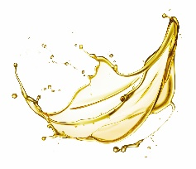
How to extend the benefits at home?
Eye & lip contours to meet every need
ANTI-POCKETS
ANTI-CERNES
NURSING
WRINKLE RESISTANT
GLOBAL ANTI-AGING
PHYTO-CONTOUR
NUTRI-CONTOUR
ALPHA-CONTOUR
CODE CONTOUR EXCELLENCE
Notes:
Yon-Ka proposes a global expert program based on 4 contours: alpha-contour, nutri-contour, phyto-contour, excellence code contours.

Slide 32
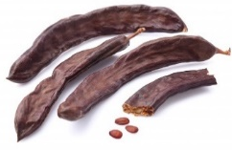
How to extend the benefits at home?
The ideal product to optimize the results of eye and lip contours.
EXFOLIATE - MOISTURIZE
YON-KA GUMMING
Notes:
This 4 in 1 botanical gel based on carob, exfoliates, moisturizes, clarifies and balances. And even more important it can be used even on the most sensitive areas. It is therefore the must-have to optimize the results of the eye and lip contour and brings luminosity to the complexion.

Slide 33
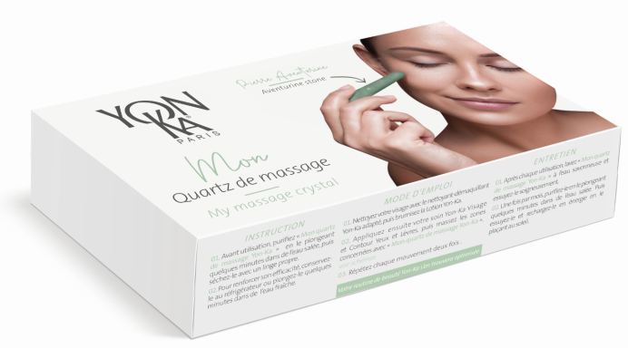
How to extend the benefits at home?
My Yon-Ka Massage Quartz
B to C
B to B
29 €
1 Yon-Ka massage quartz
+ 1 self-massage guide for face, eyes and lips
1 Yon-Ka massage quartz
HOW TO TAKE CARE OF MY YON-KA MASSAGE QUARTZ?
*Before use, purify "My Yon-Ka massage quartz" by immersing it in salt water for a few minutes.
then dry it with a clean cloth
*To increase its effectiveness, keep it in the refrigerator or immerse it in a bowl of fresh water for a few minutes.
Notes:
Big novelty !! 2 versions of massage quartz
Version for the final clients (also call B o C)
The boxe contains 1 massage quartz, 1 auto massage instruction
Version for professionals (call B to B)
The boxe contains 2 massage quartz in order to perform the Eye and lip perfection treatment.
The Yon-Ka Massage Quartz must be cleaned with soapy water, then immersed in salt water to purify it. Before use, dry it. It is also possible for increased efficiency to place it in the refrigerator or in a bowl of fresh water.

Slide 34
How to extend the benefits at home?
The extra tips that make the difference
Restorative sleep
Auto-massage
Lip gymnastics
Eye Yoga
Wear sunglasses
Do not moisten your lips too often
Notes:
EYE TIPS
*restorative sleep
* Wear sunglasses
*frozen tea bag (tannins very effective against dark circles)
*self-massage with palming created by ophthalmologist William Bates
The darkness and the warmth of the hands bring well-being and return to calm, refocusing.
Fixed pressure of the following points :
V2: inner eye corner (draining)
HM 3: middle eyebrows (reduces headaches)
TR 23: tip of the eyebrow (fight against fatigue)
V2: inner eye corner (draining)
E2: lower orbicular medium (draining)
VB 1: lower external orbicular corner (reduces headaches)
Finish in palming
*eye yoga
The pencil, the clock
LIP TIPS
*do not moisten your lips too often
*privilégier the lipstick satin finish and always put a balm underneath it.
*gymnastic of the lips: to carry out O then to yawn and A
*Limit smoking

Slide 35
Perfect eye & lip treatment
My Yon-Ka Massage Quartz
It's up to you!
Notes:
Intro to self-massage :
Allows the discovery of energy points on oneself; thus, easier to reproduce on the model.
Let yourself be guided by the sound of the trainer's voice.
Apply progressive pressure for 3 seconds (some may be painful, which is normal).
Self-massage :
- For self-massage, invite salespeople to sit comfortably, close their eyes, warm their hands and position them over their eyes for a few moments.
- State only the location
Then carry out the same sequences with the Yon-Ka massage quartz.

Slide 36
Perfect eye & lip treatment
My Yon-Ka Massage Quartz
HM1: ^{3rd} eye
V1: inner corner of the eye
E1: 1/3 ring
HM4: 2/3 circle
VB1: outer corner of the eye "tear of the eye".
V2 : head of the eyebrow
HM3: middle of the eyebrow
Notes:
Intro to self-massage :
Allows the discovery of the energy points on oneself so easier to reproduce it on the model.
Let yourself be guided by the sound of the trainer's voice.
Apply progressive pressure for 3 seconds (some may be painful, which is normal).
Self-massage :
- For self-massage, invite salespeople to sit comfortably, close their eyes, warm their hands and position them over their eyes for a few moments.
- State only the location
Then carry out the same sequences with the Yon-Ka massage quartz.
Same comments as for the previous slide?

Slide 37
Perfect eye & lip treatment
My Yon-Ka Massage Quartz
E4: corners of the mouth
VC 24: middle of the underside of the lips
3 & 4. VG 26 + VG 27: under the birth of the nose + above the heart of the lip
5. GI 19 : wing of the nose

Slide 38
05
The training kit
Notes:
In order to support you in the best conditions, we have developed a launch kit

Slide 39
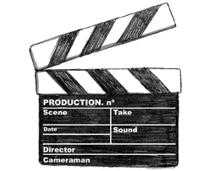
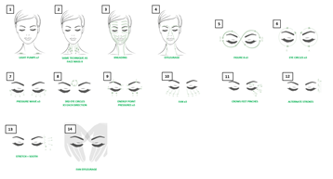
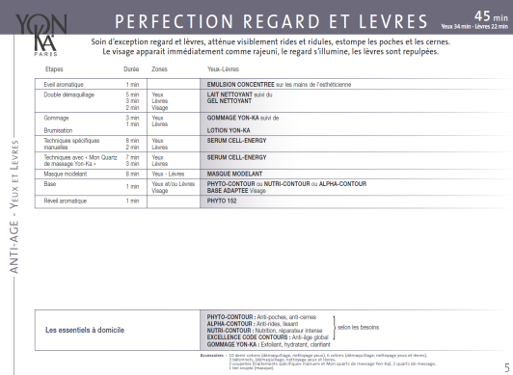
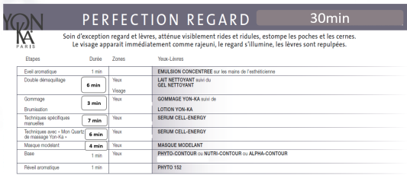
Accessories
Pedagogical activation
TO REVIEW
Massage notebook
TO TRAIN
Video/Vignette
TO MEMORIZE
technical datasheets
Care
Notes:
Technical guide containing the detailed steps of the treatment
- A video and specific brochure in order to train you
- The technical files with the 45’ and 30’ treatment step chart and the Yon-Ka Massage Quartz
The objective of this kit is to facilitate the memorization of this new treatment

Slide 40
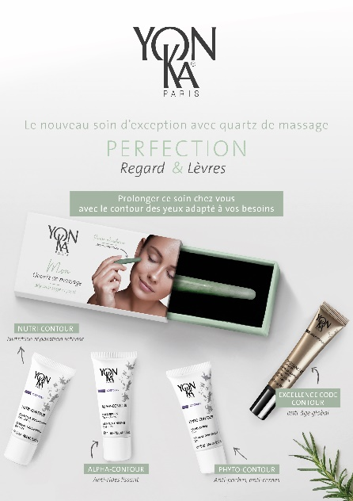
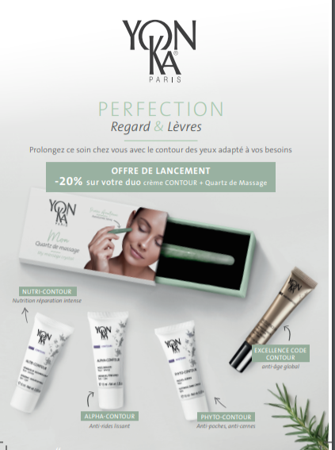
Glorifyer
Visibility activation
Commercial operation
Linear ruler
Notes:
In order to support you on the communication and visibility of this new treatment, the marketing department has created glorifyer to highlight the treatment as well as the contours and Yon-Ka massage Quartz, a linear ruler to positioning the Yon-Ka massage Quartz next to the contours. Finally, the sales department offers you a commercial offer to boost the sale of contours and Yon-Ka massage Quartz. (-20% on the duo quartz + contours).

Slide 41
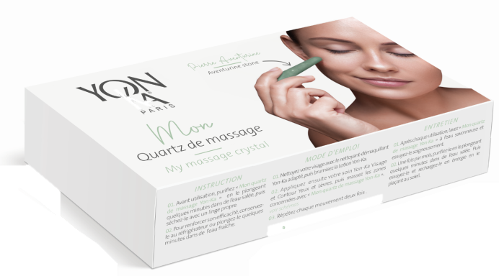
Some ideas
Cure of
4 treatments
Proposal for commercial operations
Workshop
auto-massage
Discovery care
care
4 treatments
+
outline
01
02
03
Yon-Ka massage quartz
Contour
+
Yon-Ka massage quartz
offered
offered
+
Notes:
Here i wanted to give you some ideas to dynamize and animate the beauty salon:
1: workshop auto massage for the eye and lips area
This workshop consists of 3 steps: a quick make-up removal using micellar water, the realization of the gommage Yon-Ka then the massage with the adapted contour and the Yon-Ka massage Quartz. This workshop can be offered under conditions of purchase of a contour + Quartz.
2: The second commercial offer that we suggest, is to offer the Yon-Ka Massage Quartz as part of the purchase of a Perfection Care Eye & Lips and an outline.
3: And finally, we also suggest you to offer the Yon-Ka Massage Quartz and a contour in the case of a purchase of a cure of 4 Eyes & Lips perfection treatments.
Name Proposal
Take care of your eye and lip contour area
They speak for you!
For sparkling eyes and seductive lips

Slide 42
Communication kit
Commercial film
1mn
Notes:
In order to help you to launch this new treatment in your market, beauty salon and on your networks, the training department has developed 4 videos.
The first is a one-minute commercial film

Slide 43
Commercial film
Notes:
Let’s discover together the commercial film

Slide 44
Video tutorial
Communication kit
3x30sec & 2.30
Notes:
And 3 differents tutos of 30 sec each to share on your digital displays and networks

Slide 45
Video tutorial
Notes:
Afin de faire découvrir le soin au sein de vos instituts et sur vos réseaux, le service formation a développé deux vidéos.
Le premier est un film commercial d’une minute et le second des tutos de 30 sec et 2,30 à diffuser sur vos présentoirs numériques et à partager sur vos réseaux.

Slide 46
Notes:
Thank you for your attention, if you have any question, please feel

