Slide 1
Peelings

Slide 2
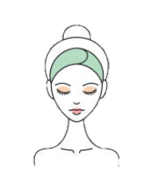
PEELINGS
BEAUTY PURPOSE :
- Revealing the beauty of the skin by reviving its radiance and a refined skin texture
HOW ?
By using AHAs and BHAs.
Acids interact with keratin and modify the inter-corneocyte bonds. They promote the elimination of dead cells from the corneous layer of the epidermis by simple contact with the skin.
CONCERNS :
- Dull complexion (smokers)
- Muddy, uneven complexion
- Tired and rough skin
- Dilated pores
- Imperfections (scars, dark spots)
- Lines, fine lines
Notes:
First of all, the main goal off an aesthetic peeling is to reveal the beauty of the skin by reviving its radiance and a refined skin texture by using AHAs and BHAs.
Acids interact with keratin and modify the inter-corneocyte bonds. They promote the elimination of dead cells from the corneous layer of the epidermis by simple contact with the skin.
Peelings acts on the upper part of the skin, and can give a concrete answer for
- Dull complexion (smokers)
- Muddy, uneven complexion
- Tired and rough skin
- Dilated pores
- Imperfections (scars, dark spots)
- Lines, fine lines

Slide 3
AHA vs BHA
AHA & BHA exfoliate by acting on the cement that holds dead skin cells to the epidermis. They also reduce the appearance of wrinkles and fine lines and correct uneven skin tone by enhancing radiance.
Alpha-HydroxyAcid AHA
Water-soluble
Acts on the surface of the skin
Prevents IWL
Stimulates the synthesis of collagen
Reduces visibles signs of aging
All skin types
Beta-HydroxyAcid BHA
Liposoluble
Acts on the surface of the skin and deep in the pores
Soothes sensitive skin
Smoothes the skin texture
It is mainly used for combination to oily skin
B.H.A: Dissolve the intercellular cement between the cell membranes.
A.H.A: Decrease the cell cohesion of the stratum corneum and cut the links between the cells.
Notes:
In the formulas of the peelings one finds mainly 2 families of acids quite distinct
AHA & BHA exfoliate by acting on the cement that holds dead skin cells to the epidermis. They also reduce the appearance of wrinkles and fine lines and correct uneven skin tone by enhancing radiance.
What is the difference between AHA and BHA?
AHA is water soluble, so it only works on the surface of the skin.
It is generally preferred for normal to dry and sun-damaged skin because of its ability to stimulate cell renewal*, prevents IWL (insensible water loss) by improving the skin's barrier function and humectant.
AHA stimulate the synthesis of collagen. They also help to reduce the appearance of dehydration lines thanks to their antioxidant action and to restore the skin's radiance.
AHA has also been shown to be effective in reducing the visible signs of wrinkles and sagging skin.
*cell renewal = migration of keratinocytes towards the epidermis, they flatten out as they go along, loose their nucleus and disappear naturally after 28 days
A.H.A: Decrease the cell cohesion of the stratum corneum and cut the links between the cells.
BHA works on the surface of the skin and deep within the pores. It is oil soluble, so it is best suited for normal to oily skin prone to pimples, blemishes. BHA also has natural soothing properties, so it is gentle enough for sensitive skin or skin prone to redness or rosacea. This complete gentle ingredient is even suitable for granular skin prone to milium.
BHA smoothes the skin texture, rid the pores and rebalance the epidermis.
Fights blemishes and blackheads, thanks to their anti-bacterial and anti-inflammatory properties.
B.H.A: Dissolve the intercellular cement between the cell membranes.

Slide 4
AHA
- Fruit acids -
GLYCOLIC ACID
derived from sugar cane, it is recognized as the most effective for an exfoliating action.
Properties :
- Refines the skin texture by limiting the thickness of the corneal layer.
- Improves skin hydration, makes it more luminous and smoother.
- Promotes the formation of new collagen.
LACTIC ACID
derived from milk, known for its exfoliating and brightening actions.
Properties :
- Helps to hydrate the skin.
- Eliminates imperfections, improves the appearance of the skin.
- Evens out the complexion and brings radiance.
- Rebalances the skin's pH, anti-microbial action.
Notes:
The different AHAs:
Glycolic acid:
Of all the AHAs, glycolic acid (which comes from sugar cane) is the most effective, as it has the smallest molecule, allowing it to exfoliate deeper into the skin. It refines the skin texture and gives radiance to the complexion. Glycolic acid reduces sebum production. Indeed, being the smallest AHA molecule, glycolic acid is able to penetrate faster and deeper than other acids. It is therefore able to improve the appearance of our skin and considerably reduce the formation of wrinkles. It is one of the most widely used acids in anti-aging cosmetics.
Lactic acid:
This is derived from the fermentation of milk, but is also found in several fruits. It is one of the gentlest acids and is therefore ideal for dry and sensitive skin. It is an excellent natural humectant. It attracts water and retains it in the skin.

Slide 5
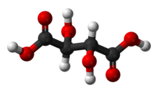
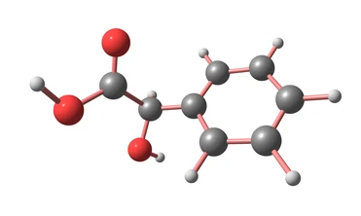
AHA
- Fruit acids -
TARTARIC ACID
extracted from grapes, this AHA is antioxidant and anti-inflammatory.
MALIC ACID
derived from apples and pears, it is hydrating and promotes oxygenation of the tissues.
derived from almonds, it helps to reduce hyperpigmentation and even out skin complexion.
MANDELIC ACID
CITRIC ACID
derived from citrus fruits. It has a regenerating, brightening and astringent effect.
Notes:
Tartaric acid: This is derived from grapes. This acid has antioxidant and anti-inflammatory properties.
Malic acid: It is found in apples, pears and grapes. It is often used in cosmetic preparations to rebalance their pH, but on the skin it is also believed to have moisturising properties and also helps to stimulate collagen production. It can penetrate deep into the skin due to its small molecular size.
Mandelic Acid: From almonds, this is one of the gentler AHAs as its molecular size is larger than other acids and therefore limits its ability to absorb deep into the skin. It acts more on the surface, and is therefore less irritating than other acids that act more intensely. It also helps to reduce hyperpigmentation and even out skin tone.
Citric acid: This comes from citrus fruits. It is mainly used for its lightening properties on brown spots and hyperpigmentation. It is also an astringent so can also reduce pore size.
Many AHA cosmetics use more than one AHA in their formula to combine their effects.

Slide 6
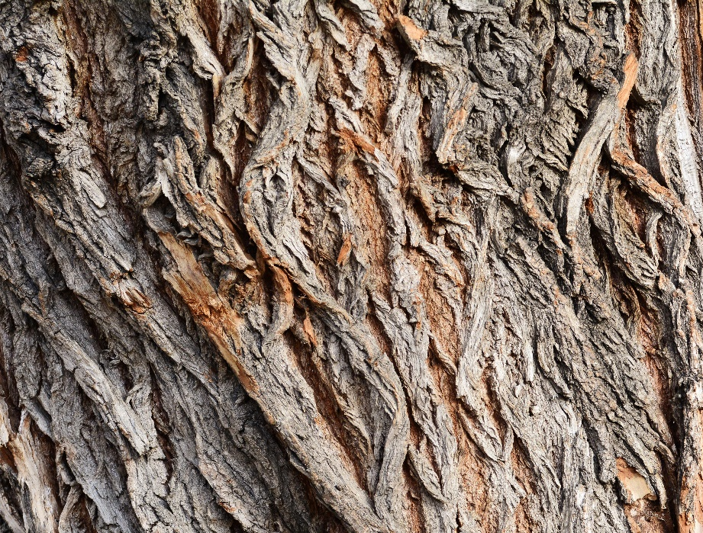
BHA
- Salicylic acid -
Properties:
Exfoliating
Anti-inflammatory
Calming
Regulates sebum production
Anti-irritant
Antibacterial
Naturally present in several plants, in particular meadowsweet and willow
Notes:
BHA/ Beta Hydroxy Acid There is only one BHA: salicylic acid, which comes from two plants, meadowsweet and willow, a tree known since Antiquity for its anti-inflammatory properties. But the one used in cosmetics is usually synthetic, and it is fat-soluble. It works on the surface and has the same exfoliating effect as AHAs, but it also works inside the pores. The anti-irritant and anti-inflammatory properties of salicylic acid make it an effective ingredient for soothing the skin and redness, but also for calming painful pimples and uneven skin tone problems.
It is ideal for combination to oily skin, as well as skin with a tendency to acne.
What does salicylic acid do?
Exfoliating
Anti-inflammatory and analgesic (soothing) effect
Calming
Regulates sebum production
Anti-irritant
The anti-irritant and anti-inflammatory properties of salicylic acid make it an effective ingredient for soothing the skin and redness, but also for calming painful pimples and uneven skin tone problems.

Slide 7
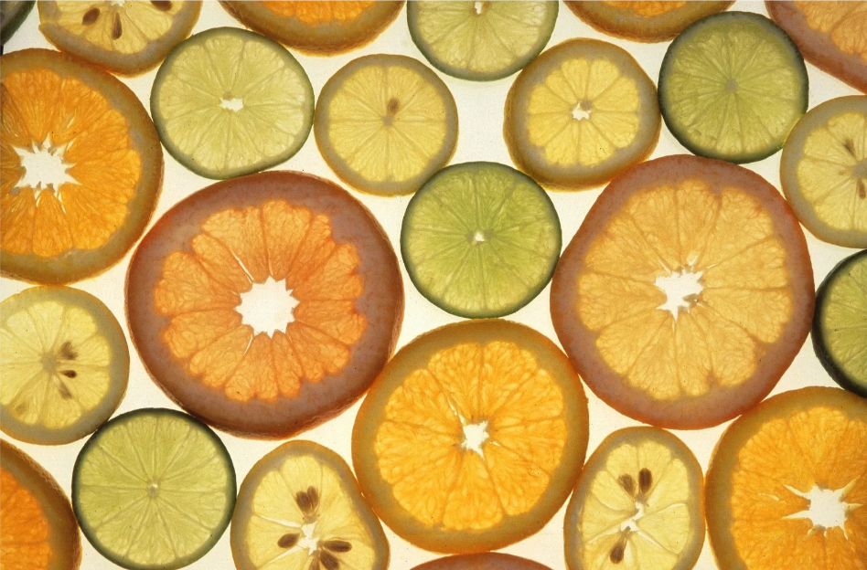
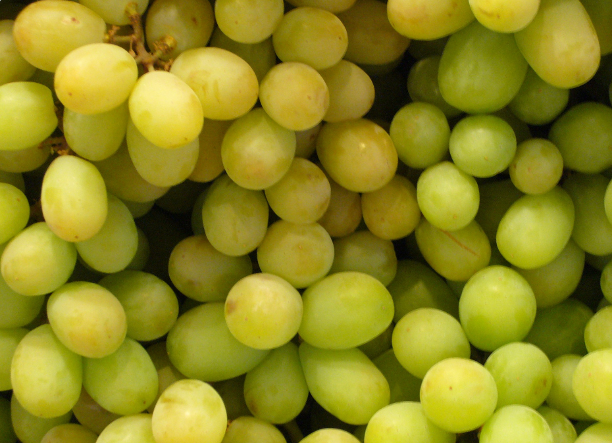
Other Acids
Ascorbic acid :
Obtained from stabilized vitamin C
Properties :
Powerful antioxidant
Stimulates collagen production
Brightening
Prevents the formation of pigment spots
Pyruvic acid :
AAA: Alpha Acetoxy Acid
Obtained by distillation of tartaric acid
Properties :
Uniformity of the complexion
Accelerates cell renewal
Stimulates collagen production
Promotes skin hydration
Notes:
in addition to AHA and BHA, our yon ka formulas also include
Ascorbic acid or vitamin C, for radiant skin
It is present in many plants (acerola, strawberry, citrus fruits). It is the champion of anti-aging as its spectrum of activity is so wide. It protects cells from oxidation, boosts collagen, brightens the skin, accelerates healing, and fights against dark spots
Pyruvic acid
*obtained by distillation of tartaric acid
provides uniformity of skin tone
Accelerates cell renewal
Stimulates collagen production
Promotes skin hydration

Slide 8
OUR PEELINGS
60% of Yon-ka essential face treatments offer a peeling
Notes:
We have seen all the different acids used in our formulas, now let's look at the formula of each peel and its mode of action
Our professional peels are included in 60% of our cabin treatments

Slide 9
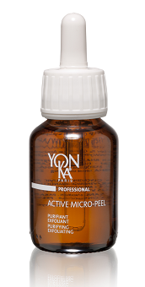
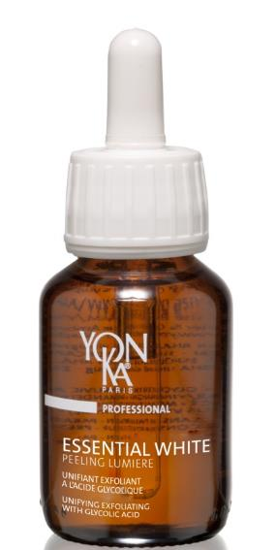
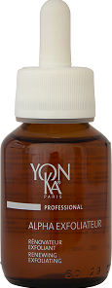
The professional Peelings
ACTIVE MICRO-PEEL
ALPHA-EXFOLIATEUR
ESSENTIAL WHITE
PEELING LUMIERE
EXFOLIATING
PURIFYING
EXFOLIATING
RENEWING
EXFOLIATING
UNIFYING
Contra-indications
20% AHA/BHA
30% AHA/BHA
30% of glycolic acid
Irritated skin, redness, cutaneous hypersensitivity
Skin under dermato treatment
Dermatosis
Œdemas
Before waxing
After hair bleach
Before or after sun/UV exposure
PREOCCUPATION
PREOCCUPATION
PREOCCUPATION
Purify
Re-surfacing
Even complexion
TREATMENT
TREATMENT
TREATMENT
Purity
Alpha vital
Essential white
Notes:
3 differents professional peelings, according to 3 differents concentration in acid and 3 differents beauty objectives :
ACTIVE MICRO-PEEL – exfoliating and purifying, for deep cleansing, restoring even and radiant complexion
ALPHA-EXFOLIATEUR- exfoliating and renewing, to smooth the skin and erase deep and fine lines
ESSENTIAL WHITE PEELING LUMIERE- exfoliating and unifying to fight againt pigmentation trouble, dark spot and uneven complexion.
The recommendations are the same for each of the 3 peels:
Do not apply on eyes & lips
Protect eyes with damp cotton pads
Inform and reassure the client that there may be a tingling sensation but that this is completely normal
And of course pay attention to :
Irritated skin, redness, cutaneous hypersensitivity
Skin under dermato treatment
Dermatosis
Œdemas
Before waxing
After hair bleach
Before or after sun/UV exposure
At the end of each treatment, specially with a peel, I strongly recommend you to apply a sun protection.

Slide 10
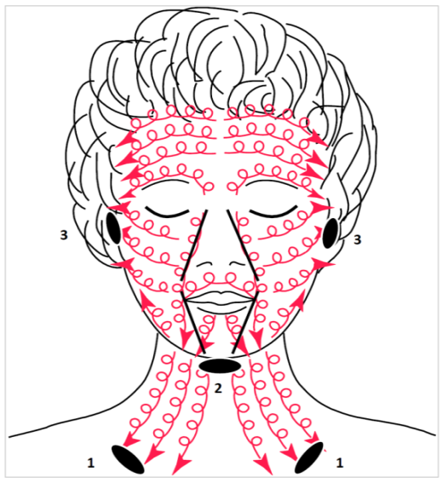
ACTIVE MICRO-PEEL
Professional Purifying and Exfoliating Peel - Grade 1
Professional use
*Apply with your hand on the areas indicated below (2 droppers)
*Leave on for 1 to 2 minutes according to the sensitivity
*Removal with gauze soaked with water with circular movements, supporting the skin, following the step below
20% ACIDS
Lactic acid
Mandelic acid
Malic acid
AHA
BHA
Salicylic acid
EXFOLIATING
PURIFYING
Other acids
Ascorbic acid
Pyruvic acid
+ CIDER VINAGAR
SOFTENING
PURIFYING
P.60 ml
Notes:
PREPARATION
*wet cotton pads on the eyes
PUT CIDER VINEGAR FORWARD VS. SCENT: PURIFYING SOFTENING PURIFYING 20.82% AHA
AHA : Pyruvic acid: obtained by distillation of tartaric acid.
Lactic acid: extracted from sugar cane
Mandelic acid: bitter almond extract
Malic acid
Ascorbic acid (vitamin C)
BHA : Black willow extract rich in salicylic acid,
Apple extract rich in malic acid (AHA) and polyphenols Cider vinegar rich in acetic and malic acids, potassium, magnesium, beta carotene, vitamins B1, B2, B6, pectin
do not use ACTIVE MICRO PEEL and ALPHA EXFOLIATOR in the same treatment or in the same week.

Slide 11
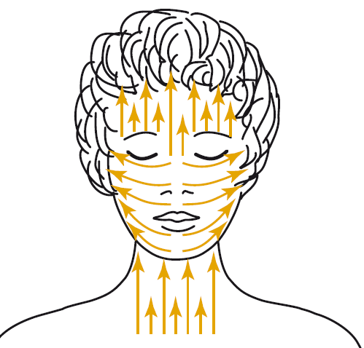
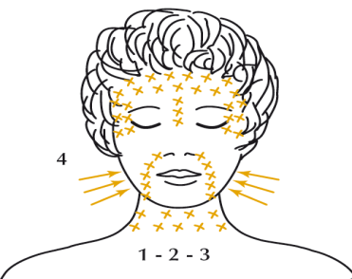
ALPHA-EXFOLIATEUR
Professional use
Professional Exfoliating and Renovating Peel - Grade 2
*Apply with 2 sticks on the areas indicated below (5 droppers)
*Work each wrinkle with the anti-wrinkle techniques and the oval of the face with the firming techniques below
*Removal with fresh water using a wipes zone by zone
30% ACIDS
EXFOLIATING
RENEWING
Application
Anti-wrinkle and firmness techniques
Citric acid
Glycolic acid
Lactic acid
Tartaric acid
AHA
BHA
Salicylic acid
P.60 ml
Notes:
ALPHA EXFOLIATEUR : 30% acids (AHA + BHA including 0.18% salicylic acid)
Citric Acid
Glycolic Acid
Lactic Acid
Tartaric Acid
Salicylic Acid
PREPARATION
*wet cotton pads on the eyes
APPLICATION
*take 5 drop accounts in a cup
*apply with large sticks to the entire face and neck (very wet skin) in a progressive way
*do not apply to lips and eyelids
*to prevent possible tingling sensations
APPLICATION TIME
*5 to 20' depending on sensitivity and if 1st or no treatment
ANTI-WRINKLE AND FIRMING TECHNIQUES ON NECESSARY AREAS
Pinches : Make pinches by working perpendicular to the wrinkle (back & forth)
Come and Go: Zig zag movement back and forth
Swirl: 1 stick whirls while the other follows smoothly the 1st (back & forth)
Tapping on the cheeks(one side first, then the other)
Rinse with fresh water zone by zone 3 to 4 times
CI
*irritated skin, redness, hypersensitivity
*skin dermato treatment
*dermatoses
*œdemas
*before waxing or UV ray or sun exposure
*after intense sun/UV exposure
*after bleaching
*do not use ACTIVE MICRO PEEL and ALPHA EXFOLIATOR in the same treatment or in the same week

Slide 12
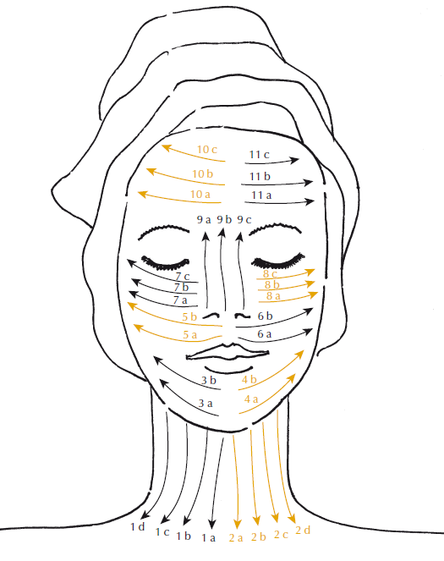
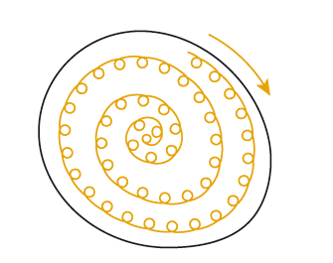
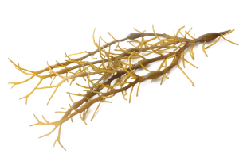
ESSENTIAL WHITE PEELING LUMIERE
Professional use
Professional Unifying and Exfoliating Peel - Grade 3
FOR A BRIGHTENING EFFECT
*Apply with a brush on the face and neck (4/5 droppers) with effleurage movements during 4 minutes
*Repeat the application and perform the same movements for 4 minutes
*Rinse with cold water
DARK SPOT CORRECTION
*Apply locally to spots with the stick in a clockwise whirling motion (4 mins)
*Rinse with cold water
AHA
Glycolic acid
30% GLYCOLIC ACID
BHA
EXFOLIATING
+ VITAMIN C & BROWN ALGAE
Salicylic acid
Other acid
Application
Ascorbic acid
BRIGHTENING
ANTI DARK SPOTS
Swirl on each spot
P.60 ml
Notes:
PREPARATION
*wet cotton pads on the eyes
ESSENTIAL WHITE PEELING LUMIERE
30% glycolic acid + salicylic + ascorbic + brown algae, chronostable vit C

Slide 13
PEELING DEMONSTRATION

Slide 14
PEELING DEMONSTRATION
1
1
ACTIVE MICRO PEEL
2
2
ALPHA EXFOLIAEUR
3
PEELING LUMIERE
3

Slide 15
HOME PRESCRIPTION
Notes:
Before concluding, a quick reminder about Yon-Ka products containing acids

Slide 16
Resurfacing
The new skin effect duo
HYDRATE all day long
REGENERATE the night
+ Beech bud peptides
+ Sweet almond peptides
ALPHA-PEEL
ALPHA-FLUID
Notes:
ALPHA-FLUID
Description
This face renovator with fruit acids, with its fine, creamy texture, moisturizes, nourishes and revitalizes all skin types lacking radiance. It clarifies and invigorates dull and tired complexions. Quickly absorbed, Alpha-Fluid tightens pores, makes the skin soft and smooth and visibly reduces fine lines. A new skin effect is guaranteed!
Promise
Renovating and moisturizing fluid
For whom?
All skin types
All ages
"I have an uneven skin tone and uneven skin texture".
"I have acne scars that persist despite the passing years".
Ingredients
AHA: renovator
Mimosa tenuiflora : regenerating
Sweet almond peptides: moisturizing
Home use
In the morning, cleanse your face thoroughly and then mist with Yon-Ka Lotion adapted to your skin type. Then apply Alpha-Fluid to your face and neck. Important: apply SPF 50 cream on top when exposed to the sun. For a reinforced new skin effect, apply Alpha Peel in the evening after cleansing and make-up removal and after spraying Yon-Ka Lotion. Avoid lips and eyelids. Leave on overnight. Note: in case of discomfort, 15 minutes after application, apply Alpha-Fluid. Important : avoid using Alpha-Peel during sun exposure or dermatological treatments with vitamin A.
Use in treatment room
Massage
End of treatment cream
Tips
It is possible to use alpha-fluid all year round by combining it with another night care product
To recommend as a global treatment to brides-to-be (propose an offer with the make-up trial / bridal make-up / Alpha-Vital treatment in package)
Product advantages
Contains 94% natural ingredients
Refines the skin texture
The skin is protected, hydrated, beautiful and soft
New skin effect
ALPHA-PEEL
Description
This renewing gel peel with precisely dosed fruit acids gently eliminates dead cells and visibly improves the skin quality on the face, neck and décolleté. Alpha-Peel is used in the evening, preferably as a one-month treatment for maximum "new skin" effect. The complexion becomes more even and radiant, the skin texture is refined, and wrinkles and fine lines are smoothed.
Promise
Renovating peel
For whom?
All skin types
All ages
"I have an uneven skin tone and uneven skin texture".
"I have acne scars that persist despite the passing years".
Ingredients
- AHA: renovator
Mimosa tenuiflora : regenerating
Beech bud peptides: regenerating
Home use
In the evening, remove make-up and cleanse your face thoroughly, then mist with Yon-Ka Lotion adapted to your skin type. Then apply 5 pumps of Alpha-Peel to the face and neck, avoiding the lips and eye area. Note: in case of discomfort, 15 minutes after application, apply Alpha-Fluid. Important: avoid using Alpha-Peel during sun exposure or dermatological treatments with vitamin A. Alpha-Peel is recommended as a one-month treatment in addition to Alpha-Fluid: - on dull and tired skin, - at the change of season to boost the renewal of the superficial layers of the epidermis and the skin's radiance. Use in treatment room
Massage
End of treatment cream
Tips
?
Product advantages
Gentle fruit acid peel
Eliminates dead cells, tightens pores
Restores radiance and softness to the skin
Works at night for a healthy glow in the morning

Slide 17
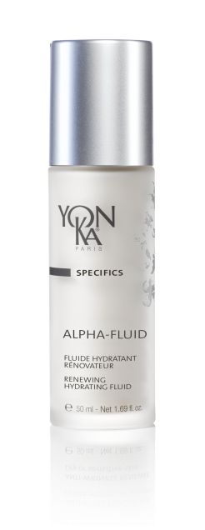
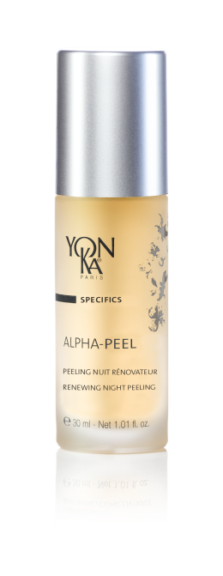
Resurfacing
The new skin effect duo
When to use this duo?
At each change of season in case of :
Dull and uneven skin complexion.
Dilated pores
Imperfections
Fine lines
Scars
From the age of 35 :
to regenerate the skin
In addition to the ALPHA VITAL professional treatment once a week for 1 month.
Notes:
ALPHA FLUID - Resurfacing
RENOVATING HYDRATING FLUID
Renews and revitalizes, for softer skin
Improves the quality of the skin
Hydrates
2% AHA: renews
Mimosa tenuiflora: regenerates
Sweet almonds peptides: hydrates
Cereal germ oil : nourishing; protective
Rice oil, vitamin E: anti-oxydant
Morning & night
use SPF 50 on top
1 month cure
PROFESSIONAL SIZE
Ideal for dull, uneven skin tone, large pores, blemishes, fine lines
ALPHA PEEL - Resurfacing
RENEWING NIGHT PEELING
Gently removes dead skin cells
Refines the skin texture
Makes the skin more radiant
8% AHA: renews
Mimosa tenuiflora: regenerate
Beech bud peptides: smoothe
HA, aloe vera: hydrate
Vitamin B5: soothes
evening
1 monht cure
Ideal for dull, uneven skin tone, large pores, blemishes, fine lines

Slide 18
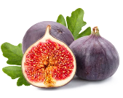
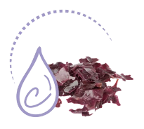
To unify the skin
Porcelain complexion care products
EXFOLIATING-UNIFYING
TARGETED ANTI-DARK SPOT
ANTI-DARK SPOT, EVEN COMPLEXION
ESSENTIAL WHITE SOLUTION CLARTE
ESSENTIAL WHITE CORRECTEUR CIBLE
ESSENTIAL WHITE CREME LUMIERE
Notes:
ESSENTIAL WHITE SOLUTION CLARTE
Description
This gentle, gradual, daily gel-textured facial peel helps eliminate dead cells and even out the complexion. The Clarity Solution is an integral part of the Essential White anti-spot program and is used in this case, during the entire treatment. Under the action of fig blossom, apple and fruit acid extracts, brown spots are reduced, the complexion becomes more even and more radiant, the skin appears clearer and smoother.
Promise
Daily gentle peel to prevent blemishes and shine
For whom?
All skin types
All ages
« I have an uneven skin tone and lack of radiance »
« I have spots that appeared after my pregnancy »
Ingredients
- AHA and BHA: exfoliant (*glycolic acid: synthetic origin, salicylic acid: black willow bark origin, lactic acid: synthetic origin, certified for use in Bio-ECOCERT products)
Fig flower extract: eliminates dead cells
Home use
Morning and evening, thoroughly cleanse your face/remove make-up and mist with the appropriate Yon-Ka Lotion. Then apply ½ pipette of the Solution Clarté all over your face and neck or locally. As part of the Essential White treatment, continue with: the Correcteur Ciblé, locally on the spots, then the Crème Lumière on the whole face (followed by an SPF 50 during the day only)
Precaution for use: avoid exposure to the sun during the entire duration of the Essential White treatment course, which will last for at least one month. Do not apply to the eye and lip contour area and for sensitive skin, use in the evening preferably.
Tips
It is possible and normal that small flakes appear a few days after the start of the treatment, this is due to the elimination of dead cells.
Product advantages
Contains 95% of natural ingredients
+66% homogeneity (best results obtained on clinical study of the finished product on a panel of 22 women)
Gel peeling, gently removes dead cells
Evens and brightens the complexion
Suitable for all skin types
ESSENTIAL WHITE CORRECTEUR CIBLE (TARGET CORRECTOR)
Description
This ultra-concentrated treatment visibly reduces brown spots on the face, neck, décolleté and hands. Thanks to the action of the C-White complex, a combination of vitamin C and red algae, the pigmentation spots fade and decrease in size and number with each application. Essential White Correcteur Cible is applied locally.
Promise
Targeted anti-spot treatment
For whom?
All skin types
All ages
"I have localized spots on my hands and around my eyes
Ingredients
C-White complex (chronostable vitamin C + red algae): exfoliating (acts on melanogenesis and tyrosinase)
Home use
In the morning and evening, carefully cleanse and remove make-up from your face and mist with the appropriate Yon-Ka Lotion. Then apply the Correcteur Ciblé locally to brown spots on the face, neck, décolleté or hands. Note: this corrector can also be used more extensively on areas with colour differences to even out the complexion. As part of the, continue with: the Correcteur Ciblé, locally on the spots, then the Crème Lumière on the whole face followed by an SPF 50. lightening treatment
Use in the treatment room
End of care
Tips
Product advantages
Contains 93% natural ingredients
33% reduction in the number and size of spots (Maximum results obtained in a 28-day clinical study conducted on a panel of 30 women)
Visibly reduces brown spots on the face, neck, décolleté and hands
Expert care for pigmentation spots and irregularities of the complexion
Effective on all skin types
High precision applicator
ESSENTIAL WHITE CREME LUMIERE
Description
Thanks to its vitamin C, this lightening cream effectively corrects and prevents the appearance of pigmentary spots (brown spots, age spots, spots caused by the sun, pregnancy mask, etc.). It is used on the face, neck, décolleté and hands. Day after day, the size, intensity and number of spots are reduced. Enriched with hyaluronic acid, this treatment combines a moisturizing and anti-aging action. In a few weeks, colour differences fade, the complexion becomes more even, more harmonious and luminous.
Promise
Clarifying cream and uniformity of the complexion
For whom?
All skin types
All ages
"I have an uneven skin tone and lack of radiance".
"I have spots that appeared after my pregnancy"
"I am looking for a lightening, unifying cream
Ingredients
Vitamin C chronostable: lightening, uniformity
Home use
In the morning and evening, cleanse your face thoroughly and mist it with the appropriate Yon-Ka Lotion.
Lightening cure lasting at least 30 days, morning and evening, after cleansing and applying Yon-Ka Lotion: apply the Solution Clarté to the face, neck and décolleté, superimpose the Correcteur Ciblé locally on the irregularities of the complexion and spots and finish with the Crème Lumière.
For maintenance, the Crème Lumière can be used alone or mixed with 1 to 2 pumps of one of the following boosters to personalize your care according to your skin's evolving needs: clarify + hydrate with the Hydra + booster, clarify + nourish with the Nutri + booster, clarify + firm with the Lift + booster, clarify + protect with the Defense + booster.
Use in the treatment room
Massage
End of treatment cream
Tips
?
Product advantages
Contains 93% natural ingredients
98% more radiant complexion (Maximum results obtained from a 28-day clinical study conducted on a panel of 30 women)
-97% pigment contrast (Maximum results obtained from a clinical study conducted on a panel of 30 women)
Helps prevent and reduce dark spots
Unifies the complexion by reducing colour differences
Suitable for all skin types

Slide 19
To unify the skin
When to use this range?
The clarifying and anti-dark spot range
For the prevention and correction of pigment spots caused by
Sun exposure
Pregnancy
Aging
Acne
Hormonal disorders
Hereditary/genetic
to unify the skin
In addition to ESSENTIAL WHITE professional treatment once a week for 1 month.
Notes:
ESSENTIAL WHITE SOLUTION CLARTE - Brightenning – dark spots
DAILY BRIGHT & PEEL SOLUTION
Brighten and unify the complexion
Exfoliates
Stimulates cell renewal
Anti dark spots
5% AHA, ficus indica flower: exfolition, stimulation of cel renewal
Apple extract: anti free radicals
Brown algae: bright, even complexion
Morning and evening
If sensitive skin, use in the evening (once a day)
Apply SPF 50
Combined together Solution Clarté + Crème Lumière + Correcteur Ciblé
ESSENTIAL WHITE CORRECTEUR CIBLE - Brightening effect dark spots
DARK SPOT TARGETED CREAM
Regulates the melanogenesis
Corrects discoloration
Prevents new one
C-White complex (= tine defying vit C + red algae): brightening anti discoloration
Polysaccharides, vegetal glycerin: hydrating
Morning & evening
Locally apply to visible discolorations
Apply sun protection on top
Combined together Solution Clarté + Crème Lumière + Correcteur Ciblé
ESSENTIAL WHITE CREME LUMIERE - Brightening effect dark spots
UNIFYING BRIGHTENING CREAM
Corrects discoloration
Prevents dark spots
Hydrates and anti aging
Time defying vitamin C: brightening anti dark spots even complexion
Apple extract, vit A and E: anti free radicals
High molecular AH, beech bud peptides: hydrating, anti aging
Morning & evening
Apply sun protection on top
PROFESSIONAL SIZE
Combined together Solution Clarté + Crème Lumière + Correcteur Ciblé

Slide 20
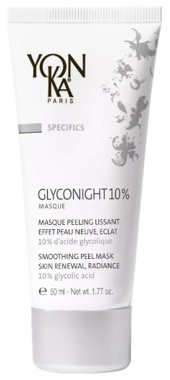
Glyconight 10% Masque
Triple-effect night peeling mask with 10% glycolic acid
RADIANCE BOOSTING MASK
FLASH CURE NEW SKIN EFFECT
ANTI-AGING INTENSIVE CURE
Apply once at night for an incredibly more radiant complexion the next morning.
Use every other night for the first week, then every night for each of the following weeks.
Repeat this course of treatment two or three times a year.
Use every other night for one week.
Notes:
GLYCONIGHT 10% MASK
All skin types
SMOTHING – RENOVATING - ILLUMINATING
Smoothes
Anti-wrinkle
Evens out the complexion
Smoothes skin texture
Tightens pores
10% pure glycolic acid: smoothing, anti wrinkle
Organic apricot kernel oil: radiance
Natural polysaccharides: soothing
Vegetable glycerin: moisturizing
YK Quintessence: balancing
Radiance boost, flash treatment (1 week, every other night) or intensive treatment (1 month, every other night for the first week, then every night)
Sleeping mask only
Clean peeling
intergenerational
Description
Glyconight 10% Mask, the clean peel that gives the skin a new lease of life. This night peeling mask with 10% pure glycolic acid has a triple proven effectiveness: anti-aging, new skin effect, radiance. It can be used as a radiance boost, flash cure or intensive treatment. The results are seen from the first moment you wake up, and get stronger with each application!
Promise
Night peeling mask with 10% pure glycolic acid
For whom?
For millennials (Blemish-free skin, radiance and first wrinkle treatment)
For more mature skin (Anti-aging effect (wrinkles++/firmness/spots) and radiance)
Ingredients
10% glycolic acid: smoothing, anti-wrinkle
Natural polysaccharides: soothing
Vegetable glycerin: moisturizer
Brown seaweed: shine
Organic apricot kernel oil: radiance
Home use
Triple use
Radiance mask: 1 application in the evening for a radiant effect the next morning
Flash or maintenance treatment: Every other night for 1 week
Intensive treatment: Every other night for the first week, then every night for the following weeks. Cure to be repeated 2 to 3 times a year
Precaution of use
Avoid contact with eyes and lips
Always use a sunscreen during the day
In case of persistent irritation or redness, discontinue use and consult a physician
Do not apply before or after hair removal
Do not use when having a retinoic acid-based treatment or in case of particular sensitivity to glycolic acid
The use of this product should be of limited frequency or duration
To see if you can tolerate glycolic acid, apply a small amount to the inside of the elbow or behind the ear.
If redness and violent sensations of discomfort appear remove and try again the next day to confirm if intolerance or not.
Remember to use sampling!
Tips
Can also be applied to the décolleté to visibly smooth it out and give it a new look!
Excellent preparation of the skin before a dermatological peeling.
Product advantages
10% pure glycolic acid
Clean peeling
Triple use and triple efficiency
Intergenerational
Radiance of the complexion: + 24%.
Pore diameter: -19%.
Depth of crow's feet wrinkles: -30
(Clinical study carried out under the supervision of a dermatologist on 15 volunteers aged 20 to 39 (1 month) and 15 volunteers aged 40 to 55 (2 months) - Average results for both groups at 1 month except for the density of the dermis in the 40-55 age group only.

Slide 21
Renewing radiance
Restorative sleep
Wheat germ food supplement
Favour foods rich in EFAs, vitamin C
Detox cure (black radish, artichoke…)
Drink green tea + lemon
Go to the hammam
Notes:
DULL SKINS - preserve your healthy glow!
*A healthy lifestyle with restorative sleep (because we are tired, the body will provide the necessary nutrients to our vital organs to the detriment of the skin)
*a balanced diet rich in vitamin C, EFAs and water
*Beware of pollution and screen exposure (blue light penetrates the dermis and reduces our cell regeneration capacity )
*Practice sports to eliminate toxins
*drink green tea + lemon
*go to the Hamman
*Dietary supplement : wheat germ
*massage your face with tonic movements to reactivate the microcirculation, oxygenate and drain and thus eliminate toxins
*Detox cure (black radish, artichoke...)
*1 glass of lemon juice every morning on an empty stomach,

