Slide 1
Bonjour!
Export Distributors Webinar - 16 March 2023

Slide 2
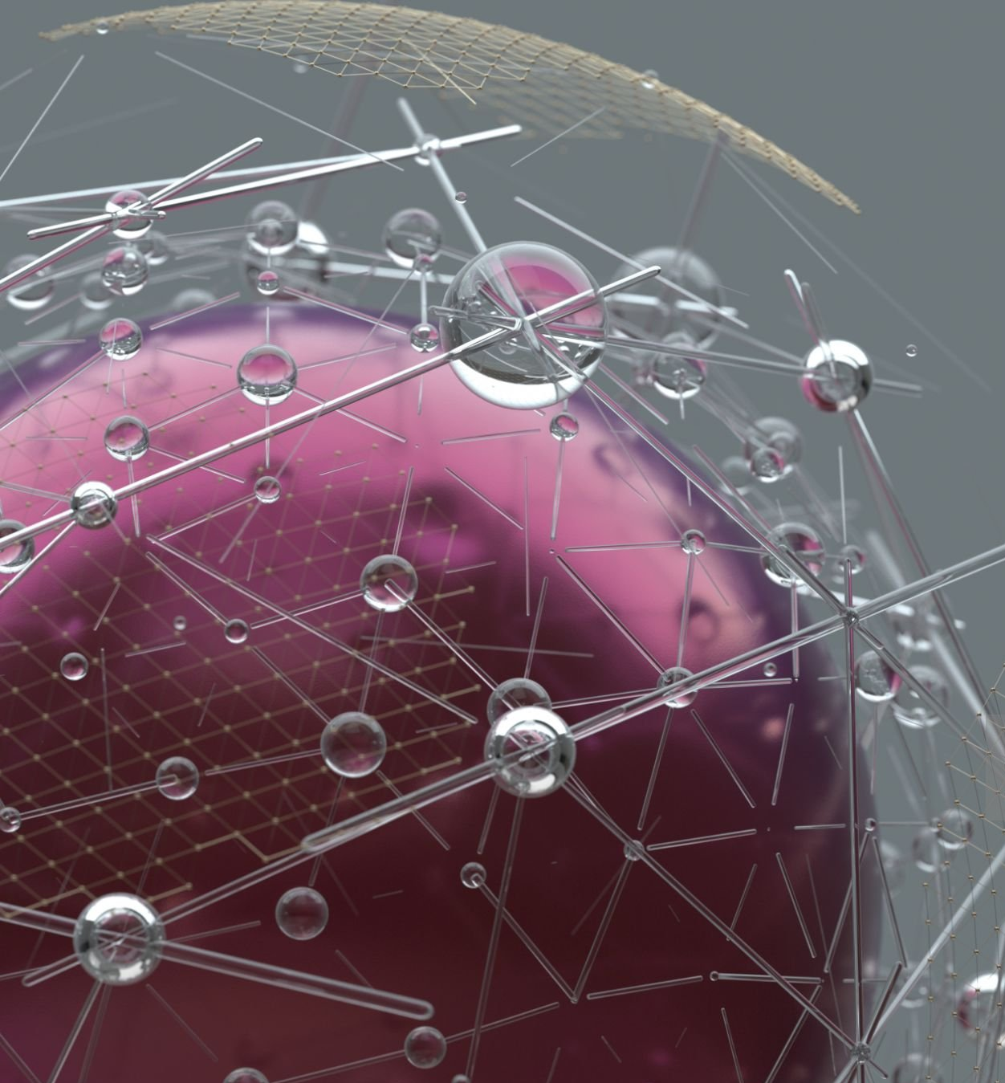
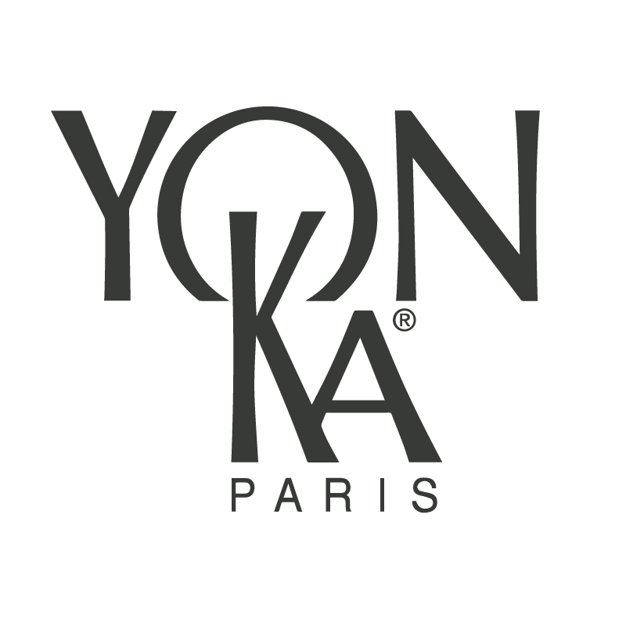
Multi-protection mist
vital defense

Slide 3

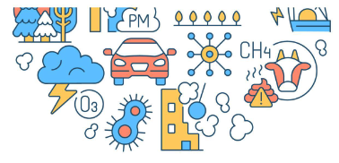
Pollution, UV, Blue light
Skin continuously exposed to many types of aggressions
Pollution * + 8%
Exposure to polluted air ** 99%
Exposure to fine particles *** 80%
Pollution
*Future Market Insights report "Anti-pollution skin care market 2017/2021" **Source OMS "Health topics air pollution" ***Partner study
Notes:
It's no secret to anyone that our skin is permanently exposed to many external aggressions.
The pollution and the light radiation(s) are the main accelerators of the ageing of our skin.
Recent studies have revealed that pollution is more and more present in our daily lives and has increased by 8% in the last 5 years*.
Today, according to the world health organization, 99% of the population is exposed to polluted air** and-
80% of the population to fine particles***
This data concerns the global population not only the urban areas
We can now consider that our skin is facing premature ageing.
*Future Market Insights report "Anti-pollution skin care market 2017/2021"
**Source OMS "Health topics air pollution"
***Partner study

Slide 4
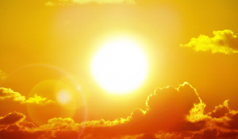

Pollution, UV, Blue light
Skin continuously exposed to many types of aggressions
UV, IR
Solar radiation
UV / IR / Blue light
+
Artificial light rays
6h per day exposure to
artificial blue light*
RADIATION
Blue light
*https://www.sciencesetavenir.fr/sante/dermato/lumiere-bleue-et-vieillissement-de-la-peau-du-marketing_128720
Notes:
In addition to pollution, there are other insidious/invisible factors that are : the light radiation
2 different types : Solar radiation and artificial light rays
Depending on their wavelength, they are called UV, infrared and blue light.
The second the artificial light :we are exposed to an average of 6 hours/day of artificial blue light,
Polluted air combined to light radiation we can say that the damage on skin is cumulative!

Slide 5
The different types of solar radiations
UV : 2 types
UVB: Responsible for sunburn and many skin cancers.
UVA: Penetrate deeper into the dermis, responsible for skin aging (pigment spots, wrinkles), and in the long run skin cancers.
UV
HEV/ Blue light:
Responsible for half of the production of free radicals and 25% of cellular damage. Painless, it amplifies accelerated skin aging.
Blue light
IR
IR :
Create heat. They intensify the damaging effects of UV and HEV. Produce free radicals that alter the functioning of the mitochondria (the cells' energy centers) and fibroblasts (loss of firmness)
Notes:
The luminous radiation (solar) which arrives on earth is made up of 3 great categories of rays: UV (Ultraviolet), HEV (High Visible Energy) of which 1/3 is represented by the blue light and IR (Infra-red).
UV represents 5 to 10% of solar radiation
About 45% for the HEV
About 45% for the IR
UV
2 types of UV arrive on earth, UVB and UVA (There is a 3rd category, UVC, which stopped by the ozone layer do not reach the surface of the globe).
The HEV (High Visible Energy) / Blue Light
Responsible for half of the production of free radicals and 25% of cellular damage (alters the structure of epidermal cells and fibroblasts, decreases the production of collagen and elastin, and increases the production and activation of tyrosinase responsible for the appearance of long-lasting spots). Painless, it amplifies accelerated skin aging.
IR
Create heat. They aggravate the harmful effects of UV and HEV. Produce free radicals that alter the functioning of the mitochondria (the cells' energy centers) and fibroblasts (loss of firmness)

Slide 6
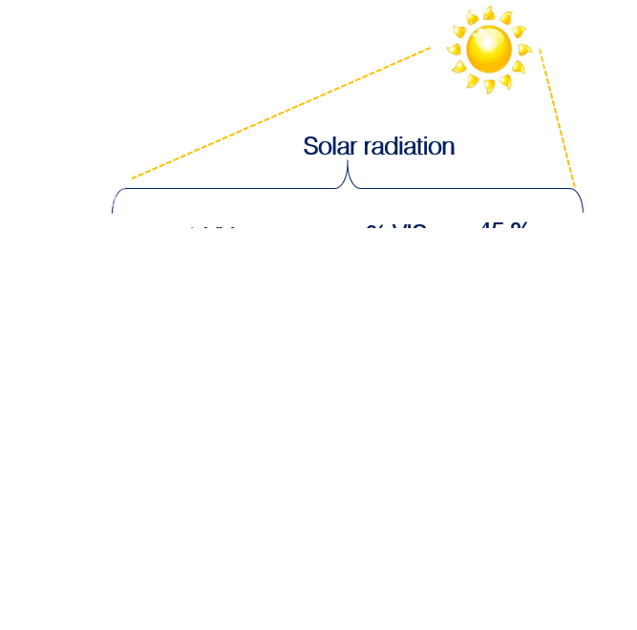
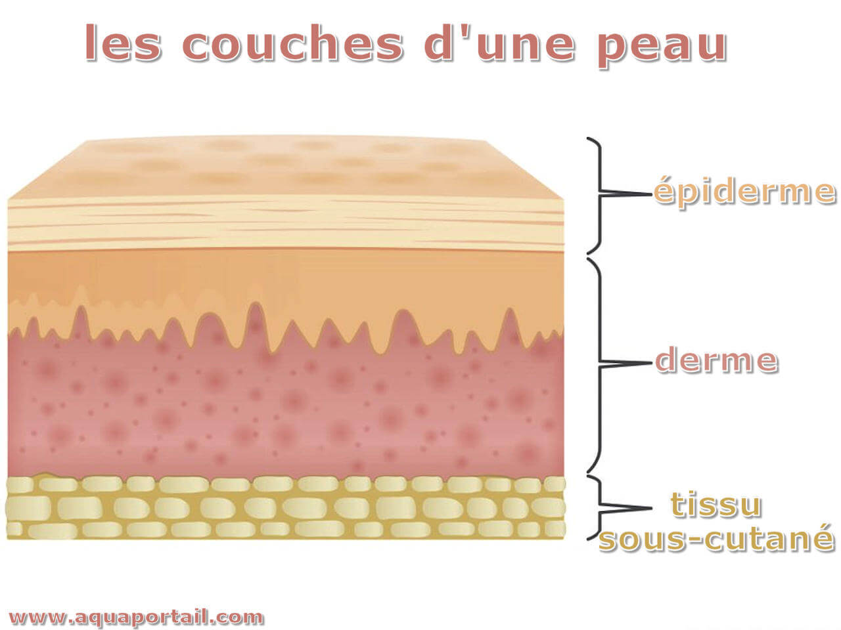
The different types of solar radiations
SOLAR RADIATION
UV
HEV
IR
UVB
UVA
VISIBLE
LIGHT
INFRAREDS
RAYS
Sunburn, burns
Skin cancers
Skin aging, wrinkles
Skin cancers
Production of free radicals,
cellular damage
Heat stroke
Increase in the deleterious effects of UV
NEGATIVE EFFECTS
EPIDERMIS
DERMIS
HYPODERMIS
Notes:
We are subjected to light rays every day of the year. They affect us all day long, even on cloudy days, even through windows.
UV:
UVB represent 10% of UV rays. They are responsible for sunburns, burns, blisters and many skin cancers.
90% of UV rays are UVA. They penetrate deeper into the dermis, and are responsible for pigment spots, skin aging, wrinkles, and over time skin cancers.
HEV / Blue light
Located in the extension of UVA (its wavelength is between 380 and 500 nanometers, compared to 290 to 400 nanometers for UVA and UVB), HEV blue light attacks all cellular constituents, such as lipids, proteins and DNA, causing deep cellular damage to the skin in the long term. With its intense energy - which gives it its name High Energy Visible - blue light is responsible for almost half of the production of free radicals and 25% of cellular damage during sun exposure (1). It has been shown that blue light, by attacking cellular DNA, alters the structure of epidermal cells (keratinocytes) and dermal cells (fibroblasts) and reduces the production of collagen and elastin. Painless, unlike UV light that burns and IR light that heats up, blue light insidiously amplifies accelerated skin aging and is responsible for the appearance of lasting dark spots. In fact, it increases the production and activation of tyrosinase, a key enzyme in the pigmentation process, responsible for longer-lasting pigmentation. Every day our skin, regardless of the weather, is exposed to blue light. In addition to natural blue light (sunlight), we are exposed to artificial blue light from LED lighting, computer screens, televisions and smartphones... Even if the intensity is 1000 times less than that emitted by the sun, the 6 hours of exposure per day (2) to this artificial blue light adds to that of the sun and insidiously amplifies its deleterious effects.
(1) Zastrow L, Groth N, Klein F et al. The Missing Link - Light-Induced (280-1,600 nm) Free Radical Formation in Human Skin. Skin Pharmacology and Physiology 2009;22: 31-44(2) Partner data
Infrareds
They penetrate the hypodermis. Being absorbed by liquid substances, they will agitate the water molecules and thus cause heat. They are responsible for heat stroke with the rise in temperature of the exposed tissues, before the effects of UV rays are felt. They potentiate the deleterious effects of UV and blue light. Big purveyors of free radicals, IR alters the functioning of mitochondria (energy centers of cells) and fibroblasts which altered a support tissue and at the mercy of MMP1 enzymes boosted by IR (MMP1 degrade the extracellular matrix).

Slide 7
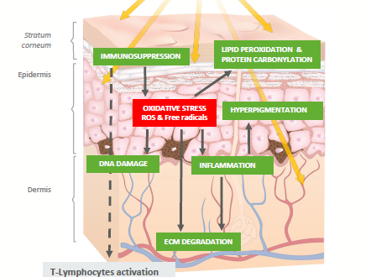

Pollution, UV, Blue Light
Many skin consequences
Weakened cutaneous barrier, dehydration
Lack of cellular oxygenation, dull complexion without radiance
Uneven complexion and hyperpigmentation
Premature aging : Wrinkles,
loss of elasticity,...
Notes:
As we know, these aggressions have many consequences:
Schematically, the impact of these aggressions on the skin is simple: aggressions => chain reactions => oxidative stress (alteration and weakening of the skin barrier, lack of cellular oxygenation, inflammation, degradation of the extracellular matrix, stimulation of melanocytes).
The results on the skin are dehydration, a dull and uneven complexion, premature aging with the appearance of wrinkles, loss of elasticity, spots,...
You understood it, it is time to find THE adapted protection!

Slide 8
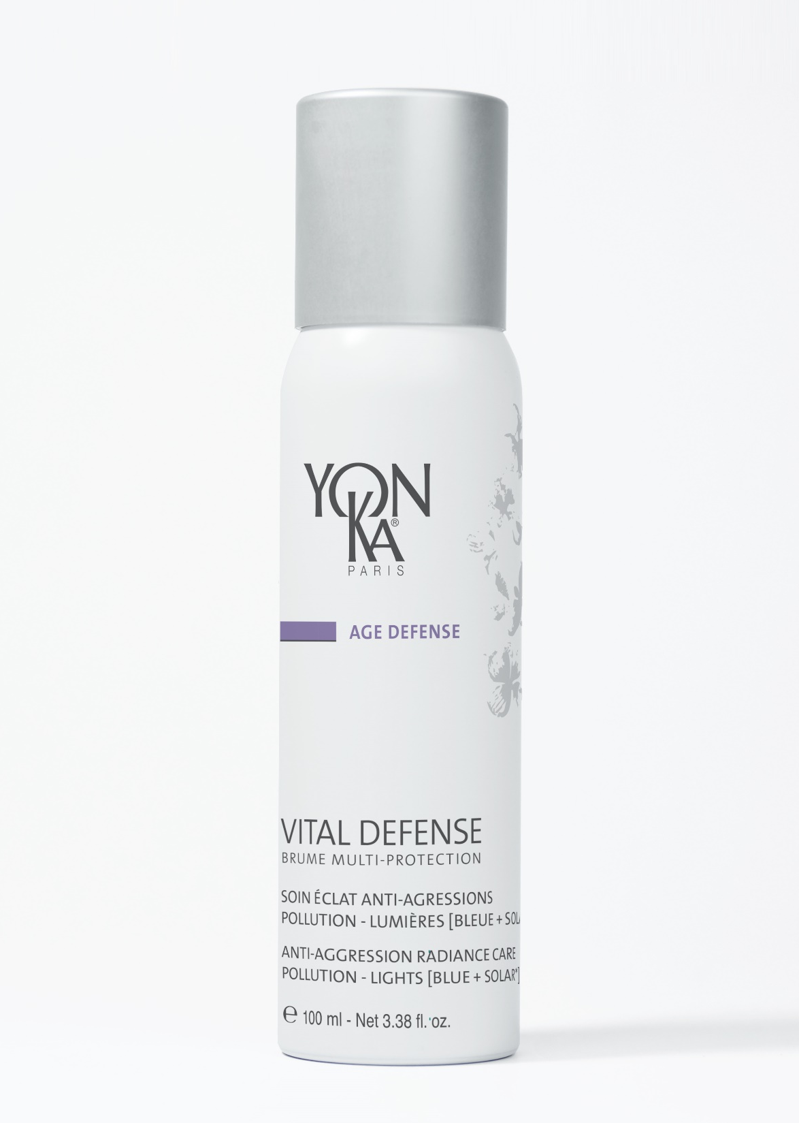
Yon-Ka’s answer
Vital Defense
multi-protection mist
ANTI-AGRESSIONS RADIANCE CARE
POLLUTION – LIGHTS [BLUE + SOLAR*]
*Does not contain sunscreen
Notes:
To satisfy this growing need for protection against external aggression and to help our skin
Yon-Ka has developed a real protective bubble,
The VITAL DEFENSE MULTI-PROTECTION MIST
A treatment capable of creating the perfect anti-aggression radiance shield in a few seconds.
With this product, Yon-Ka extends its VITAL DEFENSE range (which already includes a cream).

Slide 9
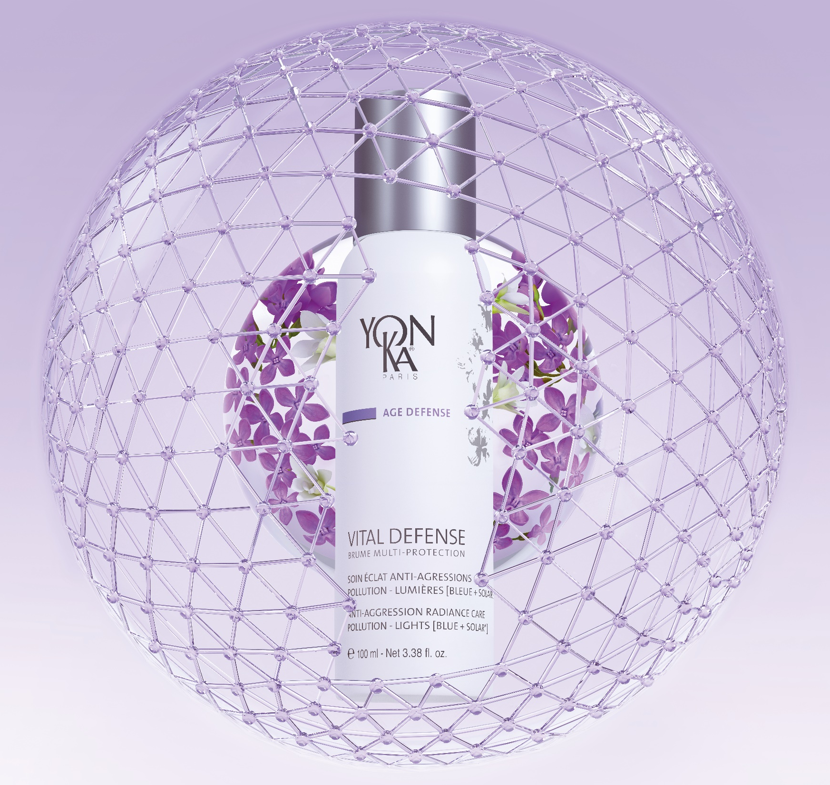
Double protection for
360° effectiveness
Surface protection
Shield action
Deep protection
Defense and repair action
Notes:
This mist offers a double protection, for 360° efficiency.
An immediate surface protection, thanks to a breathable protective film
A long-term deep protection capable of helping to boost the skin's self defense systems and regenerate the cells

Slide 10

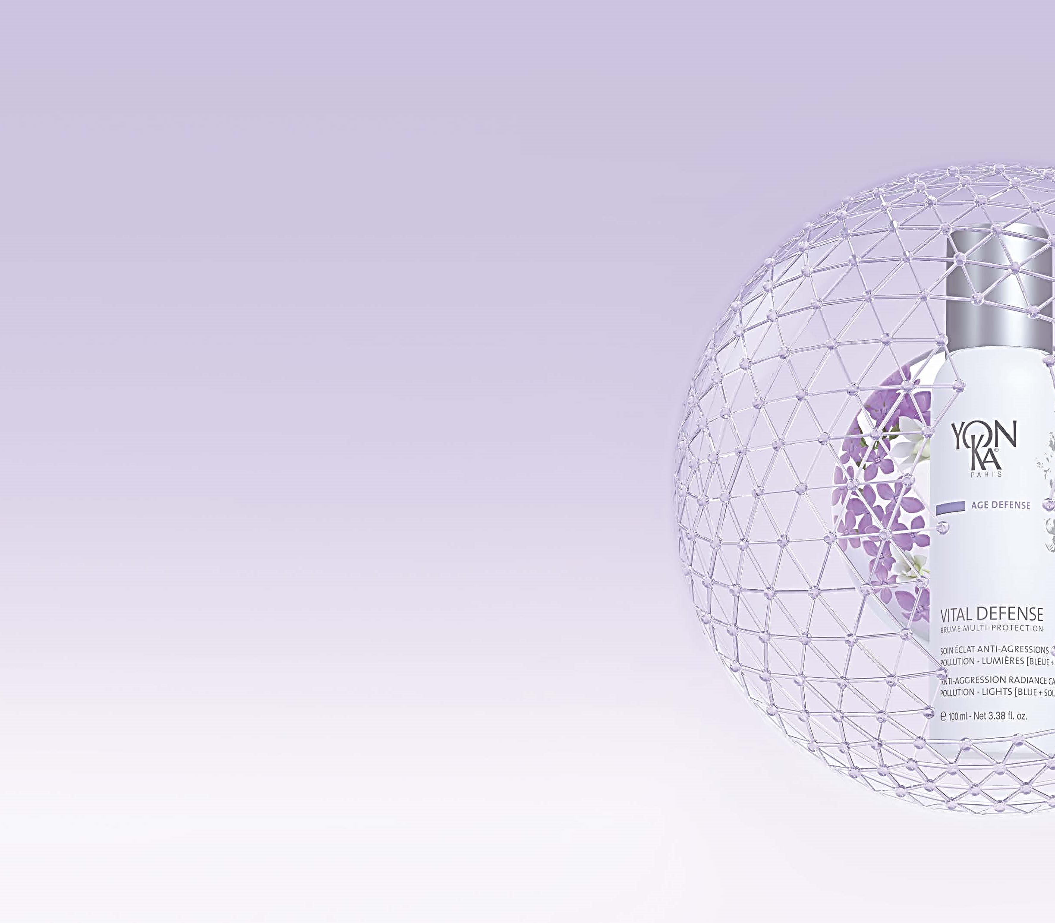
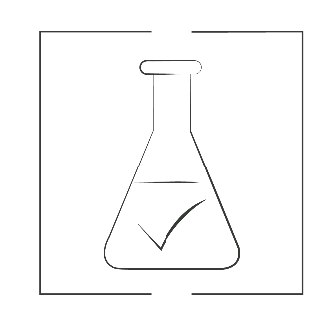

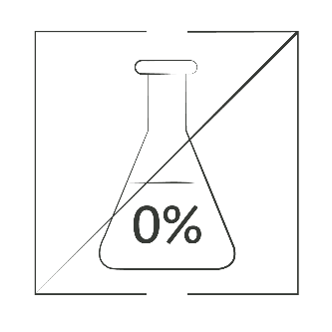
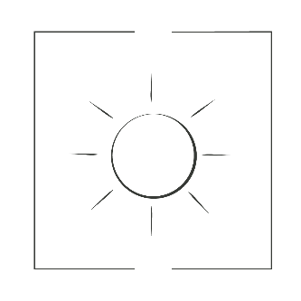
Multi-protection formula
99%
NATURAL ORIGIN INGREDIENTS
Clean
Vegan
Non GMO
No Alcohol
No Sunscreen
A formula boosted by Green Sciences
Use of science to produce and/or cultivate natural ingredients, without depleting the soil, through sustainable and high-tech processes.
*No ingredients of animal origin
Notes:
A FORMULA COMPOSED OF 99% ION,
CLEAN: Our formulation policy is very strict. We have a red list of ingredients banned from our formulas: Parabens, SLS, BHT, Phthalates, Triclosan, MIT, GMOs, proven endocrine disruptors...
In order to offer you products which are effective, safe, as natural as possible and environmentally friendly
This multi-protection formula is also
Vegan GMO free
Alcohol free
and does not contain any sunscreens but
powerful ingredients boosted by green science capable of targeting the oxidative reactions caused by light and pollution
A powerful formula with active ingredients boosted by green sciences to effectively fight against the skin consequences of oxidative stress

Slide 11
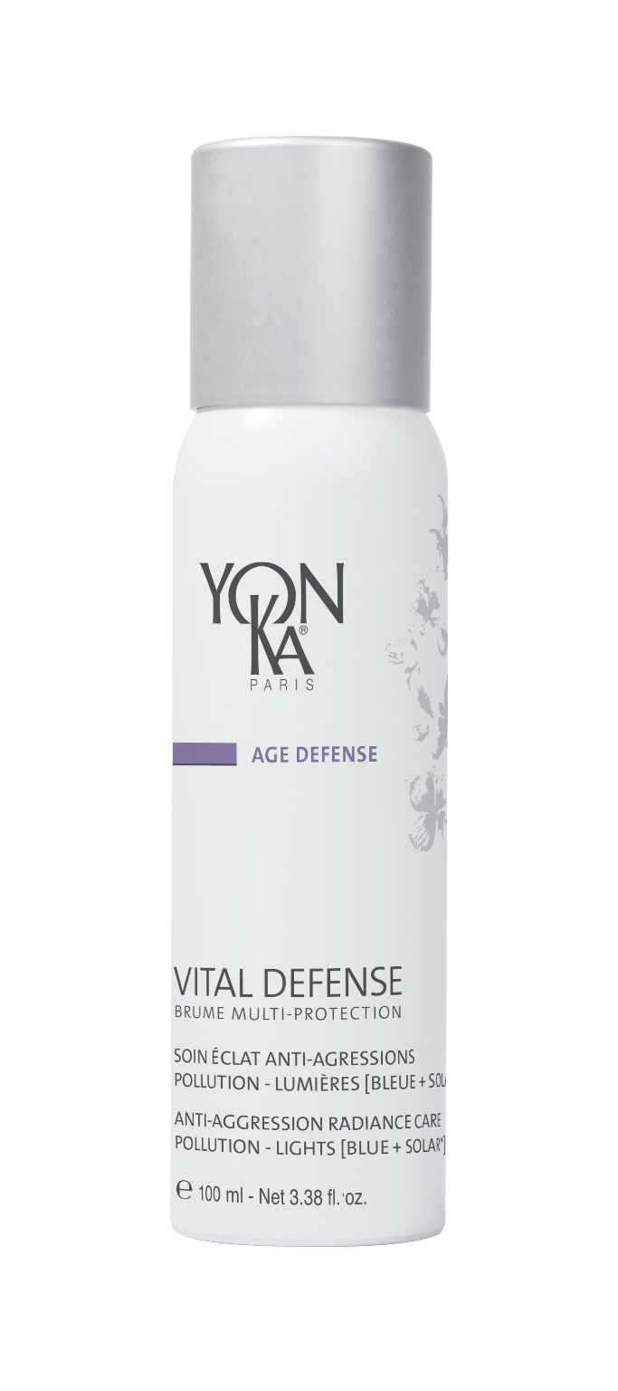
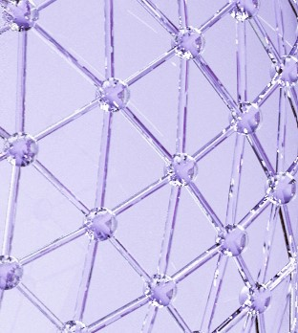
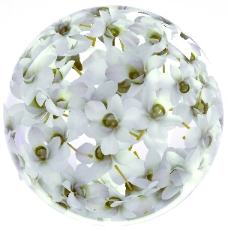
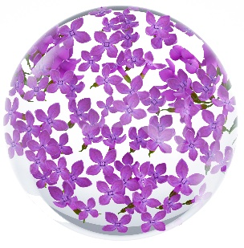
Multi-protection formula
Plant polyphenols
(Sophora Japonica + Butterfly tree)
Anti-oxidant multi-protectors
UV - Blue Light - Infrared
Biosaccharide
Protective shield against pollution and anti-particles
Aromatic composition
100% natural
including essential oils
of Sweet Orange,
Green Mandarin and Magnolia
B5 Vitamin
Soothes and moisturizes
Notes:
Let's have a look on what our multi-protection formula is made of.
BIOSACCHARIDE = SURFACE PROTECTION
The main active ingredient which create the protective shield against pollution and anti-particles.
High molecular weight Complex sugar obtained by Green Sciences (Biotechnological origin obtained via a corn fermentation process)
On the surface, the bioscaccharide reduces the number of encrusted pollution particles by instantly forming a "second skin"...
Which is breathable, homogeneous, resistant and invisible, acts as a protective shield against atmospheric pollution (carbon particles, fine particles and heavy metals) and thus limits the appearance of premature ageing and skin disorders (oxidative stress, inflammation, cellular and mitochondrial toxicity, etc.).
PLANT POLYPHENOLS = DEEP PROTECTION
It contains antioxidant and photo-protective plant polyphenols extracted from Sophora Japonica and the butterfly tree,
which target the different damaging effects of light rays, whatever their origin (solar or artificial), and their wavelength (UV, infrared and blue light).
We have completed the formula with B5 Vitamin, which moisturizes and soothes for a maximum of comfort throughout the day.
The scent also brings a lot of sensorially to this mist thanks to its 100% natural aromatic composition
including essential oils of Sweet Orange, Green Mandarin and Magnolia,
identical to the scent of the Vital Defense cream.

Slide 12
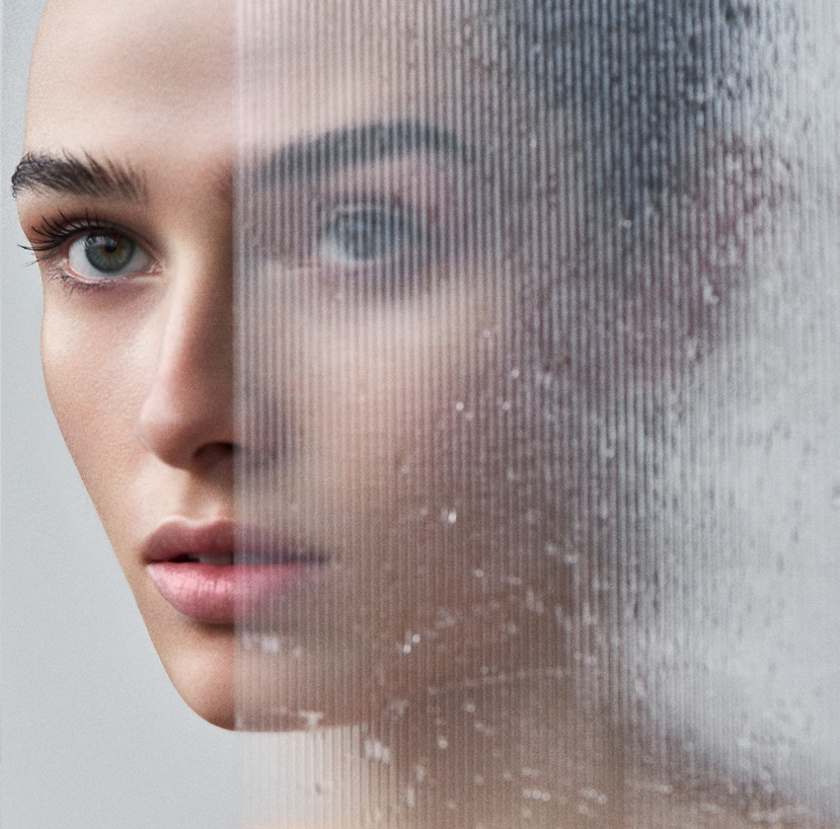
Multi-protection effectiveness
visible and measured*
360°
360° Protection
Against aggressions
POLLUTION –
LIGHTS [BLUE + SOLAR]
* Ex-vivo tests on Multi-Protection Mist
Notes:
Thanks to this powerful formula, we have visible and measured multi-protection effectiveness against aggressions.
Pollution and light rays: Solar and blue light.
Let's look at the results of these tests together.

Slide 13
Proven effectiveness
ANTI-POLLUTION ACTION
1 - ANTI-ADHESION
- 64%
Without Vital Defense
Multi-protection Mist
With Vital Defense
Multi-protection Mist
The skin is immediately and effectively protected
from pollutant particles*.
* Ex-vivo test with Vital Defense Mist / Carbon particle pollution model
Notes:
First, the anti-pollution effectiveness:
We have proven the anti-adhesive effect of our Vital Defense Multi-Protection Mist
On the left, you can see the explant which has not been treated with the mist, on which you can clearly see the pollution particles.
And on the right, the explant treated with the mist, on which the particles have almost not adhered.
With those results we can clearly say that the skin is immediately and effectively protected from the pollution particles.

Slide 14
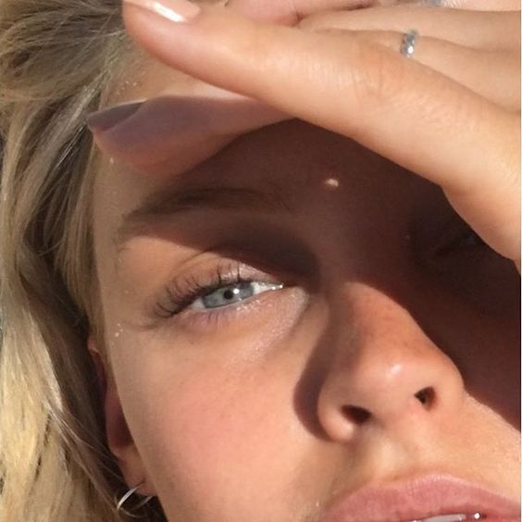
Proven effectiveness
UV ANTI-AGRESSION ACTION
UV RADIATION*
-49.4%
of free radicals
The skin is 2X more protected against the oxidant aggressions of UV* radiation
* Ex-vivo test with Vital Defense Mist / Anti-radical protection against UV rays
Notes:
In addition to this anti-pollution effectiveness, as you have understood, we have an action on the oxidative aggression's reactions caused by UV light rays
Here we can see we have almost -50% less of free radicals generated by UV radiation.
Our mist has no sunscreen (so no SPF) but powerful ingredients capable of fighting against the damaging effects of UV radiation, which, as we saw before, have very negative effects on the skin.
The skin is 2X more protected against the oxidizing effects of UV radiation*.

Slide 15
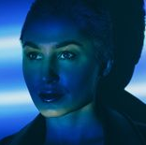
Proven effectiveness
ANTI-BLUE LIGHT ACTION
BLUE LIGHT
-31.4%
of free radicals
The skin effectively fights against the damaging effects of blue light
*Ex-vivo test with Vital Defense Mist / Anti-radical protection against blue light
Notes:
3rd effectiveness, the anti-blue light action
Tests have proven that with the use of the Vital defense mist there is around-31.4% less of free radicals generated by blue light
These effective and proven actions on pollution, UV radiation and blue light allow our skin to fight against premature aging.

Slide 16
Nearly
9 out of 10 women
convinced by its effectiveness⁽¹⁾
A protective shield effect all day long⁽²⁾
Skin is protected by an invisible anti-aggression shield
Skin is better oxygenated, complexion looks and feels purified
Skin is strengthened to resist pollution, as if detoxified
Smoother skin, protected from accelerated ageing
360°
91%
86%
After 7 DAYS RADIANCE ENHANCER⁽³⁾
Radiance of the complexion + 16%⁽³⁾
Complexion uniformity + 40%⁽³⁾
22 people (25 to 50 years old) –
2 applications/day (morning and day).
86% of the women found this product more effective than the similar care used until then
Self-evaluation at 28 daysDermatological scoring at 7 days
Notes:
These multi-protection results have been confirmed by clinical tests carried out by independent laboratories under dermatological control.
In these tests, nearly 9 out of 10 volunteers were convinced of its effectiveness (this is a self-evaluation),
and they confirmed the protective shield effect felt all day long.
91% of the panelists feel their skin more protected, more oxygenated and their complexion purified
86% of them feel their skin strenghthened to resist from pollution and as if detoxified
In addition to this self-evaluation, instrumental measurements were made by the dermatologist and proved that
after 7 days significant results were obtained on the radiance and the homogeneity of the complexion
For the test (2 mists/day)

Slide 17
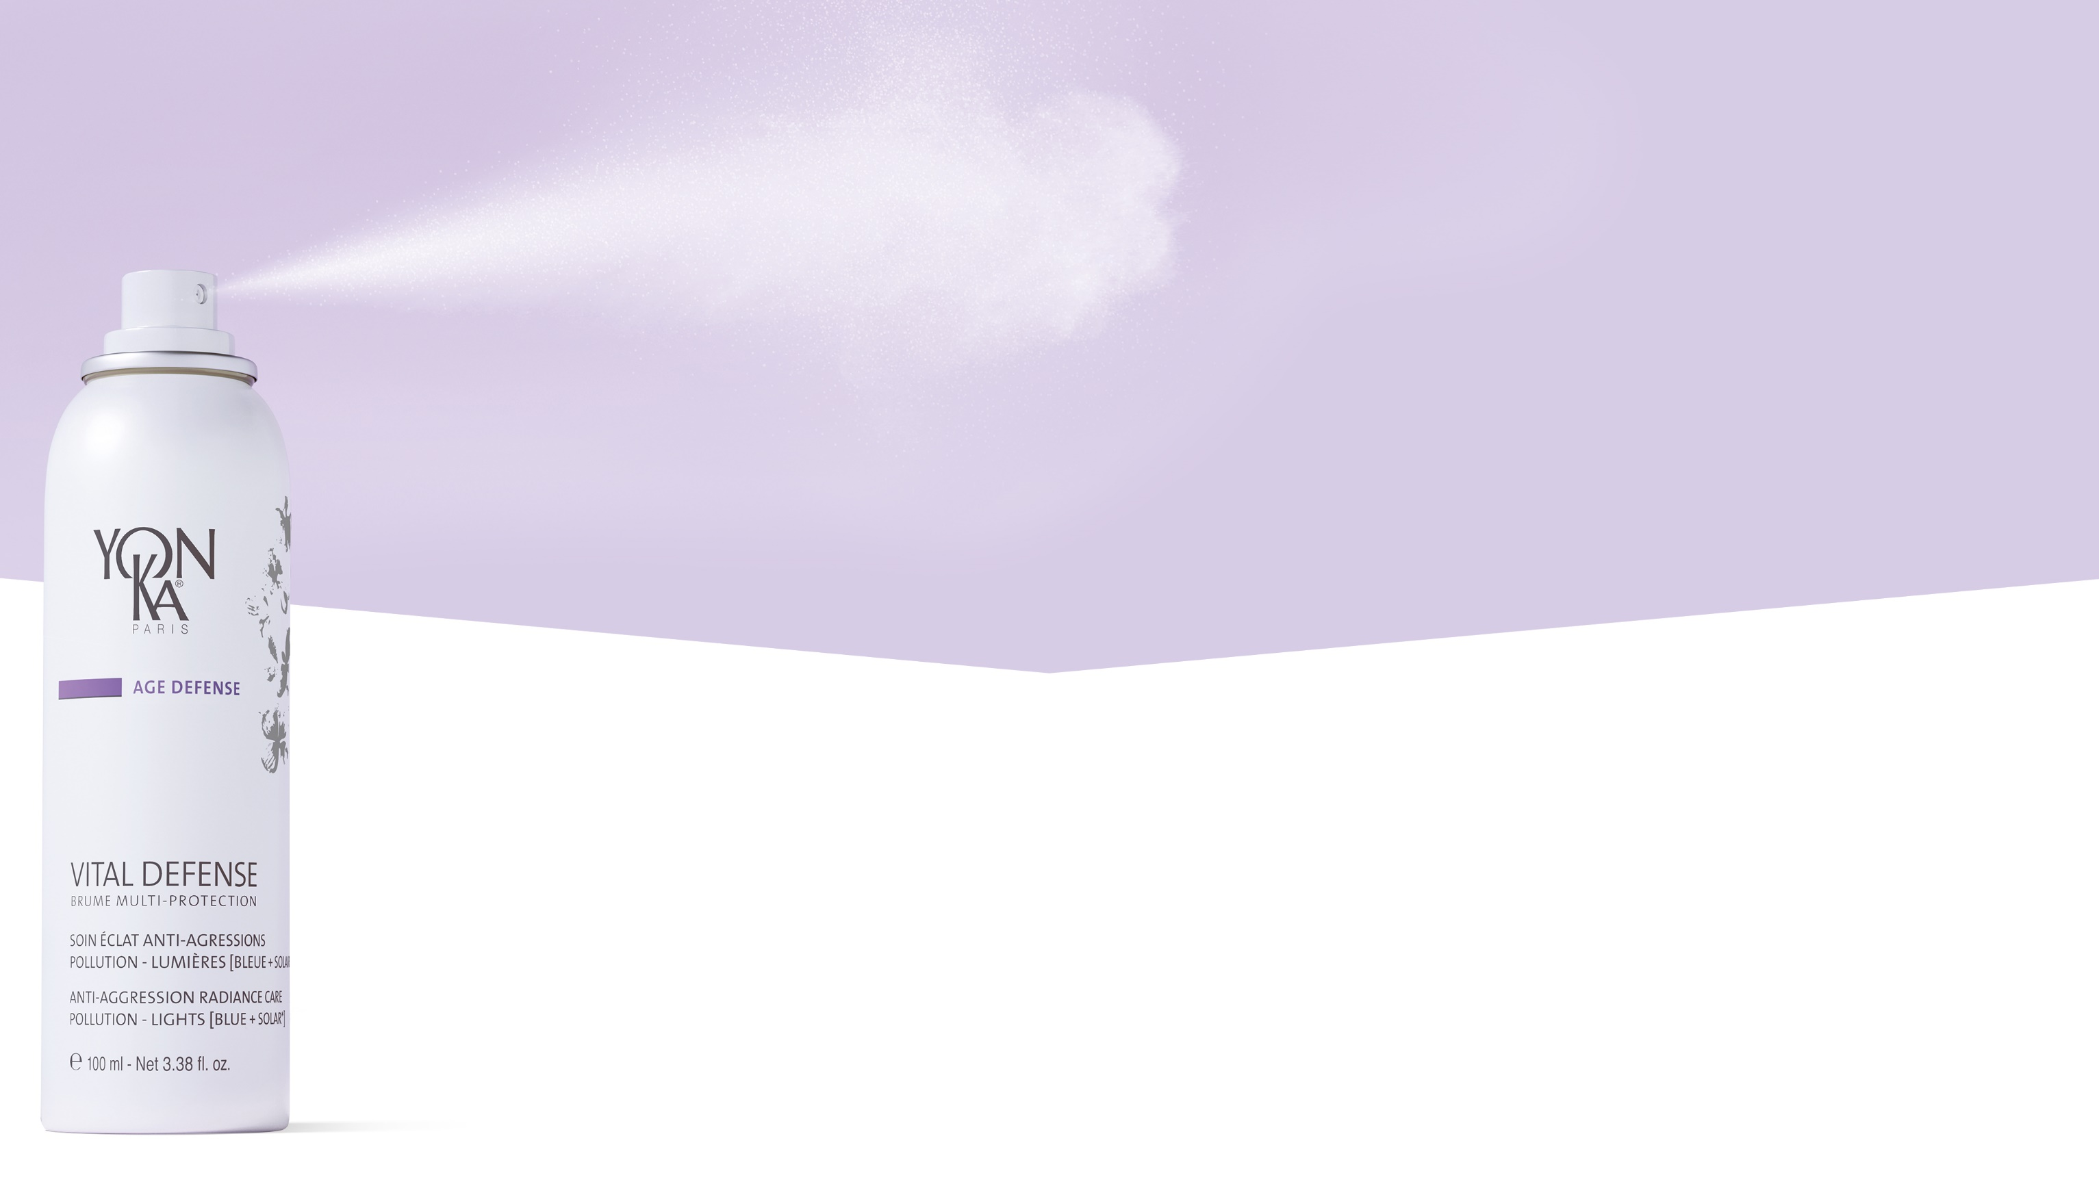
Mist texture
Texture suitable for all skin types,
even sensitive
Sensory texture
Non-sticky – Non-greasy – Non-comedogenic
Invisible and non-bleaching
Quick drying without the need to rub in
Notes:
Mist texture, suitable for all skin types, even sensitive skin
Non-sticky - Non-greasy - Non-comedogenic
Invisible and non-whitening
the texture of the mist provides a quick drying effect without the need to rub it into the skin
No Sunscreen: As a reminder - Mineral screens are forbidden for products to be sprayed on the face.
- Chemical filters do not correspond to the Yon-Ka charter.

Slide 18
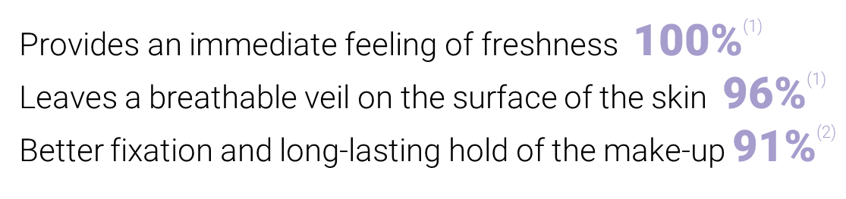
Mist texture
An ultra-fine misting, ultra-fresh and slightly
aromatic texture which everyone agrees on
22 people (25 to 50 years old) -2 applications/day (morning and day).
(1) self-evaluation at 28 days (2) self-evaluation at 7 days
Notes:
The misting of the mist is very fine and the moisturizing texture is very fresh, and delicately aromatic.
The clinical tests results revealed
100% of the testers found that the Vital defense mist provides an immediate sensation of freshness
96% of them found that it leaves a breathable film on the surface of the skin –
this BREATHING aspect is very important, as you can quickly get an occlusive film which would not be pleasant at all,
so this is not the case with our mist
For more than 90%, the Vital Defense mist provides a better fixation and a long-lasting effect of the make-up.

Slide 19
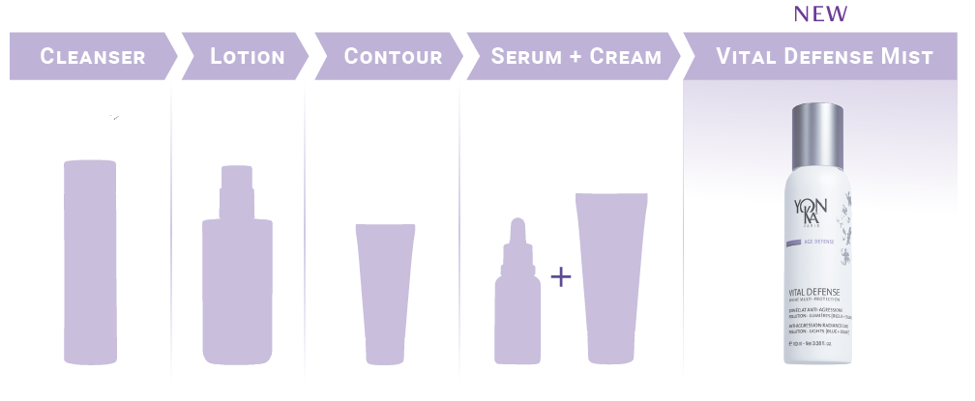
New beauty routine
Notes:
When should we use the mist in our routine?
The mist can be easily integrated into any beauty routine.
Last step in the morning, after cleansing the skin, prepare the skin with the appropriate YON-KA lotion and apply our day care (contour, serum, cream).
It is the essential for daily use.

Slide 20
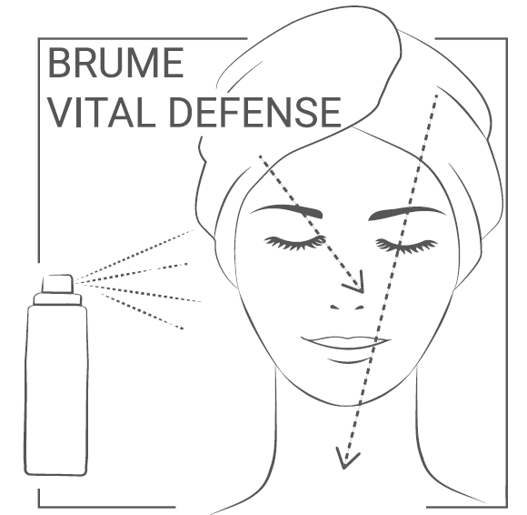
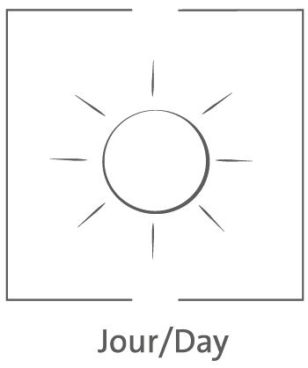
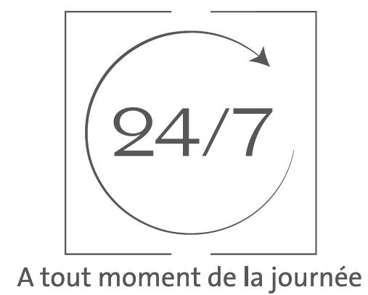
Instructions for use
How ?
When ?
Day
at any time of the day
Face - Neck - Decollete - Hands - Hair
Integrates perfectly into your beauty routine 100% ⁽¹⁾
Pleasant to use at any time of the day 100 % ⁽¹⁾
 | Face/Neck | Decollete | Hands | Hair | Total
Spray/ application | 2 | 1 | 2 | 2 | 7
22 people (25 to 50 years old) - 2 applications/day (morning and day).
(1) self-evaluation at 28 days
Notes:
How to use it ?
Spray in a Y-shape all over the face (with eyes closed), neck and chest from a distance of 30 cm. Spray 7 times (2 face, 1 decollete, 2 hands, 2 hair).
Tips: can also be applied to the hands (and hair).
When to use it?
In the morning, the last step of the ritual, after make-up.
This mist can also be applied at any time of the day and at will in the office in front of the computer screen, at the terrace of a café, during a shopping trip, on a walk in the countryside, the sea, the mountains...
Ideal for smokers
100% of the testers found that this mist fitted perfectly into their skincare routine and that it was pleasant to use at any time of the day!
We are at 7 sprays per application ( even 8 or 9 if 3 or 4 sprays for the hair depending on the length).
So reapplying the mist throughout the day makes it easy to get to 10 sprays/day (10 = face/neck/chest/hands twice in a day).
800 sprays in total (100ml)
2 uses per day, 7 sprays = 2 months minimum

Slide 21
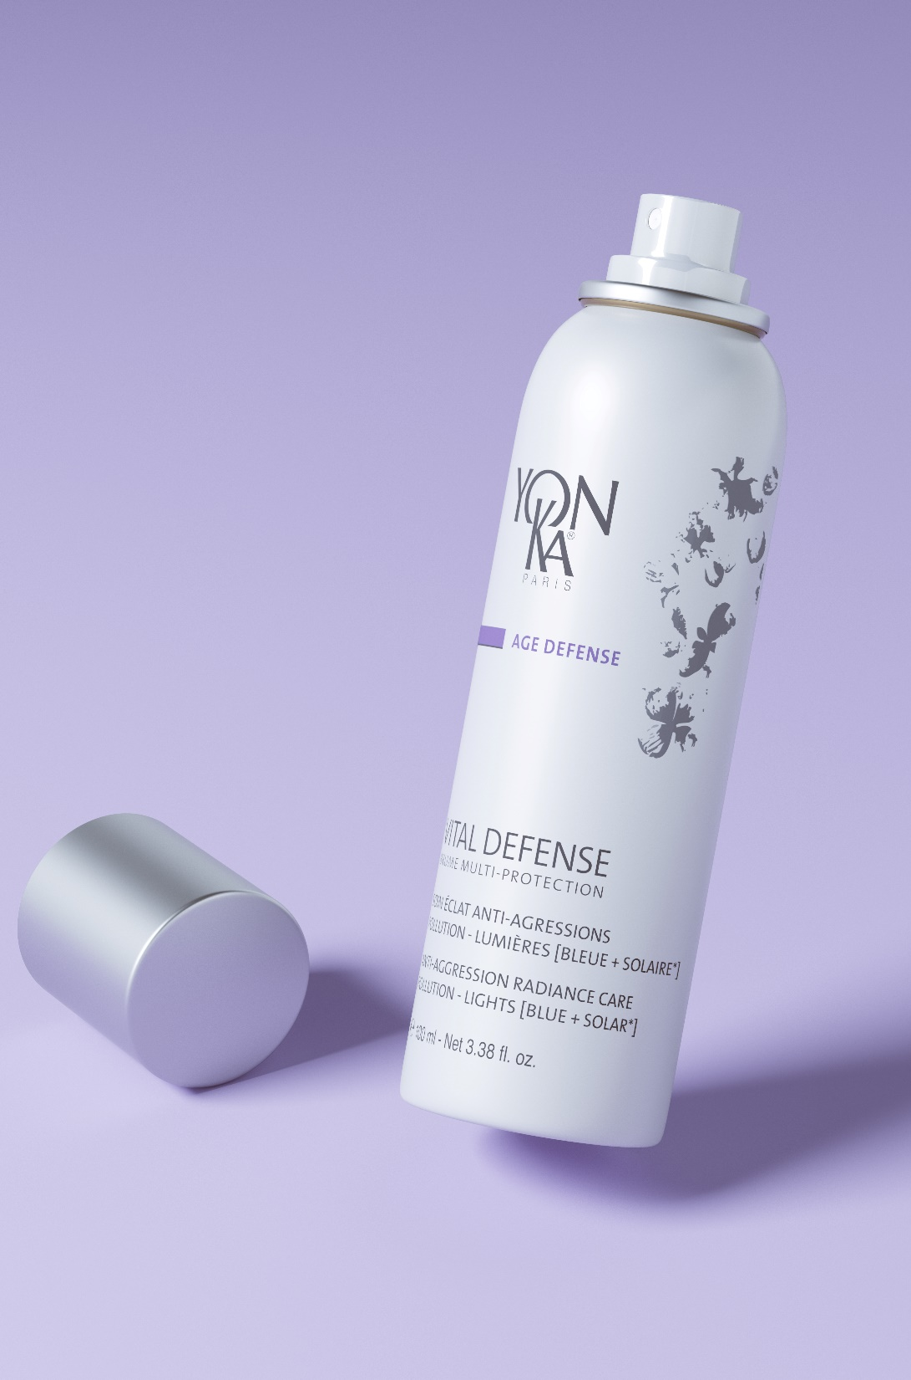
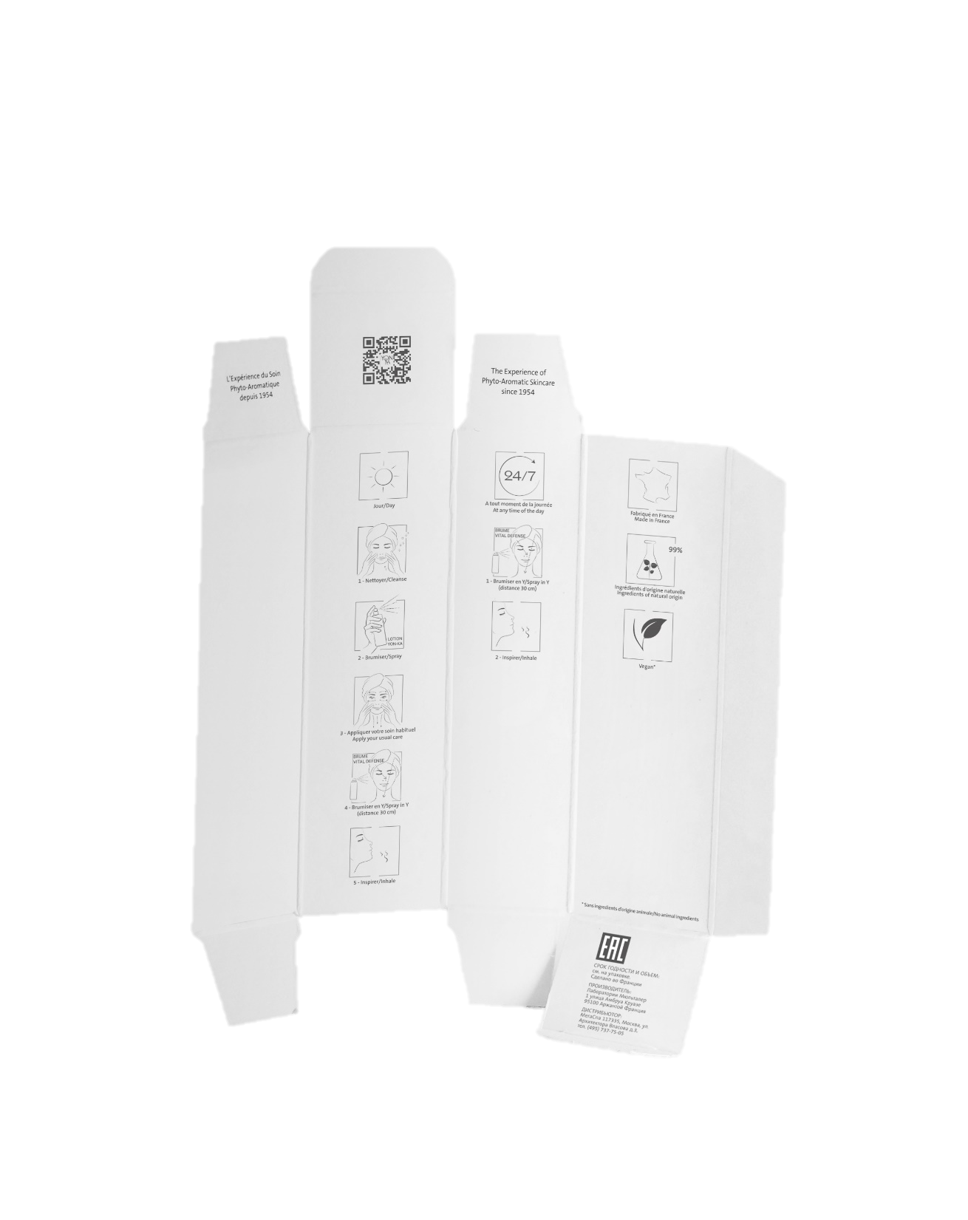
Vital Defense
multi-protection mist
Eco-friendly packaging
Recycled aluminium bottle
and infinitely recyclable
Double sided FSC box
Content
100 ml
800 sprays / bottle (3-6 months of use)
Recommended price incl. VAT
51€
Launch of authorised partners
May 2023
Notes:
The Vital defense mist has naturally an eco-designed packaging
The Bottle is made of recycled and infinitely recyclable aluminum
The plus is the double-sided case in which you can find all the detailed product information and instructions for use
the mist is nomadic with a capacity of 100ml in order to have it at any time, even in the plane
800 sprays per bottle.
The bottle generally lasts between 3 months (10 sprays/day) and 6 months depending on the use.
The recommended price is 51€.
It will be available from our approved partners from May 2023.

Slide 22

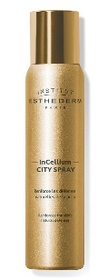
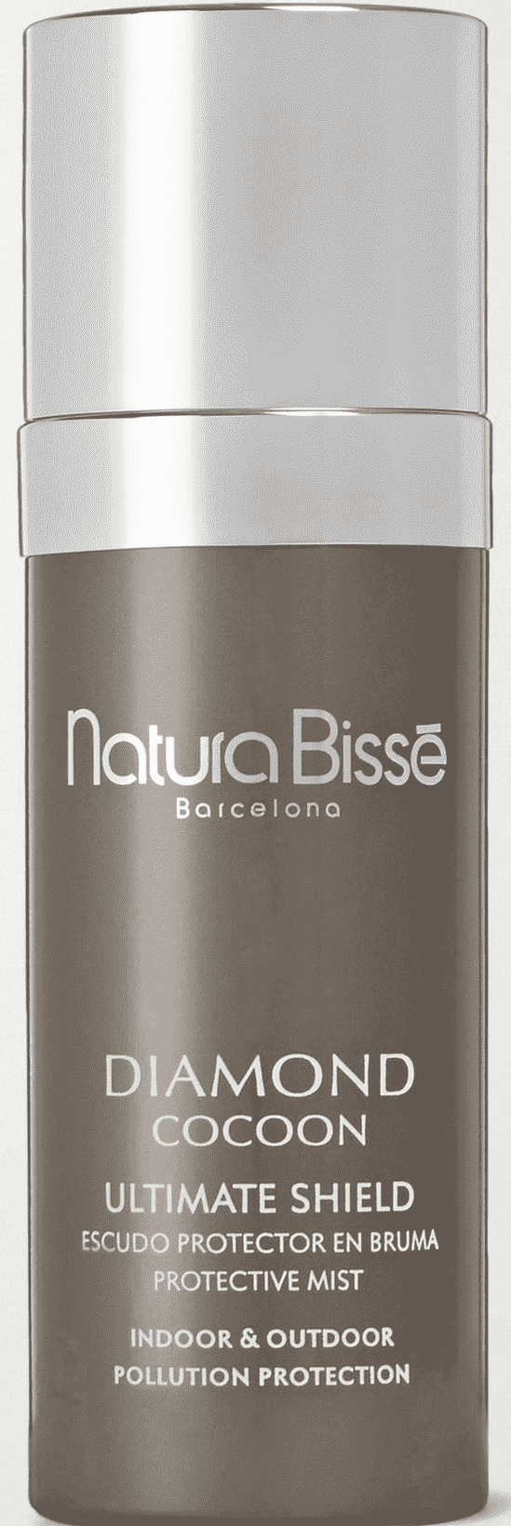
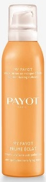
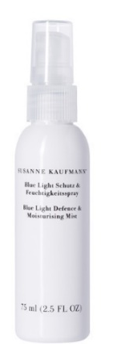
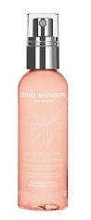
Competitors
& Competitive advantage
Biologique Recherche
150ml / 99€
→
- No anti-UV/ Blue light protection
- Price +++
Esthederm
100ml / 47€
→
Not clean (silicones, EDTA, …)
Natura Bissé
75ml / 102,95€
- No anti-UV/ Blue light protection
- Price +++
→
Payot
125ml / 25,5€
→
- No anti-UV/ Blue light protection
Suzanne Kaufmann
75ml / 65€
→
No anti-pollution
protection
Price ++
- No anti-UV/ Blue light protection
Cinq Mondes
100ml / 29€
→
Notes:
The main asset of our mist is its multi-protection against both pollution and light rays.
Competitors usually only offer one protection.
Considering its effectiveness, the recommended price of the mist is very competitive.
Finally, the third advantage is the high percentage of natural actives ingredients 99% in our mist, its clean formula and its fresh and sensory texture.

Slide 23
Ready to play ?

Slide 24


Vital Defense
Brume multi-protection
What are the actions of the Vital Defense mist ?
A. Anti-Pollution and Anti-Particle
B. SPF protection with sun filters
C. Radiance
D. Protects against UV and Blue Light aggression

Slide 25
Vital Defense
Brume multi-protection
What are the star ingredients ?
A. Biosaccharide
B. Vegetable polyphenols
C. Essential oils of daisy, jasmine and lime
D. Vitamin B3
Notes:
C. Sweet orange, green mandarin and magnolia EO
D. Vitamin B5

Slide 26
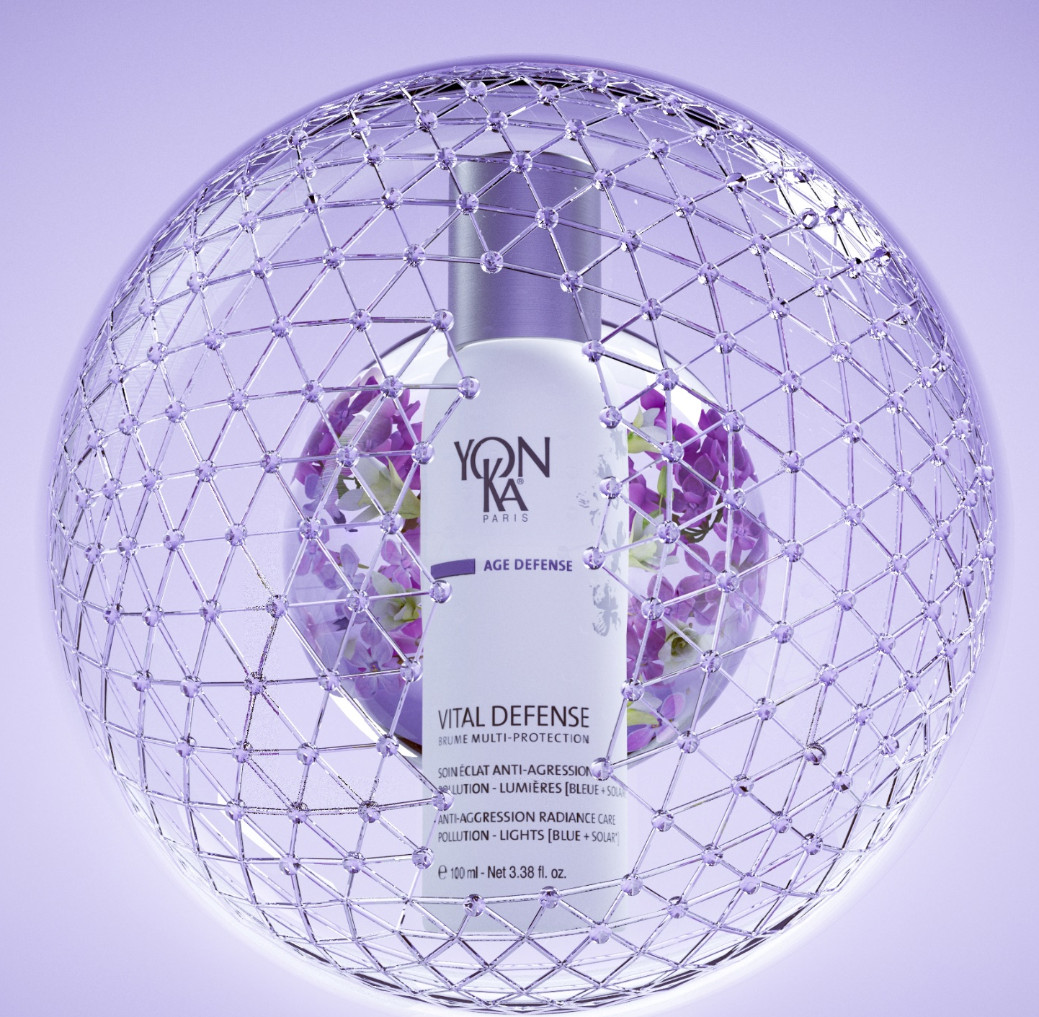
Vital Defense
Brume multi-protection
Which statements are true ?
A. Vegan, Non-GMO, Clean
B. Forms a shield against aggression
C. Boosts the cutaneous self-defense systems
D. 95% ingredients of natural origin
Notes:
D. 99%

Slide 27
Vital Defense
Brume multi-protection
Which statements are true ?
A. Use only in addition to the cream Vital Defense
B. Makeup Fixer
C. Non-sticky, non-greasy, invisible finish
D. Matified complexion and blurred effect
Notes:
A. S’intègre dans toutes les routines beauté

Slide 28
Vital Defense
Brume multi-protection
When to use the Mist Vital Defense ?
A. Just after cleaning
B. After the makeup
C. Before sunscreen
D. At any time of the day

Slide 29
Vital Defense
Brume multi-protection
The mist Vital Defense protects my face against :
A. extreme temperature changes (hot, cold)
B. pollution and particles
C. aggressions of the UV rays
D. blue light aggression

Slide 30
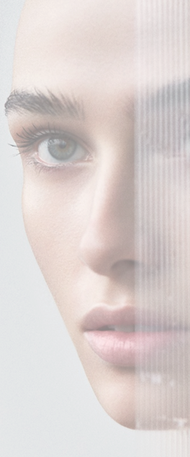
Vital Defense
Brume multi-protection
« I can replace my day cream with the Vital Defense mist ? »
TRUE
OR
FALSE
Notes:
Even if the new VITAL DEFENSE mist hydrates, it does not replace the hydrating and protective action of a cream

Slide 31
Vital Defense
Brume multi-protection
« The mist Vital Defense does not contain sunscreens but protects against the deleterious effects of UV ? »
TRUE
OR
FALSE
Notes:
Our mist has no sunscreen (so no SPF)
Our powerful ingredients protect against the damaging effects of UV radiation, which have very negative effects on the skin.

Slide 32
Vital Defense
Brume multi-protection
« The mist Vital Defense reveals radiance and evens out the complexion after 7 days ? »
TRUE
OR
FALSE
Notes:
After 7 DAYS RADIANCE ENHANCER⁽³⁾
Radiance of the complexion + 16%⁽³⁾
Complexion uniformity + 40%⁽³⁾

Slide 33
Vital Defense
Brume multi-protection
« The percentage of ingredients of natural origin in the mist Vital Defense is 96% »
TRUE
OR
FALSE
99%

Slide 34
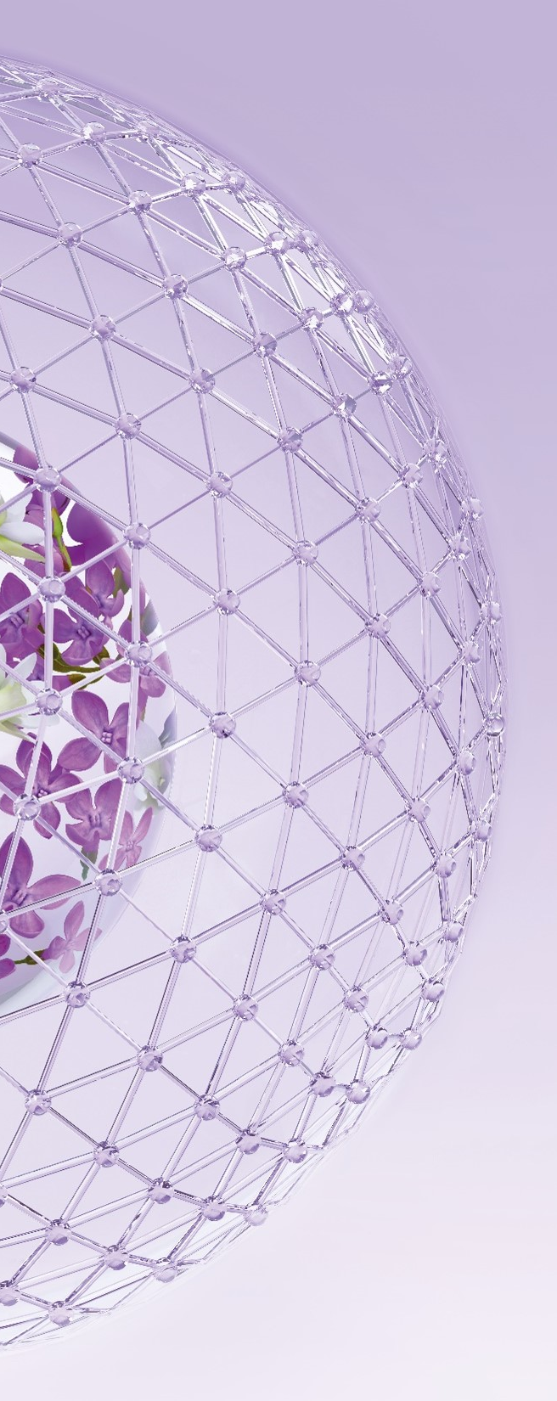
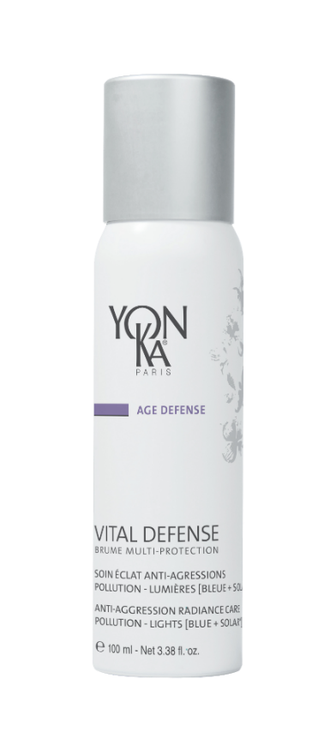
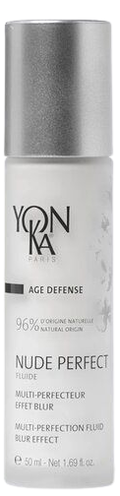
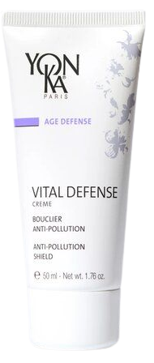
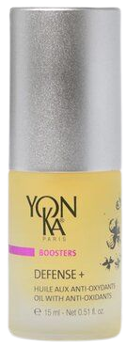
« I have a combination skin with small imperfections »
Which anti-oxidant ally(s) to recommend?
A. NUDE PERFECT Fluide
B. VITAL DEFENSE
Crème
C. DEFENSE +
D. VITAL DEFENSE Brume multi-protection

Slide 35

« I want to enrich my beauty routine »
Which anti-oxidant ally(s) to recommend?
A. NUDE PERFECT Fluide
B. VITAL DEFENSE
Crème
C. DEFENSE +
D. VITAL DEFENSE Brume multi-protection

Slide 36
« I am looking for a hydrating routine that protects me from environmental aggressions »
Which anti-oxidant ally(s) to recommend?
A. NUDE PERFECT Fluide
B. VITAL DEFENSE
Crème
C. DEFENSE +
D. VITAL DEFENSE Brume multi- protection

Slide 37
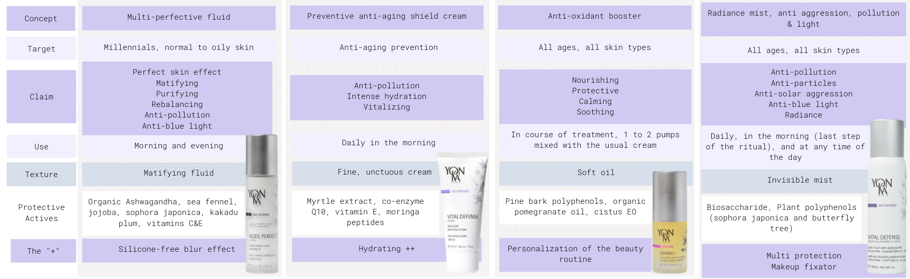
My anti-oxidant allies to PROTECT my skin
NUDE PERFECT
Fluide
VITAL DEFENSE
Crème
DEFENSE +
VITAL DEFENSE
Brume multi protection
Notes:
Here is a summary table of our different anti-oxidant allies that allows us to differentiate them and to know how to best advise them.I encourage you to print it out and distribute it to beauticians.

Slide 38
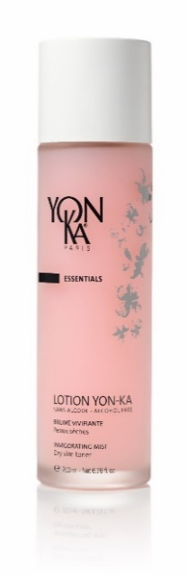
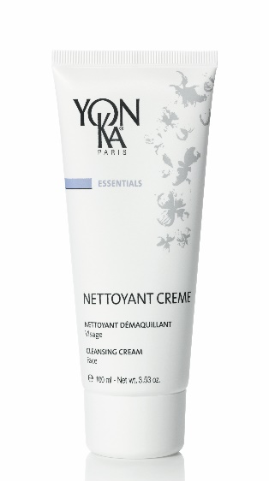
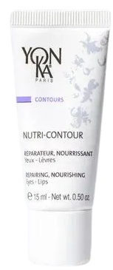
An anti-aggressions beauty routine
«I wear a lot of makeup and want to protect my skin from pollution»
BRUME MULTI-PROTECTION
1
2
3
4
I clean
I prepare
I hydrate
I protect
Notes:
As a reminder, the NETTOYANT CRÈME is not only the ideal cleanser for sensitive skin with peppermint, but also perfect for removing heavy makeup thanks to its creamy texture.
Vital Defense Crème is perfect to protect the skin against pollution thanks to myrtle extract and moringa peptides, but it is also a very hydrating and anti dehydrating cream.
The combination with the Vital Defense mist create a perfect protection againt all the external aggressions.

Slide 39
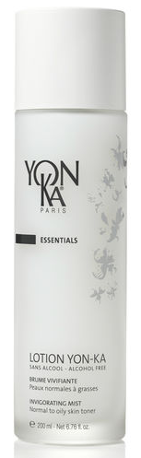

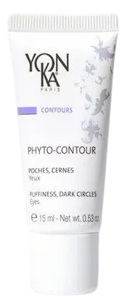
An anti-aggressions beauty routine
«I want to protect my skin from blue light while making it look more beautiful»
BRUME MULTI-PROTECTION
1
2
3
4
I clean
I prepare
I hydrate
I protect
Notes:
Nude perfect is our perfect ally to treat small imperfection while revealing the beauty of the skin with its silicone-free blur effect combined with the mist, the skin is effectively protected while revealing a glow-free complexion

Slide 40
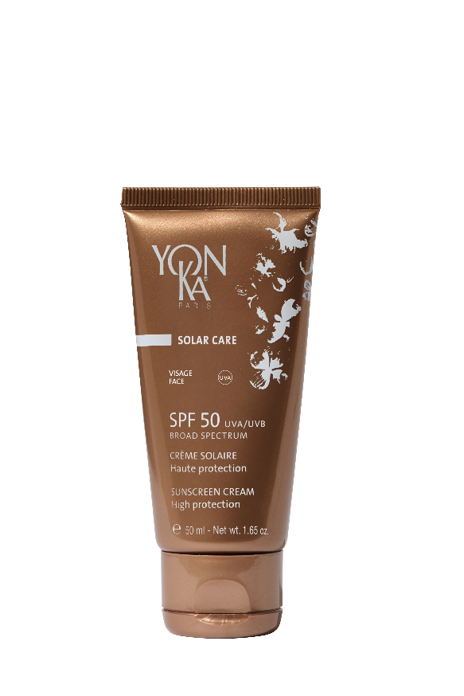
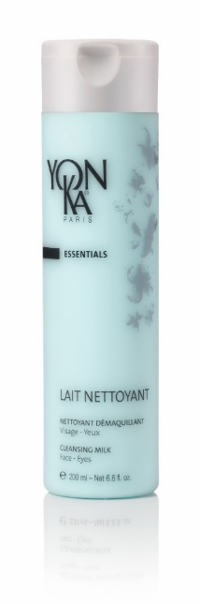
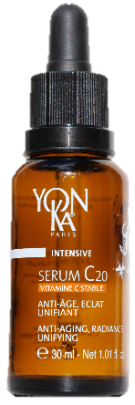
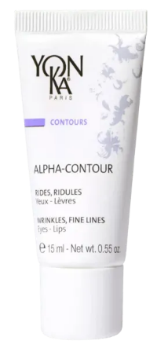
An anti-aggressions beauty routine
«I want to protect my skin from the harmful effects of UV rays and even out my complexion»
BRUME MULTI-PROTECTION
1
2
3
4
I clean
I prepare
I treat and hydrate
I protect
Notes:
You all know it by now, our previous launch, the SERUM C20 will help fight the signs of aging, pigment spots and bring radiance. Once again, followed by the mist, we obtain an ideal routine to protect the skin while optimizing its radiance.
we think to protect the skin of the sun with the spf 50 before misting the mist

Slide 41



An anti-aggressions beauty routine
«I want to reinforce my anti-aging routine by fighting against oxidative stress»
BRUME MULTI-PROTECTION
1
2
3
4
I clean
I prepare
I treat and hydrate
I protect
Notes:
As we have seen, the mist can be combined with all beauty routines and becomes an essential ally for mature skin also to maximize skin protection and fight effectively against cutaneous aging

Slide 42




An anti-aggressions beauty routine
«I would like a special men's routine to protect my skin from premature aging and external aggressions»
BRUME MULT- PROTECTION
1
2
3
4
I clean
I prepare
I hydrate
I protect
Notes:
and finally, let's not forget, the mist is a totally mixed product, perfectly adapted to men's beauty routines

Slide 43
Vital Defense
multi-protection mist
ANTI-AGRESSIONS RADIANCE CARE
POLLUTION – LIGHTS [BLUE + SOLAR*]
Forms an anti-aggression shield
Pollution – UV* – Blue light
Boosts the skin's self-defense systems
Soothes and moisturizes
Fixes make-up all day long
* Does not contain sunscreen
Notes:
The VITAL DEFENSE MULTI-PROTECTION MIST
A radiance treatment capable of creating the perfect anti-aggression shield against Pollution, UV and blue light in a few seconds
A double protection an immediate surface protection the protective shield and a long-term deep protection with the ability to boost the skin’s self defense system
Soothes and moisturizes and last advantage a better fixation and a long-lasting effect on the make-up
Now let’s see with Bruno the many tools we have developped to help you activate this launch.

Slide 44






Activation support
Press release
Commercial support
Media Kit - Video
Press file (pdf)
Poster (60x100cm)
FR ref : 7C1130A
EN ref : 7C1130B
Posterette A4 (pdf)
FR/EN
Sales presentation
FR ref : 7B0880A
EN ref : 7B0880B
Available end of march
Memo-card A5 (pdf)
Notes:
Full press release kit with
Detailed press file
Memo card A5 ( summary of the press file )
Commercial Support
Sales prese,tation FR/EN
Poster FR/EN
Posterette FR/EN
Media kit and Video available end of march

Slide 45





Additional Tools
Product sheet (pdf)
Segmentation poster
FR/EN
A3 size : 7C0308X
Poster for training rooms : 7L0246X
Beauty prescription

Slide 46


Window idea
Notes:
The idea for this showcase is to convey the action of this product at a glance.
Highlight the shield effect for the skin and bring a very pure and breathable universe.
A showcase that is simple to implement and very explicit.
Sobriety gives way to the message.

Slide 47

Point of sale animation
Notes:
if possible dedicate a corner of the point of sale or 2 to 3 large dedicated shelves
Expose as much Vital Defense mists as possible to facilitate unaccompanied purchase

Slide 48




Launch Schedule
Technical product information
Ref = 35420
Standard x48
Best use by date
= 36 months
Availability of products and tools
Product: Now
Posters and sales argument : now
Media kit and launch video: end of march
International launch in points of sales
1st May,2023

Slide 49
Thanhs !

Slide 50
Appendices

Slide 51

A dynamic cosmetics segment
Anti-pollution ingredients
US $870.4 millions
in 2022 (+5.4%)
US $1.4 Billions
by 2031
Notes:
https://www.cosmeticsandtoiletries.com/research/consumers-market/news/22418462/antipollution-ingredients-market-to-reach-us-14-b-by-2031?utm_source=pocket_saves

Slide 52

Surface protection
Anti-pollution and anti-particle protective shield
Biosaccharide
Complex sugar obtained by GreenScience (biotechnology)
On the surface, it reduces the number of encrusted pollution particles by instantly forming a "second skin"...
Resistant + Consistent + Breathable + Invisible
This surface shield preserves the key metabolism of the cells at a deeper level
-54% mitochondrial toxicity⁽¹⁾
Supplier study on treated and untreated reconstructed epidermis MDA level determination (oxidation marker)
+ quantification of cell viability by spectrophotometric assay
Notes:
Exposure to pollution, particularly PM2.5, is responsible for cellular and mitochondrial toxicity, which leads to cell death and deficiencies; as a reminder, the mitochondrion is the cell's energy centre. Without it, cellular metabolisms cannot take place. Thanks to the biosaccharide included in the Vital Defense Multi-Protection Mist, a clear reduction in mitochondrial toxicity is observed. The barrier effect obtained allows a -54% reduction in toxicity, proving effective protection of the mitochondria against pollution. Less cellular damage = preservation of key cellular metabolisms.

Slide 53

Deep protection
Multi-protective antioxidants
Plant Polyphenols
Powerful antioxidant photo-protectors extracted from Sophora Japonica and Butterfly trees
Boosts the enzymatic self-defense systems of the skin
+36% of SOD et +29% of Catalase ⁽¹⁾
Protection* from light radiation
UV light - Blue light - Infrared light
-57% protection from UV-induced cell death⁽²⁾
-35% production mediator of inflammation⁽³⁾
Protection from negative effects
Supplier studies
vs placebo studies. Explants treated with 0.5% of the active ingredient vs placebo. At D8, immunostaining and quantification of the 2 enzymes * (p<0.01) and ** (p<0.05).
(1) Up to. Reconstructed 3D model, UVB irradiation, quantification of apoptotic cells and sunburn / release of MMP-1 and Elastin / TNFα and melanin after 24h.
(2)Fibroblasts exposed to IR, 24h pre-treatment with active. Production of TGF-β1
Notes:
8 times more effective (a % equivalent) than vitamin E, the reference anti-oxidant, these plant polyphenols :Boost the enzymatic systems of cutaneous defence which are :SOD Super Oxide Dismutase: boost of +36%. This enzyme, naturally present in humans, is used by the skin to defend itself against free radical attacks caused by pollution, exposure to light rays, etc., but if the attacks are too strong, it can no longer cope.Catalase: boost + 29%. This enzyme, also naturally present in humans, works in conjunction with SOD to protect the skin from free radicals.Protects the skin from light damage:- These polyphenols protect the cells from dying as a result of exposure to light - These polyphenols protect the skin from inflammation by reducing the synthesis of certain mediators.Sophora extract stimulates the skin's self-defence systems and activates skin regeneration to help it resist oxidative stress. It stimulates the cellular detoxification mechanisms, reduces free radicals and inflammation mediators. It is therefore a 360° photoprotector, which prevents premature photoaging.

Slide 54
Why no UV filters in the
Vital Defense Mist?
The Yon-Ka formulation charter is strict = 95% minimum of natural ingredients, which excludes the use of chemical filters.
It is forbidden by regulation to spray products containing mineral screens directly on the face (obligation to carry the mention: "Do not inhale, spray in the palm of the hand before application on the face")
Sensoriality would not have been satisfactory: whitening effect + need to massage the product afterwards, which would have been incompatible with make-up.
It is technically impossible to spray mineral screens (possible with a "spray" pump but not a "mist" can which would clog up very quickly).

