Slide 2
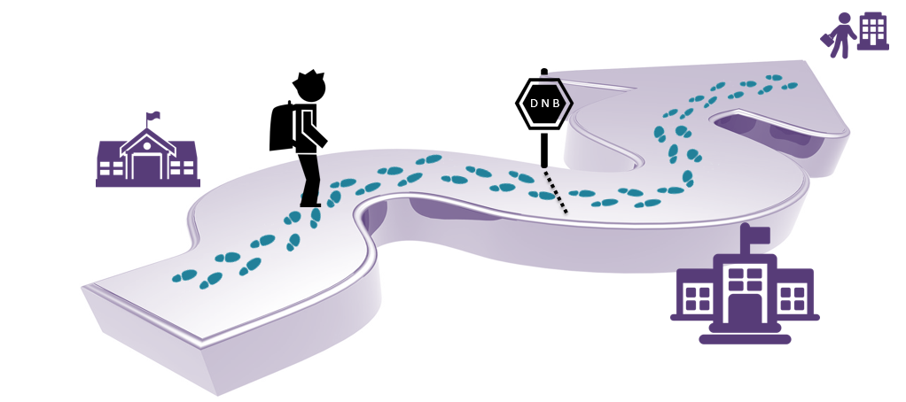
My training path
IMMERSION TRAINING LEVEL 1
VALIDATION TRAINING
LEVEL 2
Notes:
The Yon-Ka training course is divided into 2 parts:
the 5-day immersion training
the one-day validation training
During the previous "rendez-vous YON-KA" we discovered the 5 days "IMMERSION" training
Today we are going to discover the validation day, which takes place between 6 months and one year after the level 1 training

Slide 3
Validation training module
WHAT IS IT ?
A customizable training for all those who have already followed a Yon-Ka IMMERSION training.
Ideally between 6 months and 1 year after level 1 training.
To confirm, review and deepen your knowledge.
Which reinforces the new Yon-Ka training course and the follow-up of the training.
Notes:
we quickly realised that after the level 1 "immersion" training we did not see the beauticians again for several years. And when we saw them again, we noticed that the fundamental steps were not or no longer known, and that the knowledge was not sufficient to advise and sell YON-KA products and treatments.
we have therefore created a level 2 module to check the level of the beauticians and deepen their knowledge :
A customizable training for all those who have already followed a Yon-Ka IMMERSION training.
Ideally between 6 months and 1 year after level 1 training.
To confirm, review and deepen your knowledge.
Which reinforces the new Yon-Ka training course and the follow-up of the training.

Slide 4
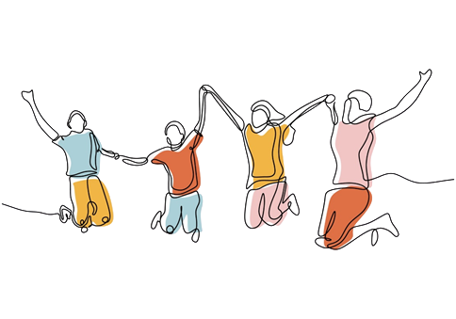
Validation training module
A TEAM BUILDING DAY !
A team spirit
One celebrity per team
Colored wristband
Competition
Gift for the winning team !
→ This one-day training course was designed to be a little bit different :
More playful and interactive approach.
The information is less ascending.
OBJECTIVES
Validate knowledge
Review everything that has been seen during the training
Identify strengths and weaknesses

Slide 5
Validation training module Planning
The
Crazy- Scientist
VIP Appointment
The Big Battle
9.30-12.30
13.30-17.30
True/false
Practice
Notes:
Table plan in advance in relation to the personality: Easel and colored bracelet for the teams: 3 teams
The crazy scientist: We start with the crazy scientist who wants to know everything about their expectations!
VIP appointments: We will then invite 3 celebrities who will ask them for their beauty routine.
Game of the great battle: 2 or 3 teams.

Slide 6
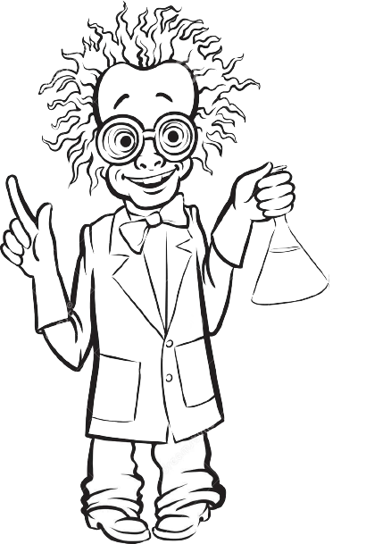
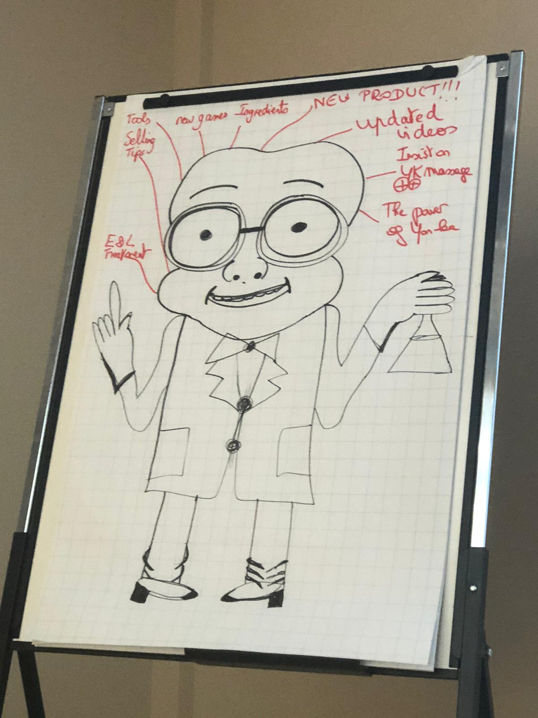
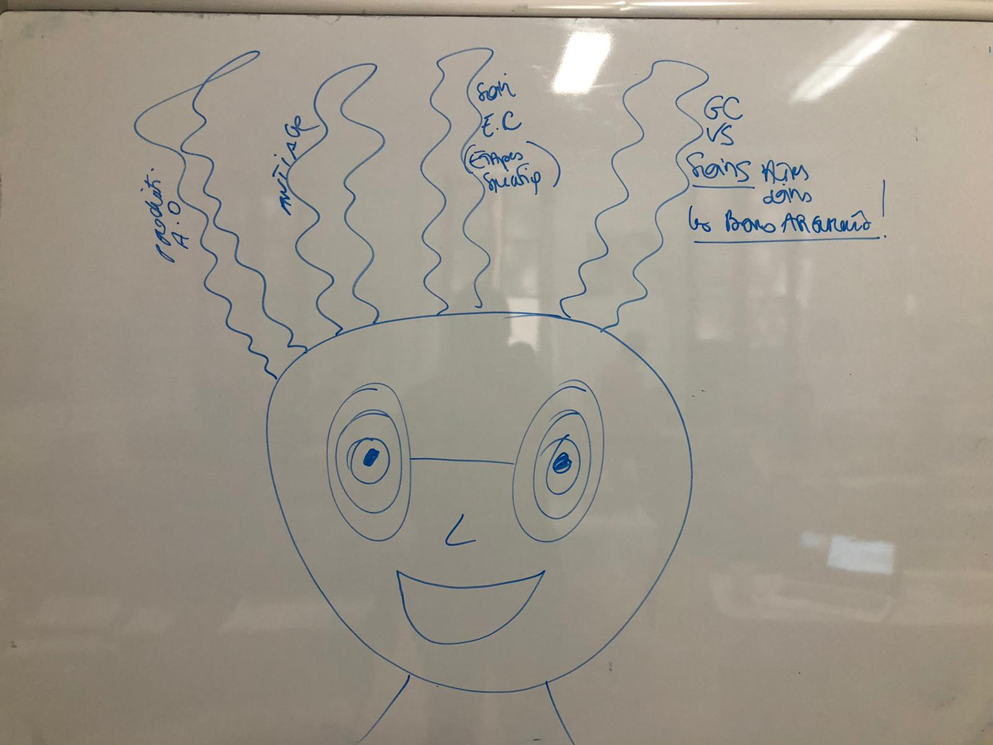
The Crazy Scientist
OBJECTIVES
Discover the expectations and needs of each participant
Orientate our tailor-made training day
Notes:
The crazy scientist:
to introduce the day, we look for the expectations and needs of each participant
We start with the mad scientist who wants to know everything about their expectations!
Draw a crazy scientist's head and complete it during the round table with the expectations of each team : each expectation represents a section of hair
you can decide to fill it in yourself or to involve each participant
Allows to adapt the “tailor made” training. Even if we have a predefined programme, we will be able to adapt it to meet the needs of the participants

Slide 7
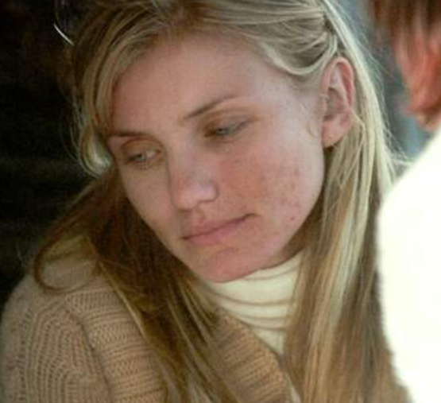
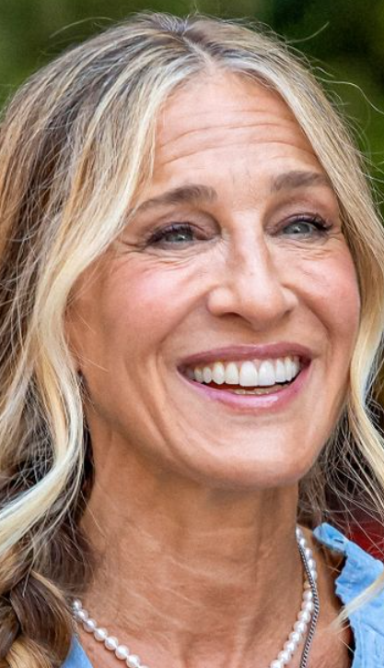
VIP appointment
THE BEAUTY PRESCRIPTION
OBJECTIVES
Learn how to ask good questions for a skin diagnosis
Practice active listening and retain important information
Use the beauty prescription in a systematic and efficient way
3 TEAMS – 3 VIP
In each team, someone will play the role of the celebrity. The other members have to ask her the right questions in order to complete her beauty prescription adapted to her needs.
1→ You have 5 minutes to make her diagnosis and ask her all the questions you want
2→ fill in the beauty prescription
(select 10 products)
The points
1 point for each good answer
+ 1 bonus point
for the treatment
Notes:
1st collective game : VIP APPOINTMENT
when possible, we ask internal people to play the role of VIPs
You all know the importance of skin diagnosis. It is therefore crucial to make it essential and effective

Slide 8
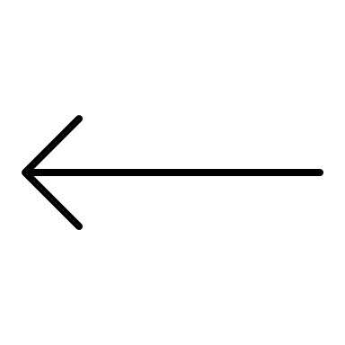
VIP appointment
ANTI AGING :
AGE CORRECTION & AGE EXCEPTION
SERUM C20
TREATMENTS :
VITAMIN C²⁵
EXCELLENCE CODE
NEW SKIN :
NUDE PERFECT & RENEWING PRODUCTS
TREATMENTS :
PEELING³⁰
ANTI-IMPERFECTIONS :
PURITY & MATIFY
TREATMENTS :
PURITY²⁰
Notes:
Each celebrity allows us to deepen our knowledge of a range or products and the associated professional treatments

Slide 9
VIP appointment

Slide 10
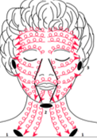
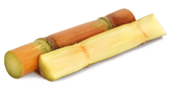
VIP appointment
THE PEELS WORKSHOP
OBJECTIVES
Deepen the knowledge of beauticians on peels
Confirm the methods of use
Feel more comfortable to recommend and use each peel
1→ Depending on your celebrity and the diagnosis made just before, select the recommended peel and all the associated. Keep only the right elements on the tray
The points
1 point for each good element.
+1 bonus point for the peel demo.
3 PEELS – 3 TECHNICS
Each team has at its disposal a tray with:
the 3 peelings, all the associated accessories and techniques, the quantity of product needed, the removal method.
Notes:
After the advice on products and cabin treatments, depending on the needs of each personality, the most suitable peel must be found by showing how to use it and with the right equipment if necessary

Slide 11
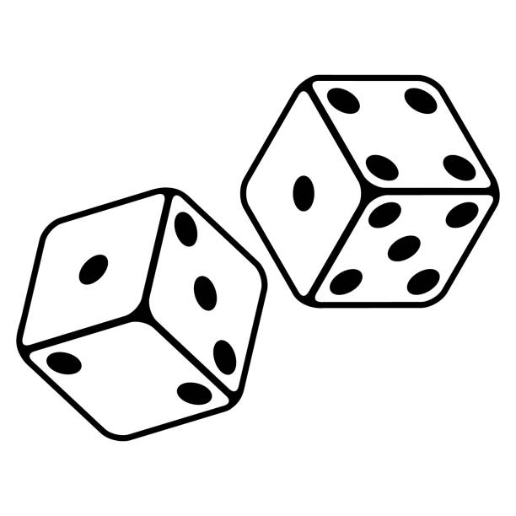
VIP appointment
have the summary table completed
Notes:
we find here again a game to summarize the use of the peelings thanks to a table to complete
you need to find out
the different acids in each peel,
in which treatments they are used
and the benefits

Slide 12
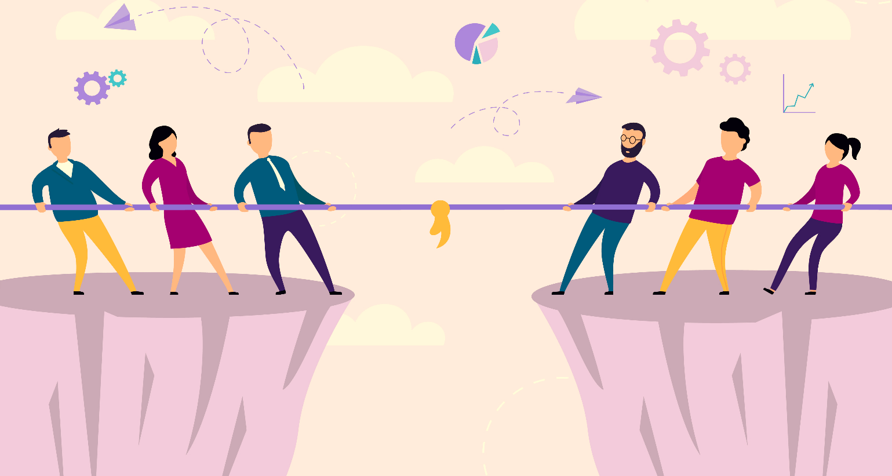
The big battle & the true/false
OBJECTIVES
Validate knowledge
Review everything that has been seen during the day
Identify strengths and weaknesses
1→ Be the fastest to answer the question
2→ Be precise in your answer
The points
1 to 3 points for each good answer
TEAMS COMPETING AGAINST EACH OTHER
Regarding THE BIG BATTLE, the trainer has questions with different levels of difficulty associated with points from 1 to 3.
The first one to have the answer must press the buzzer and give the answer.
For the TRUE/FALSE : different information scrolls on the board, each one must use her slate to give the answer: true or false
Notes:
we provide the games with suggested questions. Of course, you can customise your questions according to your respective markets

Slide 13
Practice
OBJECTIVES
Ensure that the fundamentals techniques are well respected
Measure the knowledge of the team
Review new or more difficult techniques according to individual needs
A CUSTOMIZED TRAINING
One of the main interests of this training is the personalization. Thanks to the “Crazy Scientist" and the round table discussion in the morning, we can adapt the steps practiced to each group.
In this way we have selected the 6 key steps but they can be modified according to the needs
1→ Identify and share your needs
2→ Update some knowledges
Notes:
the afternoon is dedicated to practice. depending on the information gathered at the beginning of the day from the crazy scientist, we can adapt the steps according to the needs. The objective is to control the good realization of the steps and to review them if necessary.

Slide 14
End of training
Notes:
of course, the teams' points are counted and the gifts are distributed
once again, you can customise the gifts to suit your stock. this training day is customisable from start to finish. The main idea is to meet the needs of the participants in a game-like way.
the day also allows a follow-up of your customers

Slide 15
End of training
Notes:
At the end of the day we give the participants a leaflet with the essential information of the day (many summary tables, answers to the quiz questions, mocktail recipes).

Slide 16
Implementation
Notes:
everything you need to get through the day is ready to use.If you need help I would be happy to help you and if possible to assist and animate at your side your validation training day.

Slide 17
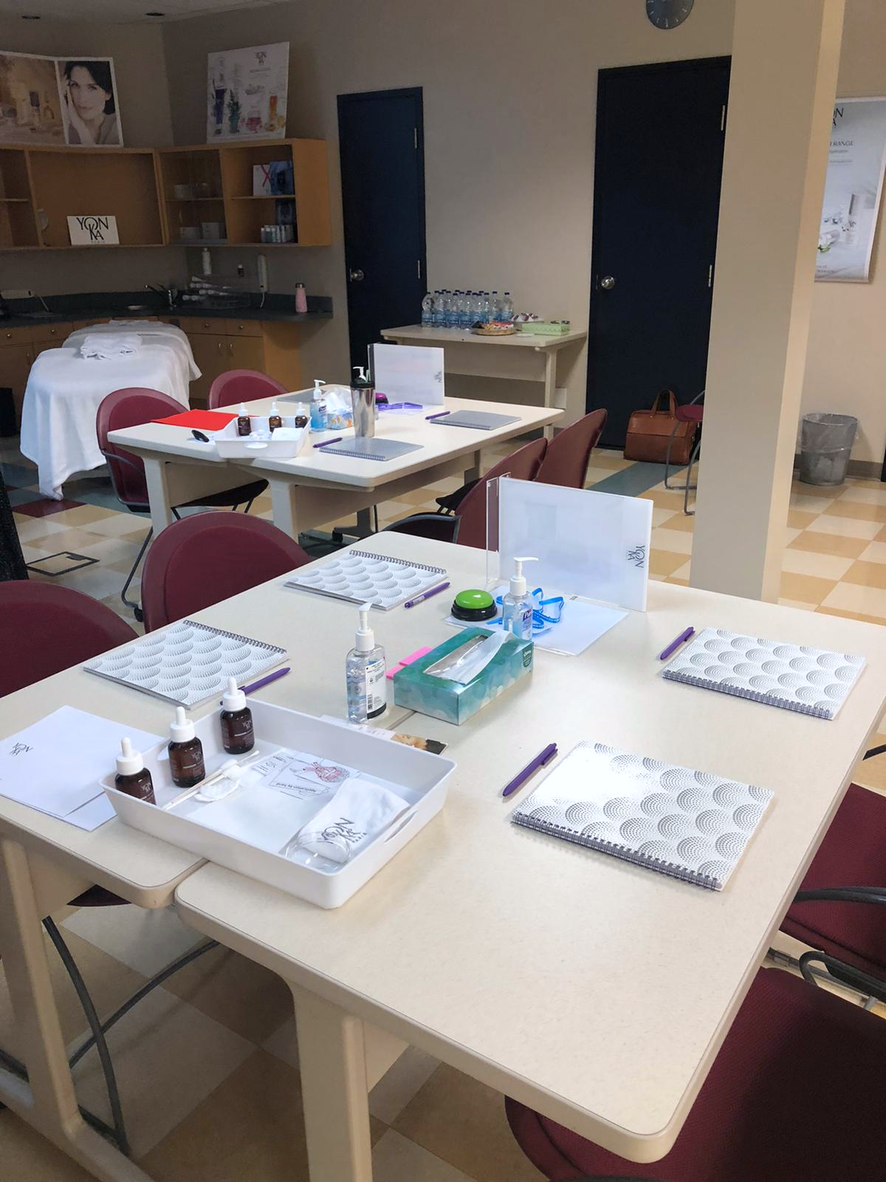
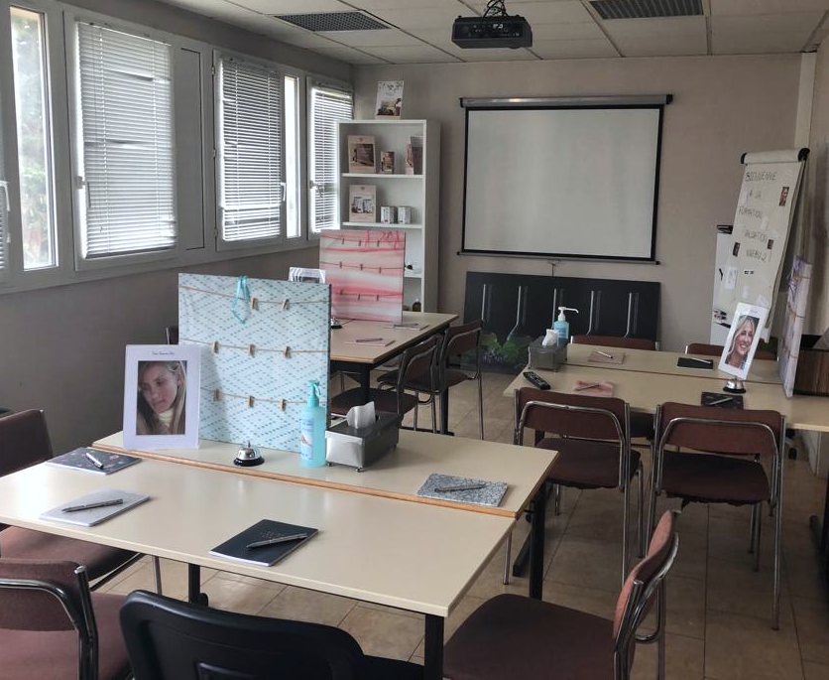
Photo report
CANADA
FRANCE

Slide 18
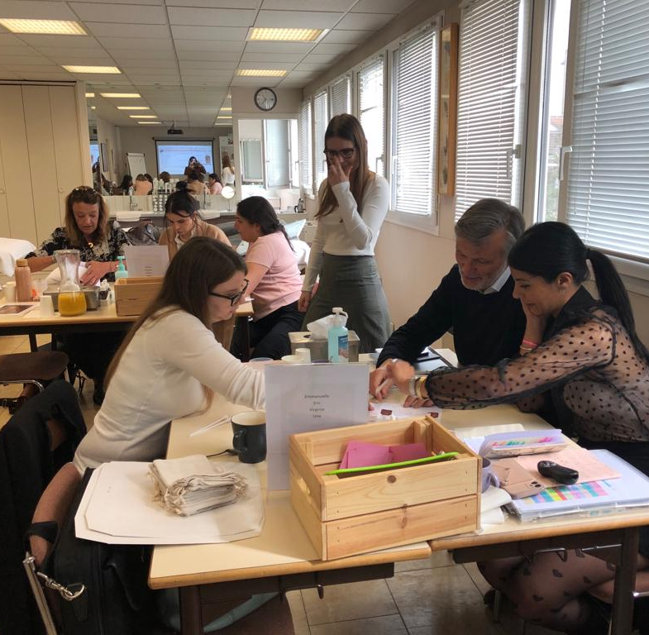
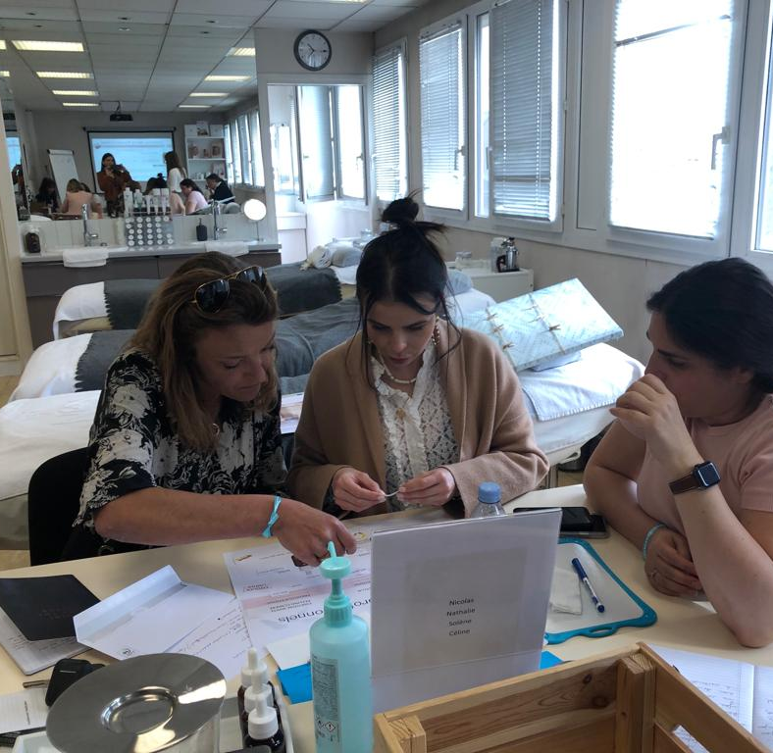
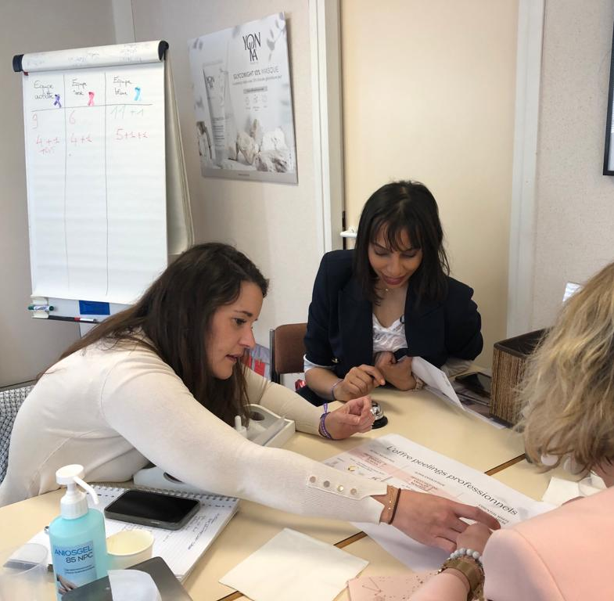
Photo report

Slide 19
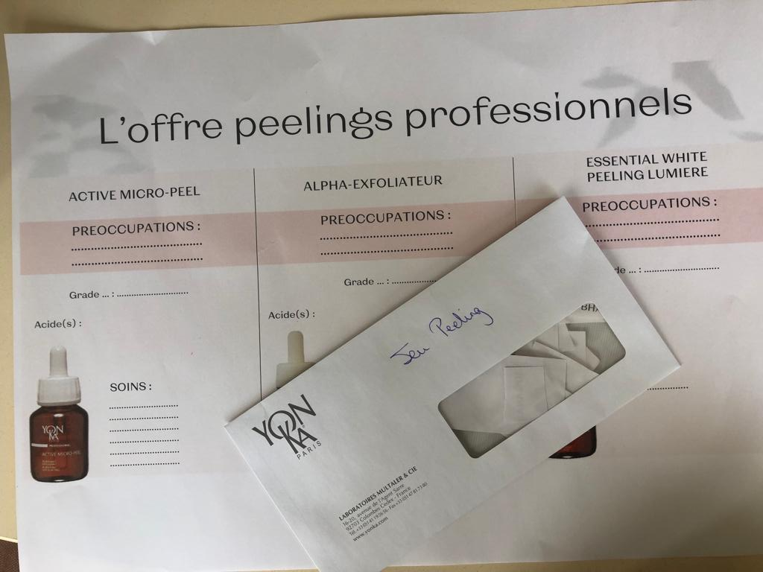
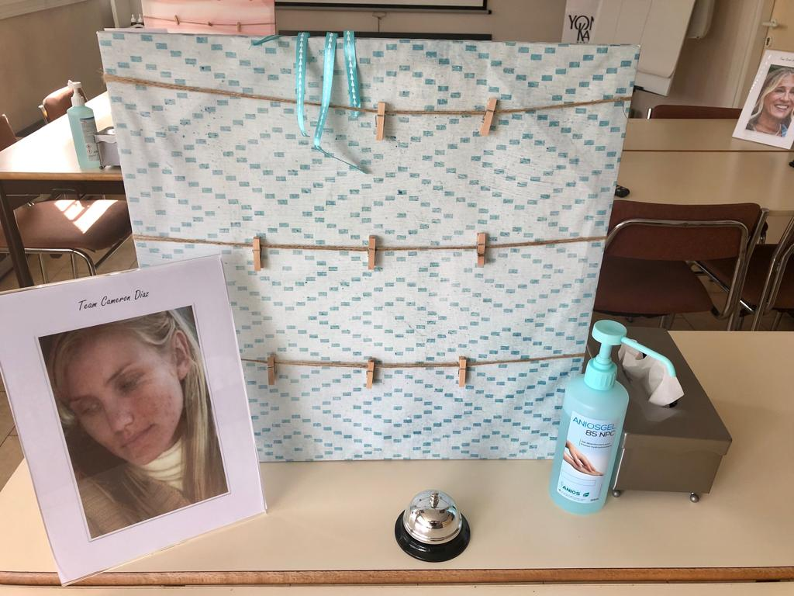
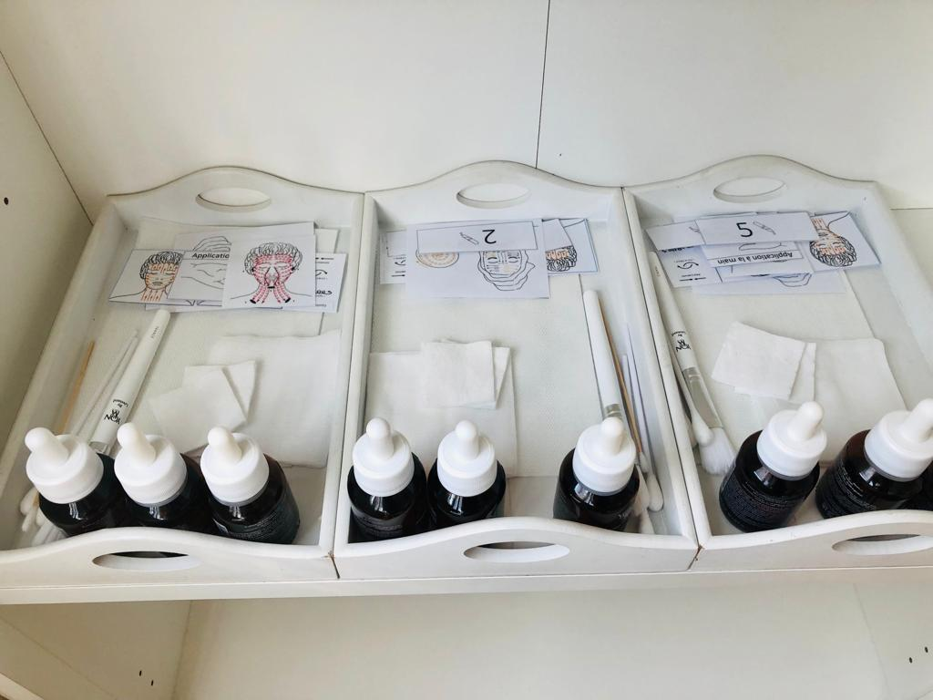
Photo report

Slide 20
Presentation video

Slide 21
Thanhs !

