Slide 1
Special festive season RDV

Slide 2
In your opinion, what percentage of sales should a sales point achieve during the festive season ?

Slide 3
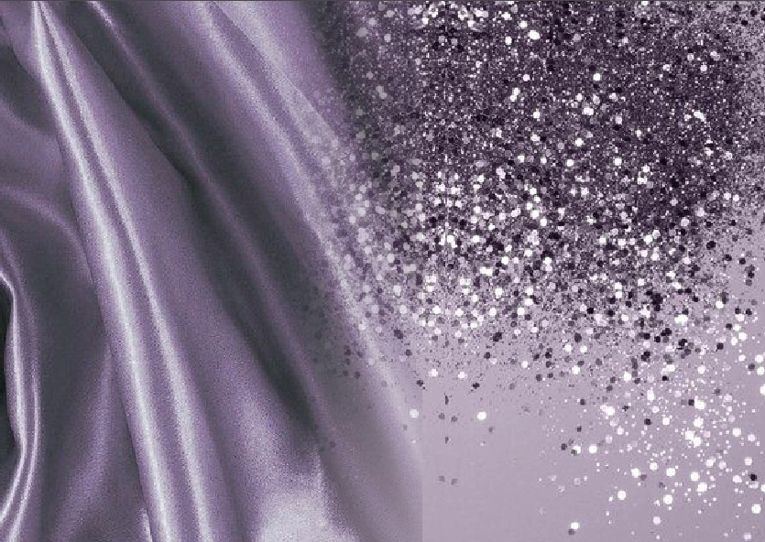
30%
September 2023
Notes:
30%, or almost a third of the year's sales. This is the ideal time of year to offer gifts, often in the form of product boxes, but also, and above all, treatments in the form of gift vouchers. It's essential to work out this sales figure in advance, because January and February are often low periods when customers come to take advantage of gift voucher treatments, or when their budget is reduced after the festive season.
As the festive season approaches, the mood is more festive and lighter. It's the perfect time to strengthen your ties with your customers and add a little glitter to your outlets.

Slide 4
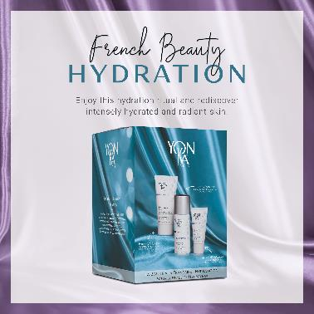
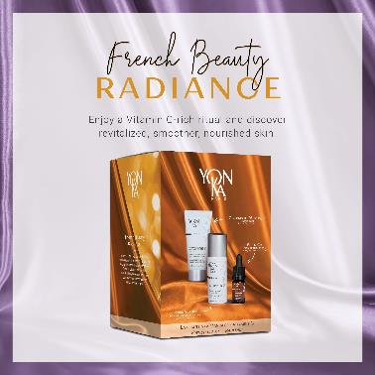
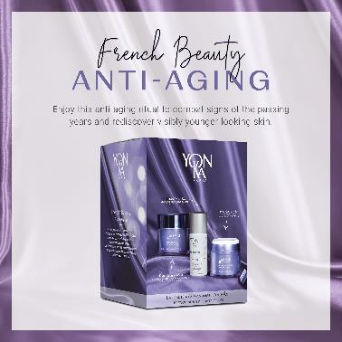
CHRISTMAS KITS

Slide 5
FRENCH BEAUTY
A complete routine, with effective, sensorial formulas for naturally beautiful skin. At the heart of your beauty secret, our iconic product
YON-KA LOTION
It will make your skincare routine more effective while providing a unique sensorial experience.

Slide 6
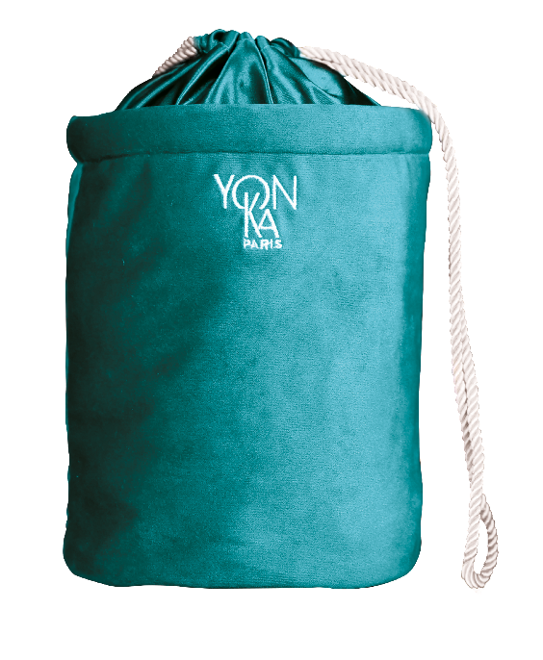
FRENCH CHIC
A kit with luxurious
and refined codes
Duck blue velvet
Duck blue satin inside
Gold satin ties
100% recycled material
Value €19

Slide 7
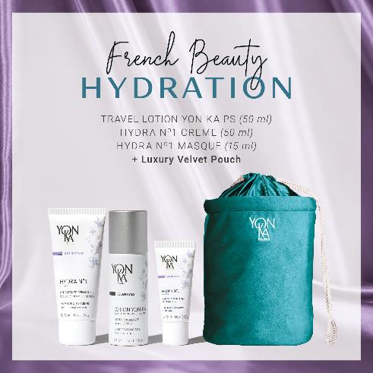
HYDRATION OFFER
Hydrated, radiant, plump skin that doesn't need any tricks to shine.
LOTION YON-KA PS TRAVEL SIZE FOR FREE
HYDRA N 1 CRÈME 50ML
HYDRA N 1 MASQUE 15ML
LUXURY KIT FOR FREE
Notes:
first box: HYDRATATION to provided hydration, radiance and plump the skin with
LOTION YON-KA PS TAILLE VOYAGE 18e
HYDRA N1 CRÈME 50ML – 54e
HYDRA N1 MASQUE 15ML – 21e
TROUSSE – 19e

Slide 8
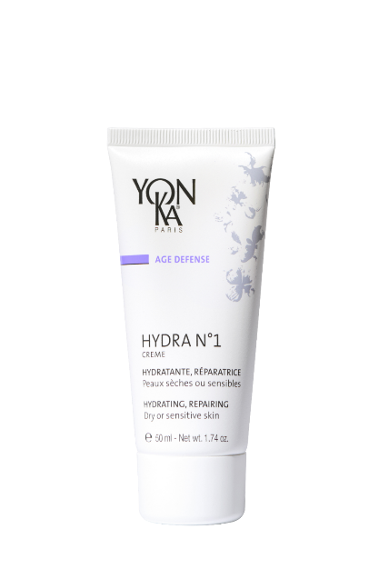
Hydra n°1 Creme
A real comforting cocoon for very dehydrated skin
Reinforces the skin's barrier function
Provides immediate comfort
Soft, supple, radiant and plump skin
+ Vitamin B5
Intense and long-lasting hydrating power:
+138% immediately and +86% after 8 hours
Used with hydra n°1 Serum
+144% immediately +102% after 8 hours
94% Natural Origin Ingredients
Rich in repairing ingredients
Notes:
HYDRA N1 CREME - 94% ION
Description
This intense and long-lasting moisturizing cream is a real comforting cocoon for very dehydrated skin.
Hydra N° 1 Cream Reinforces the skin's barrier function - Provides immediate comfort – the skin becomes Soft, supple, radiant and plump.
Results
intense and long-lasting hydrating power:
+138% immediately and +86% after 8 hours
Used with hydra n°1 serum
+144% immediately +102% after 8 hours
What we love
94% Natural Origin Ingredients
Rich in repairing ingredients

Slide 9
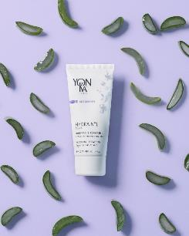
Hydra n°1 Creme
▪ Ultra-comforting cocooning texture
▪ Ideal mixed with foundation for very dehydrated skin.
▪ In addition, use Hydra N°1 Masque one to three times a week.
▪ To maximize results, combine with a Serum or a Booster
+
Hydrating Complex
Organic aloe vera, olive phytosqualane, imperata cylindrica, vitamins ACE, Low and High Molecular weight HA
shea butter, grape seed oil, hazelnut oil,
Repairing
Vegetal glycerin
Hydrating
Yeast extract and silicon
Restructuring - redensifying
Vitamin B5
Soothing
Vitamin F
Anti dehydrating
rose, chamomile and
jasmine E.O
Balancing - relaxing
Notes:
Tips
▪ Ultra-comforting cocooning texture
▪ Ideal mixed with foundation for very dehydrated skin.
▪ In addition, use Hydra N°1 Masque one to three times a week.
▪ To maximize results, combine with a Serum or a Booster
"When I get out of the shower, my skin is uncomfortable and tight”
"When I put on makeup, my foundation runs into the creases"
Ingrédients :
Complexe hydratant :
Hydrating complex with :
Organic aloe vera & olive phytosqualane : Hydrating, Reinforces the skin's barrier function:
imperata cylindrica : hygroscopic = Intense and long-lasting hydration
Low Molecular weight HA : deep hydration, skin cell renewal, redensifying and restucturing
High Molecular weigh HA = surface action : forms a moisturizing and protective film able to maintain a rate of hydration and to slow down its evaporation without being occlusive or greasy + immediate smoothing and plumping effect
Vitamins ACE : protect the cells , regenerating and antioxydant.
+ Shea Butter, grape seed oil and hazelnut oil : repairing
SHEA BUTTER : Nourishing, smoothing, healing
Vegetable butter extracted from the shea nut (shea tree: Central Africa, savannah trees)
Rich in unsaponifiables and vitamins (A, D, E, F)
GRAPE SEED OIL : moisturizing and restructuring
reduces TEWL, restores elasticity.
rich in linoleic acid (75%) provides the skin with essential fatty acids (linoleic acid, oleic acid, stearic acid, palmitic acid)
Presence of bioflavonoids, oligomeric proanthocyanidins, which are excellent anti-oxidants. Several researches have demonstrated the influence of proanthocyanidins on the stability of collagen and the health of elastin. HAZELNUT OIL : High moisturizing power Helps the penetration of active ingredients such as aromatherapy.
Origin: extracted from the fruit of the hazel tree (Corylus Avellana)
Action: : high phospholipid content / high resistance to oxidation / non-comedogenic
+
VEGETAL GLYCERIN : hydrating
+
YEAST EXTRACT AND SILICON : Restructuring - redensifying
+
VITAMIN B5 : Soothing
hygroscopic ~ healing ~ reaches the deep layers of the skin while leaving a thin film on the surface.
VITAMIN F : Antidehydrating
composed mainly of linoleic acid
ROSE, CHAMOMILE AND JASMINE E.O : Balancing - relaxing

Slide 10
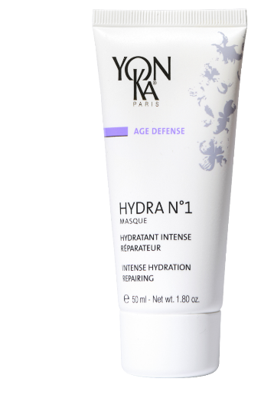
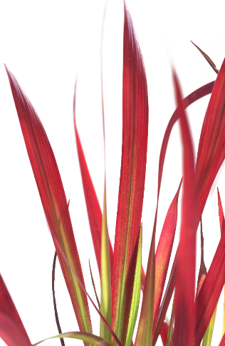
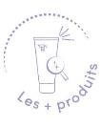
Hydra n°1 Masque
a moisturizing bath for all dehydrated skin
+ Jojoba
Smoothes the skin's surface
Reduces fine lines
Softer, firmer skin
Preserves the skin's youthful appearance
Intense hydrating action:
+124% after 2h
+73% after 8h
Gel-cream texture
Rich in vitamins
Can be used as a sleeping mask
Notes:
HYDRA N1 MASQUE : 89% ION
This mask is the best face mask for all dehydrated skin.
It Smoothes the skin's surface
Reduces fine lines
leaves the skin softer and firmer
Preserves the skin's youthful appearance
Results
Intense hydrating action:
+124% after 2h
+73% after 8 h*
* Clinical corneometry test - 10 adult volunteers
Les + produits
Gel-cream texture
Rich in vitamins A, E, C, B5 et en Jojoba
Can be used as a sleeping mask

Slide 11
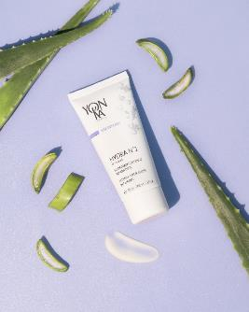
Hydra n°1 masque
▪ 1 to 3 times a week : Apply in thick layer to the face and neck. Leave on for 20 min. to an hour according to the needs. Absorb the excess with a tissue. Do not rinse off.
▪ For very dehydrated skin : Use as a sleeping mask for 1 week instead of your usual cream.
▪ Very damaged skin (excess of sun exposure, microdermabrasion…) : Use as a sleeping mask for 3 weeks instead of your usual cream.
Personnal tips : Add Hydra n°1 serum before applying your mask - take a steam bath while applying the mask
+
Imperata cylindrica, organic aloe vera bio, olive phytosqualane, vegetal glycerin, PCA
Hydratant
rose, chamomile and
shiu E.O
Balancing - relaxing
Vitamin A and silicon derivative
Regenerating
Bacopa monniera
Vitamins E, C
Antioxydant
Jojoba
Reparing
Vitamin B5
et bisabolol
Soothing
Notes:
Tips
▪ 1 to 3 times a week : Apply in thick layer to the face and neck. Leave on for 20 min. to an hour according to the needs. Absorb the excess with a tissue. Do not rinse off.
▪ For very dehydrated skin : Use as a sleeping mask for 1 week instead of your usual cream.
▪ Very damaged skin (excess of sun exposure, microdermabrasion…) : Use as a sleeping mask for 3 weeks instead of your usual cream.
▪ Personnal tips : Add hydra N°1 serum before applying your mask - take a steam bath while applying the mask
Ingredients :
imperata cylindrica, organic aloe vera bio, olive phytosqualane, vegetal glycerin, PCA : Hydrating
+
Vitamin A and silicon derivative : Regenerating
+
Bacopa monniera, Vitamins e ET c : Anti-radical and anti-oxidant
Origin: Indo-Pakistani continent. Leaf extract. Plant recognized for its soothing properties in Ayurvedic medicine
+
JOJOBA : ANTI DEHYDRATING – REPAIRING
+
VITAMIN B5 : Soothing
hygroscopic ~ healing
BISABOLOL : Soothing
Origin: Brazil, extracted from a tree, Vanillosmopsis erythropappa - same active ingredient as chamomile
Extracted from wood oil - Action: anti-inflammatory, antibacterial and antimycotic, inhibiting action against UV-induced erythema
ROSE CHAMOMILLE ET SHIU EO : Balancing and relaxing
Cinnamomum camphora à linalool (H.E. de shiu/Shiu leaf oil)
Origin: China
also called Japanese laurel
Extraction method : Distillation of the leaves of the shiu sho tree
Action : Used for its perfume, soothing, relaxing
Scent close to the essential oil of lavender
ROSA DAMASCENE (Rose E.O. / Rose flower Oil)
Origin: Turkey
Method of extraction: Distillation of the flowers
Action: Used for its perfume, softening, relaxing, anti-wrinkle
JASMINUM SAMBAC (Jasmine E.O./Jasmine Oil)
Origin : India
Extraction method : Ethanol extraction of the concrete
Action : Used for its perfume, softening
ANTHEMIS NOBILIS (Chamomile EO)
Origin: Central Europe. Cultivated in Europe (Belgium, England, Italy, France). The Egyptians venerated it.
Extraction method: Steam distillation of the flowers
Action: Anti-inflammatory, healing, antiseptic and antispasmodic

Slide 12
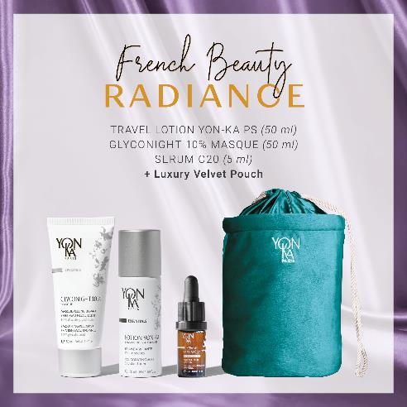
RADIANCE OFFER
Radiant, visibly younger-looking skin, with an even complexion that doesn't need any tricks to glow.
LOTION YON-KA PS TRAVEL SIZE FOR FREE
GLYCONIGHT 10% MASQUE 50ML
SERUM C20 5ML
LUXURY KIT FOR FREE
Notes:
second set: radiance to even out the complexion and reduce the signs of aging
LOTION YON-KA PS TAILLE VOYAGE 18e
GLYCONIGHT 10% MASQUE 50ML 62e
SERUM C20 5ML 35e
TROUSSE – 19e

Slide 13
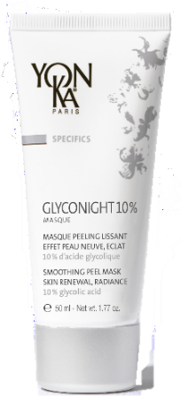
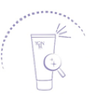
GLYCONIGHT 10% MASQUE
The clean peel that gives your skin a new breath
Immediate radiance from the first use
Skin texture is refined and pores are tightened
Smoothes fine lines and wrinkles
For millennials
(Blemish-free skin, radiance and treatment of first wrinkles)
For more mature skin
(An anti-aging effect (wrinkles++/firmness/spot) and radiance)
Cible
Radiance of the complexion: + 24%*.
Pore size: -19%*
Depth of crow's feet wrinkles: -30%*
*Etude clinique réalisée sous le contrôle d’un dermatologue sur 15 volontaires de 20 à 39 ans (1 mois) et 15 volontaires de 40 à 55 ans (2mois) - Moyenne des résultats sur l'ensemble des 2 groupes à 1 mois sauf densité du derme groupe 40-55 ans uniquement..
Notes:
GLYCONIGHT 10% MASQUE 81% ION
Description
The clean peel that gives the skin a new breath.
Benefits
Immediate radiance from the first use
Skin texture is refined and pores are tightened
Smoothes wrinkles and fine lines
Target
For millenials (Blemish-free skin, radiance and treatment of the first wrinkles)
For more mature skin (anti-aging effect (wrinkles++/firmness/spots) and radiance)
Results
Radiance of the complexion: + 24
Pore size: -19
Depth of crow's feet wrinkles: -30
(Clinical study conducted under the supervision of a dermatologist on 15 volunteers aged 20 to 39 (1 month) and 15 volunteers aged 40 to 55 (2 months) - Average results for both groups at 1 month, except for the density of the dermis in the 40-55 age group.

Slide 14
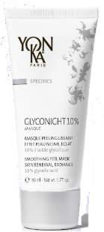
GLYCONIGHT 10% MASQUE
At night, after removing make up and cleansing, spray Yon-Ka Lotion and penetrate with effleurage movement then apply a thin layer of the mask to the face and neck.
Leave on all night. Rinse off with tepid water the next morning.
TRIPLE USE :
1 : Radiance-boosting mask: apply once at night for a radiance boost the next morning
2 : Maintenance treatment: use every other night for one or two weeks
3 : Intensive course of treatment (1 to 2 month): use every other night for the first week, then every night for each of the following weeks.
Repeat this course of treatment twice or three times a year
Can also be applied on the neckline to smooth away wrinkles visibly and restore its youthful appearance It’s an effective way to prime skin before a medical peel
10% pure glycolic acid
Smoothing - anti-wrinkles
Organic apricot kernel oil, brown algae : Radiance
Natural polysaccharides
Soothing
Vegetable glycerin
Moisturizing
Yon-Ka Quintessence
Balancing - Calming effect
Notes:
Home use :
At night, after removing make up and cleansing, spray Yon-Ka Lotion and penetrate with effleurage movement then apply a thin layer of the mask to the face and neck.
Leave on all night. Rinse off with tepid water the next morning.
TRIPLE USE :
1 : Radiance-boosting mask: apply once at night for a radiance boost the next morning (to boost radiance)
2 : Maintenance treatment: use every other night for one or two weeks (new skin effect )
3 : Intensive course of treatment (1 to 2 month): use every other night for the first week, then every night for each of the following weeks. (for a reinforced anti-aging or new skin result)
Repeat this course of treatment twice or three times a year
Can also be applied on the neckline to smooth away wrinkles visibly and restore its youthful appearance It’s an effective way to prime skin before a medical peel
Ingrédients
10% pure glycolic acid: smoothing, anti-wrinkle
Organic apricot kernel oil and brown algae: radiance
Natural polysaccharides: soothing
Vegetable glycerin: moisturizing
Quintessence: Balancing, calming
Precaution of use
• Avoid contact with eyes and lips
• Always apply sunscreen during the day
• In the event of persistent redness or irritation, discontinue use and see a doctor
• Do not apply this mask just before or just after hair removal or hair coloring or bleaching or sunburn
Do not apply at the same time as a retinoic acid-based treatment, or if your skin is sensitive to glycolic acid
This product must be used infrequently and for limited periods of time
To see if you can tolerate glycolic acid, apply a small amount to the inside of the elbow or behind the ear.
If redness and violent sensations of discomfort appear, remove and try again the next day to confirm or not the intolerance.
Remember to use the sample!
The Glyconight 10% Mask has a triple proven effectiveness: anti-aging, new skin effect, radiance. The results are seen from the first moment you wake up, and get stronger with each application!

Slide 15
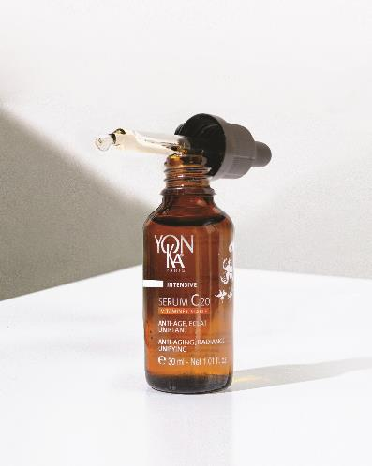
SERUM C20
Efficiency and sensoriality with 20% of stable vitamin C
Anti-aging
Radiance
Anti dark spot
After 5 days :
Measurable and visible efficacy on complexion radiance and even skin tone
After 14 days :
Wrinkle volume is reduced and skin is visibly smoother
After 28 days :
Features are smoothed1, skin is visibly younger and springier, the color of dark spots is less intense2
After 56 days :
The anti-dark spot effectiveness is intensified
99,9% ingredients of natural origin
Stable Vitamin C new generation
Oleo-serum with a non-greasy satin finish
Notes:
From 5 days : Measured* and visible* effectiveness on the radiance and evenness of the complexion: Nearly 9 out of 10 women: convinced by the radiance effect and the healthy glow action**. 100% of women: have adopted the product**' & wish to continue using it**'. After 14 days : Wrinkle volume is reduced*** Skin is visibly smoother: Nearly 9 out of 10 women: skin quality is better, more beautiful*** 100% of women: find that skin is visibly smoother. 100% of women: find that the skin is awakened, more luminous and the complexion is radiant**. After 28 days: The features are smoothed*, the skin is visibly younger and plumper, the colour of spots is less intense**: +58% more even skin tone***. +18% improvement in skin tone***. -30% reduction in wrinkle depth***. Tests carried out on 21 women - Application morning and evening. *Scoring for complexion radiance and chromametric analysis for complexion homogeneity - **Self-assessment - **'the product is easily integrated into the skin care routine.***Instrumental measurements
The + :
Formulated with 99.9% ingredient of natural origin, this new-generation sensorial serum is incredibly effective
This new generation of stable vitamin C is fat-soluble for improved bio-assimilation

Slide 16
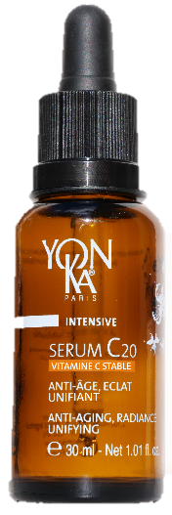
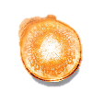
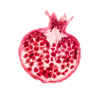
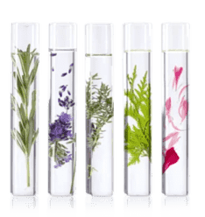
SERUM C20
All skin types
even sensitive
All year long
Or in a cure
20% of stable vitamin C
Anti-aging, Anti-oxidant,
Acts on melanogenesis
Turmeric native cells
Anti-aging, Anti-oxidant
Organic Apricot oil
Rich in Vitamin A
Acts on radiance
Pomegranate native cells
Radiance, Anti-oxidant
Sweet Orange essential oil
Acts on skin tonicity
Yon-Ka Quintessence
Potentiates the formula power
Notes:
20% of stable vitamin C :
100% natural origin, this stable form of vitamin C concentrates all the power and effectiveness of vitamin C without its disadvantages:
Ultra-stable to light, heat, air (the vitamin C molecule is stabilized 4 times), its power is guaranteed throughout its use.
Non-acidic and therefore better tolerated, it is biocompatible with all skin types (dermatologically tested on all skin types, even sensitive skin. Good tolerance).
Liposoluble for a bio-assimilation and a penetration optimized
Tumeric ; Stimulating action on epidermis and dermis
Help the skin to be firmer and more elastic.
It completes the protective
and anti-aging action of vitamin C.
Pomegranate : Action on cellular oxygenation and melanogenesis
Help the skin to be more luminous and more uniform.
They reinforce the radiance and
anti-dark spot action of Vitamin C
Organic apricot oil :
extracted from the kernel is composed mainly of Omega 9 and Omega 6, known for their nourishing, softening and smoothing properties.
This organic apricot oil is also rich in vitamins A and E (photo-protective, anti-oxidant), phytosterols (restoration of the barrier function, UV protection, anti-aging skin). Endowed with a "complexion illuminating" power (healthy glow effect), it is therefore particularly recommended in toning treatment formulas intended for dull, devitalized and dehydrated skin. Its rapid penetration, without leaving an oily feel, is suitable for all skin types, even oily and combination.

Slide 17
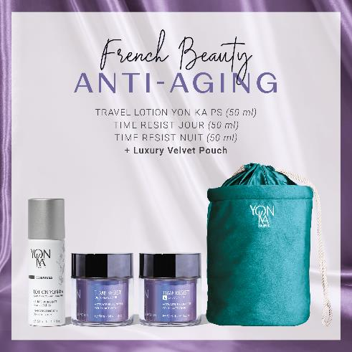
TIME RESIST OFFER
Visibly smoother features, younger, plumper skin that doesn't need any tricks to look radiant.
LOTION YON-KA PS TRAVEL SIZE FOR FREE
TIME RESIST JOUR 50ML
TIME RESIST NUIT 50ML
LUXURY KIT FOR FREE
Notes:
third set: anti aging to smooth and plump
LOTION YON-KA PS TAILLE VOYAGE – 18e
TIME RESIST JOUR 50ML – 87e
TIME RESIST NUIT 50ML – 87e
TROUSSE – 19e

Slide 18
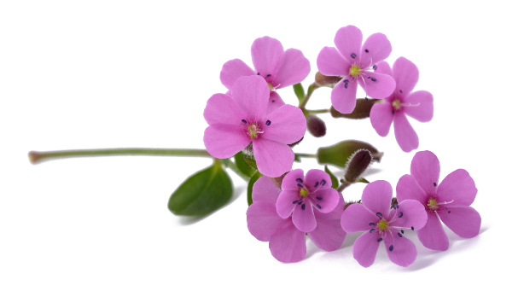
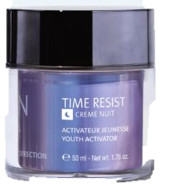
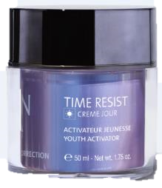
DUO TIME RESIST
A must-have duo for filling and smoothing deep wrinkles
Fills in wrinkles (TIME RESIST JOUR)
Redensifies (TIME RESIST NIGHT)
Preserves dermal stem cells
Fights inflamm'aging
Prevents and corrects the signs of ageing
Skin with deep wrinkles
Cible
Total surface area of wrinkles: - 82%
The skin is smoother
When you wake up, your skin looks rested: 76%
(5) INSTRUMENTAL EVALUATION - Measurement by video analysis (Quantirides software) of data on wrinkles after application of TIME RESIST NUIT cream for 4 weeks (best result obtained) (6) CONSUMER TEST - Self-evaluation after application of TIME RESIST NUIT cream in the evening by 20 women aged 40 to 55 for 4 weeks.
Notes:
TIME RESIST DAY/NIGHT
Description
Time Resist Day, a youth activator, works in conjunction with Time Resist Night to prevent and correct the signs of aging by fighting the processes responsible for premature skin aging, commonly known as "Inflamm'aging". This effectiveness is due to the unique combination of stem cells from an alpine plant, Saponaria pumila, and the Youth Energy amino acid complex! Time Resist Jour is enriched with oat polyoses for a smoothing effect, konjac spheres to fill in wrinkles, and hyaluronic acid to provide the skin with all the moisture it needs. Your skin is plumped up and protected from the effects of time; it becomes more toned, appears smoother and visibly younger and more radiant. We appreciate its airless "touch and slide" jar, its soft and natural scent.
Time Resist Nuit is enriched with anti-wrinkle and smoothing active ingredients: regenerating euglena gracilis extract, anti-glycation silk tree extract and highly nutritious Sacha Inchi oil. Overnight, the skin is nourished and smoothed, signs of fatigue are reduced and the complexion glows with a new radiance.
Promise
Youth Activator Duo
Time Resist Day Wrinkle Filler
Time Resist Smoothing Anti-Fatigue Night
For whom?
Skin with deep wrinkles
"I have marked wrinkles all over my face".
"I have wrinkled skin"
"My skin is dry«
Ingredients
Common base
Saponaria Pumila Stem Cells + Youth Energy Lipoamino Acid: Youth Activator
Saponaria Pumila protects and preserves the dermal stem cells.
History : During the ice age from 110 000 BC to 10000 BC, 90% of terrestrial life disappeared. Some plants survived this ice age, such as the nunataks. These extremophilic alpine plants survived the ice age because they migrated during periods of extreme cold to unglaciated mountain peaks called Nunatak (hence their name). They can still be found in the Alps and are considered the most historical species of the alpine fauna. Saponaria Pumila is one of these Nunataks that, being constantly exposed to strong UV radiation but also very cold temperatures, has developed protective and restorative properties to survive its extreme environment.
Method of production: Eco-Innovation
A very small amount of plant material (e.g. a fruit or a leaf) is needed to establish a plant stem cell culture. Thus rare and endangered plants are preserved.
This technique does not require agricultural land
It is water-efficient compared to conventional processes
It does not require pesticides or fertilizers.
Action:
The extraordinary survival potential of Saponaria Pumila allows them to protect and revitalize the skin's stem cells (dermal stem cells) so that they have the weapons to protect themselves against environmental stresses that are the main cause of skin aging. This ability translates into:
Protection of dermal stem cells from the harmful effects of UV and visible light
Increase in the density of the dermis by protecting it against breaks in its architecture (arrangement of elastin and collagen fibres).
Thus, Saponaria pumila stem cells are able to allow dermal stem cells to maintain their regenerative potential despite UV exposure.
Youth Energy protects and strengthens the skin's defences against chronic and silent reactions.
Some individuals have developed a resistance to inflammatory 'aging' that ensures harmonious aging. They are naturally resistant to stress and age-related diseases. Centenarians are the main representatives of this population. During a study on pain and inflammation, an American team of pharmacology researchers discovered the PalGly molecule in 2008. Naturally present in the brain and skin, it has anti-stress and anti-inflammatory properties, earning it the name "serenity molecule". Yon-Ka was inspired by this serenity molecule to offer the skin, thanks to Time Resist creams, the biological secrets of harmonious longevity by inserting a biotechnological active ingredient that mimics the PalGly molecule into the heart of the formulas.
Youth-Energy lipoamino acid is a Palgly mimetic molecule. Due to its anti-inflamm'aging activity, this lipoamino acid has several more or less direct actions at the skin and cell level. In particular, it acts directly on the reduction of the quantity of IL-6, a key marker of inflammation
Youth-Energy, the molecule of serenity, protects the skin from chronic and silent reactions induced by external aggressions and responsible for skin aging.
Reduction in the amount of IL-6 (marker of inflamm'aging)
Protection of the extracellular matrix (reduction of collagenase activity)
Construction of the collagen network
Improvement of the micro-vascular network
Wakame : redensifying
It reactivates 14 genes involved in the re-densification of the extracellular matrix of the dermis by acting on 3 elements:
Collagen: Activates the genes involved in the synthesis, maturation and assembly of collagen fibres
Elastin: Activates the genes involved in the synthesis, maturation and assembly of elastin fibres.
Hyaluronic acid: Activates the genes involved in the synthesis of hyaluronic acid
Grape seed oil: moisturizing, nourishing
Time Resit Day
Oat polyose: wrinkle filler
Oat polyoses allow to immediately and visibly smooth and lift the skin micro-relief. Indeed, it binds to the skin surface and forms a highly cohesive biological film capable of visibly tightening the skin. The smoothing/tensing effect is immediately visible, and long-term anti-wrinkle effectiveness has also been demonstrated.
Filling spheres (konjac + low molecular weight hyaluronic acid): wrinkle filler
Konjac is a root native to Asia which, once moistened, turns into a gel. It is often used as an appetite suppressant.
Konjac + hyaluronic acid encapsulated in the filling spheres allow to plump up the wrinkle up to 6 times.
Low molecular weight hyaluronic acid has a surface action (smoothing and plumping effect) because it forms a hydrated and protective film, is capable of maintaining water in the tissues, slowing down its evaporation (insensible water loss) and without being occlusive or greasy.
Time Resit Night
Silk tree: anti-glycation
It is a plant extract specially developed to fight against signs of fatigue thanks to its action on the detoxification processes of cellular metabolism. It fights skin signs of fatigue caused by glycation and glycoxidation. It maintains the mechanical viability of the cells and their optimal energy production, rebalances the synthesis of melatonin by fibroblasts tired by glycation and ensures the elimination of cellular waste.
Note: Glycation: the binding of a sugar to proteins causing a structural rearrangement. These glycated proteins cannot be destroyed naturally by our cells' own destruction systems. These products then pile up in the cells without being able to get rid of them. Gradually, these substances cause the cell's metabolism to malfunction and eventually lead to its death.
Euglena gracilis : regenerating
Euglene has a metabolism similar to that of skin cells with a metabolism controlled by the alternation of light and darkness (day/night). In addition, it contains phosphoinositides which act as a precursor to stimulate the skin cells. Euglene is therefore a source of vitality and cellular energy thanks to the stimulation of ATP production: +48% in 2 hours, the increase in IP3 production (a molecule involved in fibrobast/collagen communication) and the activation of calcium destocking, meaning the passage of the cell from a "resting" state to an "activated" state (Ca is involved in many metabolic reactions),
Home use
In the morning, after cleansing and misting with the appropriate Yon-Ka Lotion, apply Time Resist Jour to the entire face, neck and décolleté. Massage the cream into the skin with light strokes and gentle pinches. In the evening, after cleansing and removing make-up and applying the appropriate Yon-Ka Lotion, apply Time Resist Night to the entire face, neck and décolleté.
Use in the treatment room
Massage
End of treatment cream
Product advantages
Time Resist Day
Contains 96% natural ingredients
Unique combination of stem cells and Youth Energy Complex
Prevents and corrects the signs of aging
Wrinkles are filled in and smoothed out
The skin is soft, moisturized and plumped up
Touch & slide" airless jar
The skin is younger: 100% (Clinical test - Evaluation by a dermatologist of the severity of wrinkles in the nasolabial fold after application of the TIME RESIST duo morning and evening by 20 women aged 40 to 55 for 4 weeks (best result obtained).
Wrinkles are less visible: 75% (Clinical test - Evaluation by a dermatologist of the severity of wrinkles in the nasolabial fold after application of the TIME RESIST duo morning and evening by 20 women aged 40 to 55 for 4 weeks (best result obtained).
Time Resist Night
Contains 90% of natural ingredients
Unique combination of stem cells and Youth Energy Complex
Smoothes fine lines and wrinkles and reduces signs of fatigue
The skin is regenerated
The complexion is more radiant in the morning

Slide 19
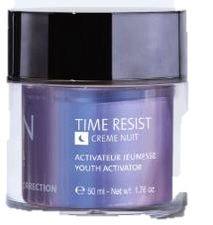
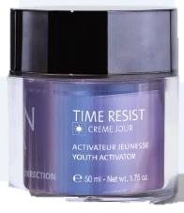
DUO TIME RESIST
Morning and evening, after cleansing and misting with Yon-Ka Lotion, apply TIME RESIST cream to the face and neck using light effleurages.
Its Airless jar for a protected formula. A single press delivers just the right amount for optimum application, saving product over the long term.
Common base
TIME RESIST JOUR
TIME RESIST NUIT
Saponaria pumila stem cells
Protect and revitalise dermal stem cells
Lipoaminoacid YOUTH ENERGY
Anti inflamm’aging
Wakame extract
Redensifying, boosts collagen, elastin and HA synthesis
Filling sphères
Wrinkle filler
Oat Polyoses
Wrinkle Filler
Hyaluronic Acid
Hydrating, smoothing
Silk tree
Anti glycation
Euglena gracilis
Regenerating
Sacha Inchi
Nourishing, soothing, softening
Notes:
Ingredients
Common base
Saponaria Pumila Stem Cells + Youth Energy Lipoamino Acid: Youth Activator
Saponaria Pumila protects and preserves the dermal stem cells.
History : During the ice age from 110 000 BC to 10000 BC, 90% of terrestrial life disappeared. Some plants survived this ice age, such as the nunataks. These extremophilic alpine plants survived the ice age because they migrated during periods of extreme cold to unglaciated mountain peaks called Nunatak (hence their name). They can still be found in the Alps and are considered the most historical species of the alpine fauna. Saponaria Pumila is one of these Nunataks that, being constantly exposed to strong UV radiation but also very cold temperatures, has developed protective and restorative properties to survive its extreme environment.
Method of production: Eco-Innovation
A very small amount of plant material (e.g. a fruit or a leaf) is needed to establish a plant stem cell culture. Thus rare and endangered plants are preserved.
This technique does not require agricultural land
It is water-efficient compared to conventional processes
It does not require pesticides or fertilizers.
Action:
The extraordinary survival potential of Saponaria Pumila allows them to protect and revitalize the skin's stem cells (dermal stem cells) so that they have the weapons to protect themselves against environmental stresses that are the main cause of skin aging. This ability translates into:
Protection of dermal stem cells from the harmful effects of UV and visible light
Increase in the density of the dermis by protecting it against breaks in its architecture (arrangement of elastin and collagen fibres).
Thus, Saponaria pumila stem cells are able to allow dermal stem cells to maintain their regenerative potential despite UV exposure.
Youth Energy protects and strengthens the skin's defences against chronic and silent reactions.
Some individuals have developed a resistance to inflammatory 'aging' that ensures harmonious aging. They are naturally resistant to stress and age-related diseases. Centenarians are the main representatives of this population. During a study on pain and inflammation, an American team of pharmacology researchers discovered the PalGly molecule in 2008. Naturally present in the brain and skin, it has anti-stress and anti-inflammatory properties, earning it the name "serenity molecule". Yon-Ka was inspired by this serenity molecule to offer the skin, thanks to Time Resist creams, the biological secrets of harmonious longevity by inserting a biotechnological active ingredient that mimics the PalGly molecule into the heart of the formulas.
Youth-Energy lipoamino acid is a Palgly mimetic molecule. Due to its anti-inflamm'aging activity, this lipoamino acid has several more or less direct actions at the skin and cell level. In particular, it acts directly on the reduction of the quantity of IL-6, a key marker of inflammation
Youth-Energy, the molecule of serenity, protects the skin from chronic and silent reactions induced by external aggressions and responsible for skin aging.
Reduction in the amount of IL-6 (marker of inflamm'aging)
Protection of the extracellular matrix (reduction of collagenase activity)
Construction of the collagen network
Improvement of the micro-vascular network
Wakame : redensifying
It reactivates 14 genes involved in the re-densification of the extracellular matrix of the dermis by acting on 3 elements:
Collagen: Activates the genes involved in the synthesis, maturation and assembly of collagen fibres
Elastin: Activates the genes involved in the synthesis, maturation and assembly of elastin fibres.
Hyaluronic acid: Activates the genes involved in the synthesis of hyaluronic acid
TIME RESIST JOUR :
Filling spheres
Combined with low molecular weight hyaluronic acid → forms filling spheres which, once in the epidermis, absorb the water that evaporates naturally from the dermis (insensible water loss). These spheres swell (x6 - in vitro test) for a long-lasting wrinkle-filling, smoothing and moisturising effect.
High molecular weight hyaluronic acid
surface action (smoothing and plumping effect)- Forms a hydrated, protective film- Able to hold water in the tissues - Slows down evaporation (insensible water loss) without being occlusive or greasy
Oat polyoses
Oat polyoses immediately and visibly smooth and lift the skin's micro-relief. It binds to the skin's surface and forms a highly cohesive biological film capable of visibly tightening the skin. The smoothing/tensing effect is immediately visible, and long-term anti-wrinkle effectiveness has also been demonstrated.
TIME RESIST NIGHT:
Euglena Gracilis
Euglena has a metabolism similar to that of skin cells, with a metabolism controlled by alternating light and darkness (day and night). It also contains phosphoinositides which act as precursors to stimulate skin cells. L'Euglène is therefore source of vitality and cellular energy
Stimulation of production ATP: + 48% in 2h
Increased production of IP3 (a molecule involved in fibrobast/collagen communication)
Activation of calcium release, meaning the cell moves from a "resting" to an "activated" state. ( Ca involved in numerous reactions metabolism),
Sacha Inchi Oil
Replenishes epidermal lipids, prevents redness and irritation.
Omégas 3 → anti-inflammatory, apaisants
Omégas 6 → adoucissants, nourrissants
Omégas 9 → feeders, softeners
Silk tree extract :
A plant extract specially developed to combat signs of fatigue thanks to its action on the detoxification processes of cellular metabolism. It combats the signs of skin fatigue caused by glycation and glycoxidation.
Maintains the mechanical viability of cells and their optimal energy production
Rebalances melatonin synthesis by fibroblasts fatigued by glycation.
Eliminates cellular waste

Slide 20
How can you turn the festive season into a success?

Slide 21
The festive season is the perfect time to boost sales.
Here are a few ideas to help your partners boost their points of sale.
Notes:
Boosting beauty salon sales over Christmas can be an excellent opportunity to boost business. Reasons for increased sales over the Christmas period include:
Gifts: Many people buy gift cards for beauty services or beauty products as gifts for loved ones over the festive period.
Festive events: The festive season, including New Year's Eve, company parties and other social events, encourages people to pamper themselves and invest in their appearance.
Special Christmas treatments: Beauty salons often offer special Christmas treatments, seasonal packages and beauty products with festive designs that attract customers.
Need to relax: Christmas can be a stressful time, so many people seek out spa treatments, relaxing massages, manicures and pedicures to unwind.
In general, many beauty salons experience a significant increase in sales over the Christmas period, sometimes by 20% to 50% or more compared to other times of the year.

Slide 22
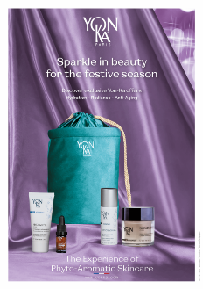
Decorate your beauty salons with Christmas decorations to create a festive atmosphere.
Festive decoration :
^{Ref 7C1151X}
^{DISPLAY}
^{Files available in:}
^{FR/EN and FR/NL}
^{POSTER 60x90}
^{Ref 7C1150A (FR) and}
^{Ref 7C1150B (EN)}

Slide 23
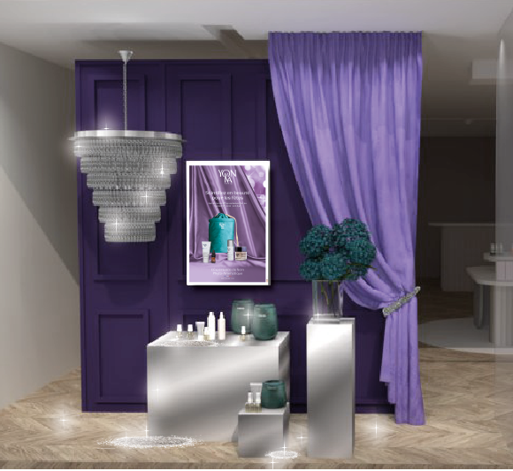
Scenography
showcase

Slide 24
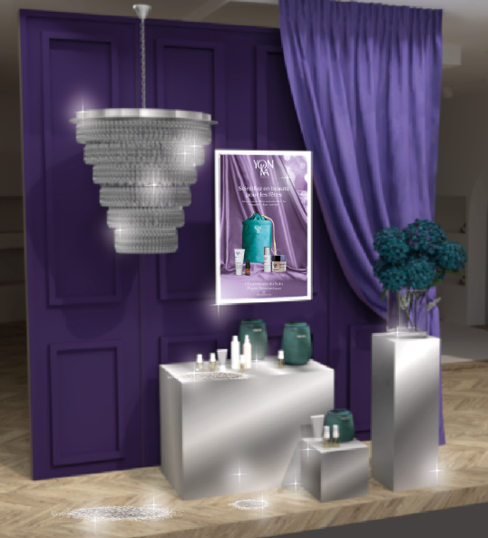
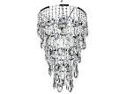
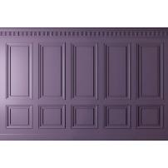
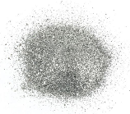
The scenography, in detail ...
Chandelier
Satin or velvet curtain hung on one side only
Hanging poster
Wallpaper window backdrop
Green/blue flowers in a large clear glass vase
LED candles
Covered podiums
Mirror film
Exhibition of Yon-Ka Christmas kits and products
Sprinkle a lot of glitter here and there to make the window sparkle.

Slide 25
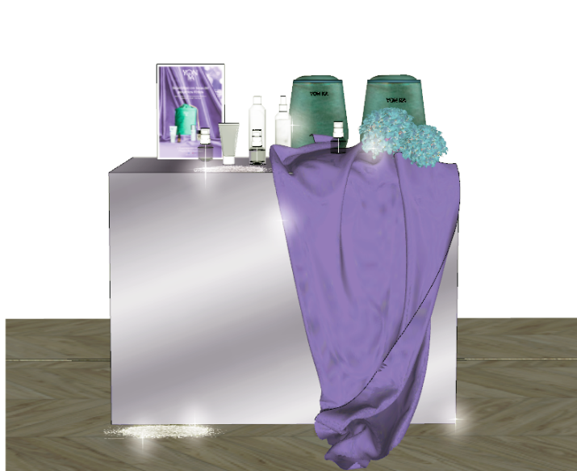
ANIMATION
Point of sale

Slide 26
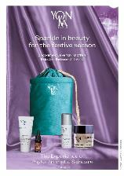
Point-of-sale animation, in detail... (if possible, dedicate a specific corner or shelf for this event)
Poster
Christmas kits + products
A few blue/green flowers
Drop cloth
in purple satin or velvet
Glitters
Sprinkle on
in the background

Slide 27
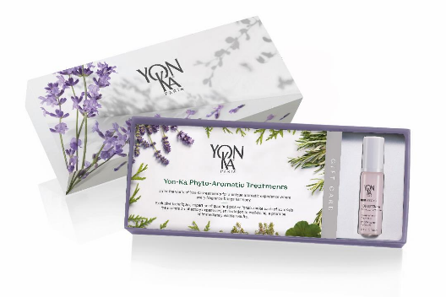
Special Christmas offers :
Offer packages or special promotions for beauty treatments
Suggest attractive YON-KA gift cards to encourage customers to offer treatments to their loved ones
Notes:
Offer packages or special promotions for beauty treatments
Don't hesitate to combine Christmas packages with a suitable facial treatment by offering an attractive discount. You can decide to run these offers throughout December, for example, on gift vouchers valid for 6 months, etc.
Offer attractive YON-KA gift cards to encourage customers to offer treatments to their loved ones. Offer gift wrapping, highlighting the fact that it is possible to wrap products and boxes in beautiful paper.

Slide 28
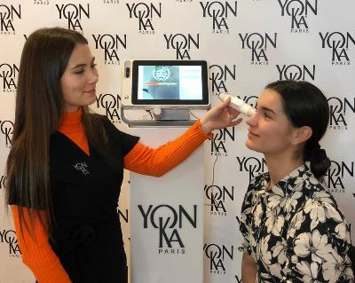
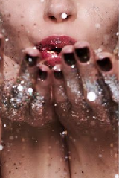
Demonstration events :
Organise coaching or beauty workshops focusing on festive looks
Mini radiance treatment: Promote the C20 Serum and Vitamin C25 treatment for maximum radiance for the festive season.
20 min appointment
Skin cleansing
Peeling Lumière
Application of C25 Serum
Beauty workshop: perfecting the beauty routine with the right products and the right gestures
1h30 appointment
Group of 4, each in front of a mirror
Skin diagnosis: complete analysis of needs
30-minute appointment
Beauty routine advice at home and in the salon
Notes:
Coaching workshop:
this is a workshop where the beautician carries out a skin diagnosis, a complete in-depth analysis using a diagnostic device, at the end of which she recommends a complete beauty routine.
30-minute appointment. Yon-Ka also markets a latest-generation device, the SOFT FX.
Mini radiance treatment:
C20 Serum and Vitamin C25 treatment for maximum radiance for the festive season.
20 min appointment
Skin cleansing
Peeling Lumière
Application of C25 Serum
Beauty workshop:
this is a type of workshop where consumers meet in groups (4 max) to perfect their beauty routines (the right gestures with the right products, each in front of a mirror) with a YON-KA beautician.
Create a convivial moment with drinks and snacks (in connection with Christmas).
These workshops can be held during the day or in the evening.

Slide 29
Local partnerships :
Partnership:
Work with other local businesses to offer cross-promotions.
E.g. 10% discount on a service (beauty salon, hairdresser, etc.) or a free coffee, dessert, glass of sparkling wine, etc. in a restaurant.
Take part in local Christmas markets to promote your institute.
Notes:
Partnership :
Set up cross-merchandise offers with shopkeepers in your street/neighbourhood. In other words, customers who visit a shop (and buy / consume) - (clothes, chocolate, jewellery, restaurant...) - can benefit from a 10% discount in your institute on facial and body treatments (for example). Conversely, give each customer a discount voucher for the participating shops.
Christmas market:
Taking part in a Christmas market near your salon will give you greater visibility and allow you to sell products and treatments at a special "Christmas market" discount.

Slide 30
Ideas for point-of-sale animations
Advent calendar:
Digital and/or physical
1 winner per day, behind each day of the December calendar a gift
To be won (example) :
Promotional / travel size products
Tombola:
Prize draw on 24 December
From 1 to 24 December, after each purchase, the customer places a piece of paper with her name on it in a box.
To be won (example) :1 year's facial treatment (1 facial treatment of 1 hour per month)
Wheel of fortune:
Spin the wheel with each customer
To be won (example) :
1 Yon-Ka travel size product
10% discount on a facial treatment
15% discount on a body treatment
20% discount on purchases of €100 or more
...
Golden Ticket:
A winning ticket hidden in a product
To be won (example) :
9 treatments worth €600
1 Yon-Ka facial treatment
1 Yon-Ka body treatment
1 semi-permanent nail polish application
1 30-minute body diagnosis
1 LPG body treatment 30 min
1 30-minute Cryo session1 face diagnosis
1 aquapure session 60 min
Notes:
Advent calendar: digital and/or physical, this is a great way to celebrate each day of the festive season and have a winner every day. To decide the winner, a draw is made at the end of each day among the day's customers (physical calendar) or a draw is made among the likes + sharing of the day's publication in a story, for example (digital calendar).
Tombola : after each checkout, from 1 December to 24 December, the customer slips a piece of paper with his/her details into a ballot box. At the end of the day on 24 December, a draw is held (online, live on the networks) and the winning ticket is offered a very attractive gift, in this case 12 one-hour facial treatments.
Wheel of fortune: spin the wheel for each customer (with or without any obligation to buy) up to a limit of once a day per customer. You can decide how long the wheel will run (the whole month of December, one week, etc.), choose the prizes to be won and how long the vouchers will be valid for.
Examples of prizes to be won:
Yon-Ka travel size products
10% discount on a facial treatment
15% discount on a body treatment
20% discount on purchases of €100 or more
...
Golden ticket: same principle as Charly and the Chocolate Factory, create an event based on the presence of a golden ticket hidden in one of your retail products. The lucky holder will receive a very attractive gift, in this case 9 treatments worth 600 euros. What's really important for this kind of offer is to talk about it as much as possible, to make it visible on all your networks and sites and to run it ahead of time (publication on 15 November). Create a buzz around an incredible gift.

Slide 31
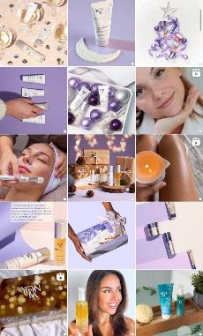
Social networks and online marketing :
Use social networks to promote Christmas special offers and publish attractive images of beauty services.
Organise online competitions to attract the attention of new customers.
Media kit
Notes:
MEDIA KIT
Use the media kit prepared by our digital department to promote your social networks. Don't forget to tell your customers about your events, games and offers on each of your communication channels.

Slide 32
Exceptional customer service :
Loyalty is essential throughout the year. The festive period is the ideal time to reward them!
Example: rose, chocolate, Christmas ornament....

Slide 33
Personalised communication :
Send personalised emails or text messages to your existing customers to let them know about your Christmas offers.
Notes:
To reward your most loyal customers, those who are part of your customer file, you can send out Christmas offers in advance, invite them to a VIP evening with an exceptional discount, etc.

Slide 34
Extended opening hours / Night-time opening
Offer extended opening hours so that your customers can make appointments at times that suit them.
Christmas party:
Organise a festive evening and invite your most loyal customers to come and celebrate the festive season with a buffet, music and exceptional offers.
E.g.: 20% discount for every 3 Yon-Ka products purchased.
Notes:
Organise a Christmas party and invite your most loyal customers with an exceptional offer valid only during the evening.
Example: -20% from 3 products purchased
It's the perfect time to buy Christmas presents and treat yourself!
Don't forget to provide a buffet suited to the festive period, and why not include some entertainment (music group, caricature painter, Christmas ornament workshop, etc.)?
Ideally, organise this evening at the beginning of November and tell your customers about it 15 to 30 days beforehand with reminders.

Slide 35
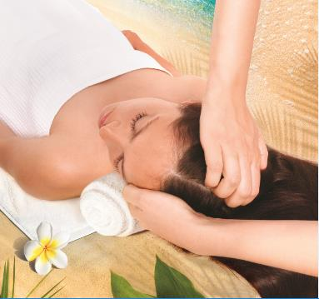
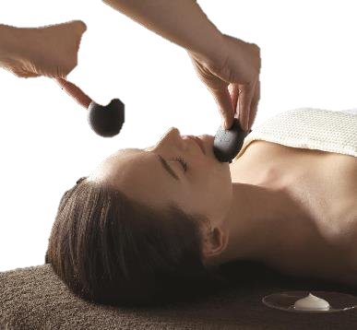
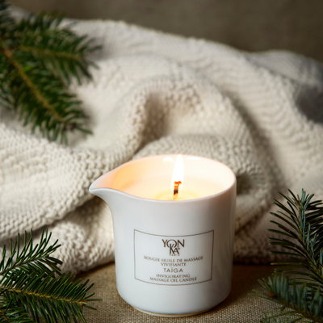
Treatments that are easy to offer or to treat yourself to
MAHANA
ECLAT COCOON
BOUGIE TAÏGA
Notes:
MAHANA :
A treatment for everyone, designed to relax, energise and escape.
Mahana will intensely relax the body and mind, release areas of tension, boost energy and calm the mind.
For the 60-minute version, the facial treatment will illuminate the complexion and provide intense hydration.
The 30-minute option is the ultimate short treatment for immediate relaxation, the ideal complementary treatment that can be added to another treatment.
ECLAT COCOON :
A unique, relaxing and hydrating treatment using hot stones.
Benefits: deeply hydrates, brightens the complexion and intensely relaxes. Double manual massage + hot stones
BOUGIE TAIGA :
With this invigorating Taiga massage candle, you'll rediscover the magic of wax melting on your skin and enveloping you in gentle warmth. Organic sesame oil, shea butter and organic mango butter, rich in vitamin E, give you peachy skin. It's a rejuvenating and relaxing interlude, a moment of total relaxation thanks to the subtle aromas of Siberian pine, cypress and Virginia cedar.
99% Natural Origin Ingredients.
Nourishes the skin and relieves tension
Skin is silky soft and regenerated
Its enveloping woody fragrance

Slide 36
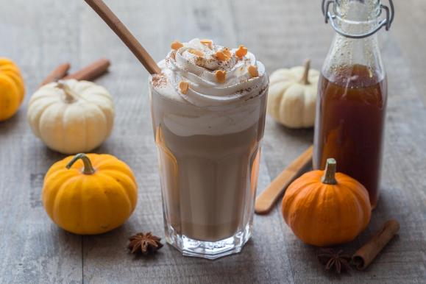
Cocktail Pumpkin spice latte
For one cup of pumpkin spice latte
2 tablespoons spiced pumpkin syrup
1 cup of coffee
100 ml milk
50 ml very cold full cream
1/2 teaspoon ground cinnamon

Slide 37
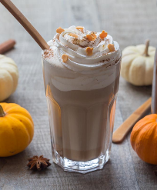
Cocktail Pumpkin spice latte
Préparez le sirop de potimarron épicé
Préchauffez le four à 180° (th6) chaleur tournante et chemisez un plat de papier sulfurisé.
Lavez et grattez le potimarron puis coupez le en petits dés en ôtant les graines.
Placez les cubes de potimarron dans le papier sulfurisé et ajoutez la cannelle, la vanille, le sucre, le sirop d'érable, le gingembre, la cardamome, la noix de muscade, l'anis étoilé, le poivre et l'eau.
Mélangez bien et refermez la papillote de papier sulfurisé.
Enfournez pour 50 minutes.
Lorsque la cuisson est terminée, versez le contenu de la papillote dans le bol d'un mixeur plongeant et mixez jusqu'à obtenir une purée lisse.
Allongez éventuellement d'un peu d'eau minérale pour obtenir une texture proche de celle d'un sirop.
Après refroidissement, versez le sirop dans un pot en verre propre, hermétiquement fermé et réservez à température ambiante.
Vous pouvez bien sûr vous préparer un pumpkin spice latte avant le refroidissement du sirop !
Préparez le pumpkin spice latte
Faites couler une tasse de bon café et faites chauffer le lait à la casserole ou au micro-ondes.
Dans une tasse, versez deux cuillères à soupe de sirop de potimarron épicé et recouvrez avec le café chaud.
Mélangez bien.
Ajoutez le lait chaud et mélangez à nouveau.
Fouettez la crème liquide entière pour obtenir une crème montée qui tient entre les branches du fouet.
Pochez la crème sur la boisson chaude, saupoudrez de cannelle moulue et régalez vous
Pour le sirop de potimarron épicé
300 g de potimarron coupé en cubes
80 g de cassonade
5 cuillères à soupe de sirop d'érable
1 cuillère à soupe d'extrait de vanille liquide
1 cuillère à café de cannelle en poudre
1/2 cuillère à café de gingembre moulu
1/4 cuillère à café de cardamome
1/2 cuillère à café de noix de muscade râpée
1 anis étoilée
1 pincée de poivre noir moulu
5 cuillères à soupe d'eau minérale de préférence

Slide 38
What about you?
Share your good ideas with us

Slide 39
