Slide 1
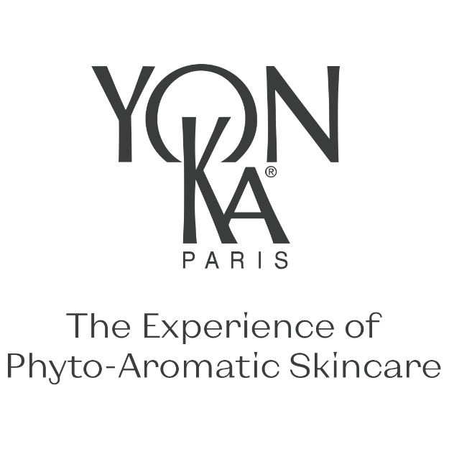

Slide 2
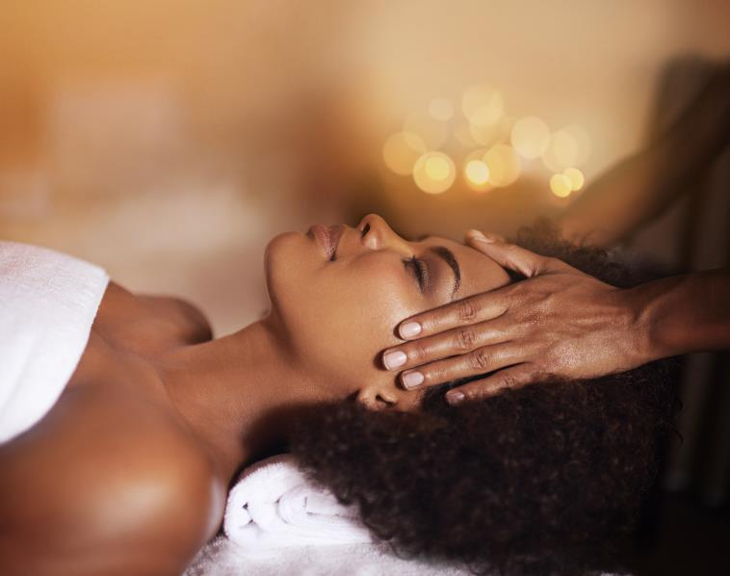
How to identify a DRY SKIN

Slide 3
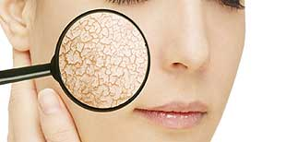
How to identify a DRY SKIN
NORMAL SKIN
DRY SKIN
Hydrolipidic film
Stratum corneum
IN CONCLUSION, THE PROBLEMS OF DRY SKIN ARE :
Deficient hydrolipidic film
Sensitivity to external aggressions
Lack of lipids
Increased water loss
Epidermis
INTACT
HYDROLIPIDIC FILM
UV rays and external aggression partially stopped
Water retained
DAMAGED
HYDROLIPIDIC FILM
UV rays and external aggressions penetrate further
Water evaporation ++
Notes:
What happens to the hydrolipidic film when the skin is normal? HYDROLIPIDIC FILM INTACTUV
rays and external aggression partially stopped
Water retained
What happens to the hydrolipidic film when the skin is dry? HYDROLIPIDIC FILM DAMAGEDUV
rays and external aggressions penetrate further
Water evaporation ++
The difference between dry skin and normal skin = defective structure :
Damaged hydrolipidic film
Sensitivity to external aggressions -> more sensitive to external agressions
Lack of lipids -> problem of cellular cohesion in the epidermis
Increased water loss -> dry skin is often dehydrated

Slide 4
How to identify a DRY SKIN
Dry skin is a type of skin that lacks nutrition and can present various symptoms and characteristics :
IN YOUR OPINION, WHAT ARE THE CHARACTERISTICS OF DRY SKIN?
FEELING OF TIGHTNESS AND/OR ITCHING
DULL APPEARANCE
DESQUAMATION
REDNESS
INCREASED SENSITIVITY
FINE LINES AND WRINKLES
LACK OF SHINE
RIGIDITY
Notes:
"What are the characteristics of dry skin? Please enter them in the chat bar. There are 8 of them
.
Here's how to identify dry skin:
Tight feeling: Dry skin can feel tight, especially after facial cleansing or exposure to water. Itchiness: A frequent itching sensation may accompany dry skin, particularly in dry weather or in winter.
Dullness: Dry skin often looks dull and rough, lacking the natural radiance of healthy skin.
Flaking: Dry skin can flake, meaning it can peel or break off into small particles.
Redness: Some areas of dry skin may become red, irritated or flushed.
Increased sensitivity: Dry skin can be more sensitive to irritation, itching and allergic reactions.
Fine lines and wrinkles: Fine lines and wrinkles may be more visible on dry skin due to the lack of natural moisture.
Lack of shine: Dry skin tends to lack the natural glow that is present on well-hydrated skin.
Rigidity: Dry skin may appear less elastic and supple than normal or oily skin.
It's important to note that dry skin can vary in intensity, from mildly dry to extremely dry and cracked. If you think you have dry skin, it's essential to look after your skin by using appropriate nourishing products and avoiding factors that can make dry skin worse, such as prolonged hot showers and the use of aggressive products..

Slide 5
How to identify a DRY SKIN
Instrumental methods for measuring skin hydration
CORNEOMETRY
Analysis of the hydration of the superficial layers of the skin
HI < 30, skin is classified as "very dry”
30 < HI > 40: "dry" skin
HI > 40: "normal" skin
HI = Hydration Index
SEBUMETRY
Measures the activity of the sebaceous glands
Oily skin: > 66
Normal skin: 33 – 66
Dry skin: < 33
Unit of measurement in μg/cm²
Insensible Water Loss
Evaluates skin barrier function
Normal skin: 7 – 8
Dry skin: > 8
Unit of measurement in g/m²/h
Sebum-free zone
Hyperseborrheic zone
Notes:
Corneometry is a method of analysing the hydration of the superficial layers of the skin by applying an electric current. The more hydrated the skin, the better the current flows:
IH < 30, the skin is classified as "very dry".
30 < HI > 40: "dry" skin
HI > 40: "normal" skin
Sebummetry measures the activity of the sebaceous glands using patches which are stuck on the skin for 30 minutes or 1 hour. The patch retains the sebum as it is produced.Level 1 corresponds to a sebum-free zone, zone 5 corresponds to a hyperseborrhoeic zone.
It is possible to measure insensible water loss (IWL), meaning the passive diffusion of water from the inside to the outside of the skin and then its evaporation. This measurement is used to assess the skin's barrier function.IWL measurements must be taken on a subject who has been at rest for at least 30 minutes, so that sweat gland activity is negligible and does not distort the measurements. Temperature and humidity conditions must be constant and defined. Normal skin has an IWL between 7 and 8 g/m²/h. A higher IWL indicates dry skin.
Tewamètre© and Vapomètre© are used to measure the IWL

Slide 6
How to differentiate
DRY SKIN from DEHYDRATED SKIN
DRY SKIN
DEHYDRATED SKIN
Skin type (generetic characteristic)
Lack of lipid (sebum)
Skin condition (hormones or environmental)
Lack of water (Internal)
Skin can be both dry and dehydrated, as these two problems can coexist
Notes:
Dry skin and dehydrated skin are two distinct skin problems, although their symptoms can sometimes overlap. Here are the main differences between the two:
Underlying cause :
Dry skin: Dry skin is generally a skin type, which means it tends to lack the natural oils (sebum) that keep it hydrated. This condition can be due to genetic factors, hormonal changes or underlying medical conditions. Dry skin is therefore skin whose epidermis is initially properly hydrated by diffusion of water from the dermis. But the deficiency of its lipid/fat barrier, which becomes porous, finally allows water to escape more easily (IWL).
Dehydrated skin: Dehydrated skin is the result of a loss of fluid rather than a loss of oil. It can be caused by various external factors such as exposure to the dry environment, wind, sun, central heating, poor diet, or taking medication. This is skin that lacks water in the epidermis, meaning in the dermis, as water circulates from the dermis to the epidermis. Skin is said to be "dehydrated" when the water level in the stratum corneum falls below the minimum level of 10%.
Symptoms :
Dry skin: Typical symptoms of dry skin include a feeling of tightness, roughness, redness, itching and possibly flaking or cracking.
Dehydrated skin: Dehydrated skin is characterised by a loss of elasticity, a tingling sensation, a dull appearance, fine dehydration lines (temporary folds that form when the skin is folded) and sometimes more visible pores.
Treatment :
Dry skin: For dry skin, the main aim is to restore the skin's natural oils. This can be achieved by using lipid-rich hydrating creams and avoiding products that dry out the skin.
Dehydrated skin: Treating dehydrated skin involves boosting the skin's ability to retain humidity. This involves using hydrating products that contain ingredients such as hyaluronic acid, glycerine and urea. It's also important to drink enough water to maintain hydration from within.
It is important to note that skin can be both dry and dehydrated, as these two problems can coexist.
Skin type is characterised by the fact that it is a genetic characteristic: you are born with it, and it is not possible to change it. The only way to change your skin type is through skin ageing. And even then, it's highly likely that it won't change over time. A skin type is, for example, oily skin, combination skin or dry skin.
A skin condition, on the other hand, is what happens to your skin temporarily. A skin condition is often linked to hormones, environmental factors such as the sun, pollution or the products you use.

Slide 7
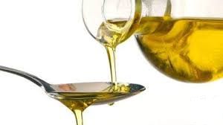
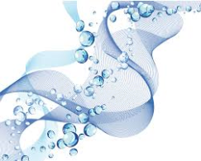
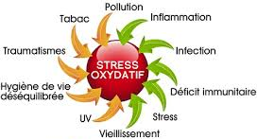
How to treat
DRY SKIN
Provide lipids
Stimulate the skin's natural defences
Provide hydration and soothing
Protect against oxidative stress
Notes:
We are going to respond to the problems of dry skin with 4 essential actions:
Provide lipids
= bring comfort to the skin
Stimulate the skin's natural defences
= keeping the skin alert
Hydrating and soothing
= Relieve tightness
= Reduce the risk of sensitivity
Protect against oxidative stress
= Prevent skin aging

Slide 8
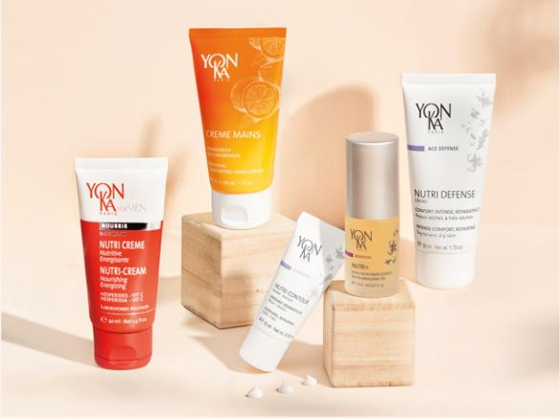
YON-KA ALLIES
to treat dry skin
Nutri-Contour
Nutri +
Nutri defense
Nutri creme YKFM
Creme mains

Slide 9
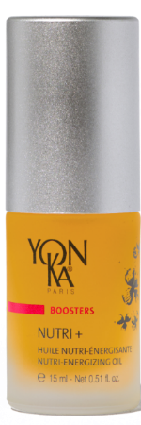
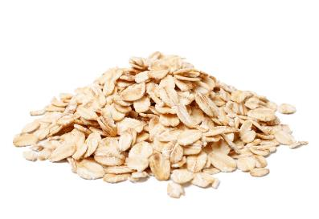
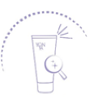
NUTRI +
S.O.S booster for dry skin and all tired skin
Nourishes and energises
Regenerates
Revitalises damaged skin
Fine, hypervitaminised oil for an instant boost of energy
Reduces the drying effects of the sun, cold, wind and certain treatments
99.8% ingredients of natural origin
The +
Skin is nourished: + 89%*.
Skin regains energy: 79%*.
With cereal germ oil
On a cure
*Test d’usage, application, une à 2 fois par jour, pendant 4 semaines consécutives, sur la peau du visage, par 19 volontaires adultes, de sexe féminin, âgés de 35 à 65 ans, à la peau de nature sèche et présentant une peau carencée / fatiguée.
Notes:
The SOS booster for dry skin and all tired skin! A real SOS treatment, this nutri-energising oil, full of vitamins E and F :nourishes and energises dry skin It regenerates and revitalises damaged skin. Especially when it's cold!
1 to 2 pumps added to our day or night cream are enough to give the skin comfort, tone and radiance.
PRODUCT BENEFITS :
We love: Its fine, ultra-vitaminised oil texture for an instant boost.
Its regenerating action that soothes dry skin
Its invigorating aromatic scent of the 5 essential oils in Quintessence Yon-Ka.
NUTRI+
Description
Nutri + is the best booster for dry skin and all skin that is in poor condition! A real SOS treatment, this energizing oil, full of vitamins E and F, nourishes and revitalizes skin that has been badly damaged by daily aggressions (climate, fatigue, pollution...). A few drops added to your day or night cream are enough to personalize your care according to your needs to bring comfort, tone and radiance to your skin. We love its regenerating action and the invigorating aromatic scent of the 5 essential oils in Yon-Ka Quintessence.
Promise
Nutri-energizing oil
For whom?
All skin types, appreciated by dry and sensitized skin
All ages
"Winter is approaching and I feel that my skin is tight, lacks comfort and is rough to the touch.
"At the change of seasons, my skin seems tired, I would like to give it a little more energy".
Ingredients
Cereal germ oil: nourishing
Quintessence: energizing
Vitamin F (from linseed, soya and sunflower oil): anti-dehydrating
Home use
In the morning and/or evening, after removing make-up/cleaning and spraying with the appropriate Yon-Ka Lotion, mix 1 to 2 pumps of Nutri + in the palm of your hand with your usual treatment cream. Massage this nourishing cocktail into the face and neck. Nutri + helps to nourish and regenerate the skin and is suitable for both dry and oily skin. It promotes the balance of the hydrolipidic film and allows for a truly tailor-made care. It reduces the drying effects of the sun, cold, wind and certain treatments that may have damaged or stripped the skin.
Use in the treatment room
- Massage
End of treatment mixed with the adapted Yon-Ka cream
Tips
It can be used alone in the evening
Product advantages
Contains 99.8% of ingredients of natural origin
+89% nourished skin
Intensely nourishes, boosts day and night care
The skin is more supple, toned and radiant
Fine oil with high vitamin content

Slide 10
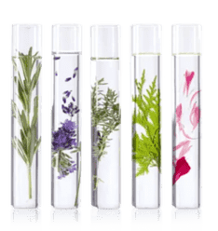
NUTRI +
Morning and/or evening, after cleansing and misting with YON-KA LOTION, mix 1 to 2 pumps of the booster with your usual cream and apply to the face and neck.
A fine, hypervitaminated oil, nourishes and revitalises all skin types in need of a boost.The skin glows with radiance, regaining suppleness, comfort and vitality.
Cereal germ oil
Regenerating/ Nourishing/ Protective
Vitamin F
Anti-dehydrating
Vitamin E
Protective/ Regenerating
/ Anti-oxidant
YON-KA Quintessence
Vitalizing / Replenishing / Sanitizing / Soothing / Purifying / Toning / Astringent / Regenerating
Notes:
Cereal germ oil (Europe) - Corn germ (cereal), soya, sunflower (oil protein): Nourishing, anti-drying, regenerating.
Quintessence Yon-Ka: Blend of essential oils = Lavender (France, Haute Provence), geranium (Egypt), rosemary (Morocco), cypress (France, Haute Provence), thyme (Spain). Used in various degrees of concentration, always pre-measured to guarantee perfect safety and optimum results, an olfactory treasure that balances, relaxes or energises depending on your needs.
Vitamin F (Plant-based, derived from linseed, soya and sunflower oil)
Anti-dehydrating : Regulates skin hydration
It allows cells to regain their full water tension by reducing their impermeability.
Protection: Reinforces the skin's resistance to external aggression
Thanks to its high linoleic acid content, which is essential for the formation of the epidermal lipid barrier.
Vitamin E (synthesis)Anti-oxidant, anti-free radical: fights against skin ageing.
Cell protection Strengthens the hydrolipidic film: helps the skin combat dehydration

Slide 11
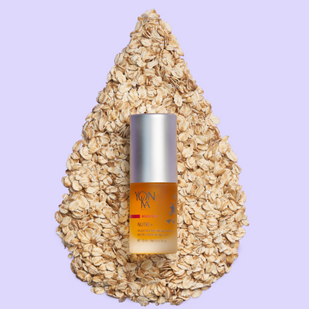
NUTRI + : testimonials
Nutri +
Judy Knox
I’ve used this product for several years. Nothing compares. !
Amy Betancourt
This little bottle of goodness has worked wonders for my dry dry skin. I use it alone or add to any of the moisturizers and it really makes a difference. It's my Yonka must have!
Jennifer Keller
This is my go-to hydrating booster for glowing skin. I mix it with Hydra cream for the perfect combo. It is Oil, and leaves me dewy, but not oily.
Makenzie Wullner
I love this Booster. Have been using it for over 1 year every 3 months and my face feels healthier and looks brighter. Friends have asked what I use on my face and I highly recommend this booster to them.

Slide 12
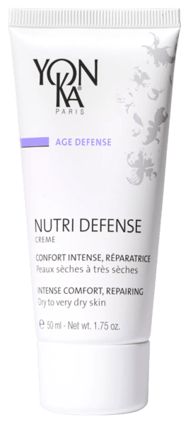
NUTRI DEFENSE
Intense comfort SOS cream for dry to very dry skin
Nourishes
Repairs
Boosts natural defences
Dry to very dry skin
Skin sensitive to everyday aggressions
Target
Nourished skin: 100%.
Feels better protected from external aggressors: 89%.
Combined with Nutri+ : +89% nutrition.
50 ml
Morning and/or evening
*Self-evaluation - Clinical study of 18 women aged between 25 and 55 with dry and very dry skin showing signs of discomfort (tightness, itching). Apply 2 times a day for 4 weeks.
Notes:
NUTRI-DEFENSE
Description
This SOS face cream is a comfort for dry to very dry skin. Its repairing active ingredients, organic Sacha Inchi, shea butter and avocado oil intensely nourish the epidermis. Rich in probiotics associated with co-enzyme Q10 and anti-oxidant vitamins, it boosts the skin's natural defences to better fight against environmental aggressions. Soft and creamy, it soothes feelings of tightness and irritation. Nutri Défense is the ideal care for skin in distress that quickly regains comfort, suppleness, velvetiness and radiance.
Promise
Intense SOS comfort cream for dry to very dry skin and repair
For whom?
Dry to very dry skin
All ages
"My skin is uncomfortable, tight and itchy
"Applying my day cream in the morning is not enough".
"My skin is weakened and has scabs".
Ingredients
Organic Sacha Inchi oil: nourishing, repairing
This oil is certified organic ECOCERT. It is derived from the seeds of a plant native to the Amazonian forest used by the Indians for its many virtues.
It is the richest oil in essential fatty acids (EFAs), composed of more than 80% EFAs (omega 3 and 6) and also contains omega 9.
Shea butter: nourishing, repairing
It is derived from the crushed, roasted and ground almond contained in the shea fruit. It has a high unsaponifiable content of 5% (terpene alcohols: esters of cinnamic acid, esters of fatty acids, promoting healing,
phytosterols: spinasterol and stigmasterol, improving the skin's barrier function) which gives it the following properties: protection of the skin against bad weather and the sun, activation of healing, elimination of
superficial irritations. It is also rich in vit. A and E (anti-oxidants) and rich in fatty acids (omega 3, 6, 9) so repairs, nourishes and protects the skin by helping to reconstitute its lipidic cement.
Lactobacilli: boosting natural defences
These are beneficial microorganisms that have been previously sterilized to avoid proliferation in the product, but which stimulate the skin's defence mechanisms.
Home use
In the morning and/or evening, after cleansing and misting with the appropriate Yon-Ka Lotion, apply Nutri Défense to the face and neck. Massage the cream into the skin.
Use in the treatment room
Massage
End of treatment cream
Tips
To complete the action of Nutri Defense, it can be combined with one of the following complementary boosters: Defence + to fight against environmental aggressions, Nutri + to nourish and regenerate, Hydra + to moisturise and Lift + to firm up
Product advantages
Contains 95% of natural ingredients
Nourishes and repairs
The skin is balanced, soft and radiant
Extreme comfort feeling

Slide 13
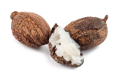
NUTRI DEFENSE
Morning and/or evening, after cleansing and misting with YON-KA LOTION, apply NUTRI DEFENSE to the face and neck.
Its repairing active ingredients + its soft, creamy texture that soothes feelings of tightness = the perfect combo to quickly regain comfort, suppleness, velvetiness and radiance.
Ideal in combination with a booster!
Organic Inca Inchi oil
Rich in EFAs
Nourishing
Repairing
Shea butter, grapeseed and avocado oils
Nourishing
Repairing
Coenzyme Q10,
Vitamins A, C, E
Antioxidant
Lactobacillus (probiotics)
Boosts natural defences
Vegetable glycerine, vitamin B5,
Vitamin PP
Hydrating
EO of petitgrain,
lavender, chamomile
Soothing
Notes:
HOME USE
Morning and/or evening, after cleansing and misting with YON-KA LOTION, apply NUTRI DEFENSE to the face and neck. Massage the cream into the skin.
Professional use: Massage + End of treatment cream
Tips
Its repairing active ingredients + its soft and unctuous texture which alleviates the feelings of tightness and irritation = the ideal care to quickly find comfort, flexibility, velvetiness and brightness.
To complete the action of Nutri Defense, it is possible to associate it with one of the following complementary boosters: Defense + to fight against environmental aggressions, Nutri + to nourish and regenerate, Hydra + to moisturize and Lift + to firm up
Ingredients
Organic Sacha Inchi oil: nourishing, repairing
This organic oil certified ECOCERT. It comes from the seeds of a plant native to the Amazonian forest used by the Indians for its many virtues.
It is the richest oil in essential fatty acids (EFA), composed of more than 80% of EFA (omega 3 and 6) and also contains omega 9.
Shea butter: nourishing, repairing, protects the skin by participating in the reconstitution of its intercellular lipidic cement.
(It is rich in vit. A and E (anti-oxidants) and rich in fatty acids (omega 3, 6, 9)
It comes from the crushed, roasted and ground almond contained in the shea fruit)
- Lactobacilli : (also called probiotics) boost natural defenses
These are beneficial microorganisms previously sterilized to avoid proliferation in the product but which allow to stimulate the skin defense mechanisms
- Grape seed oil
Restructuring, it reduces the insensible loss of water, bringing comfort and elasticity (fatty acids)
- Avocado oil
Regenerating and protective
it helps to restore and preserve the hydrolipidic film of the epidermis, bringing comfort and suppleness (fatty acids and unsaponifiables)
Description
This SOS face cream is the comfort of dry to very dry skin. Its repairing active ingredients combined with probiotics and co-enzyme Q10 and anti-oxidant vitamins, boost the skin's natural defenses to better fight against environmental aggressions.
INFO + :
EFAs are essential fatty acids for the body, they are necessary for the development and proper functioning of the human body. But our body does not know how to make them, so we must provide them.
Role of EFAs = reinforce the hydrolipidic film of the skin, healing, protective.
In the Organic Sacha Inchi oil (ECOCERT label):
Omega 3 (Ω3) or Linolenic Acid: 48% - Anti-inflammatory, it calms redness and reduces irritation = SOOTHING
Omega 6 (Ω6) or Linoleic Acid: 36% - Limits the skin's water loss and provides softening and nutritive qualities by participating in the reconstitution of the lipidic cement and by promoting the good cohesion of the skin cells
+ Omega 9 (Ω9) or Oleic Acid: Very nourishing for the skin, it makes it more supple and soft but
also brighter = NOURISHING, SOFTENING, SOFTENING

Slide 14
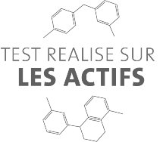
ORGANIC INCA INCHI OIL
FOCUS ON ACTIVE INGREDIENTS
NUTRI DEFENSE
Origin | A plant native to the Amazon rainforest used by the indigenous people for its multiple nutrients. The oil is produced from the seeds of the plant.
Ingredients | Oil richest in essential fatty acids (EFAs) Made up of 80% EFAs (omega 3 and 6) Also contains omega 9 fatty acids
Properties | Rebuilds skin barrier lipids, prevents inflammation, redness, irritation Omega 3 → anti-inflammatory, soothing Omega 6 → softening, nourishing Omega 9 → softening ,nourishing
Note: | Cultivation of Inca Inchi plant and production of oil = object of a sustainable development program in Peru
Notes:
ESSENTIAL FATTY ACIDS (EFAs)
EFAs are fatty acids which are essential to the growth and proper functioning of the human body. But our bodies do not know how to produce them so we must source them from elsewhere.
Role of EFAs = to reinforce the skin's hydrolipidic film, healing, protective.
Ingredients of Inca Inchi oil (ECOCERT label):
Omega 3 (Ω3) or Linolenic Acid: 48% - Anti-inflammatory, relieves redness and reduces irritation = SOOTHING
Omega 6 (Ω3) or Linoleic Acid: 36% - Limits loss of skin moisture and provides SOFTENING and NUTRITIONAL properties by helping to rebuild lipid "mortar" and stimulating the proper cohesion of skin cells
+ Omega 9 (Ω9) or Oleic Acid: Nourishes the skin, making it more supple, soft
and radiant = NOURISHING AND SOFTENING
SUSTAINABLE DEVELOPMENT PROGRAM IN PERU
Sustainable development program in Peru = OMEGA Program set up by Agroindustrias Amazonicas organization
Goals:
to provide equitable incomes for farmers and producers
to improve their working and living conditions
to ensure respect for the environment and quality of life of farmers
Action taken:
Environmental protection: goal is to develop 20,000 ha of Inca Inchi cultivation in partnership with the reforestation of deforested areas of the Amazon rainforest
Economic development: this program will create 80 000 jobs directly and indirectly within Peruvian agriculture, industry and services
Improved living conditions: we have calculated a minimum purchase price of Sacha Inchi seeds in order to guarantee a minimum income for farmers

Slide 15
SHEA BUTTER
FOCUS ON ACTIVE INGREDIENTS
NUTRI DEFENSE
Origin | Shea nut, the fruit of a tree widespread in the savannas of central Africa. The butter is produced by crushing, roasting then shaping the shea nuts
Ingredients | High content of unsaponifiables + antioxidant vitamins A and E + rich in essential fatty acids (omega 3, 6, 9)
Properties | Anti-inflammatory, soothes and relieves irritation (phytosterols) Helps the healing process Hydrates and nourishes
Notes:
Tree = butyrospermum parkii
Further information:
Ingredients of unsaponifiable:
- terpene alcohols: cinnamic acid esters, fatty acids esters, conducive to the healing process.
phytosterols: spinasterol and stigmastanol, strengthen the skin's barrier function
The high content of unsaponifiables (5%) gives it the following properties:
protects skin against bad weather and the sun, speeds up healing process, gets rid of superficial irritation.
Shea butter is also
- rich in vitamins A and E: antioxidants
- rich in fatty acids (omega 3, 6, 9): repairs, nourishes and protects skin by
helping to rebuild lipid "mortar".

Slide 16
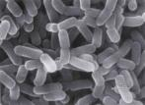
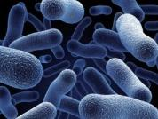
LACTOBACILLUS
FOCUS ON ACTIVE INGREDIENTS
NUTRI DEFENSE
Definition | Beneficial microorganisms
Ingredients | Lactobacillus casei and Lactobacillus acidophilus strains
Properties | Boosts the skin’s defense mechanisms*
*production of antimicrobial peptides of the epidermis
Notes:
Ingredients
Two strains of lactobacillus (lactic bacteria Lactobacillus casei and Lactobacillus acidophilus), which are sterilized* to avoid proliferation in the product, yet still retain their properties.
Action
Boosts the skin’s defense mechanisms (by stimulating the expression of gene coding for peptides** expressed in response to microbial or pro-inflammatory stimuli. (in vitro test)
(**β defensins 2 - antimicrobial peptides)
*inactivated by Tyndallization (unpressurized sterilization in order to avoid proliferation in the cosmetic product) and freeze-dried: they are therefore not alive but a "fingerprint" remains which retains its properties
Find out more:
Defensins play a key role in the skin's defense system (part of immune system mechanisms). They act directly by attaching themselves to the surface of pathogens and altering their cell walls, which causes them to die.
β defensins are secreted through cells in most epithelial barriers, including the skin.
The HBD2 (β defensins 2) is expressed in response to microbial stimuli.

Slide 17
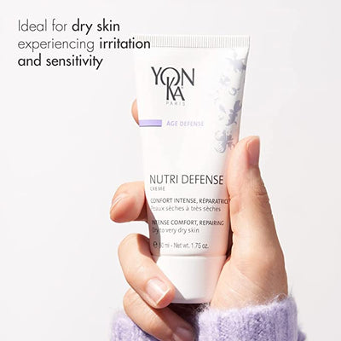
NUTRI DEFENSE : testimonials
Alice Dashiell
This is a must for dry weather exposed skin as mine was. I receive many compliments on how great my skin looks. A must have.!
Kim Christenson
I have super dry skin & this is lovely! Keeps my skin soft all day.
Christy G.
Nutri Defense is my go to day moisturizer in the winter. Winters are a triple threat being dry, windy, and cold. This is the perfect moisturizer and barrier against the elements
Sara Fields
I love this creme, I've been using it for a while now and it has helped my dry skin out so much. If you have dry skin I definitely recommend trying. It has been a life saver for me

Slide 18
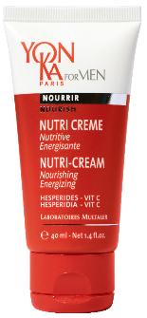
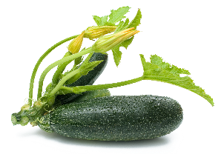
NUTRI CREME
Nourishing and energizing cream
Nourishes
Protects the skin against environmental aggressions
Instant radiance
Normal to dry skin
Target
Energising multivitamin cream
Creamy texture with a velvety finish
50 ml
The +
Morning and/or evening
Notes:
NUTRI CREAM
Description
This energizing multi-vitamin cream nourishes and protects the skin against environmental aggressions, giving your skin an immediate radiance boost. Nutri Crème provides hydration and comfort without any greasy effect. You will appreciate its unctuous texture, its velvety finish, its fresh and fruity fragrance of grapefruit, orange, lemon, lime - 100% natural.
Promise
Nourishing and energizing cream
For whom?
Dry skin
Ingredients
Organic pumpkin seed oil: nourishing
Grapefruit: moisturizing
Citrus E.O.: energizing
Home use
In the morning and evening, cleanse your face and neck with Gel Mousse and then mist with YK Lotion. Then apply Nutri Crème in a thin layer to the face and neck. Alternate if necessary with the Anti-Aging Cream.
Use in the treatment room
Tips
Do you want your skin to be soft and supple when you wake up? Don't forget to apply your cream in the evening to enjoy its benefits while you sleep.
Product advantages
Contains 91% natural ingredients
Protects against environmental aggression
The skin is nourished, moisturized and comfortable
Suitable for normal to dry skin

Slide 19
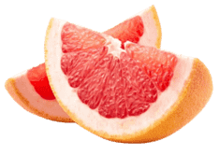
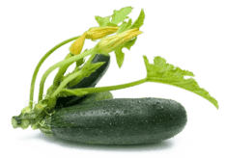
NUTRI CREME
Morning and/or evening, after cleansing with YON-KA Gel Mousse and misting with YON-KA LOTION, apply a thin layer to the face and neck.
Fresh, fruity fragrance of grapefruit, orange, lemon and lime - 100% natural.
Grapefruit
Hydrating
Vitamin A
Regenerating
Vitamin C & E
Anti-oxidant
Organic virgin pumpkin seed oil
Nourishing / Protective
Quintessence YON-KA
Vitalizing / Replenishing / Sanitizing / Soothing / Purifying / Toning / Astringent / Regenerating
Notes:
NUTRI CREAM
Description
This energizing multi-vitamin cream nourishes and protects the skin against environmental aggressions, giving your skin an immediate radiance boost. Nutri Crème provides hydration and comfort without any greasy effect. You will appreciate its unctuous texture, its velvety finish, its fresh and fruity fragrance of grapefruit, orange, lemon, lime - 100% natural.
Promise
Nourishing and energizing cream
For whom?
Dry skin
Ingredients
Organic pumpkin seed oil: nourishing
Grapefruit: moisturizing
Citrus E.O.: energizing
Home use
In the morning and evening, cleanse your face and neck with Gel Mousse and then mist with YK Lotion. Then apply Nutri Crème in a thin layer to the face and neck. Alternate if necessary with the Anti-Aging Cream.
Use in the treatment room
Tips
Do you want your skin to be soft and supple when you wake up? Don't forget to apply your cream in the evening to enjoy its benefits while you sleep.
Product advantages
Contains 91% natural ingredients
Protects against environmental aggression
The skin is nourished, moisturized and comfortable
Suitable for normal to dry skin for all age

Slide 20
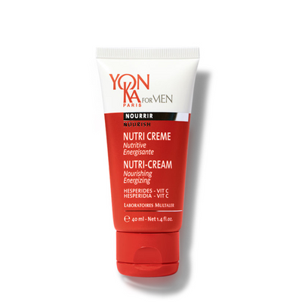
NUTRI CRÈME : testimonials
MB
A friend at the gym offered me the opportunity to try Yon-Ka Nutri-Creme and I was amazed! It didn't feel greasy and my skin felt smoother almost instantly. Now, one month later, after using it daily I can really see the difference in my skin.
Heather Herrera
The Nutri Creme is great for moisturizing my drier, sensitive skin without leaving it feeling heavy or greasy
Mark Levy
Been using this moisturizer for three years now. Everyday day and during all seasons. It's the perfect texture... not too thick but moisturizing without being greasy. A little goes a long way. Love the smell!

Slide 21
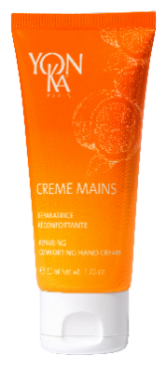
CRÈME MAINS
Repairing and ultra-comforting hand cream
3 in 1: Nourishes, hydrates and repairs intensely
Preserves the youthful appearance of hands and nails
All skin types
Very dry and damaged hands
Target
Skin repaired: 79%
Nourished skin: 89%
50 ml
Matin et/ou Soir
use test under dermatological control - self-evaluation on 19 women aged 18 to 42 - 1 application for 28 days
Notes:
CREME MAINS
DESCRIPTIVE
This 3-in-1 Hand Cream, with essences of mandarin and sweet orange, nourishes, moisturizes and intensely repairs very dry and damaged hands. Multivitamin, rich in shea butter and vegetable glycerin, it preserves the youthfulness of hands and nails and envelops them in a pleasant 100% natural citrus scent with toning and revitalizing notes.
PROMISE
Repairing and ultra-comforting hand cream
FOR WHOM?
All skin types
"I like the lemon scent.
"I wash my hands very often and they are completely malnourished.
EFFICACY (use test under dermatological control - self-evaluation on 19 women aged 18 to 42 - 1 application for 28 days)
Skin repaired: 79
Nourished skin: 89
HOME USE
At any time of the day, apply the cream on clean and dry hands.
USE IN THE TREATMENT ROOM
*Hand massage
*Mask for hands and feet in case of manicure or pedicure
PRODUCT ADVANTAGES - Contains 97% natural ingredients - Nourishes and repairs with shea butter and grape seed oil - Leaves skin moisturized, soft and satin-like - Preserves the youthfulness of hands
TIPS
- For very damaged hands, renew the application, in the evening, in thick layer. Wear cotton gloves all night to help repair the epidermis and get soft hands in the morning. - Can also be applied on the feet, to soften and smooth the dry and rough zones and to nourish the skin.

Slide 22
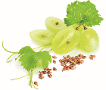
CRÈME MAINS
HOME USE
At any time of the day, apply the cream on clean and dry hands. Can also be applied on the feet
Multi-vitamin, it envelops hands in a pleasant 100% natural citrus scent with invigorating and revitalising notes.
Mandarin essential oil
Anti-stress
Sweet orange essential oil
Balancing
Shea butter
Nourishing / Protective
/ Repair
Grape seed oil
Restructuring / Nourishing
/ Repairing
Vitamins A, C , E & B5
Anti-oxidant / Hydrating
Soothing / Regenerating
Notes:
HOME USE
At any time of the day, apply the cream on clean and dry hands.
INGREDIENTS
Shea butter = repairer
Grape seed oil = nourishing
Bisabolol = comforting, soothing
Vitamins A, C, E = Anti-oxidant

Slide 23
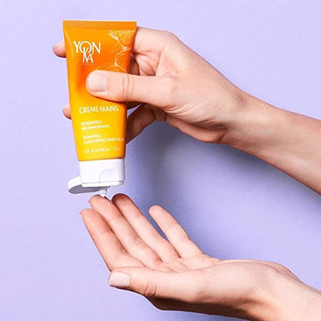
CRÈME MAINS : testimonials
Kathy B
This hand cream is easily absorbed and keeps your hands smooth and moisturized for hours. And, it smells delicious, a citrusy orange scent that is divine. This is the best hand cream I have found and I have tried many
Susan C C Walling
I absolutely love this hand cream ! I live in the desert, and it's the very best for hydrating my hands and cuticles in our dry, hot weather ! It smooths my skin, but doesn't leave any sticky residue !
ANN SAMELA
I love this hand cream as it is not greasy and is very healing and light. I love the smell of it.
Rebecca
My hands are dry and I love this cream! It is not greasy at all and sinks into my hands. Must have!

Slide 24
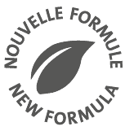
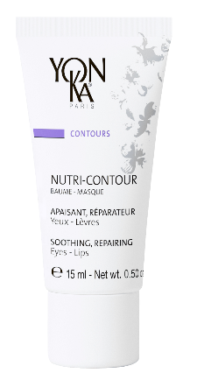
NUTRI CONTOUR
Intense nourishing and repairing eye and lip care
NUTRI CONTOUR
2 in 1: eyes & lips
Nourishes, hydrates and smoothes the eye and lip contours
Prevents fine and deep lines
All skin types
All ages
Target
Reduces irritation around the eyes 82%
Protects the eye contour area from drying out 90%
Eye make-up is more even and lasts longer for 7/10 women
50 ml
Morning and/or evening
*Effective after 7 days** Test carried out under dermatological and ophthalmological control.
Apply NUTRI-CONTOUR to the eye and lip contour area every day, morning and evening, for 28 days on perfectly cleansed skin.
Test carried out on 22 adult female volunteers, aged between 30 and 60, with dehydrated, weakened and irritated skin.
Notes:
NUTRI-CONTOUR 2024
Description
A true cocoon of softness with organic chamomile, this 2-in-1 multi-vitamin cream - eye and lip contour - intensely nourishes the skin and protects it from drying out as well as from the first signs of ageing. Perfectly moisturized and protected from free radicals, which are ageing factors, Nutri-Contour provides the skin with the active repairing ingredients necessary for its balance. It is also an excellent SOS balm for chapped lips.
Promise
Intense nutrition and repair eye and lip care
For whom?
All skin types
All ages
"I have a tightness around my eyes
"I have chapped lips"
"I'm afraid I'll get wrinkles like my mother«
Ingredients
niacinamide: soothing and repairing properties
Chamomile: soothing
Vitamin F: anti-dehydrating
Home use
In the morning and/or evening, after cleansing and de-moistening with the appropriate Yon-Ka Lotion, apply a thin layer of Nutri-Contour cream to the lip and eye area - one pea-sized amount per area. Gently massage it into the skin. Pay particular attention to crow's feet. Use in the treatment room
Tips
Are your lips dry and chapped? Apply a thick layer of Nutri-Contour in the evening. A simple gesture to make your lips soft, naturally!
Product advantages
2 in 1: eyes & lips
Triple use: daily, SOS chapped lip balm, sleeping mask
Contains hazelnut oil and chamomile
Nourishes, moisturizes and smoothes the eye and lip area
Prevents wrinkles and fine lines
Creamy texture that penetrates quickly

Slide 25
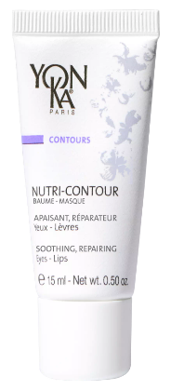
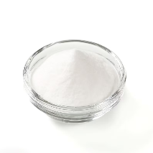
Nutri-Contour
Reformulation
A new clean and more natural formula
98% of ingredients of natural origin including 21% of organic origin
Main ingredients :
+
Organic chamomile
[Niacinamide]
15 ml recyclable tube FSC case without leaflet
Notes:
So let’s now take a look at this new NUTRI-CONTOUR formula
The Current % of ingredients of natural origin: 65%, with no organic ingredient. We will now have 98% ION, including 21% of organic origin (chamomile, glycerin and olive oil) )= clean & more natural formula.
Main ingredients : Organic chamomile + Niacinamide
Switched to organic chamomile
Niacinamide already present but not valorized (= vit B3/PP). We wanted to highlight the Niacinamide because as you may know is a fashionable ingredient with soothing and repairing properties

Slide 26
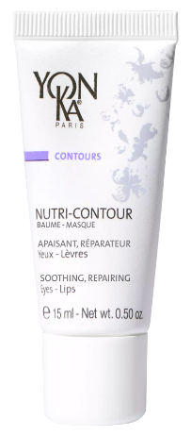
Nutri-Contour
Reformulation
A new clean and more natural formula
Enriched with
* organic olive squalene (restores, hydrates)
* a trio of protective and moisturizing plant waxes (rice-jojoba-candelilla)
* a patented synergy of phospholipids and polysaccharides for an ultra-soft finish and easy make-up application
15 ml recyclable tube FSC case without leaflet
Notes:
The formula is even more comfortable and restorative. Indeed, it has been enriched with:
olive squalene (cosmos certified) that helps restore the skin barrier and plays a fundamental role in skin suppleness and hydration
a trio of vegetable waxes from rice, jojoba and Candelilla (shrub) to protect fragile areas from dehydration
a patented synergy of phospholipids and polysaccharides for an ultra-smooth finish and to make makeup application easier.
In the formula you still find the hazelnut oil and the vitamins E and F.
___
phospholipids = natural lecithin
polysaccharides = pullulan

Slide 27
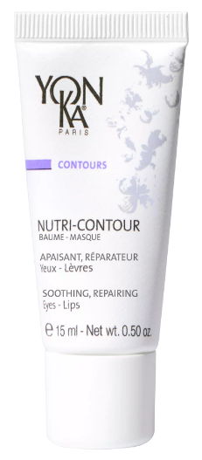
Nutri-Contour
Reformulation
Proven: a new more effective* and more pleasant** formula
Visible effectiveness in as little as 7 days**
82%
Reduction of irritation around the eyes
Protected eye area from drying out
Eye makeup is more even
and with better hold
90%
7 out
of 10 women
*Effectiveness as from 7 days
** Test conducted under dermatological and ophthalmological control. Application of NUTRI-CONTOUR around the eyes and lips every day, morning and evening for 28 days on perfectly cleansed skin. Test carried out by 22 adult female volunteers, aged between 30 and 60, with dehydrated, weakened and irritated skin.
Notes:
For this new formula we have conducted new test under dermatological and ophthalmological control
The formula is more effective* and more pleasant**
RESULTS ON THE EYE AREA
Visible effectiveness in as little as
7 days after **
A Reduction of irritation around the eyes 82%
The nutri-contour had Protected eye area from drying out 90%
Eye makeup is more even 7 out of 10 women said
and with better hold
*Effectiveness as from 7 days
** Test conducted under dermatological and ophthalmological control. Application of NUTRI-CONTOUR around the eyes and lips every day, morning and evening for 28 days on perfectly cleansed skin. Test carried out by 22 adult female volunteers, aged between 30 and 60, with dehydrated, weakened and irritated skin.

Slide 28
Nutri-Contour
Reformulation
Nourished and protected lip contour
from dryness
Lips are more supple and comfortable
after just 7 days
Chapped lips are repaired and instantly
relieved after just 7 days
9 out of 10
women
95%
77%
Texture is pleasant to use
100%
Notes:
RESULTS ON LIPS AND LIP CONTOURS
Nourished and protected lip contour 9 out of 10 women
from dryness
Lips are more supple and comfortable 95% felt their
after just 7 days
Chapped lips are repaired and instantly 77% saw their
relieved after just 7 days
Texture is pleasant to use 100% they all agreed on how pleasant the new texture is
*Effectiveness as from 7 days
** Test conducted under dermatological and ophthalmological control. Application of NUTRI-CONTOUR around the eyes and lips every day, morning and evening for 28 days on perfectly cleansed skin. Test carried out by 22 adult female volunteers, aged between 30 and 60, with dehydrated, weakened and irritated skin.

Slide 29
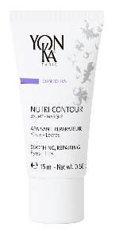
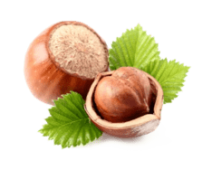
NUTRI CONTOUR
In the morning and/or evening, after cleansing and de-moistening with the appropriate Yon-Ka Lotion, apply a thin layer of Nutri-Contour cream to the lip and eye area - one pea-sized amount per area. Gently massage it into the skin. Pay particular attention to crow's feet.
Triple use: daily, SOS chapped lip balm, sleeping mask
Organic chamomile
Soothing
Softening
Niacinamide
Soothing
Repairing
Organic olive squalene
Restores the skin barrier
Hydrates
Softens
Trio of vegetable waxes
(rice-jojoba-candelilla)
Anti-dehydrating
Phospholipids and Polysaccharides Smooth finish
Makes make-up easier to apply
Vitamin E & F
Anti-oxidant
Anti-dehydrating
Hazelnut oil
Repairing
Nourishing
Notes:
NUTRI-CONTOUR
Description
A true cocoon of softness with hazelnut oil, this 2-in-1 multi-vitamin cream - eye and lip contour - intensely nourishes the skin and protects it from drying out as well as from the first signs of ageing. Perfectly moisturized and protected from free radicals, which are ageing factors, Nutri-Contour provides the skin with the active repairing ingredients necessary for its balance. It is also an excellent SOS balm for chapped lips.
Promise
Intense nutrition and repair eye and lip care
For whom?
All skin types
All ages
"I have a tightness around my eyes
"I have chapped lips"
"I'm afraid I'll get wrinkles like my mother«
Ingredients
Main ingredients : Organic chamomile + Niacinamide
Niacinamide already present but not valorized (= vit B3/PP): soothing and repairing properties
olive squalene (cosmos certified) that helps restore the skin barrier and plays a fundamental role in skin suppleness and hydration
a trio of vegetable waxes from rice, jojoba and Candelilla (shrub) to protect fragile areas from dehydration
a patented synergy of phospholipids and polysaccharides for an ultra-smooth finish and to make makeup application easier.
In the formula you still find the hazelnut oil and the vitamins E and F.
Home use
In the morning and/or evening, after cleansing and de-moistening with the appropriate Yon-Ka Lotion, apply a thin layer of Nutri-Contour cream to the lip and eye area - one pea-sized amount per area. Gently massage it into the skin. Pay particular attention to crow's feet. Use in the treatment room
Tips
Are your lips dry and chapped? Apply a thick layer of Nutri-Contour in the evening. A simple gesture to make your lips soft, naturally!
Product advantages
2 in 1: eyes & lips
Triple use: daily, SOS chapped lip balm, sleeping mask
Contains hazelnut oil and chamomile
Nourishes, moisturizes and smoothes the eye and lip area
Prevents wrinkles and fine lines
Creamy texture that penetrates quickly

Slide 30
Yon-Ka’s formulation charter
A continuous improvement process for a progressive update
Gradual increase of the percentage of ingredients of natural origin*
Gradual increase of the number and percentage of certified organic ingredients
Gradual increase of sustainable and local sourcing
Gradual phasing out of the red listed-ingredients
* ISO16128 standard
Notes:
Before Just a quick reminder on Yon-Ka’s formulation charter
It is a continuous improvement process for a progressive update
We gradually increase the percentage of ingredients of natural origin
For the moment we have an average of 92% of ingredients of natural origin
We aim for a minimum percentage of 95% for all the new products and with a will to go even beyond (as you saw for the vit C launch and the Vital Defense mist).
We will also increase the number and percentage of certified organic ingredients
(We have established the list of our organic ingredients, in which product you can find them - We now have 25 organic certified ingredients in our products !)
We want to increase the sustainable and local sourcing
We supply our active ingredients while respecting biodiversity and people in order to limit our environmental impact
For example we use and will use more and more biotechnology (as we saw with SERUM C20)
We also use local sourcing when it is possible (with SERUM C20, vit C and native cells are made in France)
And of course phase out the red-listed ingredients such as the
(parabens, BHA, phtalates, triclosan, MIT, GMO ingredients, SLS, recognized endocrine disruptors, …)
Gradually, what you will NO LONGER find in the Yon-Ka products (new products, products being reformulated) acrylates, EDTA, phenoxyethanol, silicones, PEG, PPG, mineral oils, chlorphenesin, …

Slide 31
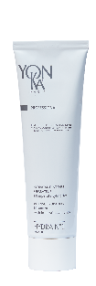
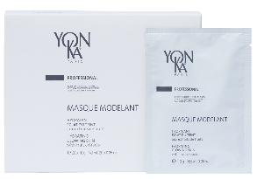
NUTRILESSENCE
Ideal after weather extremes, i.e sun, cold, wind etc
For all dry, very dry skin and over-treated skin
Customised professional mask
Intensely nourishes thanks to organic Inca Inci oil
Soothes feelings of tightness and irritation
Repairs the skin and boosts skin’s natural defences
Protects the skin

Slide 32
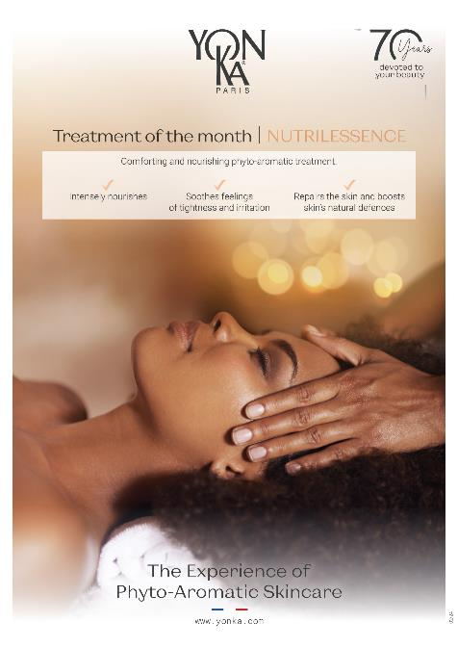

Slide 33
NUTRITION TIPS
EXTRA TIPS
In addition to cosmetics, you can combat dry skin with food
ZINC | Reduces redness by reducing irritation and inflammation. Fights oxidative stress by promoting cell regeneration through its antioxidant properties. seafood (mainly oysters), red meat, cheese, chocolate powder and wholemeal bread
VITAMIN B5 | Helps to maintain hydration and improve the skin's ability to retain water. Vitamin B5 regulates the production of lipids in the skin, helping to prevent dehydration and keep skin supple and hydrated. green vegetables, nuts, whole grains and meat
OMEGA 3&6 | Skin cells are mainly made up of lipids. It is therefore important to enrich your diet with essential unsaturated fatty acids reinforce the lipid barrier from the inside. oily fish (sardines, mackerel, trout, salmon), walnut and rapeseed oils
Notes:
The skin needs essential nutrients to protect and regenerate its structure. Certain vitamins and minerals contribute to normal skin function
Dry skin responds gratefully to a conscious diet: foods containing beta-carotene, zinc and vitamins , the skin vitamins, as well as Omega-3 and Omega-6 fatty acids strengthen the lipid barrier from within.
Vitamin B1: combats skin aging.
Vitamin B2: promotes energy.
Vitamin B3: anti-aging and hydrates.
Vitamin B5: hydrates.
Zinc is particularly important for the skin, and because it is so abundant in the epidermis, zinc deficiency can lead to rough skin and damaged barrier function. Skin becomes increasingly dry
Like other cells in the body, skin cells are mainly made up of lipids. It is therefore important to enrich your diet with essential unsaturated fatty acids by eating oily fish (sardines, mackerel, trout, salmon) and using seasoning oils rich in omega 3, such as walnut and rapeseed oils.
VITAMIN B5
Vitamin B5 is also beneficial for dry skin, helping to maintain hydration and improving the skin's ability to retain water. Vitamin B5 regulates the production of fats in the skin, helping to prevent dehydration and keep skin supple and hydrated.
Vitamin B5 is found in abundance in everyday foods such as green vegetables, nuts, whole grains and meat. By using skincare products containing vitamin B5 and following a diet rich in vitamin B5, you'll be doing the right thing to combat dry skin.

Slide 34
NUTRITION TIPS
EXTRA TIPS
INTERNAL HYDRATION
MANAGE STRESS
AVOID HOT SHOWERS
BALANCED DIET
AVOID SMOKING AND ALCOHOL
ADEQUATE SLEEP
Notes:
Internal hydration: Drinking enough water is essential for keeping skin well hydrated. The general recommendation is to drink at least 8 glasses of water a day.
Balanced diet: A diet rich in essential nutrients, such as vitamins, minerals and omega-3 fatty acids, contributes to healthy skin. Foods such as fruit, vegetables, nuts, seeds and oily fish can help maintain radiant skin.
Avoid showers that are too hot: Hot water can strip skin of its natural oils, leaving it dry. Opt for lukewarm showers and limit their duration.
Use humidifiers: Humidifiers add moisture to the air, which can help prevent skin dryness, especially in winter when the air is dry.
Protect skin from the sun: UV rays can damage the skin and dry it out. Always use sunscreen with an appropriate SPF, even on cloudy days.
Wear appropriate clothing: Soft, natural fabrics such as cotton are less likely to irritate the skin than synthetic fabrics. Choose loose-fitting, breathable clothing.
Avoid smoking and limit alcohol consumption: Smoking and excessive alcohol consumption can have a negative effect on skin health. Avoid them wherever possible.
Manage stress: Stress can have harmful effects on the skin. Regular practice of stress management techniques, such as meditation and yoga, can help maintain healthy skin.
Adequate sleep: Getting enough sleep allows the skin to regenerate. Try to maintain a good sleep routine to promote overall skin health.
Avoid harsh cleansers: Use gentle facial cleansers that don't strip away the skin's natural oils. Excessive cleansing can lead to dryness.

Slide 35
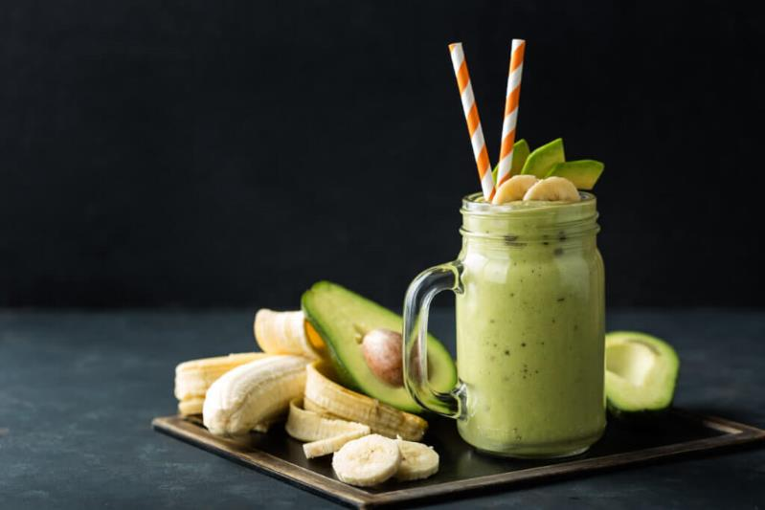
NUTRITION TIPS
BANANA & AVOCADO SMOOTHIE WITH ALMOND MILK
3 bananas
2 avocados
500 ml of almond milk
1 - Blend the peeled and chopped bananas with the avocado flesh
2 - Add the almond milk
3 - Blend until you get a smooth juice
Enjoy!
Notes:
Texture depends on the quantity of milk

Slide 36
LET'S PLAY!
GET YOUR PHONE READY AND SCAN THE QR CODE THAT WILL BE DISPLAYED
INDICATE YOUR NAME AND COUNTRY
PERSONALISE YOUR AVATAR IF YOU LIKE
READ THE QUESTION ON THE COMPUTER AND ANSWER IT ON YOUR PHONE

Slide 37
Thanhs !

