Slide 1
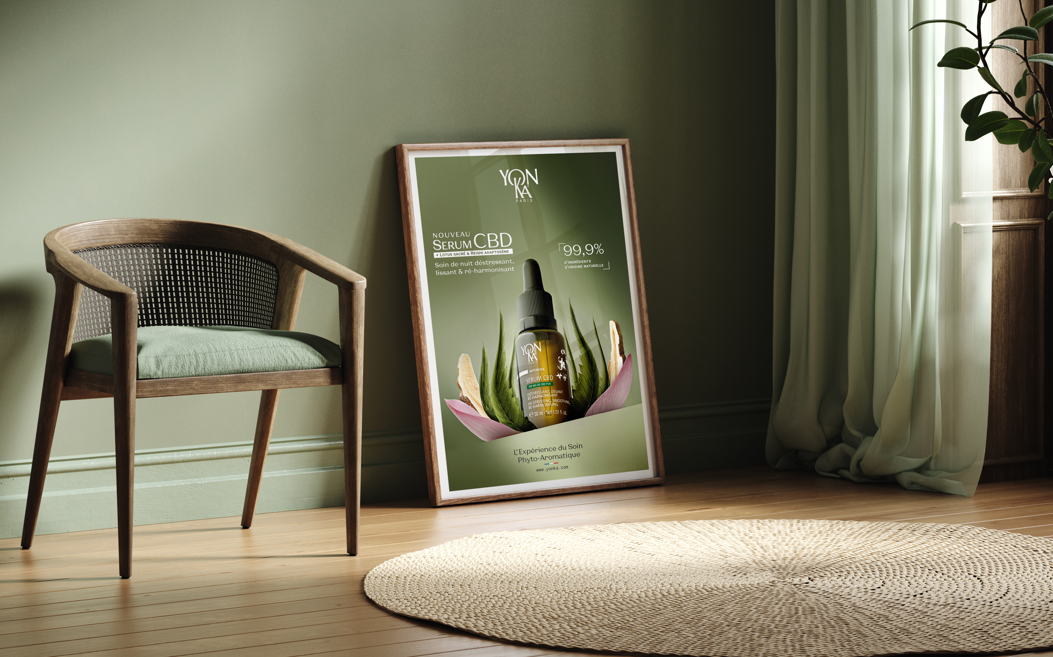
Welcome to the digital training SERUM CBD SLEEP THERAPY TREATMENT (PHYTO & CBD)

Slide 2
Stress & lack of sleep
A global phenomenon with a lasting impact
95%
Of the population is stressed or anxious*.
4 billion
people wake up
tired every day
100 billion $
spent worldwide annually
to solve this issue**
*https://www.ifop.com/wp-content/uploads/2022/05/communique-presse-mesbienfaits.pdf.
**https://worldsleepday.org/usetoolkit/talking-points
Notes:
A few figures :
95% of the population is stressed or anxious
Environmental stress (climate, pollution, etc.),
Lifestyles (psychological stress, overwork, the "always on the move" culture)
Stress due to unstable world situation (wars, pandemics, economy, etc.)
All these stressful situations degrade sleep quality: sleep disorders, difficulty falling asleep, night-time awakenings.
4 billion people wake up tired every day
This is a major concern for many people.
100 billion $ are spent worldwide annually to solve this issue**
https://www.who.int/fr/news/item/02-03-2022-covid-19-pandemic-triggers-25-increase-in-prevalence-of-anxiety-and-depression-worldwide

Slide 3
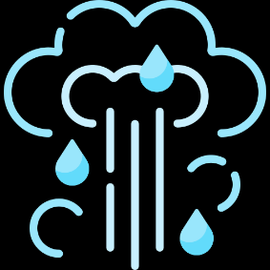
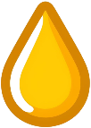
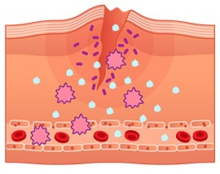
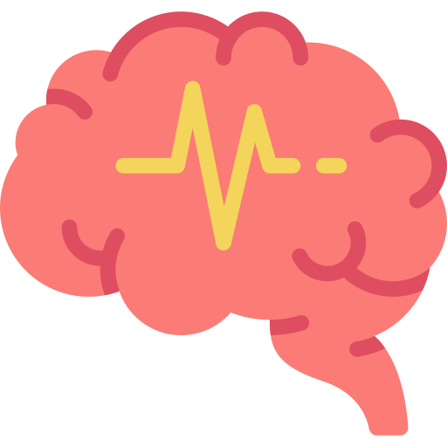
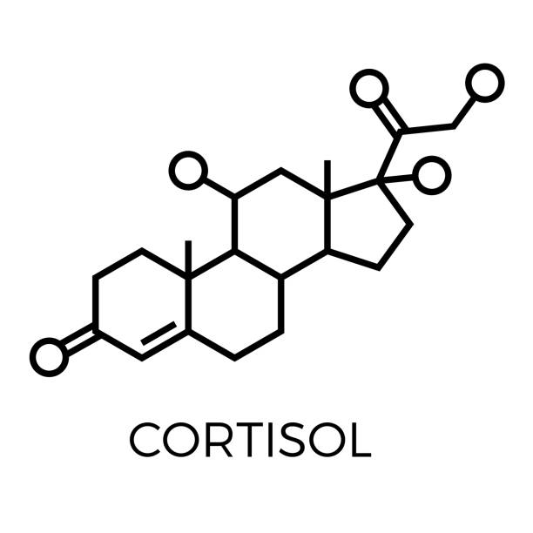
Stress & lack of sleep
5 visible skin consequences
Inflammation
Sebum excess
Transepidermal water loss
Impaired healing/cell renewal processes
Reduced immune defenses
Accelerated skin aging, acne (adults), loss of radiance, dehydration and irritation (redness)
Notes:
Stress and lack of sleep are a source of cellular oxidative stress and inflammatory phenomena. Over time, this greatly upsets the skin's balance and prevents it from regenerating effectively during the night.
5 consequences of cutaneous stress on the skin : Accelerated skin aging (it is estimated that extreme stress causes skin to age 2 times faster)
Acne (adult) - due to excess sebum
Loss of radiance
Dehydration
and irritation (altered skin barrier, redness).

Slide 4
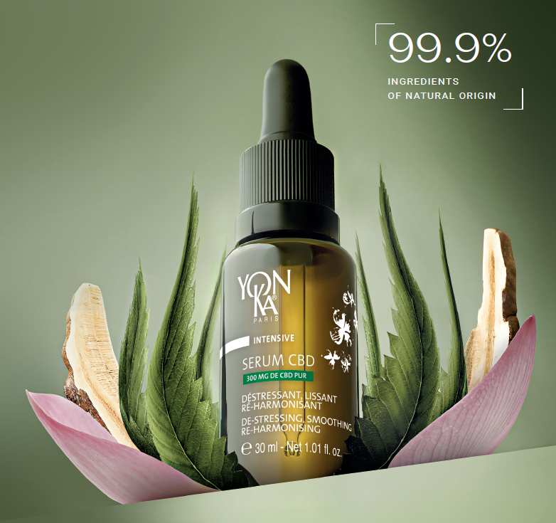
Yon-Ka’s
answer
NEW
SERUM CBD
De-stressing, smoothing &
re-harmonising night serum
300 mg PURE* CBD
*in a 30ml bottle
Notes:
The Yon-Ka answer?
CBD SERUM
A de-stressing, smoothing and re-harmonising night oleo-serum.
Contains 300 mg of pure CBD (in a 30ml bottle).
This is THE new Yon-Ka innovation to combat skin damage caused by stress and lack of sleep.
With this serum, every morning is a bloom of beauty. Skin is visibly de-stressed, looking more beautiful and radiating new youthfulness.

Slide 5
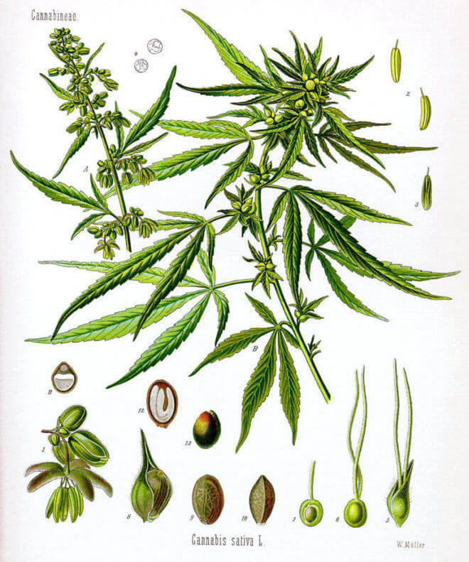
CannaBiDiol
What is CBD?
HEMP
SEEDS
Allow extraction of hemp oil
LEAVES
Allow CBD extraction
Cosmetic legislation regulates the CBD used: No psychotropic effect
0 < THC < 0.2%
Notes:
CBD is extracted from hemp and should not be confused with cannabis.
Botanically, it's the same species, Cannabis sativa L, but they are different varieties (cultivars*) with variations in morphology (size of stems, leaves, flowers) and composition.
Hemp is rich in CBD, but THC (TetraHydroCannabinol), the psychotropic molecule, is present in minute quantities (less than 0.2%).
*A cultivar is a plant variety bred, generally by selection, for its unique characteristics.

Slide 6
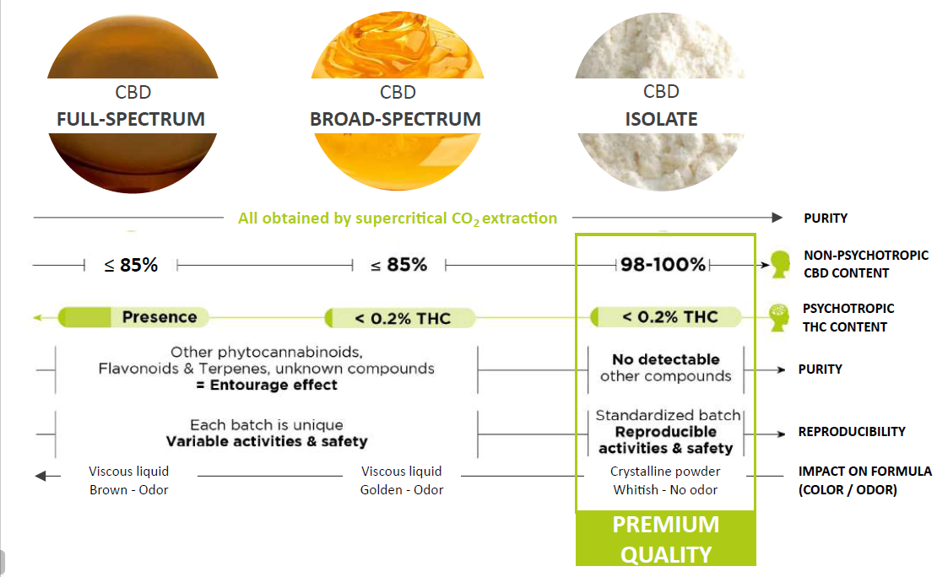
What are the different types of CBD?
Focus on CBD
Safety
Purity
Stability
Yon-Ka’s choice

Slide 7
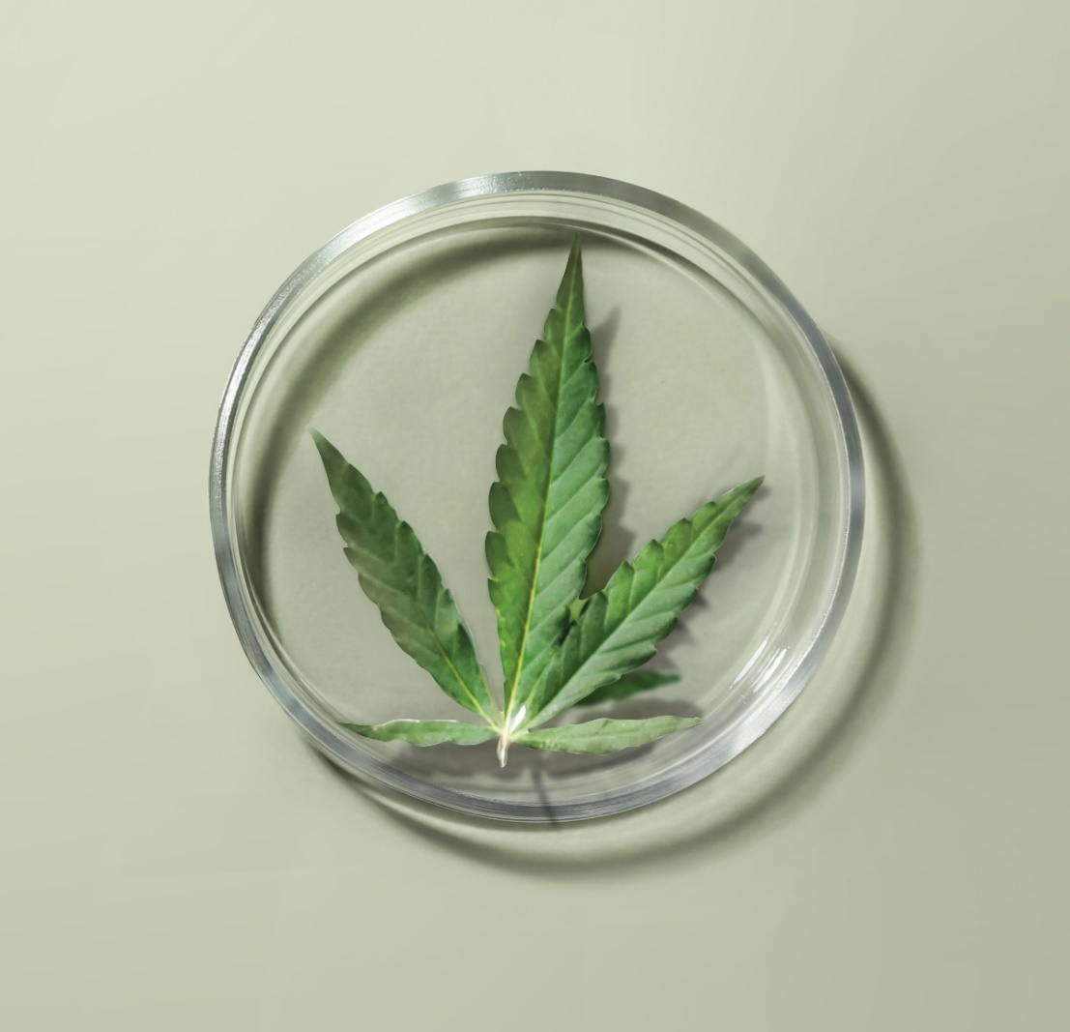
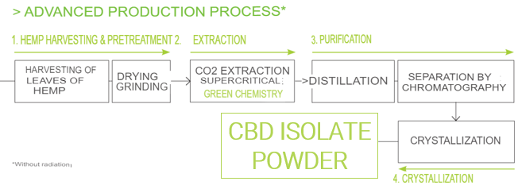
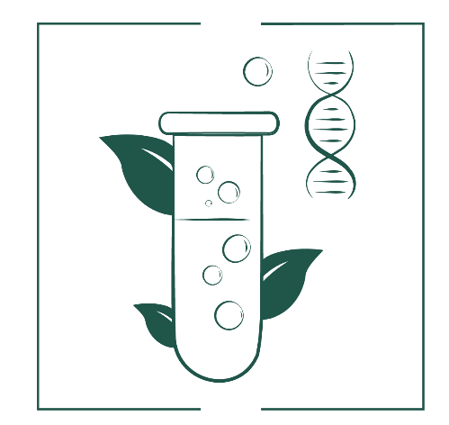
Focus on CBD
What: Non-psychotropic therapeutic molecule
from hemp leaf CBD ISOLATE: CBD powder (THC < 0.2%)
Where: Sustainably grown in Colombia
(traced supply chain, CSR* actions)
How : Process from Green Sciences
Green Sciences
*Educational support for children, pychological support for disabled patients, preservation of ecosystems and biodiversity
Notes:
Extraction with supercritical CO ₂
It's a Greenscience extraction method. Although it is expensive and complex to implement, it is very interesting because it combines a number of advantages:
An ecological method that does not use chemical solvents that are aggressive and/or harmful to people and the environment. The solvent is CO2 (captured before it is released into the environment) in its supercritical form (a state between gas and liquid obtained by adjusting the pressure and temperature of the CO2). It is then trapped for further use.
A high-purity method that enables advanced extraction of the components, obtaining pure molecules with no residue as the C02 evaporates completely.
A gentle method (relatively low temperatures) that guarantees the quality of the extracted molecules.
A selective method which, by adjusting pressure and temperature parameters, selects and isolates the molecule or molecules to be extracted.

Slide 8
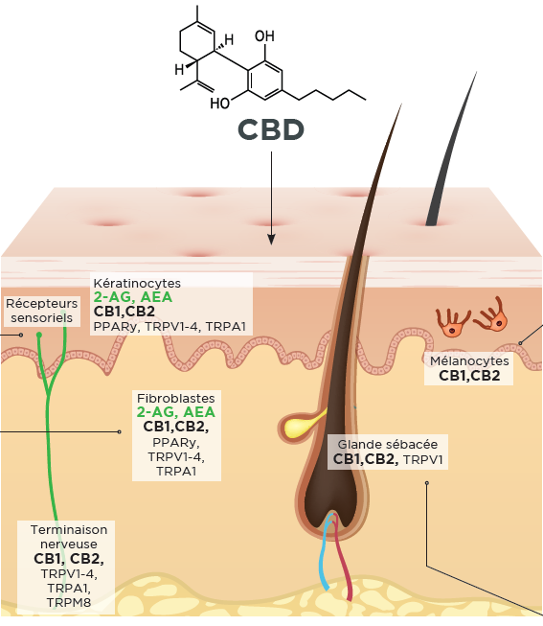
Multi-cellular action*
Focus on CBD
ANTI-INFLAMMATORY EFFECT
ANTIOXIDANT EFFECT
KERATINOCYTES
ANTI-AGEING EFFECT
FIBROBLASTS
SEBOCYTES
SEBOREGULATING EFFECT
MAST CELLS
ANTI-STRESS EFFECT
The skin's endocannabinoid system
* Scientific publications
Notes:
The efficacy of CBD on the skin has already been the subject of hundreds of scientific studies, demonstrating its remarkable effectiveness on numerous parameters.CBD interacts with a large number of cellular receptors, particularly those of the endocannabinoid system (CB1, CB2), which are expressed by all skin cells.
This gives CBD a wide range of actions and quite extraordinary power!
- Anti-inflammatory action: by inhibiting the synthesis of certain inflammation molecules (IL-6 and 8), CBD combats redness and irritation, and soothes sensitive skin. CBD also shows great promise in the treatment of certain pathologies such as eczema and psoriasis.
- Anti-aging action It boosts fibroblast expression of key proteins involved in dermal matrix quality (dermal-epidermal junction) and fibroblast-matrix interactions: collagen VII, integrin β-1 and integrin α-2. It also helps reduce the synthesis of certain MMPs).
- Anti-oxidant action Protects cells from free-radical attacks and boosts the cell defense system via NRF2.
- Seboregulating action It controls the multiplication of sebocytes and inhibits their lipid synthesis.
- Anti-stress action CBD also has numerous mind-soothing properties.
Preliminary studies demonstrate CBD's beneficial action on anxiety and stress. It is often used as a supplement to help alleviate the symptoms associated with these issues, particularly in the case of depressive episodes. Recent research has provided evidence of the essential role of the endocannabinoid system in skin homeostasis and function. As a non-psychotropic phytocannabinoid, similar to endogenous endocannabinoids, CBD is a biomimetic active ingredient. Applied to the skin, it could modulate the cutaneous endocannabinoid system.

Slide 9
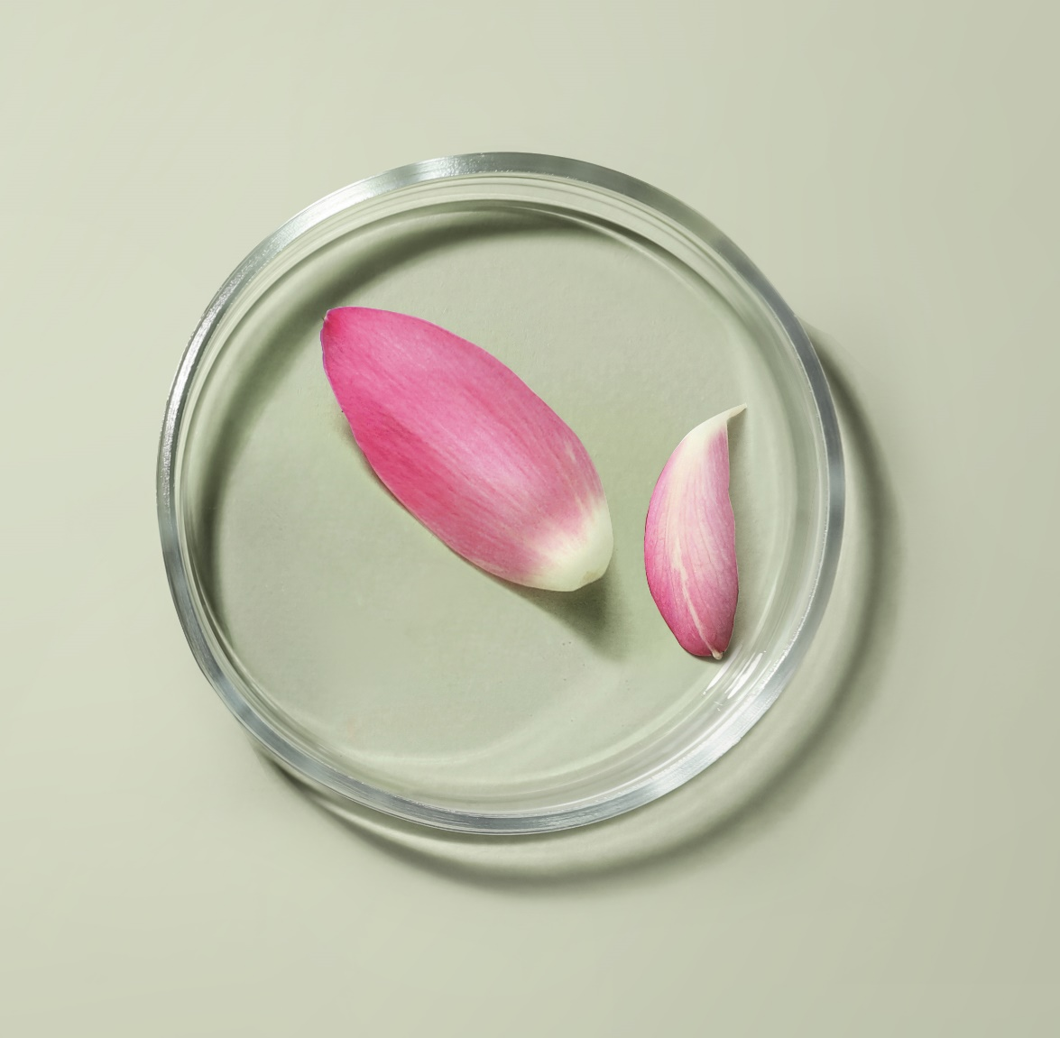
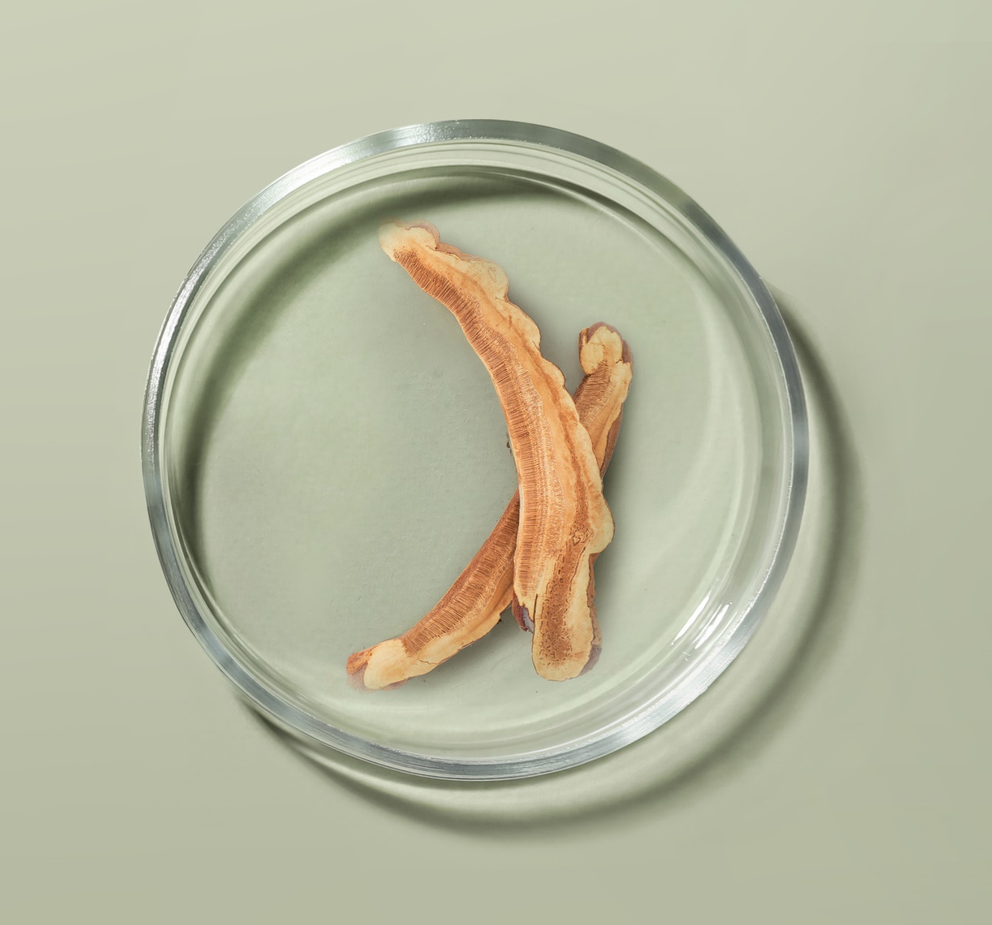
A high-performance formula
Synergy of powerful active ingredients
750,000 Native cells
of Sacred Lotus
Adaptogenic Reishi extract
De-stress, calm the skin and help reduce feelings of irritation.
It helps the skin adapt to stress and fatigue. Anti-oxidant, Moisturizing.
Notes:
Native Sacred Lotus plant cells (obtained in France through biotechnology)
A fragile, sacred plant, the Lotus is the symbol of divine beauty and purity. Widely used in Ayurvedic medicine for its rebalancing properties, it helps combat sleep disorders and regain inner strength. Native Lotus plant cells have been shown to have an anti-stress effect on the skin, acting on the synthesis of several neurotransmitters:
Boosts expression of melatonin, a powerful antioxidant molecule known for its positive effect on relaxation and sleep, by +55%.
Reduces the synthesis of Substance P and Interleukins (-20 to -24%), which are mediators of inflammation.
Through these actions, Sacred Lotus native plant cells de-stress, calm the skin and help reduce feelings of irritation.
Adaptogenic Reishi extract:
Reishi, or "long-life mushroom", has been used in traditional Chinese medicine for its therapeutic virtues for over 2,000 years. Renowned for its adaptogenic power, it contains 150 antioxidants and nutrients (polyphenols, triterpenes...). A composition close to perfection, which explains why this mushroom is also widely used in nutrition.
Its many qualities help to maintain good health, while eliminating energy blockages responsible for insomnia. It helps the skin adapt to stress and fatigue. Antioxidant / Moisturizing

Slide 10
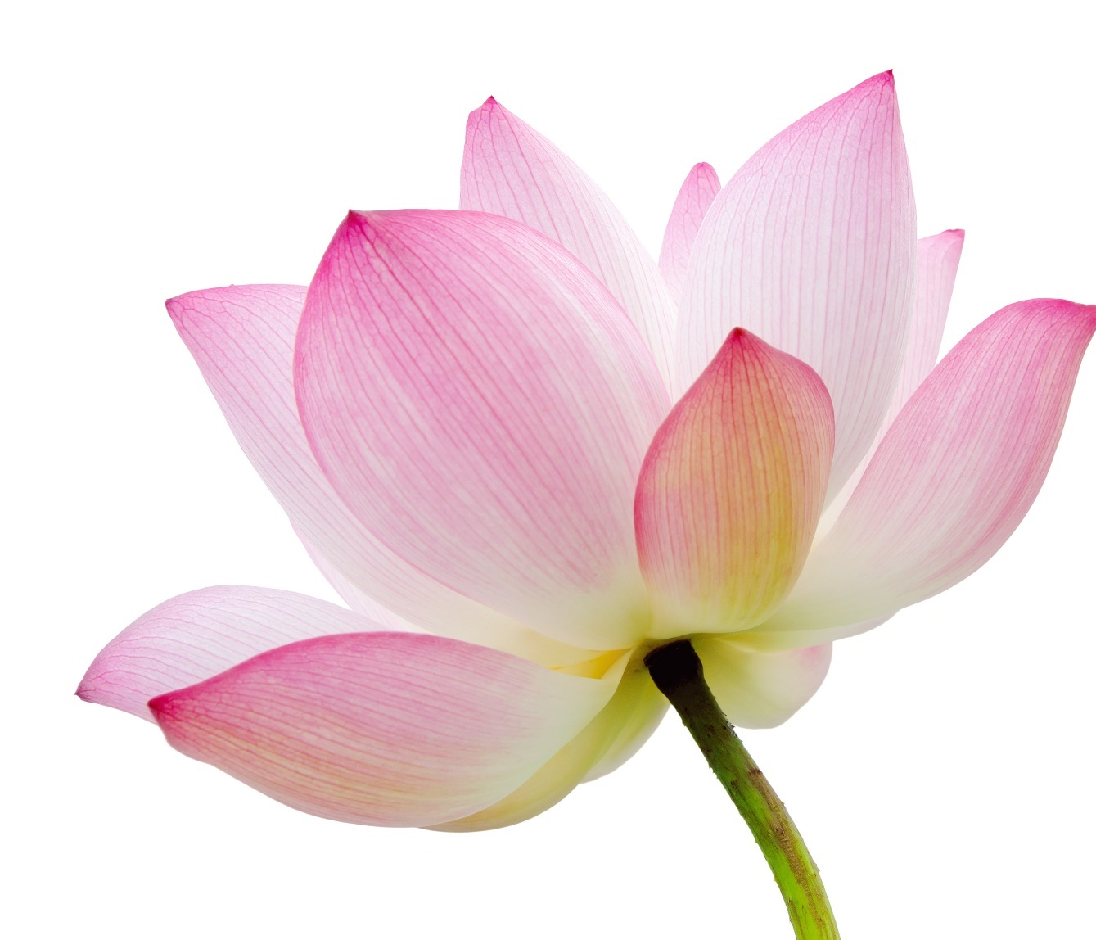
A high-performance formula
Enriched with 750,000 native cells of Sacred Lotus*
Combats skin stress and promotes a feeling of well-being
Action on two levels:
Action on melatonin (the molecule responsible for relaxation and sleep) Powerful antioxidant
+55%⁽¹⁾
Anti-inflammatory effect
Action on inflammation mediators IL-1 alpha IL-6 PGE2
-24%⁽¹⁾ -20 %⁽¹⁾ -21 %⁽¹⁾
Complementary actions with CBD
Soothing, relaxing
* In a 30ml vial (1) in vitro
Notes:
Native Sacred Lotus plant cells (obtained in France through biotechnology)
A fragile, sacred plant, the Lotus is the symbol of divine beauty and purity. Widely used in Ayurvedic medicine for its rebalancing properties, it helps combat sleep disorders and regain inner strength. Native Lotus plant cells have been shown to have an anti-stress effect on the skin, acting on the synthesis of several neurotransmitters:
Boosts expression of melatonin, a powerful antioxidant molecule known for its positive effect on relaxation and sleep, by +55%.
Reduces the synthesis of Substance P and Interleukins (-20 to -24%), which are mediators of inflammation.
Through these actions, Sacred Lotus native plant cells de-stress, calm the skin and help reduce feelings of irritation. Made in France, Sacred Lotus native plant cells are obtained by biotechnology, and more specifically by dedifferentiation and plant cell culture. This patented technology consists in taking a Lotus cell, without destroying the plant, and multiplying it in order to obtain standardized molecules of reproducible quality with a constant concentration of active molecules; they contain all the richness of the plant species from which they are derived. This sustainable technique respects the environment and biodiversity, as it does not require cultivation in open fields, thus ensuring maximum protection and preservation of natural resources and biodiversity. Sourcing is secure, independent of the season, sustainable and mostly located in France.

Slide 11
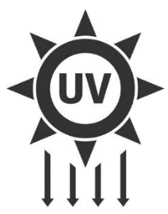
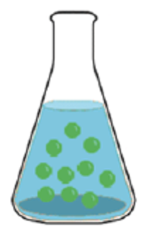
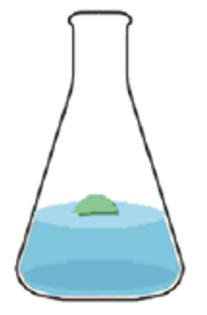
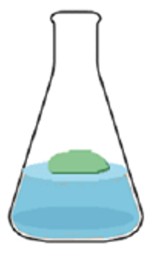
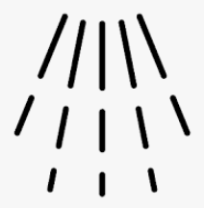
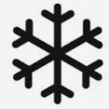
Cell culture focus
To obtain native cells Sacred Lotus
Plant selection
and sampling
In vitro culture of the collected plant piece
Successive replications on a nutrient medium
UV lighting stimulation of cell culture to produce active molecules
Rinsing
Filtration
Low-temperature drying
Notes:
Native cells are whole cells harvested locally from the plant.
They are the result of a biotechnological process that respects the environment and biodiversity in several stages:
1- Plant selection and sampling: Picking a piece of the plant
2- In vitro culture of the sampled plant part
3- Successive transplants on a new nutrient medium consisting of water, minerals, sugar and vitamins;
4- UV stimulation of cell culture to produce active molecules (Elicitation);
5- Rinsing (Removal of all traces of nutrient medium)
6- Cell filtration
7- Low-temperature drying to remove water from a product while maintaining its properties (=suspension or freeze-drying).
This extraction method preserves all the active molecules present in the plant's cells. Maximum effectiveness guaranteed, while respecting the planet's resources.

Slide 12
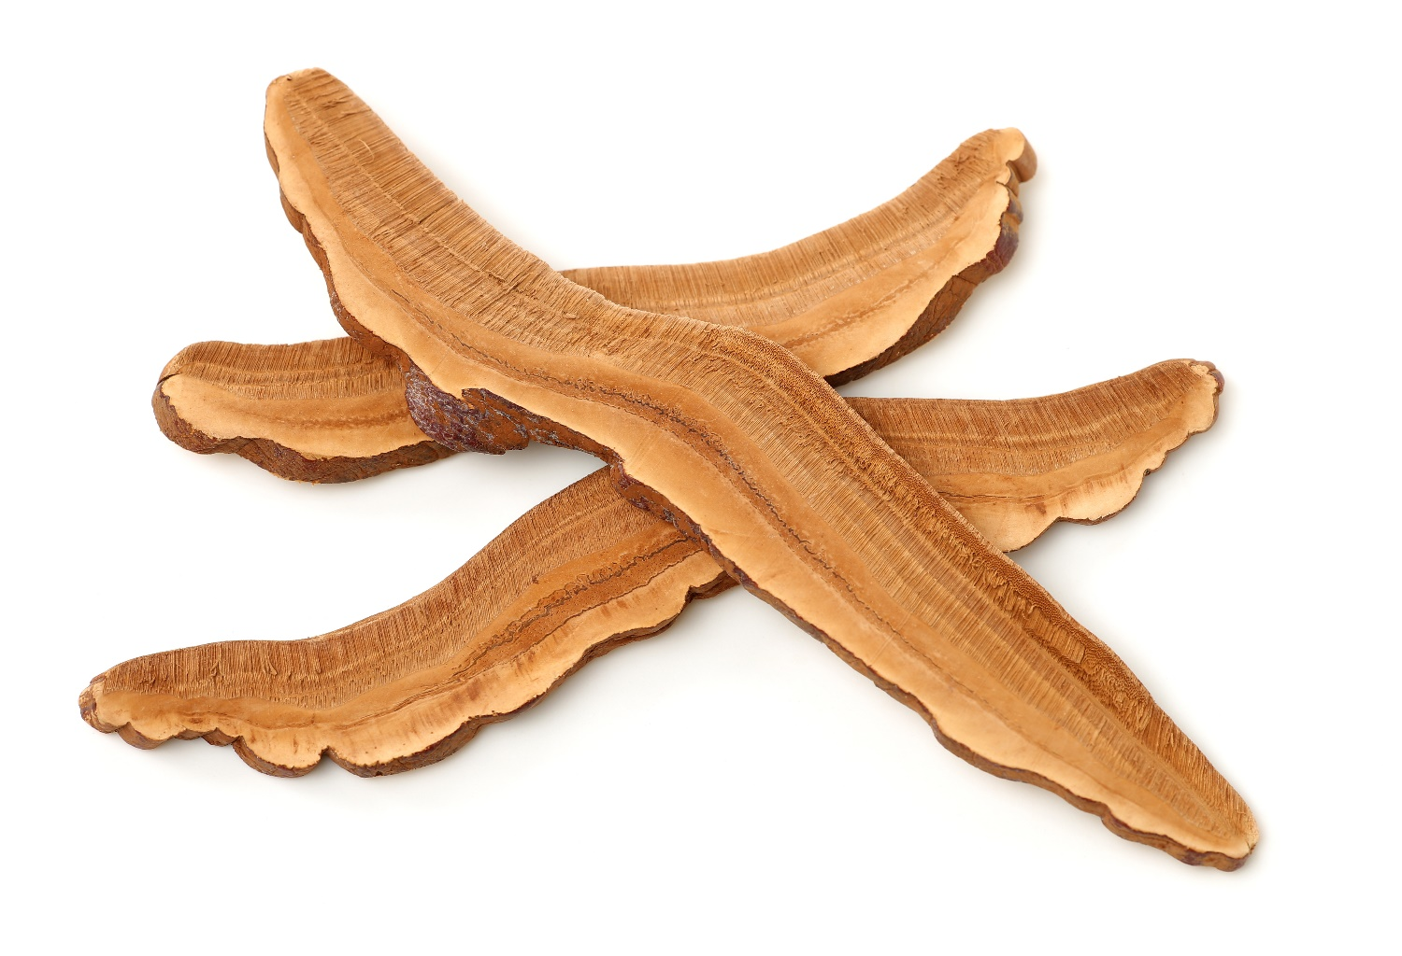
An ultra-complete formula
Enriched with mushroom oleo-extracts
Adaptogenic superfood = helps the body adapt to stress and fatigue.
Reishi (immortality mushroom)
Moisturizing, antioxidant and anti-inflammatory
Enhanced actions with CBD Anti-oxidant, Moisturizing
Notes:
Adaptogenic Reishi extract:
Reishi, or "long-life mushroom", has been used in traditional Chinese medicine for its therapeutic virtues for over 2,000 years. Renowned for its adaptogenic power, it contains 150 antioxidants and nutrients (polyphenols, triterpenes...). A composition close to perfection, which explains why this mushroom is also widely used in nutrition.
Its many qualities help to maintain good health, while eliminating energy blockages responsible for insomnia. It helps the skin adapt to stress and fatigue.
The oleo-extract is made in Saint-Beauzire near Clermont Ferrand (France) from plants grown in China.
* Reishi is the name given to Ganoderma Lucidum in traditional medicine.

Slide 13
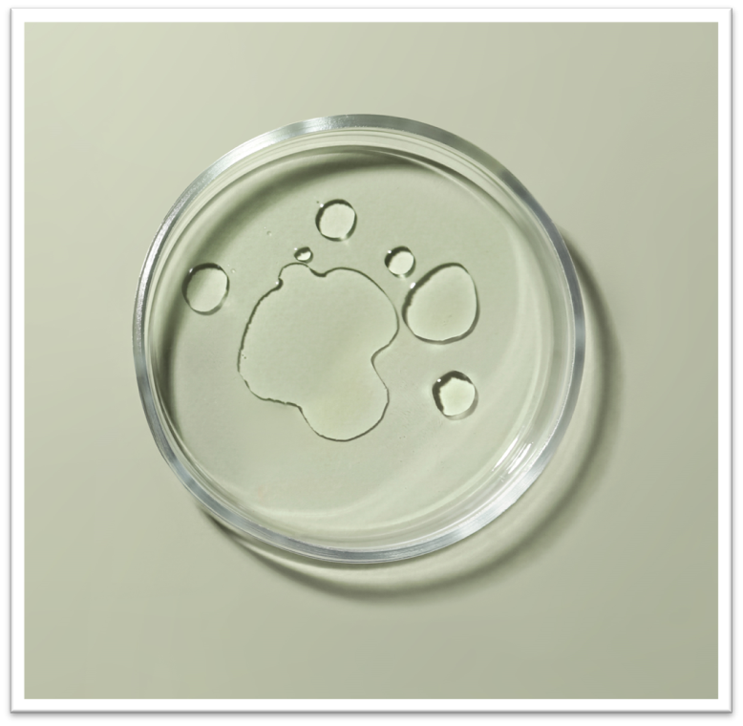
A high-performance formula
Synergy of powerful active ingredients
30% Organic vegetable oils
Hemp + Inca Inchi
Essential Oils Lavender + Chamomile + Neroli + Quintessence Yon-Ka
Hemp : Reduces irritation, Moisturizes, Regulates, Anti-Aging Action
Inca Inchi : Regenerates, Nourishes, Soothes
Invites relaxation and promotes sleep for an intensely regenerating night of high recovery
Notes:
In addition to these main active ingredients
30% organic plant oils of hemp and Inca Inchi, rich in omegas 3 and 6 and vitamins (A, E, B), to help rebalance skin disorders, whatever the skin type
Essential oils of lavender, chamomile and neroli for a relaxing, soothing effect, ideal before bedtime. Invites relaxation and promotes sleep for an intense, regenerating night of recuperation.
And, of course, the brand's signature Quintessence Yon-Ka, which enhances the formula.

Slide 14
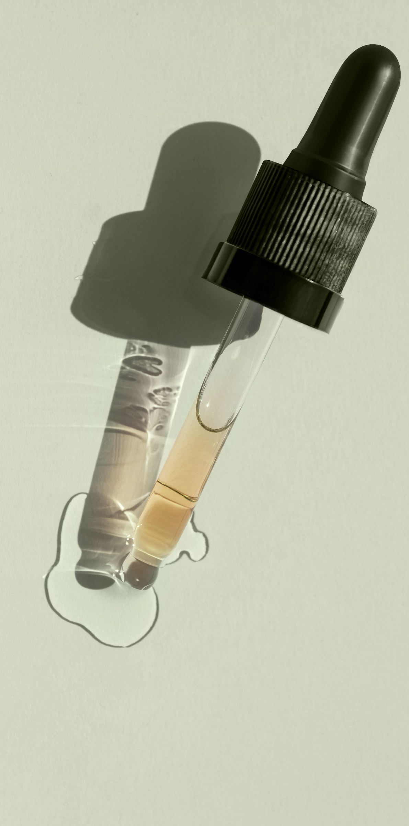
An oleo-serum texture
Oleo-serum with a non-greasy finish
Waterless
Preservative-free
Alcohol-free
Non-comedogenic
A texture that penetrates quickly without leaving a greasy film,
that convinced users
100% this oleo-serum is pleasant to use ⁽¹⁾ 97% integrates perfectly into your skin care routine ⁽¹⁾
Clinical study 32 women. 1 application per day (evening)
⁽¹⁾ Self-evaluation - 1 request
Notes:
An oily serum with a non-greasy finish
Waterless
Preservative-free
Alcohol-free
Non-comedogenic
A texture that penetrates quickly without leaving a greasy film,
that has convinced users of all skin types:
100% this oleo-serum is pleasant to use ⁽¹⁾ 97% integrates perfectly into your skin care routine ⁽¹⁾

Slide 15
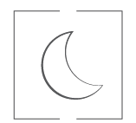
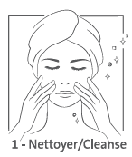
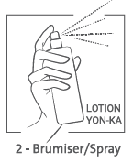
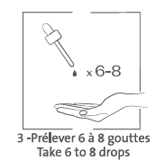
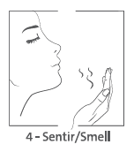
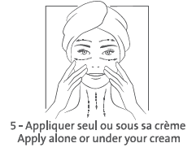
Serum CBD
For whom?
All ages, all skin types, stressed skin, even the most sensitive, with redness and pimples. Men & Women.
When?
In the evening, all year round
Instructions for use?
Notes:
Evenings, all year round,
1- cleanse the skin
2- Spray on the iconic Lotion Yon-Ka
3- take 6 to 8 drops of SERUM CBD
4- Warm your hands. Breathe in the soothing, relaxing scent,
5- then apply with gentle movements, alone or under your usual cream, depending on your mood and skin type.
Contraindicated (precautionary principle) in pregnant / breast-feeding women

Slide 16
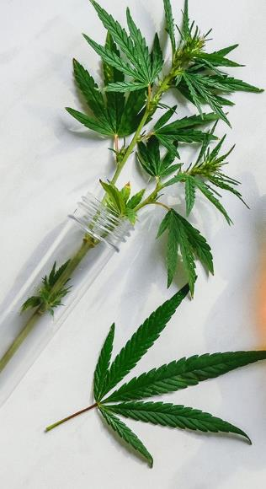
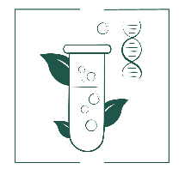
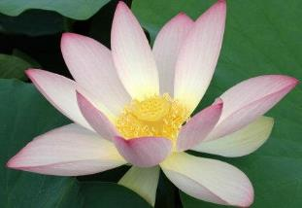
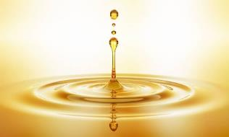
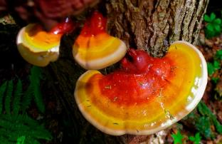
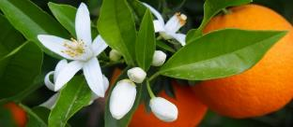
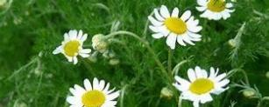
A complete, high-performance formula
DE-STRESSING, SMOOTHING, RE-HARMONISING OLEO-SERUM
99.9% ingredients of natural origin, vegan, non-GMO
750,000 Native cells of sacred lotus*
300 mg of pure CBD
Adaptogenic
mushroom extract
Reishi
30% Organic vegetable oils
Hemp + Inca Inchi
Essential oils
Lavender + Chamomile + Neroli
Quintessence Yon-Ka
*in a 30 ml bottle
Notes:
A complete, high-performance formula
% ION = 99.9% (30% organic) - Vegan, Non-GMO
300 mg pure CBD* (*for 30 ML = 1% pure CBD) ➔ Pure CBD (high-purity / solvent-free extraction process)
De-stress "body and soul", smooth, re-harmonize
It's like a yogi master for your skin!
Has no psychotropic action (= no THC)
Anti-inflammatory, antioxidant, anti-aging, regulator
100% natural (THC*-free - in compliance with regulations<0.2% )
Made from hemp grown sustainably in Colombia
30% organic plant oils Hemp + Inca Inchi
rich in omegas 3 - 6 and vitamin E = moisturizes, regulates and soothes for optimal comfort
Native sacred lotus plant cells = Anti-stress (stimulates the synthesis of melatonin, the molecule responsible for sleep and relaxation) 750,000 native sacred lotus cells in 30ml
10% adaptogenic Reishi mushroom extract (mushroom of immortality) = boosts resistance to stress
= helps skin adapt to stress and fatigue.
Relaxing and soothing essential oils Lavender + Chamomile + Neroli
Invites relaxation and promotes sleep for an intense, regenerating night of recuperation.
Quintessence Yon-Ka = Potentiates the power of the formula
0.1% tocopheryl acetate / vitamin E

Slide 17
Let's play!
Notes:
as you're used to by now, we're going to play together in the chatroom

Slide 18
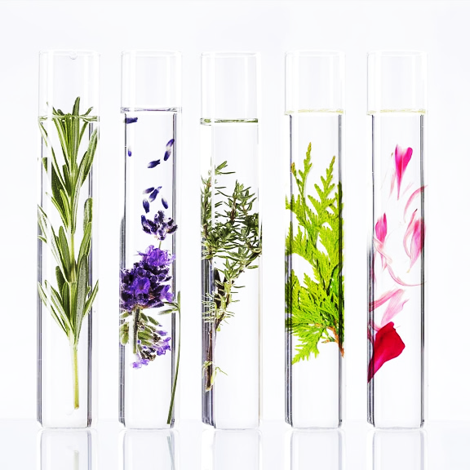
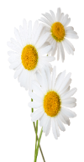
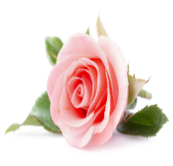
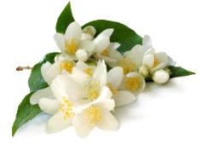
SERUM CBD
What is the fragrance of Serum CBD ?
+
A. Lavender, Chamomile and Neroli E.O.
+
B. Rosemary, Chamomile and Rose E.O.
+
C. Thyme, Jasmine and Neroli E.O.
Notes:
What is the fragrance of Serum CBD ? Lavender, Chamomile and Neroli E.O.
Choice of relaxing and de-stressing essential oils
For an invitation to relax, to promote sleep and prepare for an intensely regenerating night of recovery.

Slide 19
SERUM CBD
What is its percentage of naturality?
A. 95,9 %
B. 98,9 %
C. 99,9 %
Notes:
What is % of naturality?
A complete, high-performance formula
% ION = 99.9% (30% organic) - Vegan, Non-GMO

Slide 20
SERUM CBD
What's its texture?
A. Aqueous serum
B. Dual-phase serum
C. Oleo serum with non-greasy satin finish
Notes:
What's its texture?
oleo serum with non-greasy satin finish
Waterless
No preservatives
Alcohol-free
Non-comedogenic
Suitable for all skin types
Dermatologically tested
Dry skin
Comfort and hydration (less dryness and tightness)
Combination to oily skin
Regulates sebum (matte finish, fewer imperfections)
Sensitive skin
Soothes feelings of discomfort and calms redness.

Slide 21
SERUM CBD
What are the benefits of CBD?
A. Anti-inflammatory
B. Antioxidant
C. Regulates sebum production
Notes:
What are the benefits of CBD?
Anti-inflammatory: Inhibition of certain inflammatory mediators + Boosts synthesis of β− endorphins(well-being molecules).
Anti-oxidant : Neutralizes oxidative stress + Boosts antioxidant self-defense systems.
Regulator: Balances sebum lipid synthesis.

Slide 22
SERUM CBD
What are the 3 key actions of SERUM CBD?
A. Purifying, smoothing, exfoliating
B. De-stressing, smoothing, re-harmonising
C. Anti-dark spot, unifying, radiance
Notes:
What are the 3 key actions of SERUM CBD?
Smoothing means reducing wrinkles and skin texture, truly smoothing the complexion.

Slide 23
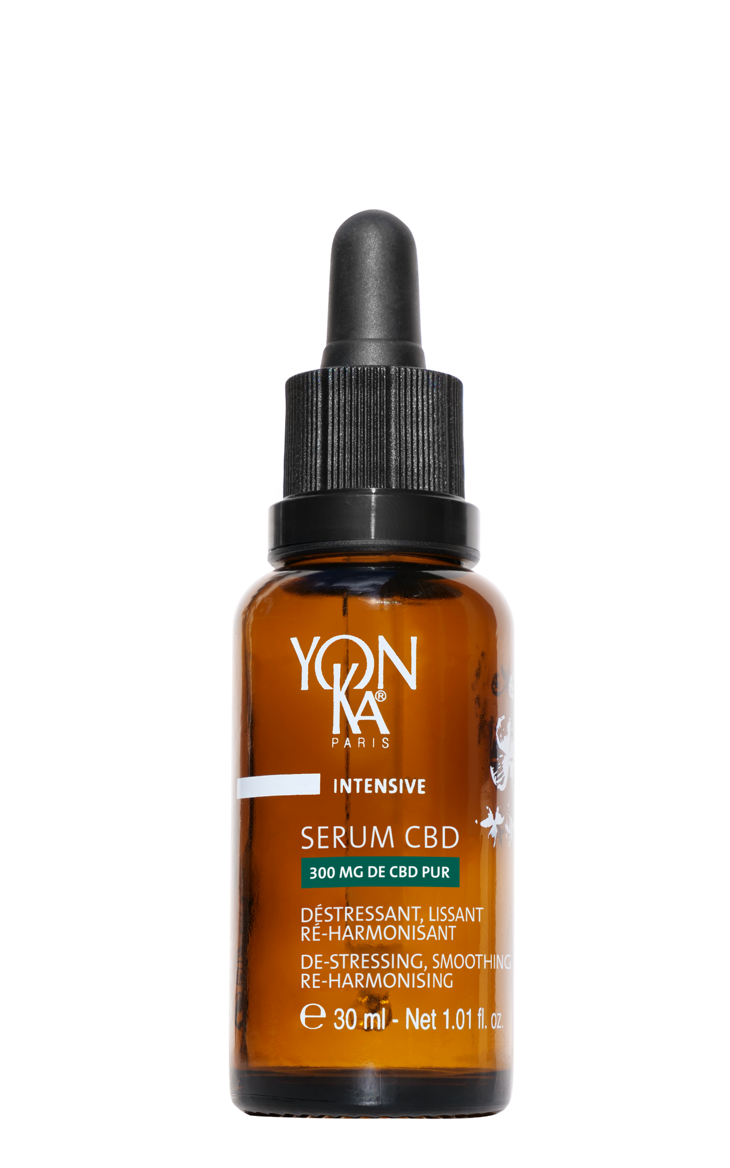
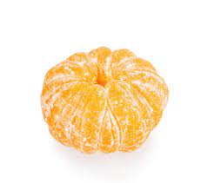
SERUM CBD
"I can use SERUM CBD alone".
+
M.
TRUE
OR
FALSE
Notes:
"I can use SERUM CBD alone".
True, depending on your needs and skin type, Serum CBD can be used on its own.
A texture that penetrates quickly without leaving a greasy film,
that has convinced users of all skin types:
100% this oleo-serum is pleasant to use ⁽¹⁾ 97% integrates perfectly into your skin care routine ⁽¹⁾

Slide 24
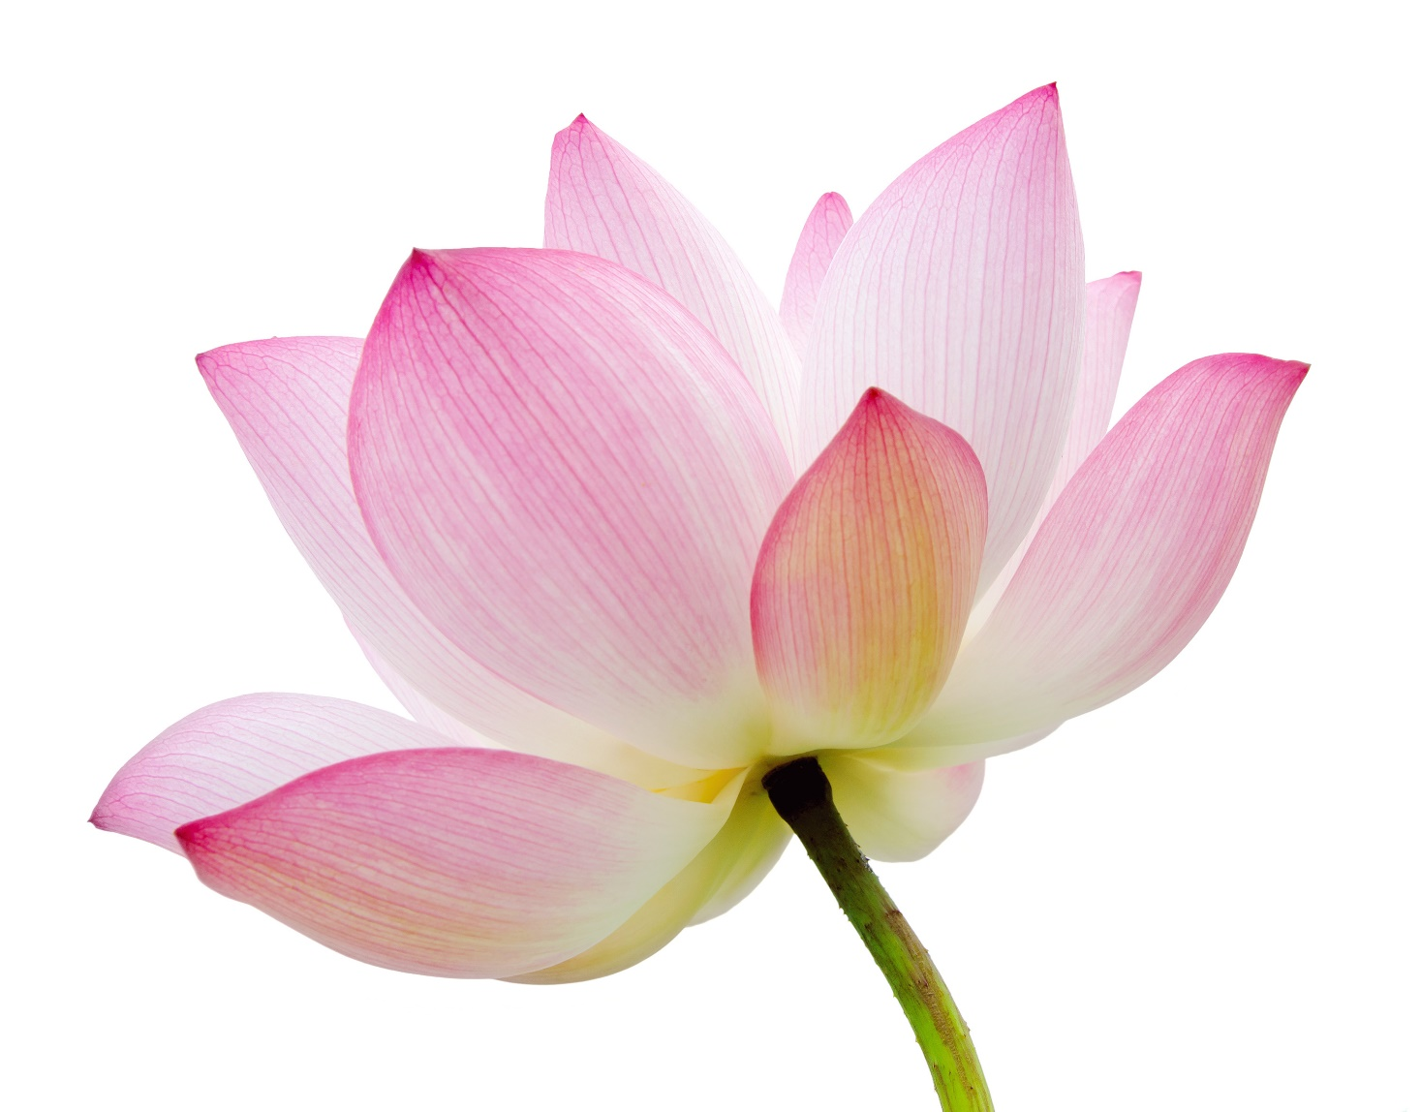
SERUM CBD
Native plant cells from Sacred Lotus
fight skin stress.
TRUE
OR
FALSE
Notes:
TRUE
Native Lotus plant cells have demonstrated their anti-stress effectiveness on the skin by acting on the synthesis of several neurotransmitters:
Through these actions, Sacred Lotus native cells de-stress, calm the skin and help reduce feelings of irritation.

Slide 25
SERUM CBD
Mushroom oleo-extracts
have an antioxidant action.
TRUE
OR
FALSE
Notes:
TRUE
REISHI mushroom of immortality: moisturizing, antioxidant and anti-inflammatory
Enhanced actions with CBD Helps boost skin's resistance to stress

Slide 26
Which serum, for which need?
Notes:
The CBD serum joins our 5 other serums.It is essential to know and understand them well in order to give the best advice.

Slide 27
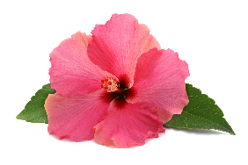
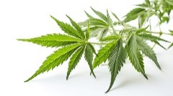
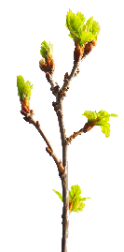
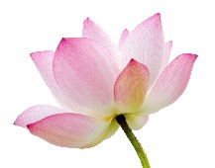
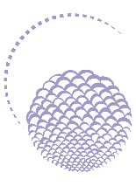
SERUMS
Serums for in-depth actions and optimized results
NEW
HYDRATING
FIRMING
GLOBAL ANTI-AGING
PREVENTION & REPAIR ANTI-AGING
ANTI-AGING
RADIANCE
UNIFYING
DE-STRESSING, SMOOTHING
RE-HARMONISING
Hibiscus
peptides
Vitamine C
CBD
Beech bud
and soy
peptides
Hyaluronic
acid
Native cells of sacred lotus
Collagen
Pomegranate
& Turmeric Native Cells
Cell-Energy complex
Reishi
HYDRA N°1 SERUM
ADVANCED OPTIMIZER SERUM
CELLULAR CODE
SERUM
ELIXIR VITAL
SERUM C20
SERUM CBD
Notes:
don't hesitate to print this summary page of the Yon-Ka Serums family
HYDRA N1 SERUM
Description
This moisturizing serum with hyaluronic acid is the SOS treatment for severely dehydrated skin, providing deep, long-lasting hydration. Enriched with restructuring and anti-oxidant active ingredients such as vitamins A, C and E, Hydra N° 1 Sérum intensely nourishes and regenerates skin, leaving it soft, supple and plump. An ally for thirsty, tired and lackluster skin. Its gel-cream texture is rapidly absorbed, leaving the skin with the light, floral scent of rose and jasmine, 100% natural.
Promise
Genuine hydration booster with intense, long-lasting effect
For whom?
Dehydrated skin
All ages
"My skin is uncomfortable and tight"
"My skin is flaking"
"My foundation plaque"
"I've just come back from the sun and my skin is dull and uncomfortable".
Ingredients
Low molecular weight hyaluronic acid: moisturizer
NMF (serine, PCA sodium): moisturizer
Imperata cylindrica: long-lasting moisturizer
Organic aloe vera: moisturizing
Home use
Morning and/or evening, after cleansing/make-up removal and misting with the appropriate Yon-Ka Lotion, apply 2 to 3 pumps of serum to the face, neck and décolleté. Gently massage the serum into the skin. Follow with your complementary skincare product: Hydra N°1 Moisturizing Matifying Fluid for normal to oily skin or Hydra N°1 Moisturizing Repair Cream for dry skin.
Use in the treatment room
Massage
End of care
Tips
To intensify your moisturizing routine, Hydra N°1 Masque, applied 1 to 3 times a week, is ideal.
Product advantages
Contains 93% ingredients of natural origin
Intensive, long-lasting hydration
Skin is soft, supple and plumped up
Anti-ageing action (or preserves the skin's youthful appearance)
ADVANCED OPTIMIZER SERUM
Description
Advanced Optimizer Sérum, a redensifying serum with a tightening effect, works in synergy with the cream, reinforcing its firming action and multiplying its anti-aging effect. Rich in hibiscus peptides that stimulate collagen production, it visibly firms skin on the face and neck. Features appear redefined, skin more toned and smoother.
Promise
Firming serum, tensor effect
For whom?
Sagging skin
"I have sagging in the oval of my face".
"I have a looseness in my arms".
"My bust has lost its firmness".
"I have a crumpled neckline"
Ingredients
Hibiscus peptides: firming, tensing effect
Collagen: moisturizing, smoothing
Horsetail: firming
Home use
Remove make-up and cleanse your face thoroughly, then mist with Yon-Ka Lotion adapted to your skin type. Maintenance: Morning or evening, apply Advanced Optimizer Sérum (2 to 3 pumps) to face and neck, followed by Advanced Optimizer Crème. 30-day intensive treatment: Repeat the same application, morning and evening. To optimize the benefits of the anti-sagging program, combine Advanced Optimizer Sérum and Advanced Optimizer Crème.
Use in the treatment room
- End of care
Tips
Be careful not to apply too much product, as it may cause linting.
Product advantages
Contains hibiscus peptides and horsetail extracts
Firms face and neck
Boosts the effectiveness of Advanced Optimizer Crème
Provides an immediate tightening effect
CELLULAR CODE SERUM
Description
A veritable rejuvenating serum, Cellular Code helps reactivate the skin's youth code thanks to the "Cell-Energy" complex, a combination of super-powerful natural active ingredients that combat cellular aging. Day after day, this intelligent serum energizes and regenerates the epidermis. Wrinkles and signs of fatigue fade, and skin becomes smoother, firmer and more radiant. We love its fine, silky texture, refined fragrance, airless pump bottle and the fact that it can be used morning and night under your usual cream to combat the passage of time.
Promise
Intelligent serum resets skin's youthfulness
For whom?
For mature skin
"My skin shows wrinkles, spots and loss of firmness".
"With the hormonal upheavals, I'm looking for a global routine that would treat all the signs of aging".
Ingredients
Cell-Energy Complex
What is the Cell-Energy Complex?
Lipoamino acid: a combination of fatty acids and amino acids. Derived from coconut biotechnology, it helps improve communication between cells and plays a defensive role thanks to Langerhans cells.
Baicalin: a polyphenol derived from baikal root
The combination of lipoaminacid + baicalin ensures cell longevity by acting on proteins, so the cell lives longer; acting on stem cells, so a breeding ground for skin cells; and acting on chromosome telomeres, which tend to shorten over time. Telomeres serve to protect and stabilize chromosomes and the integrity of genetic heritage.
Dribose: a natural complex sugar. It comes from the biotechnology of corn seeds and increases ATP synthesis, thus producing energy for the cells.
Nasturtium extract: rich in arabinoglicans, it comes from flowers, leaves and roots. It promotes cellular oxygenation.
Home use
Morning and evening, cleanse your face thoroughly and mist with Yon-Ka Lotion for your skin type. Then apply 2 to 3 pumps of Cellular Code Sérum to the face and neck. Your skin will absorb it in a flash! Follow with your usual treatment cream. For mature skin, it optimizes the action of Excellence Code Crème.
Product advantages
Contains 96% ingredients of natural origin
Gives skin energy and firmness
Resets its youth code
Smoothes signs of fatigue
ELIXIR VITAL
Description
This aromatic phyto double serum, with its biomimetic formula modelled on the hydrolipidic film, is a genuine anti-aging and repairing treatment for all skin types. It respects and consolidates the cutaneous barrier, protecting the skin from external aggression and the effects of the passage of time. This face serum is the multi-regenerating SOS treatment for skin in distress. It is highly recommended after fatigue, excessive sun exposure, emotional stress...
Promise
Double serum phyto-aromatic Prevention & Repair Anti-aging
For whom?
All skin types
Tired, stressed, damaged skin
"I've just given birth, I'm very tired and I don't recognize my skin anymore".
"I'm 45 and I've just spent a month in Martinique. My skin has been damaged by the sun and heat.
Ingredients
Peptides [beech + soy]: restructuring, moisturizing
Organic soybean, sunflower and corn oil (GMO-free): nourishing, repairing
Niacinamide and vitamin B5: soothing, revitalizing
Home use
Morning and/or evening, cleanse your face thoroughly and mist with the appropriate Yon-Ka Lotion. Shake the Elixir Vital bottle well before use, then apply 2 to 3 pumps to the face, neck and décolleté. Gently massage into skin. Use alone or with your usual skin care product.
Tips
Ideal for stretch marks
Product advantages
Contains 92% ingredients of natural origin, 43% ingredients of organic origin, vegan and gluten-free.
88% revitalized skin
Repairs and revitalizes deficient, tired skin
Skin is soothed and regenerated
Fine texture and fast absorption
Double efficacy & double use: prevention-repair & anticipation (all year round, morning or evening) - intensive treatment (1 month, morning and evening)
SERUM VIT C
Turmeric
Epidermal level +16% keratinocytes.
Dermal level +17% synthesis of collagen and elastin fibers.
Pomegranate
Acts on cellular oxygenation*: +22% CO2 release in extreme conditions
Acts on the regulation of melanogenesis *: -15% melanin synthesis
Native pomegranate and turmeric plant cells.
These cells are obtained by cell culture, a patented biotechnology made in France that respects the environment and biodiversity. This technology requires no field cultivation, and only a micro-sampling of the plant is needed to obtain these native plant cells.
Natural resources are preserved, and these active native plant cells are obtained without traumatizing or destroying the plant.
Native plant cells have a high molecular content (essential amino acids, vitamins and minerals, etc.), making them complementary to the other active ingredients in serum C20 and C25.
Each⁽³⁾ vial of serum contains over 1.5 million cells, or around 12,500 native cells per application.
Turmeric :
With its beautiful orange color and strong flavor, turmeric has exceptional properties. It has been used since the dawn of time as a condiment, tincture or medicine. Known as the "spice of long life", Turmeric is widely used in traditional Ayurvedic and Chinese medicine for its anti-inflammatory and antioxidant properties, notably in the treatment of digestive and intestinal disorders, but also to protect the liver and promote healing.
Turmeric seems to hold great promise in the treatment of a number of pathologies, and research into its anti-cancer potential is currently underway.
There are many varieties of turmeric (around 80), the most widely used being Curcuma Longa.
Grenada:
Originally from Asia, pomegranates are now grown in Europe, mainly in Tunisia, Morocco and Israel.
Mentioned in holy manuscripts, the pomegranate has been a symbol of life and fertility, but also of power, since time immemorial. Extremely rich in polyphenols, powerful antioxidants, over 250 scientific studies show that pomegranate may have a positive effect on cardiovascular disease, cancer and arthritis.
A true superfood, pomegranate, here in its native plant cell form, helps boost skin radiance and even out skin tone:
Pomegranate's native plant cells promote cellular oxygenation:
Action on cellular respiration⁽⁴⁾ + 22% in extreme conditions⁽⁵⁾ .
Pomegranate's native plant cells regulate melanogenesis⁽⁴⁾ :
By regulating tyrosinase (18% inhibition), native plant cells reduce melanin synthesis by 15%.
Through these actions, pomegranate's native plant cells help the skin to better protect itself from free radical attacks, to be more luminous and even-toned. They reinforce the radiance and anti-spot actions of vitamin C.
Organic apricot oil
Obtained from organic apricots, the oil extracted from the kernel is composed mainly of Omega 9 and Omega 6, recognized for their nourishing, softening and soothing properties.
This organic apricot oil is also rich in vitamins A and E (photo-protective, anti-oxidant), phytosterols (restoring barrier function, UV protection, anti-aging). With its ability to "illuminate the complexion" (healthy glow effect), it is particularly recommended in toning skin care formulas for dull, devitalized and dehydrated skin. Its rapid penetration, without leaving a greasy feel, is suitable for all skin types, even oily and combination.
Sweet orange is renowned for its toning action on the skin.

Slide 28
THE SERUMS
NEW
PREVENTION & REPAIR
ANTI-AGING
DE-STRESSING, SMOOTHING
RE-HARMONISING
"I have tired, damaged skin or I want to maintain its balance to delay the signs of aging!"
"I'm stressed at the moment and it's showing on my skin. I want my skin to be more resistant, soothed and more even."
All skin types
Anti-aging prevention and skin repair
All skin types
Ensures anti-stress action on body and mind
Phyto-aromatic serum
Night Oleo-serum
Two-phase texture
Oily texture with a non-greasy finish
Notes:
let's take a closer look at ELIXIR VITAL and SERUM CBD

Slide 29
ELIXIR VITAL or SERUM CBD?
« My skin is damaged and sensitized after several
mesotherapy treatments ... »
ELIXIR VITAL
SERUM CBD
OR
Notes:
Damaged, sensitized... the aim here is to bring comfort and to recreate and reinforce our skin's protective barrier. Elixir Vital is our ally.

Slide 30
ELIXIR VITAL or SERUM CBD?
« In times of stress, my skin is more
sensitive to external aggressions. »
ELIXIR VITAL
SERUM CBD
OR
Notes:
In times of stress my skin is more sensitive to external aggressions:
SERUM CBD: the ideal ally for boosting skin's resistance to stress

Slide 31
ELIXIR VITAL or SERUM CBD?
« I have a few imperfections and rough skin
and feelings of tightness... »
ELIXIR VITAL
SERUM CBD
OR
Notes:
I have a few imperfections and rough skin and feelings of tightness...
SERUM CBD : the CDB and the entire formula of the new CBD Serum is perfect for dealing with various needs :
Comfort and hydration (less dryness and tightness)
Regulates sebum (matte finish, fewer imperfections)
Soothes feelings of discomfort and calms redness

Slide 32
My NIGHT routine
"My skin is dull and starting to lose its elasticity".
SERUM CBD
My Complementary Product
1
2
3
2
4
I clean
I prepare
I treat
I protect
Notes:
I'm now going to show you various night-time routines depending on needs
Ideal routine to be completed in the morning with serum C20 . Duo C20 in the morning and CBD in the evening for even the skin or combining with the Advanced Optimizer range to fight against the loose of elasticity
My Complementary Product : Phyto Contour

Slide 33
My NIGHT routine
"My skin is shiny and has small imperfections."
SERUM CBD
My Complementary Product
1
2
3
4
I clean
I prepare
I treat
I protect
Notes:
As we have already seen, CBD Serum is ideal for treating minor imperfections and regulating sebum production..
Combining with the Gel Nettoyant and the Lotion Yon-Ka PNG, perfect night routine for mattify and treat imperfection
My Complementary SOS spot

Slide 34
My NIGHT routine
"My skin is sensitive with redness."
My Complementary Product
SERUM CBD
1
2
3
2
4
I clean
I prepare
I treat
I protect
Every other evening instead of cream
Notes:
Serum CBD very interesting for skin showing redness :
Anti-inflammatory effect: CBD exerts potent anti-inflammatory activity on skin cells, decreasing the NF-kB signaling pathway (key regulatory factor) and pro-inflammatory cytokines. CBD has promising effects on an experimental model of dermatitis (Gegotek et al., 2019; Petrosino et al., 2018).
Native cells of Sacred Lotus also have an anti inflammatory effect
My Complementary Product : Sensitive Masque

Slide 35
My NIGHT routine
"I'm going through a stressful period. My skin is tired
and the signs of aging are more visible".
SERUM CBD
My Complementary Product
1
2
3
2
4
I clean
I prepare
I treat
I protect
Notes:
Stressful period = CBD Serum
For the signs of aging , according to the client you can choose betwen TR or Excellence code creme.
My Complementary Product : Excellence Code Contours

Slide 36
My NIGHT routine
- For Men -
SERUM CBD
My Complementary Product
Or
1
2
3
4
I clean
I prepare
I treat
I protect
Notes:
and of course, as we've seen, Serum CBD is completely compatible with men and fits in perfectly with a man's night-time routine.
My Complementary Product : Gel yeux

Slide 37
Serum CBD
Consumer insight / Trend
Stress, lack of sleep / CBD
Naturalness
99.9% ingredients of natural origin
Synergy of active ingredients
300mg pure CBD +
Native cells of sacred lotus + adaptogenic reishi
Skin/mind effectiveness
De-stressing - Smoothing - Re-harmonising
Sensoriality
Texture : Self-adapting oleo-serum
Fragrance: Lavender, Chamomile and Neroli
All year round
All skin types
even sensitive

Slide 38
CBD SLEEP THERAPY
NEW
SLEEP THERAPY
treatment
PHYTO SLEEP THERAPY or CBD SLEEP THERAPY

Slide 39
CBD SLEEP THERAPY
De-stressing, smoothing and re-harmonising face and back treatment with CBD for restful sleep
Stressed skin showing one or more of the characteristics of a lack of sleep: dehydration, dull complexion, fine lines and wrinkles, puffiness, sensitivity, acne, redness...
As soon as you feel the need,
ideally after 5pm.
90 min
€130-€210 $275-$325
+
Possibility of customizing the
Yon-Ka facials with the
SERUM CBD

Slide 40
SLEEP THERAPY
90 min. – WELLNESS
The Yon-Ka +
PHYTO BAIN and stimulation of 9 personalized energy points (anti-insomnia, anti-anxiety, pain relief)
Use of accessories during treatment: quartz crystal (de-stressing techniques), hot stones (on areas of tension) for even greater relaxation
Unique and 14-step
multi-sensory experience (specially designed playlist and warmed products)
YON-KA Sleep Therapy
(Spotify)
30-minute option
to be combined with a face or body treatment (back, energy points) to restore restful sleep

Slide 41
SLEEP THERAPY products
Option PHYTO
HUILE DE MASSAGE
CONCENTRE AROMATIQUE DETOX
NUTRI +
SERUM
HYDRA N°1

Slide 42
CBD SLEEP THERAPY
Option PHYTO
HUILE NEUTRE + CONCENTRE AROMATIQUE DETOX
PHYTO 52/58 + NUTRI+ (1/2 ampoula)
PHYTO CONTOUR
SERUM HYDRA N°1
CREME PHYTO 58/52

Slide 43
Special "Sleep ritual" questionnaire
Research customer needs and expectations using open-ended, sleep-oriented questions
"How are you feeling today?"
"What is the quality of your sleep right now?"
Insomnia: energy points = ankles
"On average, how many times do you wake up during the night?"
Anxiety: energy points = hand
"Do you have worries or anxious thoughts that keep you awake?"
"On a scale of 1 to 10, how would you estimate your stress level right now?"
Pain: energy points = face and skull
"Do you feel any muscle tension or pain? If so, where?"
Notes:
First contact with the client to learn more about how she is feeling and target her main problematics : insomnia, anxiety or any migraines
This moment is a relaxing first step to the treatment when we offer a foot ritual with phyto bain
Ask questions to understand the need of the client and personnalise if necessary the energy points
We can let the client know that dépend on how she is feeling, she might be more sensitive to certain points

Slide 44
VIDEO

Slide 45
Our anti-insomnia tips
Pamper your body and mind
Progressive muscle relaxation: Relax by gradually tensing and relaxing every muscle in your body. Start with your feet, then slowly work your way up. Concentrate on the sensation of muscle relaxation with each exhalation, allowing tension to escape your body.
A hot-water bottle on the shoulders, back or feet (important, as the nerve endings are located on the feet).
The warmth encourages muscle relaxation.
A few minutes to relax before bed:
Meditation and/or self-massage of the temples and 3rd eye.
Notes:
As we have seen, the new Sleep Therapy treatment aims to de-stress, soothe and re-harmonise body and mind. To complement the benefits of the treatment in the institute, we also offer tips for home use.
ANTI INSOMNIA TIPS :
a timeless classic, the hot water bottle : whether on the shoulders, back or even feet the warmth generated will provide deep muscle relaxation.
Meditation and or self massage of the temples and 3rd eye : take some time for yourself, calm your body and mind before going to bed
Progressive muscle relaxation : using the visualisation of a wave of well-being, which sails over your breathing, relax muscle after muscle from the tips of your toes to the top of your head. A few minutes to release tension

Slide 46
Our anti-anxiety tips
Get rid of all sources of stress
:
Autogenic training: This method involves concentrating on physical sensations and imagining yourself in a peaceful environment. Take time to feel the warmth, heaviness and relaxation of every part of your body, allowing your mind and body to relax deeply.
Opt for a pair of soft, comfortable slippers or booties as soon as you get home.
Dressing comfortably only for the night tells the body that it's time to go to sleep.
Notes:
ANTI ANXIETY TIPS :
In order to limit anxiety, it is important to establish a wellbeing routine:
when you get home after the day's work, opt for comfortable slippers
change your outfit for something more comfortable and pleasant
Autogenic training : a relaxation technique similar to self-hypnosis, which aims to bring about a state of disconnection to allow the body and mind to relax. by concentrating on fixed formulas. For example: "I'm calm. I'm completely calm. "My arms are heavy. "I breathe slowly and evenly. ...

Slide 47
Our anti-anxiety tips
Create a relaxing, soothing atmosphere in your home
Light a candle with relaxing scents to create a pleasant atmosphere and encourage meditation and dive into a bath with PHYTO-BAIN.
Adapt the light:
Warm-colored bulbs, around 2700K, reproduce the light of sunset and can help stimulate the production of melatonin, the hormone associated with sleep.
Spray Lotion Yon-Ka on your face and lavender essential oil or incense in your home to enjoy the benefits of aromachology.
Notes:
ANTI ANXIETY TIPS :
As part of your well-being routine, light your Taiga candle to create a calm and peaceful atmosphere. Enjoy a rejuvenating and relaxing interlude, thanks to the subtle aromas combining the woody scents of Siberian pine, cypress and Virginia cedar. Don't hesitate to enhance this relaxing interlude with a foot bath containing a few drops of Phyto Bain and enjoy a real spa at home.
Prefer Warm-colored bulbs, around 2700K, reproduce the light of sunset and can help stimulate the production of melatonin, the hormone associated with sleep
spray on your face the Yon-Ka Lotion and diffuse lavender essential oils to release its aromachological power : reputed to combat stress and insomnia. As a calming agent, it soothes the nerves, helps the body and mind to relax and makes it easier to fall asleep.

Slide 48
Our pain relief tips
Stretch the upper body first
Bear hug
This stretch works the rhomboids and trapezius muscles of the upper back. It relieves any discomfort or pain in the shoulder blades.
Neck stretch
Helps relieve tension in your head, neck and shoulders.
Start standing, with feet hip-width apart and arms as far apart as possible (without tiring yourself too much).
Cross one arm over the other at the elbows, reaching over opposite shoulders and grasping the back of the shoulders.
Gently pull your shoulders forward and hold the stretch for 20 seconds, remembering to breathe deeply.
Repeat the stretch, alternating to cross the arms on the opposite side.
Sit down in a comfortable armchair.
Bring your right hand to the top of your head or to your left ear.
Gently bring your right ear towards your right shoulder, holding this position for five breaths.
Repeat on the other side.
Then turn to look over your right shoulder, keeping the rest of your body facing forward. Hold this position for five breaths. Repeat on the other side.
Notes:
ANTI RELIEF TIPS
to relieve aches and pains, here are some easy stretches you can do at home:
BEAR HUG : to stretch the upper back , to stretch the upper back; while standing, grab your shoulder blades, crossing your arms as far as possible behind your back and hold the stretch for a few seconds before changing the crossing of your arms.
NECK STRECH : to relieve neck and shoulder tension : in a seated position, lean your head to one side, using your hand to maintain the stretch, then to the other side.

Slide 49
Our pain relief tips
Relieve back and thighs
Child's posture
Perfect for listening to your breathing, relaxing your body and reducing stress. It also relieves pain and tension in the back, shoulders and neck.
Butterfly
Helps relieve stiffness in the thighs and lower back. Softens the body.
Get down on all fours, shoulders level with hands.
Slowly rock forward on your arms, rounding your shoulders and bringing your lower back to the floor. Hold for 5 seconds.
Back away slowly and sit back on your heels.
Extend your arms and turn towards the floor to keep your neck in line with your spine. Hold for 5 seconds.
Sit upright with your spine and head aligned, your legs bent in front of your body and the soles of your feet touching. Place your hands on your feet.
Activate your abdominal muscles and gently bend your hips to lower yourself forward with a straight back, bringing your elbows to rest on your inner thighs.
Lightly push your thighs down as far as you can without discomfort. Hold for 15 to 30 seconds, release and rest for 30 seconds.
Notes:
ANTI RELIEF TIPS
CHILD’S POSTURE : relieves pain and tension in the back, shoulders and neck. has four paws on the ground, hands as far away from the head as possible and buttocks on the heels
BUTTERFLY : relieve stiffness in the thighs and lower back : in a seated position, with your back straight, bring your knees as close to the ground as possible by pressing gently on them
each of these exercises is performed with deep, regular breathing

Slide 50
Focus on the press event (France)
Event with the CBD SLEEP THERAPY TREATMENT
January 17th-18th, 2024
24 journalists
Press webinar
January, 23rd
+/- 20 journalists
Elle, Biba, Santé Magazine, Stratégies, Parents, Version Femina, Modes &Travaux, Voici, Aufeminin.com, Madame Figaro, Gala, Biba, Stylist, Top Santé, Cosmopolitan, Marie Claire, Les Echos,
Le Parisien, Marie France, Cosmetique Mag, Amina, M Le Monde,
Point de Vue, Living Paris

Slide 51
Training
TRAINING VIDEO
The 30-minute option
SERUM CBD PRODUCT SHEET
French
English
PDF
TECHNICAL GUIDE
SLEEP THERAPY TREATMENT
French English
PDF
Available in PHYTO SLEEP THERAPY version

Slide 52
Questions and answers

Slide 53
Thank you !

Slide 54
APPENDICES

Slide 55
What's the difference between stem cells and native cells?
Stem cells and native cells correspond to the same definition.
We have chosen to use the term "native cells" to highlight the radiance and antioxidant protection benefits.
Notes:
Stem cells and native cells correspond to the same definition
Our choice to call them native cells is a marketing choice: often in the consumer's imagination, stem cells are linked solely to the notion of anti-aging, and here we want to emphasize the anti-oxidizing and complexion-evening (radiance) power of our cells.
We have chosen to use the term "native cells" to emphasize the radiance and antioxidant protection benefits of the product.

Slide 56
Competitors
CBD serums
Typology CBD botanical assemblage
650mg CBD or 1300mg / 30ml
15ml / €35
- No other active ingredients
- Broad spectrum and unspecified purity
- no proven efficacy
→
SVR
CBD Ampoule RESIST N/A mg CBD
30ml / €37
→
- No CBD dosage claimed
Saint Jane
Luxury beauty serum 600mg CBD / 30ml 30ml / €102
- No other complementary active ingredients
- Broad spectrum and unspecified purity
Ho Karan Antidote 1500 mg CBD / 30ml 30ml / €112
- Not applicable on skin
- No other complementary active ingredients - Sensoriality - - (not dry oil)
- High prices
→
→
Herbivore Emerald Serum 100 mg CBD / 30ml 30ml / €60
-Broad spectrum and unspecified purity
- Low CBD dosage
- Sensoriality - - (sticky)
Aurelia
Probiotic Skinare
CBD Super Serum
N/A mg CBD
30 ml / €87
→
→
- No CBD dosage claimed
Notes:
Competitors' CBDs are not all isolates, so the mg of pure CBD is smaller.

Slide 57
Why the different concentrations?
Does the more concentrated it is,
the more effective it is?
There are products with a higher % or grammage of CBD, sometimes with a choice of several dosages. This is mainly the case for per os products (to be swallowed) where, depending on the concentration, there may be different indications: stress, sleep, muscle/joint pain. But beware: depending on the purity level of the CBD used, the concentration of pure CBD should be put into perspective:
Example: - Yon-Ka Serum CBD 300mg pure CBD: 300 mg = the concentration of pure CBD in the product. - Serum dosed at 1000mg of Broad Spectrum CBD (pure CBD + other molecules) actually contains between 300 and 799mg of pure CBD.
In cosmetics, the maximum concentration recommended by CBD suppliers is 1%. This is the maximum concentration we have chosen to use in our Serum CBD.

Slide 58
Why the price difference in the competition?
As with vitamin C treatments, it all depends on the quality of the CBD, its purity, the concentration used and whether or not it is accompanied by other high-performance active ingredients.
In our case, to make this oleo-serum unique,
Yon-Ka has combined 300 mg of pure CBD with sacred lotus plant cells and reishi.
This exclusive combination, with 99.9% of its ingredients of natural origin, helps combat stress and skin damage more globally.
All this is enhanced by 30% organic oils (Hemp + Inca Inchi) which, thanks to their rich Omega content, help to gently re-equilibrate certain skin disorders
(redness, imperfections, dryness).

Slide 59
Why this CBD?
How was it selected?
Is it better than our competitors?
Laboratoires Yon-Ka selected CBD that perfectly met these commitments: "COSMOS approved" and highly pure (over 98% - on the market, depending on the extract chosen, the % of CBD ranges from 30 to 99%), it is obtained by supercritical CO2 extraction from hemp varieties authorized by French regulations, grown sustainably in Colombia and processed locally (high-quality sourcing, traced supply chain and CSR* actions).
*CSR actions: educational support for children, psychological support for disabled patients, etc. preservation of ecosystems and biodiversity.

Slide 60
Why source from Colombia when there are hemp fields in France/Europe?
Is there a difference in "quality"?
In France / Europe, until very recently, CBD was not authorized / used for cosmetics (recently authorized).
Hemp grown in France is still mainly used for industry (textiles, construction, paper (cellulose)) and food (animal feed (hemp straw), human food and cosmetics (hemp oil, very rich in omegas).
The CBD we use comes from hemp grown sustainably in Colombia and processed locally (high-quality sourcing, traced supply chain and CSR* actions).
*CSR actions: educational support for children, psychological support for disabled patients, etc. preservation of ecosystems and biodiversity.

