Slide 1
The Experience of
Phyto-Aromatic Skincare

Slide 3
Eye and Lip tips and techniques
Notes:
The eye contour area is a true mirror of our general well-being. A little fatigue or stress and dark circles appear.

Slide 4
What are the particularities of the
EYE CONTOUR AREA ?
The skin around the eyes is particularly delicate and sensitive
IN YOUR OPINION, WHAT ARE THE CHARACTERISTICS OF THE EYE CONTOUR ?
THIN AND DELICATE SKIN
FEWER SEBACEOUS AND SWEAT GLANDS
LACK OF ADIPOSE TISSUE
PRESENCE OF MUSCLES AND REPEATED MOVEMENTS
CONSTANT EXPOSURE TO EXTERNAL ELEMENTS
Notes:
Thin and delicate skin: The skin around the eyes is much thinner than the skin on the rest of the face, with an average thickness of about 0.5 mm. This thinness makes it more vulnerable to damage and signs of aging.
Fewer sebaceous and sweat glands: The eye contour has fewer sebaceous and sweat glands compared to other parts of the face, meaning it has less ability to produce sebum to moisturize the skin and expel sweat, making it more prone to dryness.
Lack of adipose tissue: Unlike other facial areas, the eye contour has little to no subcutaneous fat tissue to protect and cushion it. This makes the skin more prone to dark circles, puffiness, and wrinkles.
Presence of muscles and repeated movements: The muscles around the eyes are constantly in motion due to facial expressions such as smiling, blinking, and frowning. This repeated muscular activity can contribute to the development of wrinkles and fine lines.
Constant exposure to external elements: The eye contour is often exposed to external elements such as sunlight, wind, and pollution, without the natural protection provided by eyelashes and eyebrows. This can lead to premature skin degradation and UV damage.

Slide 5
The specificities of the eye contour
10,000 blinks per day
Rich in muscles, 22 in total, 14 of which activate every 10 seconds
The eye area suffers from dryness
Skin 3 to 5 times thinner than facial skin
The skin around the eyes is nothing like the rest of the face. It requires adapted care and techniques
Notes:
The skin around the eyes is under constant pressure (10,000 blinks per day).
Extremely thin (3 to 5 times thinner than facial skin)
Poor in collagen, elastin, sebaceous glands and fat cells, the eye area suffers from dryness
Rich in muscles, 22 in total, 14 of which activate every 10 seconds to ensure permanent hydration of the cornea
The specificities of the eye contour
The skin around the eyes is constantly solicited (10,000 blinks per day). And to facilitate this mobility, it is light and extremely thin (3 to 5 times thinner than the face skin) which makes it vulnerable. Poor in collagen, elastin and fat cells, the eye contour suffers from dryness. Thus weakened, it becomes the favourite place for the apparition of wrinkles. Although this area is poor in fat, it is rather rich in muscles, 22 in total, 14 of which activate every 10 seconds to ensure permanent hydration of the cornea. These perpetual movements deteriorate the fibres more quickly and they loose their firmness.
Ageing of the eye area
Sagging skin around the eyes is often the first sign of aging. Over time, the elastic and collagen fibres deteriorate, causing the lower eyelid to sag and wilt. The skin slackens and a small pouch appears. But loose skin is not the only sign of aging. The sensitive area under the eyes, which is under constant pressure, is also subject to the early appearance of fine lines. The first expression lines appear on the outer corner of the eye and form crow's feet.
What are dark circles?
The skin is thinner under the eyes and this "transparency" makes the slightest circulation problems or dark shadows more visible. Moreover, with age or fatigue, the blood and lymphatic microcirculation of the eye contour (already very slowed down) becomes even more "lazy". The hollow of the lower eyelid becomes coloured and dark circles appear. With time, it doesn't get any better: the skin becomes thinner and the skin slackening will modify the shape of the dark circles, which will increase in length and darken the eyes. This often blue-black colour of the dark circles comes from the fact that micro blood waste can stagnate in the capillaries.
Dark circles, which can be occasional or long-lasting, will worsen if you don't get enough sleep, if you are stressed, or if you drink or smoke.
Dark circles are not the same as puffiness (swelling under the eyes), which can result from ageing and/or poor lymphatic circulation. As with dark circles, a family affliction, stress and fatigue accentuate them.

Slide 6
Puffiness, dark circles...
How to differentiate them ?
BLUE OR VASCULAR CIRCLES
Slowdown in blood and lymph circulation
Genetic Lifestyle
BROWN OR PIGMENTED CIRCLES
High concentration of melanin in the skin around the eyes
Sun's rays Genetic
HOLLOW OR STRUCTURAL CIRCLES
The thin layer of subcutaneous fat around the lower eyelid diminishes, causing the face to become more skeletal
Age Genetic Massive weight loss
AQUEOUS BAGS
Slowdown in blood and lymph circulation, tends to fade during the day
Fatigue Alcohol Diet Stress
ADIPOSE BAGS
Shift in the fatty tissues that protect the eye who are normally found in the orbit
Relaxation of the skin and muscles around the eye Genetic
Notes:
Blue or vascular circles: these form as a result of a slowdown in blood and lymph circulation. Blood pigments transported by these pathways accumulate in the lower eyelid and are poorly evacuated, giving a violet-blue colour. As the skin in this area is very thin, small blood vessels are easily visible. Although there is a genetic component to the appearance of dark circles, they are also closely linked to lifestyle. For example, lack of sleep and the consumption of tobacco or alcohol greatly increase the appearance of dark circles.
Brown or pigmented circles: these are due to a high concentration of melanin in the skin around the eyes. This area is quite prone to hyperpigmentation, due to its thinness, which allows the sun's rays to penetrate easily. The sun's rays stimulate melanogenesis and accentuate the appearance of dark circles. Another cause of dark circles is genetics.
Hollow or structural dark circles: as we age, the thin layer of subcutaneous fat around the lower eyelid diminishes, causing the face to become more skeletal. The result is the appearance of a shadow under the eyes. Structural dark circles can be genetic in origin or develop gradually over time or after massive weight loss.
AQUEOUS BAGS / In the case of puffiness, the oedema responsible for the swollen lower eyelid forms during the night as a result of slower blood and lymphatic circulation. Also known as water bags, this water retention tends to fade during the day and is completely natural. However, certain factors can accentuate the appearance of puffiness:
Fatigue: lack of sleep disrupts the microcirculation of blood around the eye. As a result, puffiness is more pronounced than normal when you wake up in the morning, indicating that the skin has not had a full night's sleep.
Alcohol and tobacco: consumed in excess, they disrupt the body's functions and sensitise the epidermis. While alcohol abuse dries out the skin, smoking damages venous and lymphatic microcirculation, leaving the complexion dull and tired.
Eating habits: a poor diet, especially one based on salt, can encourage water retention and therefore the development of puffiness.
Stress: the release of cortisol in the body encourages the appearance of bags under the eyes. In fact, this hormone interferes with collagen production and facilitates water retention under the eye contour area.
ADIPOSE BAGS / With age, the skin's functions deteriorate as the years go by. Because our skin is thinner and more fragile, the area around the eyes is the first to be affected by skin ageing. As a result, fatty deposits can accumulate under the eyes, leading to the formation of fatty or adipose bags. This phenomenon is caused by a shift in the fatty tissues that protect the eye and are normally found in the orbit. It may be due to a simple relaxation of the skin and muscles around the eye as a result of ageing, but it can also occur in congenital or hereditary conditions.

Slide 7
And what about the LIPS ?
Presence of the lip border
-> prone to wrinkles and fine lines with age
Thin and delicate skin
-> increased sensitivity
Fewer sebaceous gland
-> need hydration
Constant exposur to movements and external elements
-> need protection
Because of these characteristics, it is recommended to pay special attention to the lip contour by using moisturizing and protective products
Notes:
Thin and delicate skin: Like the eye contour, the skin around the lips is thin and delicate, making it more prone to damage and signs of aging = Increased sensitivity: Due to its thinness, the skin of the lip contour may be more sensitive to irritations and allergic reactions.
Fewer sebaceous glands: The lip contour has fewer sebaceous glands than other parts of the face, meaning it has less ability to produce sebum to moisturize the skin = Need for hydration: Since lip skin lacks sebaceous glands, it tends to be drier. Therefore, it is important to regularly apply a moisturizing lip balm to keep them supple and soft.
Constant exposure to movements and external elements: Lips are constantly in motion during speech, eating, and facial expressions. Additionally, they are often exposed to external elements such as sunlight, wind, and cold, which can make them more sensitive.
Presence of the lip border: The lip border, also known as the vermilion border, is the boundary between the lip skin and the surrounding facial skin. This line can be more pronounced in some individuals and may be prone to wrinkles and fine lines with age.

Slide 8
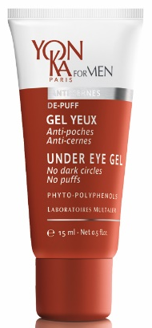
YON-KA EYE & LIP OFFER
Eye & lip contours to meet every need
ANTI-PUFFINESS
ANTI-DARK CIRCLES
NOURISHING
ANTI-WRINKLE
GLOBAL
ANTI-AGING
REGENERATING
TONIFYING
PHYTO-CONTOUR
NUTRI-CONTOUR
ALPHA-CONTOUR
EXCELLENCE CODE CONTOURS
GEL YEUX
Notes:
Yon-Ka proposes a global expert program based on 5 contours: alpha-contour, nutri-contour, phyto-contour, excellence code contours and gel yeux.
Phyto-contour wih rosemary and beech bud peptides : visibly reduces puffiness and dark circles / restores firmness to eye and lip contours / procures a feeling of freshness and relaxation to tired eyelids.
Nutri-contour with chamomile and niacinamide : nourishes / providing protection from drying and aging. It is also perfect for chapped lips
Alpha-contour with fruit acids and hyaluronic acid : visibly smoothes wrinkles and fine lines / hydrates
Excellence Code Contours with Persian silk tree and St Paul’s wort : defies the signs of aging / brings radiance / reduces puffiness and dark circles / smoothes out deep and fine lines / lifts the upper eyelids / defines the lip contours. Exteme precision applicator
Under eye gel with arnica and cypress nut : anti puffiness, anti dark circles, repairs the eye contours, smoothes lines and tones eyelids, refreshing thanks to the peppermint EO.

Slide 9
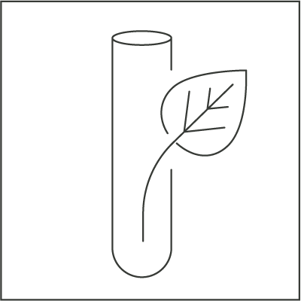
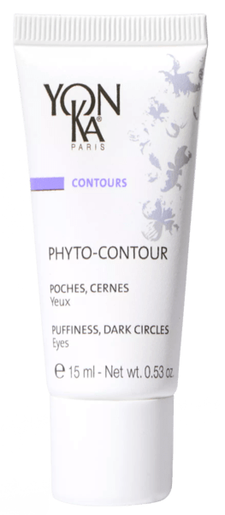
PHYTO-CONTOUR
Anti-puffiness anti-dark circles
92%
ingredients
Of natural origin
We love its effectiveness on milia and headaches
ROSEMARY
BEECH BUD PEPTIDES
ORGANIC ALOE VERA
VITAMIN E
REFRESHING
DRAINING
TONIFYING
DETOXIFYING
RESTRUCTURING
SMOOTHING
REGENERATING
SOFTENING
MOISTURIZING
PROTECTING
REGENERATING
ANTIOXIDANT
R.15 ml
Notes:
PHYTO-CONTOUR
Description
This fine, aromatic eye cream with rosemary extract visibly reduces dark circles and bags under the eyes. Rosemary is particularly effective against skin irregularities such as milia, blemishes or inflammation. Phyto-Contour firms the eyelids and gives an immediate sensation of freshness and lightness. Everything is combined to offer a relaxed and energetic look!
Promise
Fatigue-relieving eye contour care
For whom?
All skin types
All ages
"I have bags and dark circles"
"I have a tired eye area
"My eyelid falls slightly"
Ingredients
- Rosemary: draining
Beech bud peptides: smoothing
Organic aloe vera: moisturizing
Home use
In the morning and/or evening, after removing make-up/cleaning and spraying with Yon-Ka Lotion, apply a thin layer of Phyto-Contour to the eye contour area. Use smoothing and draining movements from the inner corner of the eyes to the temples. Repeat this movement 3 times in a row on the upper and lower eyelids.
Tips
For an immediate anti-fatigue effect or in case of swollen eyelids on waking, apply Phyto-Contour in a thick layer. Close your eyes for about 1 minute to give the rosemary essential oil time to evaporate and avoid watering. Leave on for 10 to 15 minutes and rub in any residual excess if necessary.
Also ideal in case of migraine!
Product advantages
Contains 92% natural ingredients
Visibly and permanently reduces dark circles and puffiness
The look is relaxed
Immediate freshness effect thanks to the action of rosemary
Double use: daily and sleeping mask

Slide 10
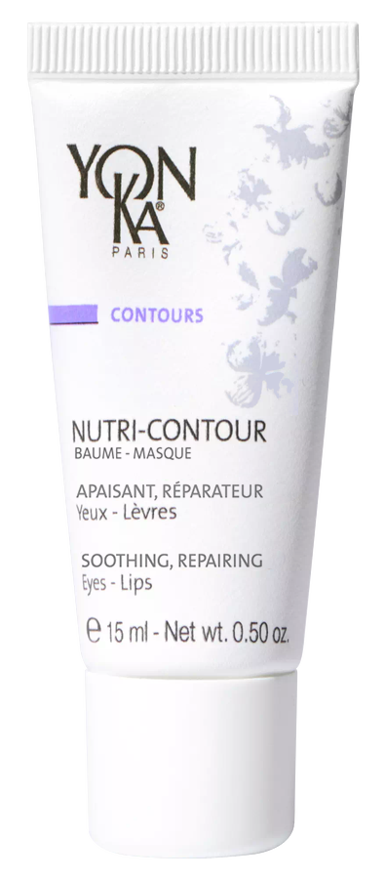
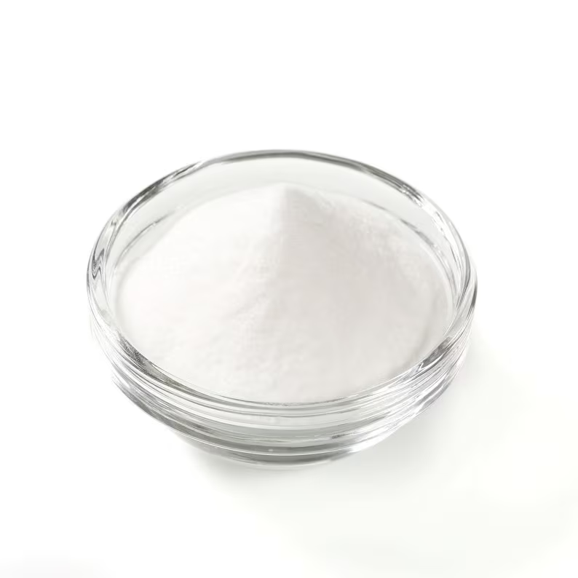
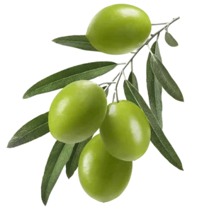
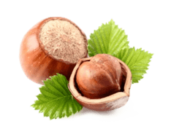
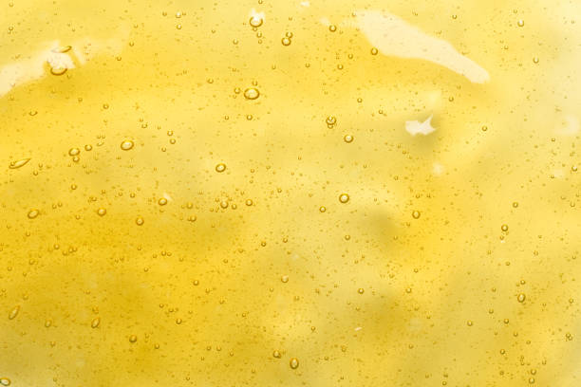
NUTRI-CONTOUR
Nutrition - prevention
98%
ingredients
Of natural origin
Ideal as a lip balm for all chapped lips
R.15 ml
ORGANIC CHAMOMILE
NIACINAMIDE
ORGANIC OLIVE SQUALENE
RICE – JOJOBA – CANDELILA
PHOSPHOLIPIDS & POLYSACCHARIDES
HAZELNUT OIL
VITAMIN E&F
REPAIRING
NOURISHING
SOOTHING
REPAIRING
HYDRATING
RESTORING
HYDRATING
PROTECTING
SOFT FINISH
EASY MAKE-UP APPLICATION
REPAIRING
NOURISHING
PROTECTING
REGENERATING
ANTI-OXIDANT
ANTI-DEHYDRATION
Notes:
NUTRI-CONTOUR
Description
A true cocoon of softness with chamomille and niacinamide, this 2-in-1 nourrishing cream - eye and lip contour - intensely nourishes the skin and protects it from drying out as well as from the first signs of ageing. Perfectly moisturized and protected from free radicals, which are ageing factors, Nutri-Contour provides the skin with the active repairing ingredients necessary for its balance. It is also an excellent SOS balm for chapped lips.
Promise
Intense nutrition and repair eye and lip care
For whom?
All skin types
All ages
"I have a tightness around my eyes
"I have chapped lips"
"I'm afraid I'll get wrinkles like my mother«
Ingredients
Organic chamomille
Niacinamide
olive squalene (cosmos certified) that helps restore the skin barrier and plays a fundamental role in skin suppleness and hydration
a trio of vegetable waxes from rice, jojoba and Candelilla (shrub) to protect fragile areas from dehydration
a patented synergy of phospholipids and polysaccharides for an ultra-smooth finish and to make makeup application easier.
phospholipids = natural lecithin
polysaccharides = pullulan
In the formula you still find the hazelnut oil and the vitamins E and F
Home use
In the morning and/or evening, after cleansing and de-moistening with the appropriate Yon-Ka Lotion, apply a thin layer of Nutri-Contour cream to the lip and eye area - one pea-sized amount per area. Gently massage it into the skin. Pay particular attention to crow's feet. Use in the treatment room
Tips
Are your lips dry and chapped? Apply a thick layer of Nutri-Contour in the evening. A simple gesture to make your lips soft, naturally!
Product advantages
2 in 1: eyes & lips
Triple use: daily, SOS chapped lip balm, sleeping mask
98% ION, including 21% of organic origin (chamomile, glycerin and olive oil) )= clean & natural formula
Nourishes, moisturizes and smoothes the eye and lip area
Prevents wrinkles and fine lines
Creamy texture that penetrates quickly

Slide 11
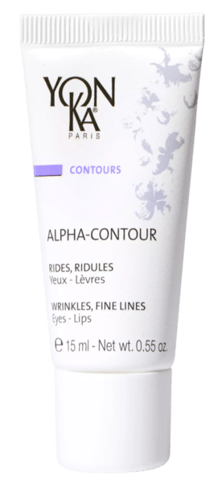
ALPHA-CONTOUR
Anti-wrinkle, hydrating
96%
ingredients
Of natural origin
Ideal as a 10-15 minute mask for immediate smoothing before an important meeting
FRUITS ACID
HYALURONIC ACID
MIMOSA TENUIFLORA
SOY PEPTIDES
LAVANDER ESSENTIAL OIL
ANTI-WRINKLE
RENOVATORS
HYDRATING
SMOOTHING
FIRMING
RESTRUCTURING
SMOOTHING
REGENERATING
BALANCING
REFRESHING
CALMING
R.15 ml
Notes:
ALPHA-CONTOUR
Description
This 2-in-1 renewal gel, with precisely dosed fruit acids, moisturizes the eye and lip contour. Alpha-Contour provides a pleasant sensation of freshness, acts gently on cell renewal and visibly smoothes fine lines and wrinkles. The eye contour area feels lifted. The eyes look younger and brighter.
Promise
Anti-wrinkle eye & lip care
For whom?
All skin types
All ages
"I have wrinkles on my crow's feet
"I have a dehydrated and uncomfortable eye area
Ingredients
AHA: anti-wrinkle
Hyaluronic acid: moisturizer
Home use
Remove your make-up and clean your face thoroughly, then mist with Yon-Ka Lotion adapted to your skin type. In the morning and/or evening, apply Alpha-Contour Gel in a thin layer around the eyes and lips. Massage it in with light tapping and pinching. For an optimal effect, Alpha-Contour can be applied as a mask. Apply a thick layer once or twice a week. Leave it on for 15 minutes and then massage the excess into the skin with light tapping and pinching. If necessary, rinse with fresh water and reapply the product in a thin layer.
Tips
For an energetic action and a better relaxation, use the massage Quartz according to the protocol described and the online video.
Product advantages
Contains 96% natural ingredients
2 in 1: eyes & lips
Double use: daily & mask
Smoothes wrinkles and fine lines around the eyes and lips
Provides a pleasant feeling of freshness
The look is visibly rejuvenated

Slide 12
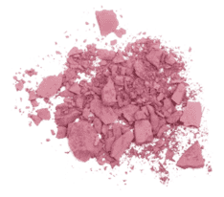
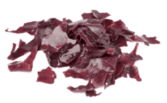
EXCELLENCE CODE CONTOUR
Global anti-aging
94%
ingredients
Of natural origin
High precision applicator with ice cube effect
WHITE LUPIN
& ALFALFA
HYALURONIC ACID
SILK TREE & DIVINE HERB
NATURAL PINK PIGMENTS & ORGANIC SOFT FOCUS POWDER
RED ALGAE
ANTI-PUFFINESS
HYDRATING
RESTRUCTURING
REDENSIFYING
ANTI-DARK CIRCLES
UPPER EYELID
LIFT EFFECT
ILLUMINATING EFFECT
BLUR EFFECT
BRIGHTNESS / EVEN COMPLEXION
R.15 ml
Notes:
EXCELLENCE CODE CONTOUR
Description
This high-performance eye-lip treatment acts globally on the signs of aging that mark these sensitive areas. Its rich formula, patented ingredients and silky texture significantly improve the skin's firmness and elasticity, visibly reducing the appearance of wrinkles and fine lines, puffiness and dark circles. Perfectly moisturized, the eye contour area becomes smoother and firmer. The eyelids appear lifted. The lip contour is redefined and plumped up. Thanks to its ice-cube effect applicator and natural pink pigments, Excellence Code Contours illuminates and refreshes the eyes, which appear rejuvenated.
Promise
The global anti-aging eye & lip care with 5 patents
For whom?
All skin types
All ages
"I have a dark circle around my eyes"
"I have more and more pouches"
"I have deep wrinkles and my upper eyelid is drooping"
"I have pigment spots that have appeared«
Ingredients
Konjac + Hyaluronic acid: plumping (plumps up the wrinkle up to 6 times)
Divine herb + silk tree: lifting
The flowers of the silk tree form a graceful plume, generally pink in colour, reminiscent of the silky brushes of make-up artists or eyelashes. Its leaves have the particularity of opening in the sunlight and closing at night, a phenomenon called nyctinasty. This is why Persian poets have nicknamed it the "night sleeper".
White lupin + alfalfa: draining
Thanks to its richness in oligopeptides and oligosaccharides, white lupin reduces puffiness under the eyes by stimulating lymphatic drainage to promote the elimination of liquids present in the skin tissue, reducing oedema
and limits skin slackening to strengthen the fine and fragile skin around the eyes
Acanthus Leaf Thistle : Repairer
Red Ague + Great Nasturtium = uniformity
Organic soft focus powder: illuminator (Mineral material validated by ecocert - Silica bead encapsulating titanium dioxide which masks imperfections by blurring them)
Home use
Remove make-up and cleanse your face thoroughly, then mist with Yon-Ka Lotion adapted to your skin type. In the morning and/or evening, apply a small amount of cream around your eyes and lips. Massage the cream into the skin with your index finger or with the tip of your applicator tube for a cool effect. Repeat each movement 3 times in a row, insisting on the crow's feet.
Product advantages
Contains 94% natural ingredients
Visibly reduces the signs of aging
The eye and lip contours for mature skin are smoothed
High precision ice cube applicator
All contours are available as professional products except Excellence Code Contours.
Use in the treatment room:
Massage
Mask
End of treatment eye contour care

Slide 13
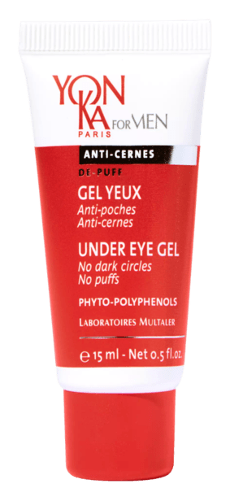
GEL YEUX
Draining, tonifying
94%
ingredients
Of natural origin
We love its refreshing gel texture and its energizing scent
ARNICA
ORGANIC BEECH BUDS
CHAMOMILE ESSENTIAL OIL
SWEET ALMOND PROTEIN
PEPPER MINT ESSENTIAL OIL
DRAINING
REGENERATING
HYDRATING
DECONGESTING
SMOOTHING
REFRESHING
R.15 ml
Notes:
GEL YEUX
Description
This 4-in-1 Fresh Eye Gel visibly reduces dark circles and puffiness, relaxes the eye contour area, smoothes fine lines and tones the eyelids thanks to its draining arnica and cypress nut polyphenols, and regenerating beech buds. With its 100% natural scent, with refreshing notes of peppermint, the eyes are relaxed and full of energy.
Promise
Anti-puffiness and anti-dark circle energizing gel
For whom?
All skins
Ingredients
Arnica and Cypress nut: draining
Chamomile E.O.: decongestant
Organic beech buds: invigorating
Home use
Morning and evening, cleanse face and neck with the Gel Mousse and then mist with YK Lotion. Then apply a thin layer of the Anti-Ageing cream to the face and neck. For a well-moisturized skin as soon as you wake up, remember to reapply your Anti-Ageing cream in the evening at bedtime.
Use in the treatment room
Massage
Mask
End of care
Product advantages
Contains 94% natural ingredients
Reduces dark circles and puffiness
The look is smoothed and relaxed
Refreshing gel texture

Slide 14
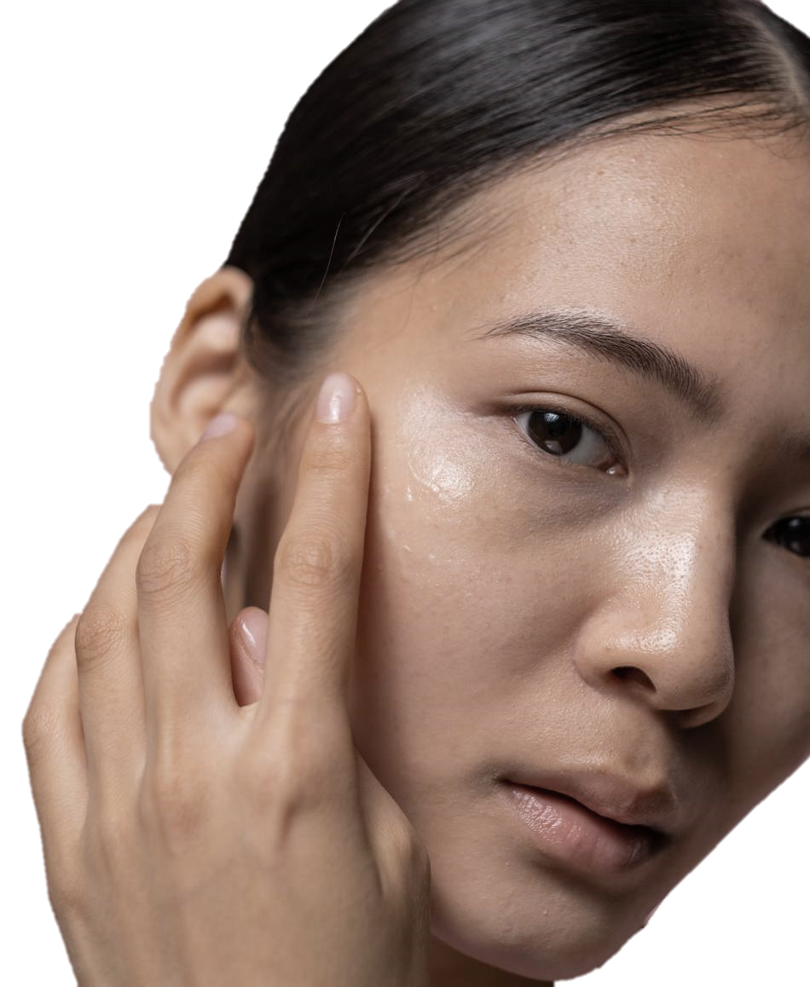
APPLICATION TIPS
Morning and evening, cleanse face and neck with your YON-KA cleanser and then mist with your Lotion YON-KA.
Take just the rigt amount
= a grain of rice for both eyes
Apply eye contour products at the right place
= following the orbicular bone
Gentle massage with your ring finger
Light tapping to erase dark circles
Smoothing from the inside to the outside to erase puffiness
Notes:
Take just the right amount of eye contour cream: The equivalent of a grain of rice... for both eyes! Too much product could cause congestion and swelling around the eyes, as this part of the face is highly vascularised. We're all looking for a fresh look! Applying too much or too rich an eye contour cream can also lead to the appearance of grains of milium
Apply eye contour products at the right place: To apply eye contour correctly, start at the inner corner of the eye and draw a semi-circle under the eye, following the bone. The bone of the eye socket is your reference point for applying the product correctly.Then start at the inner corner of the eye and work your way up over the eyebrow, following the bone under the eyebrow to the temple. This creates a second wide semi-circle above the eye. Avoid applying the product too close to the lash line to avoid irritation or contact with the eyes
Use your ring finger or a soft applicator to avoid exerting excessive pressure on the delicate skin around the eyes.
Gentle massages: If you wish, you can use gentle massaging movements to help stimulate blood circulation and reduce puffiness under the eyes: light tapping in the case of dark circles, smoothing from the inside to the outside in the case of puffiness.

Slide 15
SALES TIPS
FACE CREAM VS EYE CONTOUR CREAM
The main difference between a face cream applied to the eye contour and an eye contour cream lies in their formulation and adaptation to the specific needs of the delicate skin around the eyes.
FORMULATION AND INGREDIENTS
RICHER & THICKER VS LIGHTER & GENTLER
TEXTURE AND ABSORPTION
DEEPLY HYDRATE & NOURISH VS QUICKER ABSORPTION & AVOID MIGRATING INTO THE EYES
SKINCARE OBJECTIVES
DIFFERENT GOALS VS TARGET COMMON CONCERNS AROUND THE EYES
Notes:
Formulation and ingredients:
Face creams are generally formulated to be richer and thicker, with active ingredients tailored to the needs of facial skin, which can be thicker and less sensitive than the skin around the eyes.
Eye contour creams are specially designed to be lighter and gentler, with ingredients suitable for the thin and sensitive skin around the eyes. They often contain moisturizing ingredients such as hyaluronic acid, antioxidants to combat signs of aging, and soothing ingredients to reduce irritation.
Texture and absorption:
Face creams often have a richer and thicker texture, designed to deeply hydrate and nourish facial skin.
Eye contour creams typically have a lighter texture and quicker absorption, making them suitable for the thin and delicate skin around the eyes. They are also formulated to avoid migrating into the eyes, which can cause irritation.
Skincare goals:
Face creams are intended to provide general hydration, address skin issues such as acne, pigmentation spots, or wrinkles and fine lines across the entire face.
Eye contour creams are specifically designed to target common concerns around the eyes, such as dark circles, puffiness, fine lines, and crow's feet. They are also formulated to help protect the delicate skin around the eyes from environmental damage and premature aging.
In summary, while it's possible to apply a face cream to the eye contour, it's preferable to use an eye contour cream specially formulated to address the unique needs of this delicate area. Eye contour creams are generally gentler, lighter, and more suited to the thin and sensitive skin around the eyes, thus providing more effective results and increased comfort.

Slide 16
TAKING CARE OF THE EYE CONTOUR
EXTRA TIPS
USE SUITABLE PRODUCTS
PROTECT FROM THE SUN
APPLY GENTLY
HYDRATE REGULARLY
MAINTAIN A HEALTHY LIFESTYLE
USE COLD COMPRESSES
Notes:
Use suitable products: Choose products specifically formulated for the eye contour, which are often gentler and less irritating. Look for products containing moisturizing ingredients such as hyaluronic acid, vitamin E, and peptides.
Apply gently: Gently pat the product around the eye area with your ring finger, as it applies less pressure than other fingers. Avoid rubbing or pulling on the delicate skin around the eyes to prevent damage and the formation of wrinkles.
Protect from the sun: Wear sunglasses to protect this sensitive area from harmful UV rays that can accelerate skin aging.
Maintain a healthy lifestyle: A balanced diet, adequate hydration, sufficient sleep, and stress reduction can all contribute to maintaining the health of the skin around the eyes and preventing signs of premature aging.
Use cold compresses: Applying cold compresses in the form of chilled tea bags, refrigerated spoons, or eye contour cream from the refrigerator can help reduce under-eye puffiness and decongest the area.
Hydrate regularly: Ensure to keep the skin around the eyes well hydrated by using moisturizing creams or gels morning and night. This can help reduce the appearance of fine lines and prevent dryness.

Slide 17
The Exceptionals
- 45/90 min -
Most advanced and premium category
With aventurine YON-KA crystals massage
EYE AND LIP PERFECTION
Exceptional targeted anti-aging treatment to refresh and plump the eye and lip contours
EXCELLENCE CODE
Exceptional global anti-aging treatment
EYE & LIP CONTOUR MASSAGE with crystals and CELL ENERGY* serum
* Or the mix of 2 eye & lip contour cream

Slide 18
YON-KA crystals
Aventurine, its cosmetic virtues
Draining / Decongestant
Anti-dark circles
Anti-pockets
Detoxifying
Improves the elimination of toxins
Smoothing / Plumping
Reduces fine lines and wrinkles
Liftant
Tones the eyelid
Relaxing
Rebalance
Harmonise
Notes:
Draining: stimulates blood and lymphatic circulation
*Detoxifying: elimination of toxins by its reflex action linked to pressure on energy points.
*Decongestant: relaxes eyelids and eyes - anti-puffiness, anti-dark circles
*Smoothing/Repulping: reduces wrinkles and fine lines
*Natural lifting effect: tones the tissues
*Relaxing effect: harmonizes body and mind and relaxes intensely
BENEFITS
A luminous skin, bags and dark circles faded, wrinkles and fine lines smoothed.

Slide 19
Traditional Chinese Medecine
- Objectives -
Balance the energies
Maintain in good health
Notify
imbalances & diseases
Notes:
*Medicine based on the theory of Yin/Yang (two complementary energies, inseparable, opposed, always in movement) and on the theory of the 5 elements;
*At the heart of this medicine: the energy that circulates via meridians
Our body is composed of 365 meridians
There are 2 categories of meridians :
- Regular meridians
*12 main meridians :
6 yin meridians (lung - P, spleen/pancreas - R, heart - C, kidney - Re, master heart - MC, liver - F) These meridians circulate from the bottom to the top of the anterior face of the body.
6 yang meridians (large intestine - GI, stomach - E, small intestine - GI, bladder - V, triple heater - TR, gallbladder - VB)
These meridians circulate from the top to the bottom of the posterior face of the body.
*8 extraordinary vessels (design vessel, governor vessel, attack vessel, belt vessel, YIN ankle vessel, YANG ankle vessel, YIN connecting vessel, YANG connecting vessel)
- Connecting Meridians
*Objective: balance of energies / maintenance of good health / prevention

Slide 20
Focus on energy points
- 3 sec pressure on each point -
Improves elimination, draining & decongesting effect
Improves digestion
Decongesting
Relieves headache, calms the mind, soothes the eyes
Improves elimination, draining & decongesting effect
Soothes the mind, dissipates pain
Notes:
UB1 (Yang urinary bladder meridian) : inner corner of the eye
S2 (Yang stomach meridian): 1/3 dark circle
HM8 (Quihou “Behind the ball”) : 2/3 dark circle
GB1 (Yang gallbladder meridian) : outer corner of the eye
UB2 (Yang urinary bladder meridian : head of the eyebrow
HM3 (Yuyao “fish waist”) : middle of the eyebrow

Slide 21
Focus on energy points
- 3 sec pressure on each point -
Improves digestion
Regulates all conception vessels
Empties and quiet the mind, promotes concentration
Empties and quiet the mind, promotes concentration
Calms the mind, opens nasal walls
Notes:
S4 (“Earth granary” yang stomach meridian) : corners of the mouth
CV 24 (Ren Mai “fl uid receptacle” conception vessel*) : in the center underneath the lips
3 & 4. GV 26 + GV 27 (Mai “center of man” governing vessel*) : below de base of the nose + above the heart of the lips
5. LI 19 (“Grain bone hole” large intestine yang meridian) : nostrils

Slide 22
LET'S PLAY!
GET YOUR PHONE READY AND SCAN THE QR CODE THAT WILL BE DISPLAYED
INDICATE YOUR NAME AND COUNTRY
PERSONALISE YOUR AVATAR IF YOU LIKE
READ THE QUESTION ON THE COMPUTER AND ANSWER IT ON YOUR PHONE

Slide 23
The Eye and Lip techniques with crystals
- 10 min-

Slide 24
Thanhs !

